Slide 1



x

Slide 2

Devon O'Reilly
x
Senior Director, Community Engagement and Leadership Development, Detroit Regional Chamber

Slide 3
The Changing Role of Media
x
Bob Ellis, Vice President and General Manager, WDIV
Devin Scillian, Anchor, WDIV
Jamie Kaye Walters, Chief Operating Officer, VVK PR and Creative

Slide 4
Lunch
x
Anita’s Kitchen

Slide 5
x

Slide 6
Personal Branding Workshop
x
Robert Courtney
Founder, Robert Courtney & Associates

Slide 7
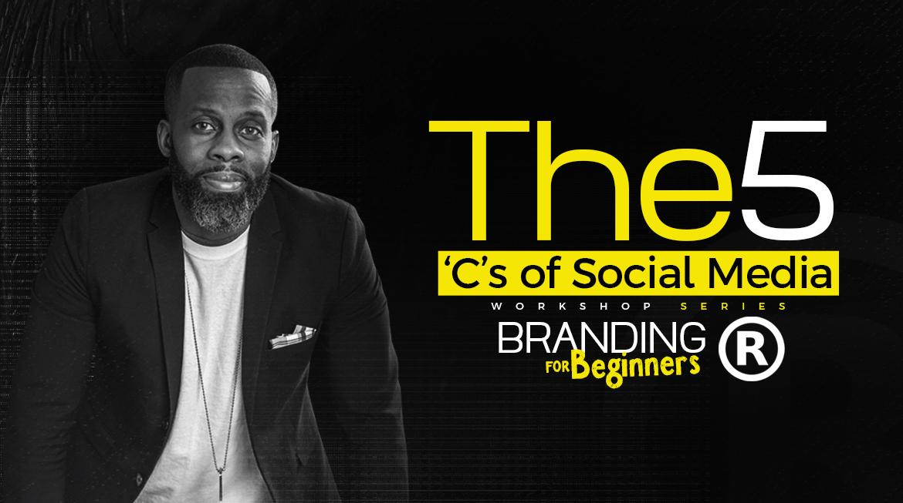
B

Slide 8
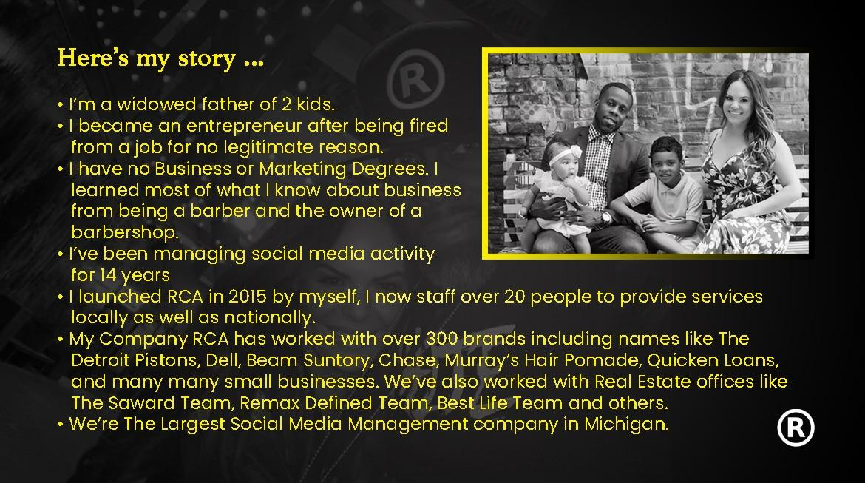

Slide 9
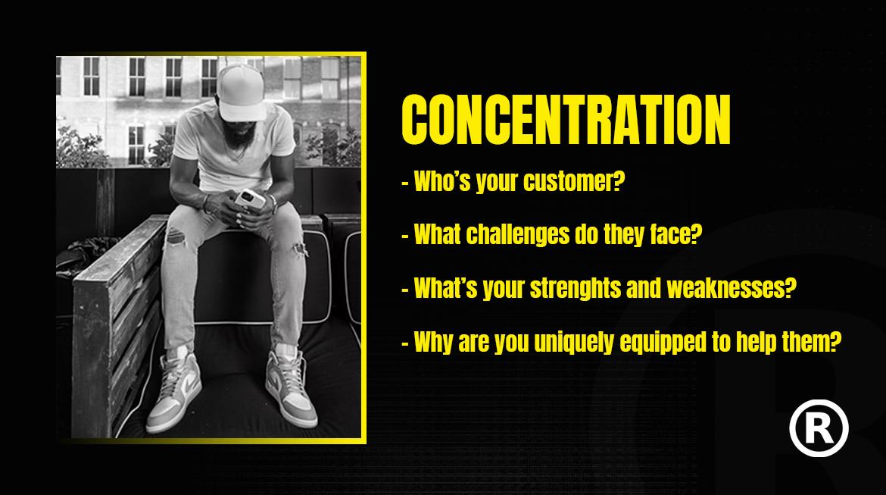
INFO VS STRATEGY

Slide 10
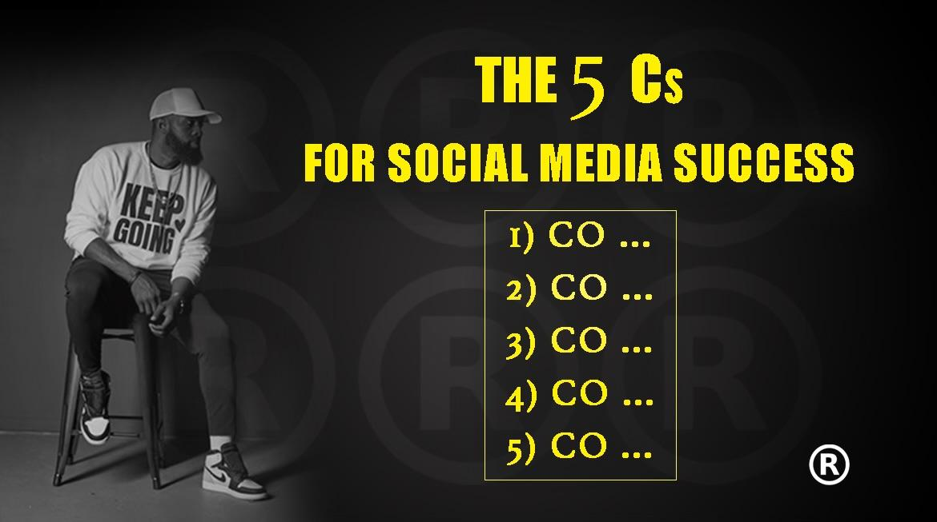
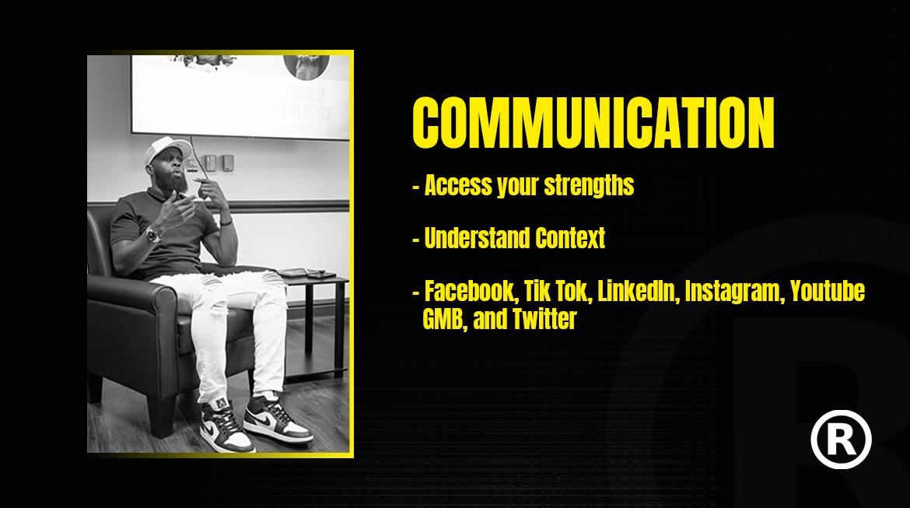

Slide 11
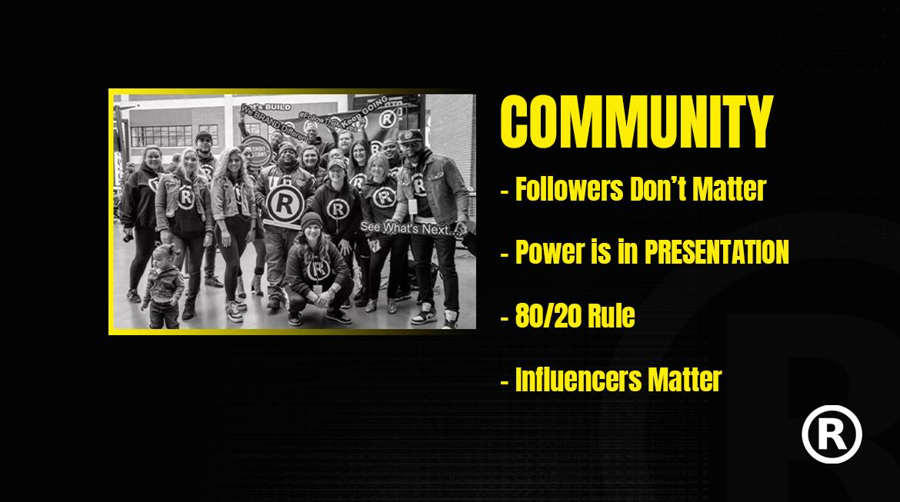

Slide 12
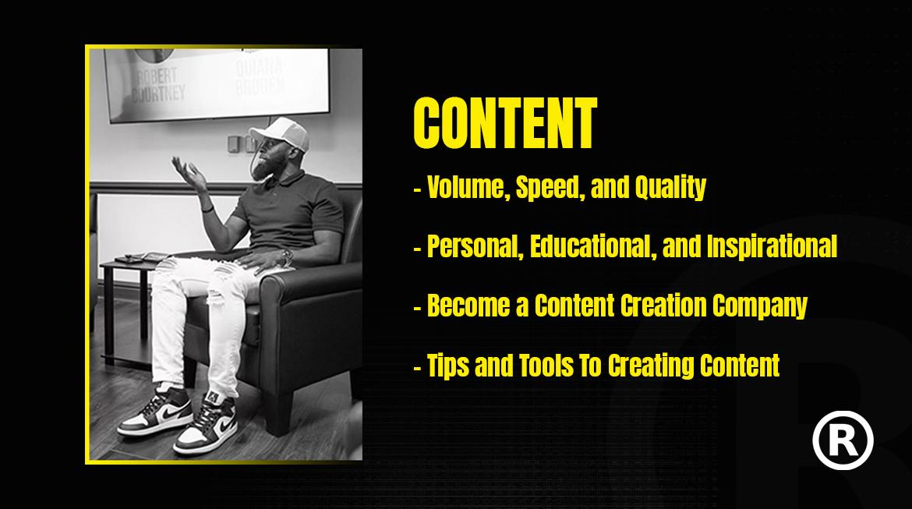

Slide 13



Slide 14
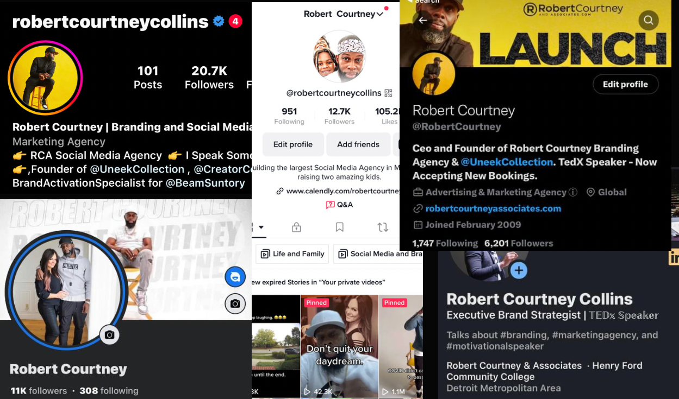

Slide 15


Slide 16
Media’s Role in Storytelling
x
Tina Kozak, CEO, Franco
Ed Moore, Vice President, Content, DPTV
Eric Thomas, Senior Vice President, External Relations, Invest Detroit

Slide 17
Class Announcements
x
Next Session: Economic Development & Local Government
Thursday, November 9th
Flagstar Strand Theater

Slide 18

https://bit.ly/LD44Media
x

Slide 19
Class Announcements
x
Social Committee Meeting Tomorrow 10:30 a.m.
Class Resource Page
Class Share Out: Events

Slide 20
Social Hour
x
Grazing Hearts Charcuterie

Slide 21
x

