Slide 1



x

Slide 2

Devon O'Reilly
x
Senior Director, Community Engagement and Leadership Development, Detroit Regional Chamber

Slide 3
Dimitrius Hutcherson
x
Executive Vice President, Chief Technology Officer, and Chief Administrative Officer

Slide 4
Dave Coulter
x
County Executive, Oakland County

Slide 5
Tour of Flagstar Strand Theater & Downtown Pontiac
x
Michael McGuiness, President, Pontiac City Council

Slide 6
Local Elected Leaders
x
Nicole Brown, Mayor, City of Ypsilanti
Melanie Piana, Mayor, City of Ferndale
Eli Savit, Prosecuting Attorney, Washtenaw County

Slide 7
x

Slide 8
Ned Staebler
x
President & CEO, TechTown Detroit

Slide 9
A New Economic Development Agenda For Michigan

Slide 10
Much of what we think we know about Economic Development is wrong
Production jobs are no longer middle-class jobs
Talent doesn’t follow investment and people don’t chase jobs
Michigan has plenty of jobs already

Slide 11
Purpose of Economic Development
Jobs?
Growth?
Investment?
Improve the economic well-being of residents

Slide 12
Is it working in Michigan?
In 1990, Michigan was the 20th state in per capita Income
    In 2020… we’re 33rd

Slide 13
Why?
Conventional wisdom:
We (the US) don’t make things anymore.
What we do make is made in the southeast- they’re taking our good jobs
This informs our response, our economic development policy:
Fight harder for those remaining jobs
MEGA, IDRB, worker training, Renaissance Zones, site prep, SOAR

Slide 14
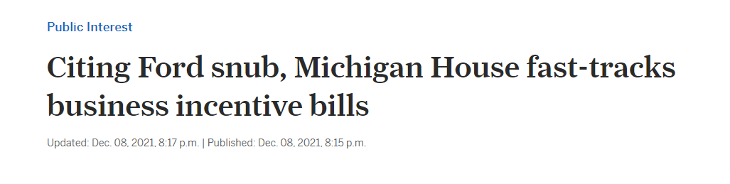

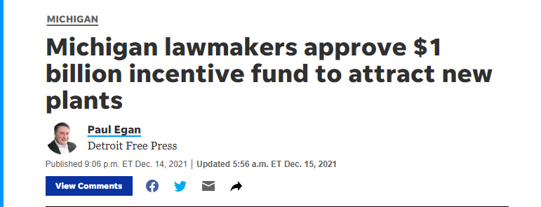

Slide 15
But, as usual with ‘Conventional Wisdom,’ we rarely stop to ask:
Are we right?

Slide 16
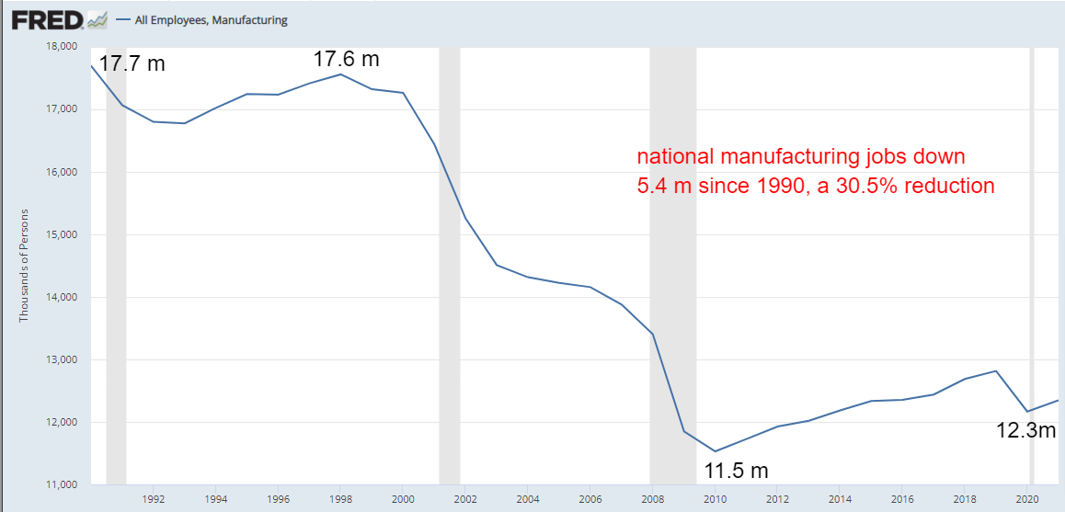
Manufacturing employment is near recent lows
Notes:
Source:
U.S. Bureau of Labor Statistics
Release:
Employment Situation
Units:
Thousands of Persons, Seasonally Adjusted
Frequency:
Monthly
The series comes from the 'Current Employment Statistics (Establishment Survey).'The source code is: CES3000000001
U.S. Bureau of Labor Statistics,
All Employees, Manufacturing [MANEMP],
retrieved from FRED,
Federal Reserve Bank of St. Louis;
https://fred.stlouisfed.org/series/MANEMP,
April 4, 2022.
Source:
Board of Governors of the Federal Reserve System (US)
Release:
G.17 Industrial Production and Capacity Utilization
Units:
Index 2017=100, Seasonally Adjusted
Frequency:
Monthly
Board of Governors of the Federal Reserve System (US),
Industrial Production: Manufacturing (NAICS) [IPMAN],
retrieved from FRED,
Federal Reserve Bank of St. Louis;
https://fred.stlouisfed.org/series/IPMAN,
April 4, 2022.

Slide 17
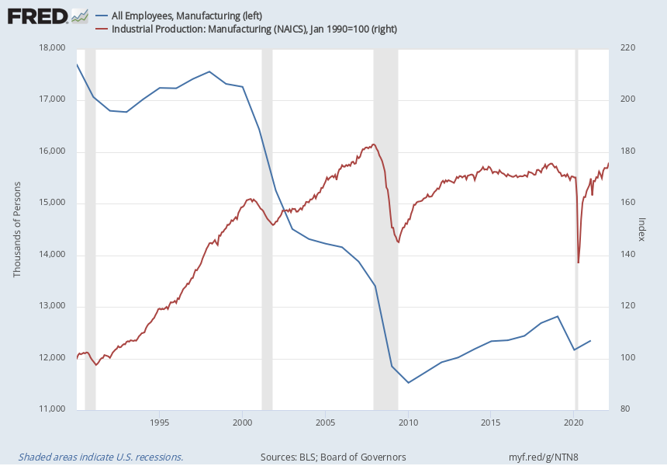
Manufacturing output is near record highs
Notes:
Source:
U.S. Bureau of Labor Statistics
Release:
Employment Situation
Units:
Thousands of Persons, Seasonally Adjusted
Frequency:
Monthly
The series comes from the 'Current Employment Statistics (Establishment Survey).'The source code is: CES3000000001
U.S. Bureau of Labor Statistics,
All Employees, Manufacturing [MANEMP],
retrieved from FRED,
Federal Reserve Bank of St. Louis;
https://fred.stlouisfed.org/series/MANEMP,
April 4, 2022.
Source:
Board of Governors of the Federal Reserve System (US)
Release:
G.17 Industrial Production and Capacity Utilization
Units:
Index 2017=100, Seasonally Adjusted
Frequency:
Monthly
Board of Governors of the Federal Reserve System (US),
Industrial Production: Manufacturing (NAICS) [IPMAN],
retrieved from FRED,
Federal Reserve Bank of St. Louis;
https://fred.stlouisfed.org/series/IPMAN,
April 4, 2022.

Slide 18
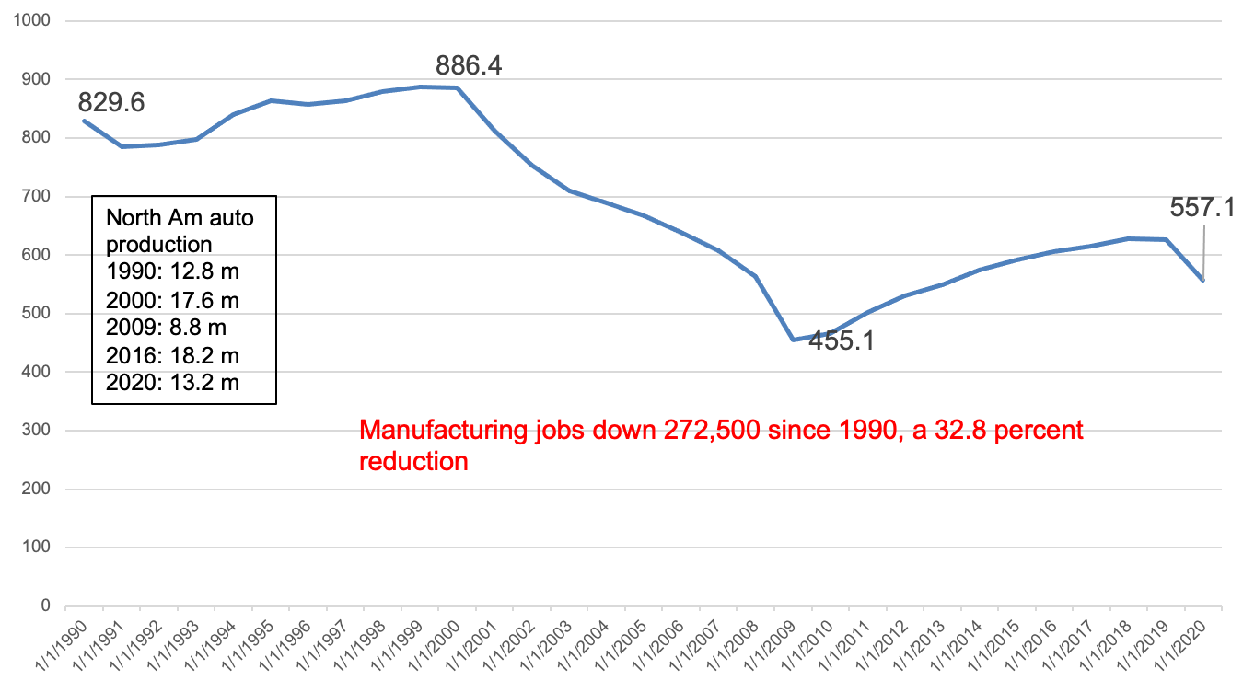
Manufacturing jobs in Michigan

Slide 19
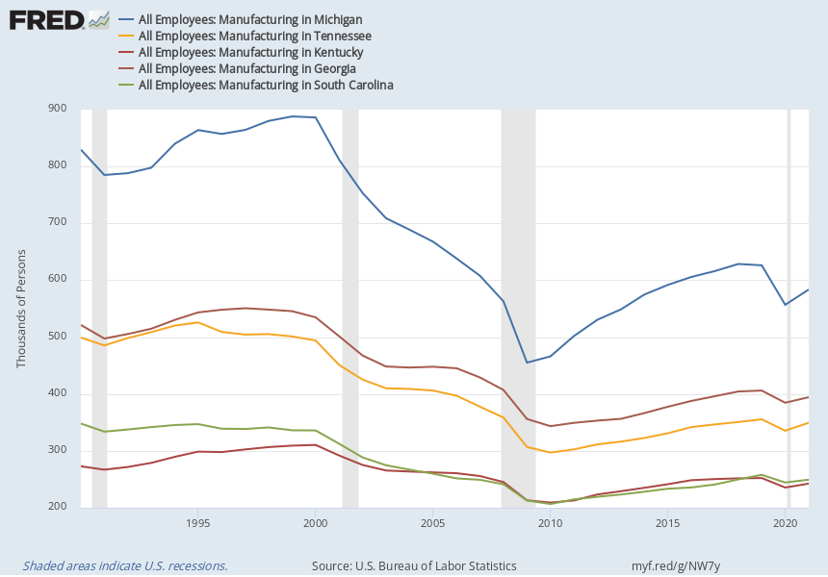
Those Jobs aren’t going to the South
-33%
Michigan
-26%
Georgia
-33%
Tennessee
-30%
South Carolina
-14%
Kentucky
Notes:
Source:
U.S. Bureau of Labor Statistics
Release:
State Employment and Unemployment
Units:
Thousands of Persons, Seasonally Adjusted
Frequency:
Monthly
U.S. Bureau of Labor Statistics,
All Employees: Manufacturing in Michigan [MIMFG],
retrieved from FRED,
Federal Reserve Bank of St. Louis;
https://fred.stlouisfed.org/series/MIMFG,
April 5, 2022.
Source:
U.S. Bureau of Labor Statistics
Release:
State Employment and Unemployment
Units:
Thousands of Persons, Seasonally Adjusted
Frequency:
Monthly
U.S. Bureau of Labor Statistics,
All Employees: Manufacturing in Tennessee [TNMFG],
retrieved from FRED,
Federal Reserve Bank of St. Louis;
https://fred.stlouisfed.org/series/TNMFG,
April 5, 2022.
Source:
U.S. Bureau of Labor Statistics
Release:
State Employment and Unemployment
Units:
Thousands of Persons, Seasonally Adjusted
Frequency:
Monthly
Industry based on 2002 North American Industry Classification System (NAICS). Please consult the U.S. Census Bureau (http://www.census.gov/cgi-bin/sssd/naics/naicsrch?chart=2002) for additional information about NAICS.
U.S. Bureau of Labor Statistics,
All Employees: Manufacturing in Kentucky [KYMFG],
retrieved from FRED,
Federal Reserve Bank of St. Louis;
https://fred.stlouisfed.org/series/KYMFG,
April 5, 2022.
Source:
U.S. Bureau of Labor Statistics
Release:
State Employment and Unemployment
Units:
Thousands of Persons, Seasonally Adjusted
Frequency:
Monthly
U.S. Bureau of Labor Statistics,
All Employees: Manufacturing in Georgia [GAMFG],
retrieved from FRED,
Federal Reserve Bank of St. Louis;
https://fred.stlouisfed.org/series/GAMFG,
April 5, 2022.
Source:
U.S. Bureau of Labor Statistics
Release:
State Employment and Unemployment
Units:
Thousands of Persons, Seasonally Adjusted
Frequency:
Monthly
U.S. Bureau of Labor Statistics,
All Employees: Manufacturing in South Carolina [SCMFG],
retrieved from FRED,
Federal Reserve Bank of St. Louis;
https://fred.stlouisfed.org/series/SCMFG,
April 5, 2022.

Slide 20
And,production jobs in the south pay worse than in Michigan

Slide 21




Slide 22

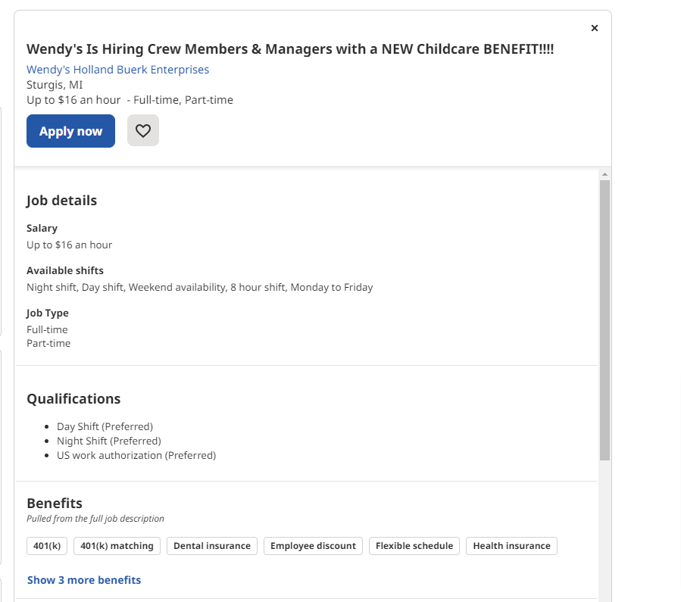

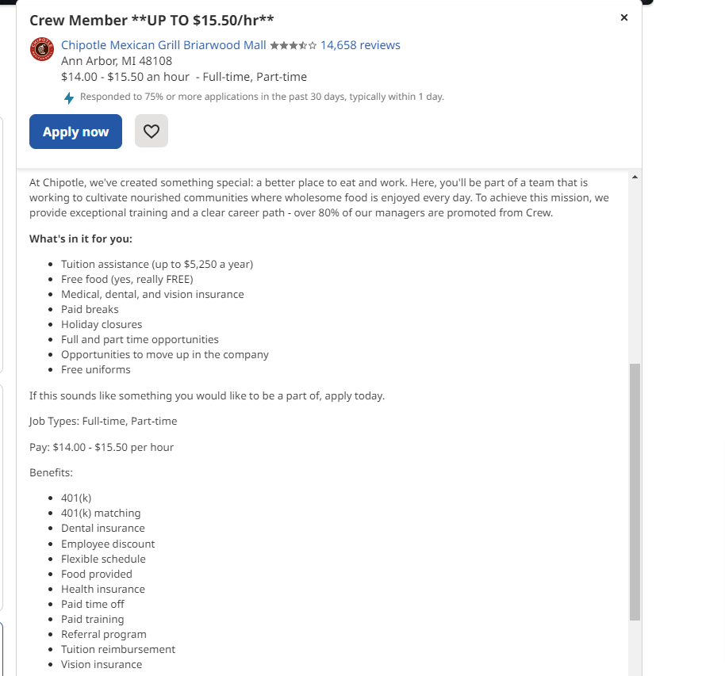

Slide 23

Good production jobs aren’t going to the South… they’re going to the history books

Slide 24
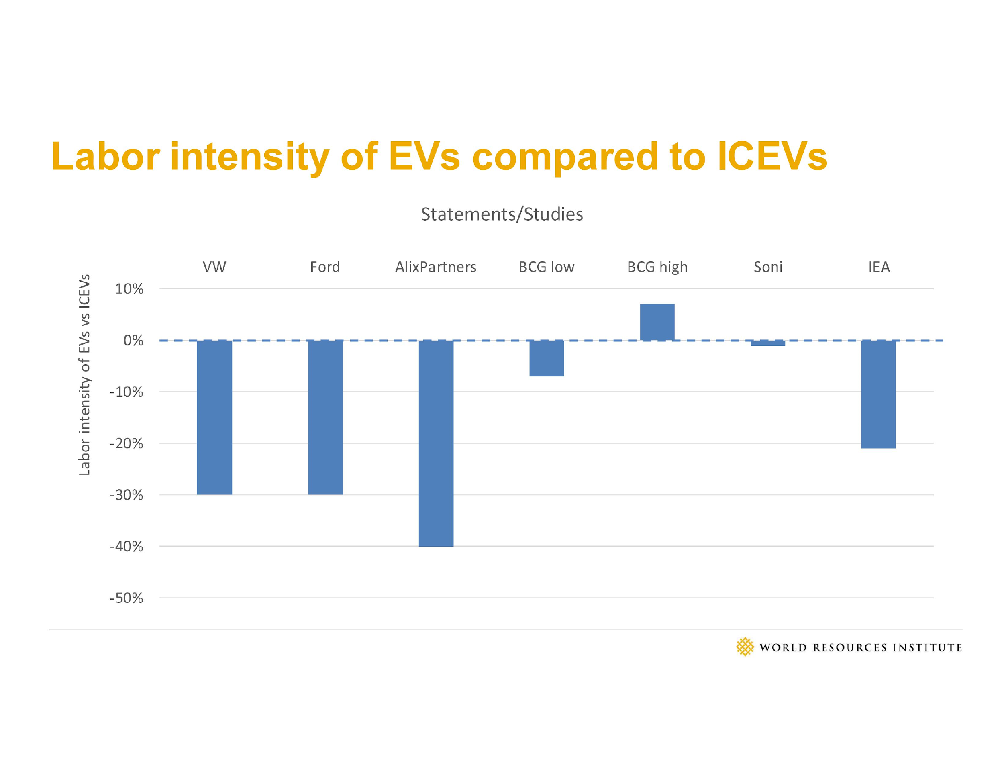
They’re not coming back

Slide 25
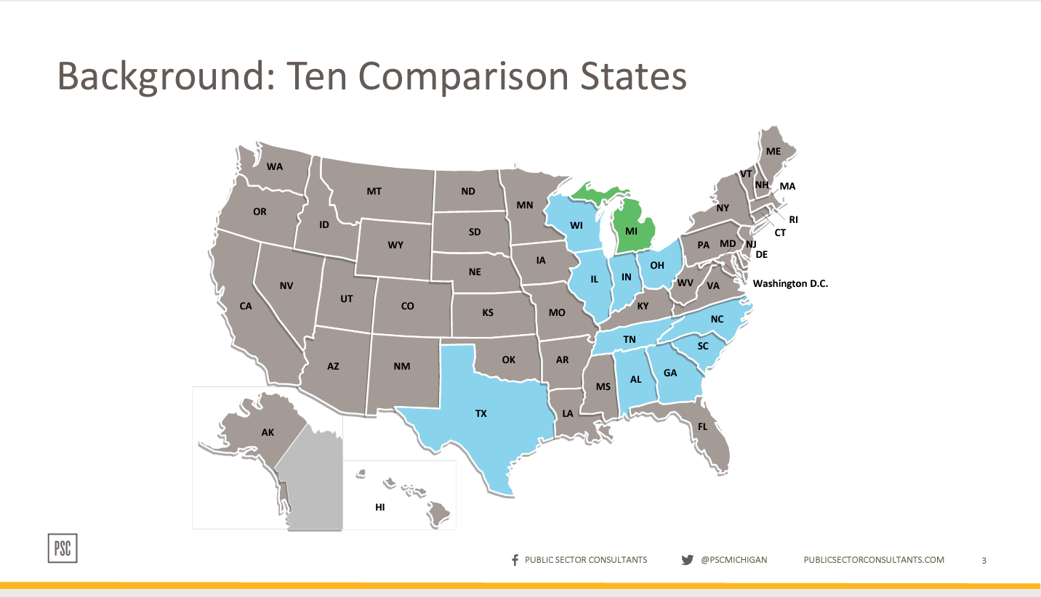
And yet, our economic development strategy is still focused on them

Slide 26
FAQ
Q1) What was the rationale for selecting the 10 states included in the RFP for comparison purposes?
A1) The MEDC selected states that commonly compete with Michigan for business development deals.

Slide 27
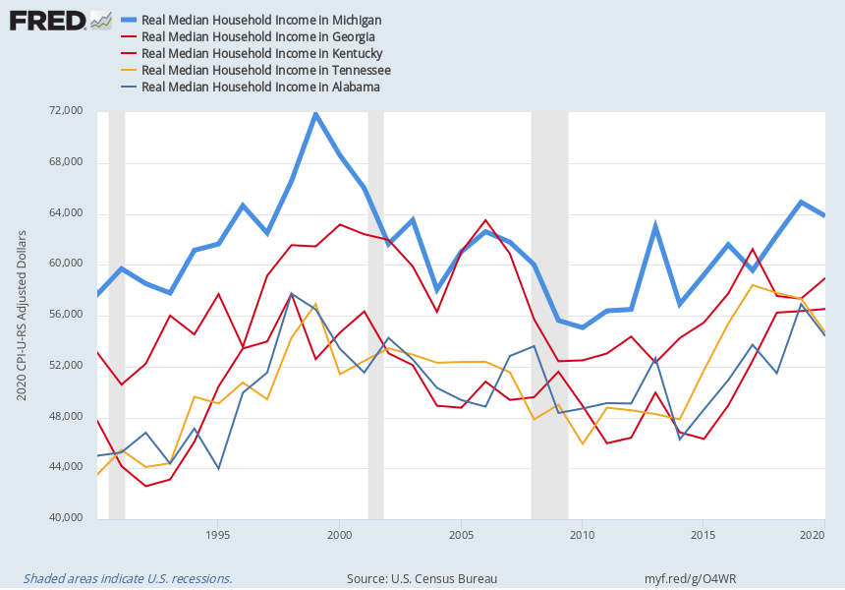
Why?
Michigan
Georgia
Kentucky
Tennessee
Alabama
Notes:
Source:
U.S. Census Bureau
Release:
Income and Poverty in the United States
Units:
2020 CPI-U-RS Adjusted Dollars, Not Seasonally Adjusted
Frequency:
Annual
Household data are collected as of March.Consumer Price Index research series using current methods (CPI-U-RS) presents an estimate of the CPI for all Urban Consumers (CPI-U) that incorporates most of the improvements made over that time span into the entire series. More information can be found at https://www.bls.gov/cpi/research-series/home.htm.As stated in the Census's "Source and Accuracy of Estimates for Income, Poverty, and Health Insurance Coverage in the United States: 2011" (http://www.census.gov/hhes/www/p60_243sa.pdf):Estimation of Median Incomes. The Census Bureau has changed the methodology for computing median income over time. The Census Bureau has computed medians using either Pareto interpolation or linear interpolation. Currently, we are using linear interpolation to estimate all medians. Pareto interpolation assumes a decreasing density of population within an income interval, whereas linear interpolation assumes a constant density of population within an income interval. The Census Bureau calculated estimates of median income and associated standard errors for 1979 through 1987 using Pareto interpolation if the estimate was larger than $20,000 for people or $40,000 for families and households. This is because the width of the income interval containing the estimate is greater than $2,500.We calculated estimates of median income and associated standard errors for 1976, 1977, and 1978 using Pareto interpolation if the estimate was larger than $12,000 for people or $18,000 for families and households. This is because the width of the income interval containing the estimate is greater than $1,000. All other estimates of median income and associated standard errors for 1976 through 2011 (2012 ASEC) and almost all of the estimates of median income and associated standard errors for 1975 and earlier were calculated using linear interpolation.Thus, use caution when comparing median incomes above $12,000 for people or $18,000 for families and households for different years. Median incomes below those levels are more comparable from year to year since they have always been calculated using linear interpolation. For an indication of the comparability of medians calculated using Pareto interpolation with medians calculated using linear interpolation, see Series P-60, Number 114, Money Income in 1976 of Families and Persons in the United States (www2.census.gov/prod2/popscan/p60-114.pdf).
U.S. Census Bureau,
Real Median Household Income in Michigan [MEHOINUSMIA672N],
retrieved from FRED,
Federal Reserve Bank of St. Louis;
https://fred.stlouisfed.org/series/MEHOINUSMIA672N,
April 9, 2022.
Source:
U.S. Census Bureau
Release:
Income and Poverty in the United States
Units:
2020 CPI-U-RS Adjusted Dollars, Not Seasonally Adjusted
Frequency:
Annual
Household data are collected as of March.Consumer Price Index research series using current methods (CPI-U-RS) presents an estimate of the CPI for all Urban Consumers (CPI-U) that incorporates most of the improvements made over that time span into the entire series. More information can be found at https://www.bls.gov/cpi/research-series/home.htm.As stated in the Census's "Source and Accuracy of Estimates for Income, Poverty, and Health Insurance Coverage in the United States: 2011" (http://www.census.gov/hhes/www/p60_243sa.pdf):Estimation of Median Incomes. The Census Bureau has changed the methodology for computing median income over time. The Census Bureau has computed medians using either Pareto interpolation or linear interpolation. Currently, we are using linear interpolation to estimate all medians. Pareto interpolation assumes a decreasing density of population within an income interval, whereas linear interpolation assumes a constant density of population within an income interval. The Census Bureau calculated estimates of median income and associated standard errors for 1979 through 1987 using Pareto interpolation if the estimate was larger than $20,000 for people or $40,000 for families and households. This is because the width of the income interval containing the estimate is greater than $2,500.We calculated estimates of median income and associated standard errors for 1976, 1977, and 1978 using Pareto interpolation if the estimate was larger than $12,000 for people or $18,000 for families and households. This is because the width of the income interval containing the estimate is greater than $1,000. All other estimates of median income and associated standard errors for 1976 through 2011 (2012 ASEC) and almost all of the estimates of median income and associated standard errors for 1975 and earlier were calculated using linear interpolation.Thus, use caution when comparing median incomes above $12,000 for people or $18,000 for families and households for different years. Median incomes below those levels are more comparable from year to year since they have always been calculated using linear interpolation. For an indication of the comparability of medians calculated using Pareto interpolation with medians calculated using linear interpolation, see Series P-60, Number 114, Money Income in 1976 of Families and Persons in the United States (www2.census.gov/prod2/popscan/p60-114.pdf).
U.S. Census Bureau,
Real Median Household Income in Georgia [MEHOINUSGAA672N],
retrieved from FRED,
Federal Reserve Bank of St. Louis;
https://fred.stlouisfed.org/series/MEHOINUSGAA672N,
April 9, 2022.
Source:
U.S. Census Bureau
Release:
Income and Poverty in the United States
Units:
2020 CPI-U-RS Adjusted Dollars, Not Seasonally Adjusted
Frequency:
Annual
Household data are collected as of March.Consumer Price Index research series using current methods (CPI-U-RS) presents an estimate of the CPI for all Urban Consumers (CPI-U) that incorporates most of the improvements made over that time span into the entire series. More information can be found at https://www.bls.gov/cpi/research-series/home.htm.As stated in the Census's "Source and Accuracy of Estimates for Income, Poverty, and Health Insurance Coverage in the United States: 2011" (http://www.census.gov/hhes/www/p60_243sa.pdf):Estimation of Median Incomes. The Census Bureau has changed the methodology for computing median income over time. The Census Bureau has computed medians using either Pareto interpolation or linear interpolation. Currently, we are using linear interpolation to estimate all medians. Pareto interpolation assumes a decreasing density of population within an income interval, whereas linear interpolation assumes a constant density of population within an income interval. The Census Bureau calculated estimates of median income and associated standard errors for 1979 through 1987 using Pareto interpolation if the estimate was larger than $20,000 for people or $40,000 for families and households. This is because the width of the income interval containing the estimate is greater than $2,500.We calculated estimates of median income and associated standard errors for 1976, 1977, and 1978 using Pareto interpolation if the estimate was larger than $12,000 for people or $18,000 for families and households. This is because the width of the income interval containing the estimate is greater than $1,000. All other estimates of median income and associated standard errors for 1976 through 2011 (2012 ASEC) and almost all of the estimates of median income and associated standard errors for 1975 and earlier were calculated using linear interpolation.Thus, use caution when comparing median incomes above $12,000 for people or $18,000 for families and households for different years. Median incomes below those levels are more comparable from year to year since they have always been calculated using linear interpolation. For an indication of the comparability of medians calculated using Pareto interpolation with medians calculated using linear interpolation, see Series P-60, Number 114, Money Income in 1976 of Families and Persons in the United States (www2.census.gov/prod2/popscan/p60-114.pdf).
U.S. Census Bureau,
Real Median Household Income in Kentucky [MEHOINUSKYA672N],
retrieved from FRED,
Federal Reserve Bank of St. Louis;
https://fred.stlouisfed.org/series/MEHOINUSKYA672N,
April 9, 2022.
Source:
U.S. Census Bureau
Release:
Income and Poverty in the United States
Units:
2020 CPI-U-RS Adjusted Dollars, Not Seasonally Adjusted
Frequency:
Annual
Household data are collected as of March.Consumer Price Index research series using current methods (CPI-U-RS) presents an estimate of the CPI for all Urban Consumers (CPI-U) that incorporates most of the improvements made over that time span into the entire series. More information can be found at https://www.bls.gov/cpi/research-series/home.htm.As stated in the Census's "Source and Accuracy of Estimates for Income, Poverty, and Health Insurance Coverage in the United States: 2011" (http://www.census.gov/hhes/www/p60_243sa.pdf):Estimation of Median Incomes. The Census Bureau has changed the methodology for computing median income over time. The Census Bureau has computed medians using either Pareto interpolation or linear interpolation. Currently, we are using linear interpolation to estimate all medians. Pareto interpolation assumes a decreasing density of population within an income interval, whereas linear interpolation assumes a constant density of population within an income interval. The Census Bureau calculated estimates of median income and associated standard errors for 1979 through 1987 using Pareto interpolation if the estimate was larger than $20,000 for people or $40,000 for families and households. This is because the width of the income interval containing the estimate is greater than $2,500.We calculated estimates of median income and associated standard errors for 1976, 1977, and 1978 using Pareto interpolation if the estimate was larger than $12,000 for people or $18,000 for families and households. This is because the width of the income interval containing the estimate is greater than $1,000. All other estimates of median income and associated standard errors for 1976 through 2011 (2012 ASEC) and almost all of the estimates of median income and associated standard errors for 1975 and earlier were calculated using linear interpolation.Thus, use caution when comparing median incomes above $12,000 for people or $18,000 for families and households for different years. Median incomes below those levels are more comparable from year to year since they have always been calculated using linear interpolation. For an indication of the comparability of medians calculated using Pareto interpolation with medians calculated using linear interpolation, see Series P-60, Number 114, Money Income in 1976 of Families and Persons in the United States (www2.census.gov/prod2/popscan/p60-114.pdf).
U.S. Census Bureau,
Real Median Household Income in Tennessee [MEHOINUSTNA672N],
retrieved from FRED,
Federal Reserve Bank of St. Louis;
https://fred.stlouisfed.org/series/MEHOINUSTNA672N,
April 9, 2022.
Source:
U.S. Census Bureau
Release:
Income and Poverty in the United States
Units:
2020 CPI-U-RS Adjusted Dollars, Not Seasonally Adjusted
Frequency:
Annual
Household data are collected as of March.Consumer Price Index research series using current methods (CPI-U-RS) presents an estimate of the CPI for all Urban Consumers (CPI-U) that incorporates most of the improvements made over that time span into the entire series. More information can be found at https://www.bls.gov/cpi/research-series/home.htm.As stated in the Census's "Source and Accuracy of Estimates for Income, Poverty, and Health Insurance Coverage in the United States: 2011" (http://www.census.gov/hhes/www/p60_243sa.pdf):Estimation of Median Incomes. The Census Bureau has changed the methodology for computing median income over time. The Census Bureau has computed medians using either Pareto interpolation or linear interpolation. Currently, we are using linear interpolation to estimate all medians. Pareto interpolation assumes a decreasing density of population within an income interval, whereas linear interpolation assumes a constant density of population within an income interval. The Census Bureau calculated estimates of median income and associated standard errors for 1979 through 1987 using Pareto interpolation if the estimate was larger than $20,000 for people or $40,000 for families and households. This is because the width of the income interval containing the estimate is greater than $2,500.We calculated estimates of median income and associated standard errors for 1976, 1977, and 1978 using Pareto interpolation if the estimate was larger than $12,000 for people or $18,000 for families and households. This is because the width of the income interval containing the estimate is greater than $1,000. All other estimates of median income and associated standard errors for 1976 through 2011 (2012 ASEC) and almost all of the estimates of median income and associated standard errors for 1975 and earlier were calculated using linear interpolation.Thus, use caution when comparing median incomes above $12,000 for people or $18,000 for families and households for different years. Median incomes below those levels are more comparable from year to year since they have always been calculated using linear interpolation. For an indication of the comparability of medians calculated using Pareto interpolation with medians calculated using linear interpolation, see Series P-60, Number 114, Money Income in 1976 of Families and Persons in the United States (www2.census.gov/prod2/popscan/p60-114.pdf).
U.S. Census Bureau,
Real Median Household Income in Alabama [MEHOINUSALA672N],
retrieved from FRED,
Federal Reserve Bank of St. Louis;
https://fred.stlouisfed.org/series/MEHOINUSALA672N,
April 9, 2022.

Slide 28
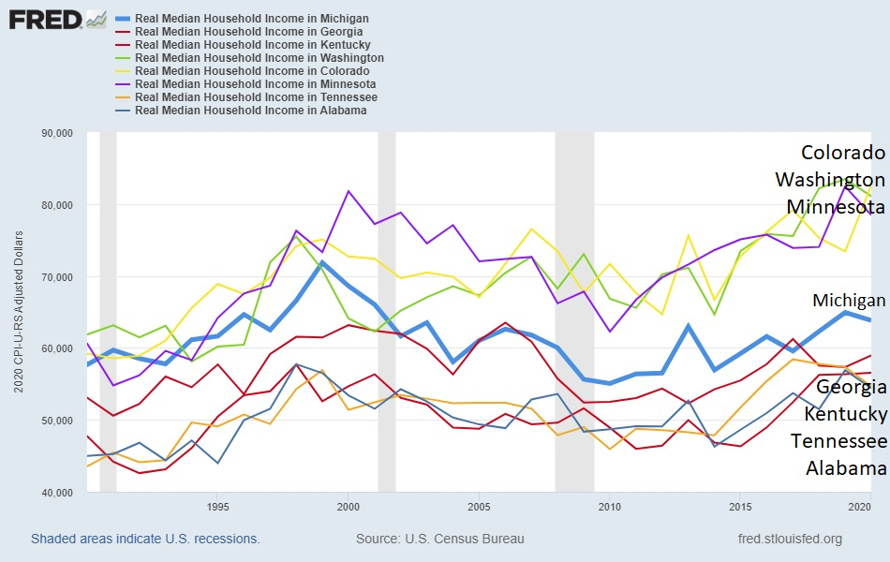
Other “peer states”

Slide 29
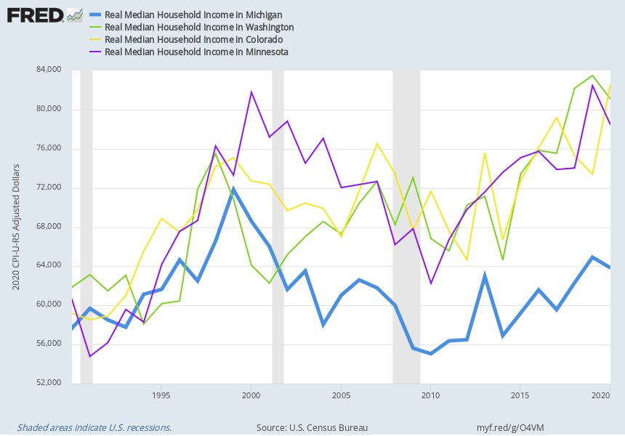
We found the new “good jobs”
Colorado
Washington
Minnesota
Michigan
Notes:
Source:
U.S. Census Bureau
Release:
Income and Poverty in the United States
Units:
2020 CPI-U-RS Adjusted Dollars, Not Seasonally Adjusted
Frequency:
Annual
Household data are collected as of March.Consumer Price Index research series using current methods (CPI-U-RS) presents an estimate of the CPI for all Urban Consumers (CPI-U) that incorporates most of the improvements made over that time span into the entire series. More information can be found at https://www.bls.gov/cpi/research-series/home.htm.As stated in the Census's "Source and Accuracy of Estimates for Income, Poverty, and Health Insurance Coverage in the United States: 2011" (http://www.census.gov/hhes/www/p60_243sa.pdf):Estimation of Median Incomes. The Census Bureau has changed the methodology for computing median income over time. The Census Bureau has computed medians using either Pareto interpolation or linear interpolation. Currently, we are using linear interpolation to estimate all medians. Pareto interpolation assumes a decreasing density of population within an income interval, whereas linear interpolation assumes a constant density of population within an income interval. The Census Bureau calculated estimates of median income and associated standard errors for 1979 through 1987 using Pareto interpolation if the estimate was larger than $20,000 for people or $40,000 for families and households. This is because the width of the income interval containing the estimate is greater than $2,500.We calculated estimates of median income and associated standard errors for 1976, 1977, and 1978 using Pareto interpolation if the estimate was larger than $12,000 for people or $18,000 for families and households. This is because the width of the income interval containing the estimate is greater than $1,000. All other estimates of median income and associated standard errors for 1976 through 2011 (2012 ASEC) and almost all of the estimates of median income and associated standard errors for 1975 and earlier were calculated using linear interpolation.Thus, use caution when comparing median incomes above $12,000 for people or $18,000 for families and households for different years. Median incomes below those levels are more comparable from year to year since they have always been calculated using linear interpolation. For an indication of the comparability of medians calculated using Pareto interpolation with medians calculated using linear interpolation, see Series P-60, Number 114, Money Income in 1976 of Families and Persons in the United States (www2.census.gov/prod2/popscan/p60-114.pdf).
U.S. Census Bureau,
Real Median Household Income in Michigan [MEHOINUSMIA672N],
retrieved from FRED,
Federal Reserve Bank of St. Louis;
https://fred.stlouisfed.org/series/MEHOINUSMIA672N,
April 9, 2022.
Source:
U.S. Census Bureau
Release:
Income and Poverty in the United States
Units:
2020 CPI-U-RS Adjusted Dollars, Not Seasonally Adjusted
Frequency:
Annual
Household data are collected as of March.Consumer Price Index research series using current methods (CPI-U-RS) presents an estimate of the CPI for all Urban Consumers (CPI-U) that incorporates most of the improvements made over that time span into the entire series. More information can be found at https://www.bls.gov/cpi/research-series/home.htm.As stated in the Census's "Source and Accuracy of Estimates for Income, Poverty, and Health Insurance Coverage in the United States: 2011" (http://www.census.gov/hhes/www/p60_243sa.pdf):Estimation of Median Incomes. The Census Bureau has changed the methodology for computing median income over time. The Census Bureau has computed medians using either Pareto interpolation or linear interpolation. Currently, we are using linear interpolation to estimate all medians. Pareto interpolation assumes a decreasing density of population within an income interval, whereas linear interpolation assumes a constant density of population within an income interval. The Census Bureau calculated estimates of median income and associated standard errors for 1979 through 1987 using Pareto interpolation if the estimate was larger than $20,000 for people or $40,000 for families and households. This is because the width of the income interval containing the estimate is greater than $2,500.We calculated estimates of median income and associated standard errors for 1976, 1977, and 1978 using Pareto interpolation if the estimate was larger than $12,000 for people or $18,000 for families and households. This is because the width of the income interval containing the estimate is greater than $1,000. All other estimates of median income and associated standard errors for 1976 through 2011 (2012 ASEC) and almost all of the estimates of median income and associated standard errors for 1975 and earlier were calculated using linear interpolation.Thus, use caution when comparing median incomes above $12,000 for people or $18,000 for families and households for different years. Median incomes below those levels are more comparable from year to year since they have always been calculated using linear interpolation. For an indication of the comparability of medians calculated using Pareto interpolation with medians calculated using linear interpolation, see Series P-60, Number 114, Money Income in 1976 of Families and Persons in the United States (www2.census.gov/prod2/popscan/p60-114.pdf).
U.S. Census Bureau,
Real Median Household Income in Washington [MEHOINUSWAA672N],
retrieved from FRED,
Federal Reserve Bank of St. Louis;
https://fred.stlouisfed.org/series/MEHOINUSWAA672N,
April 9, 2022.
Source:
U.S. Census Bureau
Release:
Income and Poverty in the United States
Units:
2020 CPI-U-RS Adjusted Dollars, Not Seasonally Adjusted
Frequency:
Annual
Household data are collected as of March.Consumer Price Index research series using current methods (CPI-U-RS) presents an estimate of the CPI for all Urban Consumers (CPI-U) that incorporates most of the improvements made over that time span into the entire series. More information can be found at https://www.bls.gov/cpi/research-series/home.htm.As stated in the Census's "Source and Accuracy of Estimates for Income, Poverty, and Health Insurance Coverage in the United States: 2011" (http://www.census.gov/hhes/www/p60_243sa.pdf):Estimation of Median Incomes. The Census Bureau has changed the methodology for computing median income over time. The Census Bureau has computed medians using either Pareto interpolation or linear interpolation. Currently, we are using linear interpolation to estimate all medians. Pareto interpolation assumes a decreasing density of population within an income interval, whereas linear interpolation assumes a constant density of population within an income interval. The Census Bureau calculated estimates of median income and associated standard errors for 1979 through 1987 using Pareto interpolation if the estimate was larger than $20,000 for people or $40,000 for families and households. This is because the width of the income interval containing the estimate is greater than $2,500.We calculated estimates of median income and associated standard errors for 1976, 1977, and 1978 using Pareto interpolation if the estimate was larger than $12,000 for people or $18,000 for families and households. This is because the width of the income interval containing the estimate is greater than $1,000. All other estimates of median income and associated standard errors for 1976 through 2011 (2012 ASEC) and almost all of the estimates of median income and associated standard errors for 1975 and earlier were calculated using linear interpolation.Thus, use caution when comparing median incomes above $12,000 for people or $18,000 for families and households for different years. Median incomes below those levels are more comparable from year to year since they have always been calculated using linear interpolation. For an indication of the comparability of medians calculated using Pareto interpolation with medians calculated using linear interpolation, see Series P-60, Number 114, Money Income in 1976 of Families and Persons in the United States (www2.census.gov/prod2/popscan/p60-114.pdf).
U.S. Census Bureau,
Real Median Household Income in Colorado [MEHOINUSCOA672N],
retrieved from FRED,
Federal Reserve Bank of St. Louis;
https://fred.stlouisfed.org/series/MEHOINUSCOA672N,
April 9, 2022.
Source:
U.S. Census Bureau
Release:
Income and Poverty in the United States
Units:
2020 CPI-U-RS Adjusted Dollars, Not Seasonally Adjusted
Frequency:
Annual
Household data are collected as of March.Consumer Price Index research series using current methods (CPI-U-RS) presents an estimate of the CPI for all Urban Consumers (CPI-U) that incorporates most of the improvements made over that time span into the entire series. More information can be found at https://www.bls.gov/cpi/research-series/home.htm.As stated in the Census's "Source and Accuracy of Estimates for Income, Poverty, and Health Insurance Coverage in the United States: 2011" (http://www.census.gov/hhes/www/p60_243sa.pdf):Estimation of Median Incomes. The Census Bureau has changed the methodology for computing median income over time. The Census Bureau has computed medians using either Pareto interpolation or linear interpolation. Currently, we are using linear interpolation to estimate all medians. Pareto interpolation assumes a decreasing density of population within an income interval, whereas linear interpolation assumes a constant density of population within an income interval. The Census Bureau calculated estimates of median income and associated standard errors for 1979 through 1987 using Pareto interpolation if the estimate was larger than $20,000 for people or $40,000 for families and households. This is because the width of the income interval containing the estimate is greater than $2,500.We calculated estimates of median income and associated standard errors for 1976, 1977, and 1978 using Pareto interpolation if the estimate was larger than $12,000 for people or $18,000 for families and households. This is because the width of the income interval containing the estimate is greater than $1,000. All other estimates of median income and associated standard errors for 1976 through 2011 (2012 ASEC) and almost all of the estimates of median income and associated standard errors for 1975 and earlier were calculated using linear interpolation.Thus, use caution when comparing median incomes above $12,000 for people or $18,000 for families and households for different years. Median incomes below those levels are more comparable from year to year since they have always been calculated using linear interpolation. For an indication of the comparability of medians calculated using Pareto interpolation with medians calculated using linear interpolation, see Series P-60, Number 114, Money Income in 1976 of Families and Persons in the United States (www2.census.gov/prod2/popscan/p60-114.pdf).
U.S. Census Bureau,
Real Median Household Income in Minnesota [MEHOINUSMNA672N],
retrieved from FRED,
Federal Reserve Bank of St. Louis;
https://fred.stlouisfed.org/series/MEHOINUSMNA672N,
April 9, 2022.

Slide 30

4-year degrees, not factory jobs lead to high prosperity
 | 2020 per capita income rank | 1990 per capita income rank | 2019 BA attainment rank | 2020 production location quotient
Washington | 6 | 15 | 12 | 0.86
Colorado | 9 | 17 | 3 | 0.63
Minnesota | 12 | 16 | 11 | 1.22
Michigan | 33 | 20 | 34 | 1.66
Tennessee | 38 | 36 | 41 | 1.41
Kentucky | 45 | 43 | 48 | 1.58
Alabama | 47 | 42 | 45 | 1.74

Slide 31
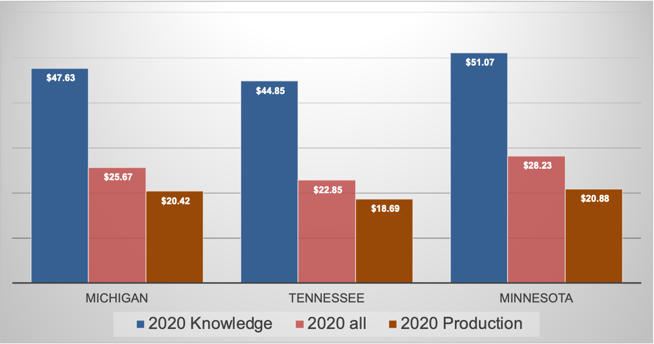
Production work pays less...than the average, and far less than knowledge jobs (hourly wage average)
Source: US Bureau of Labor Statistics

Slide 32
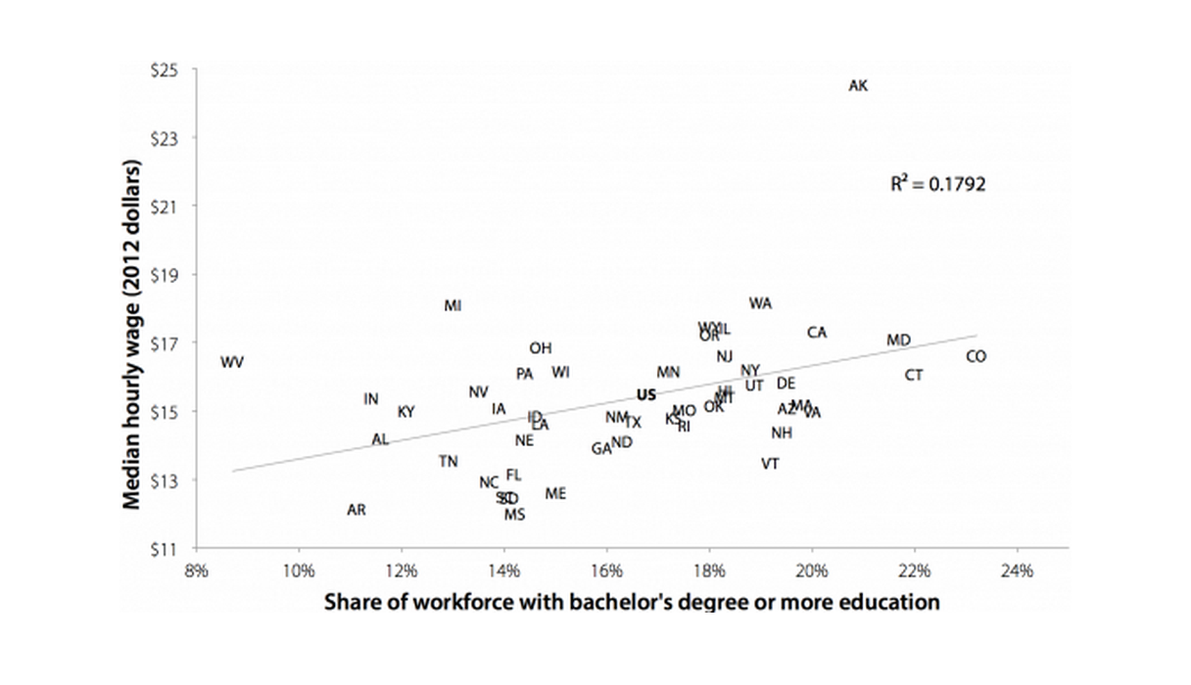
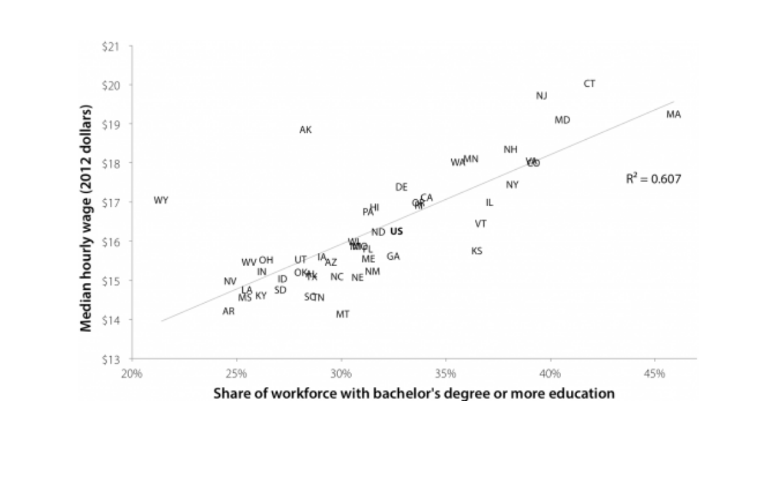
The conventional wisdom wasn’t always totally wrong… but it is now.
1979
2013

Slide 33
The NEW strategy has to adjust to this reality

Slide 34

How do we get more talent?
Develop it
Retain it
Attract it
Employ it
Unleash it

Slide 35

Developing Talent is Education
We need more people with 4-year degrees
  Let's not fight about STEM/Liberal Arts
The #1 reason for people not going to college is cost
Michigan is 50th in state $ for financial aid
Governor Whitmer/legislature increased by about 10% FY 2023
  But, we needed to raise by 11.3% just to get back to FY 2020 + CPI

Slide 36
In real dollars, we’re at modern lows...
$1b

Slide 37
Which has caused tuition to skyrocket

Slide 38
Public University General Fund Revenue Source History
Notes:
Not updated, HEIDI issue

Slide 39



Meanwhile

Slide 40
Michigan needs to
1
2
3
Make college affordable
  New (means tested?) scholarship program
  Endowment with federal $
  Clawbacks/tax credits to retain
Restore higher education appropriation to 2000 level ($1b+)
  Getting kids into college isn’t enough. We have to support them and get them to the finish line.
Require FAFSA completion
  More aid leads to higher levels of degree completion

Slide 41
Retaining and Attracting
Basically, the same issue… where does globally mobile talent WANT to be?
Three ways to figure this out
  Ask them
  Track them
  Listen to people with a vested interested in being around them
Good news:
  All 3 ways point to the same thing:
    It’s all about PLACE

Slide 42

Walkable urbanism/Place/Cool Cities
Call it whatever you want… Talent wants:
Transit
Walkable retail and entertainment options
Public safety
Cultural amenities
Housing options
Public Spaces/Infrastructure

Slide 43
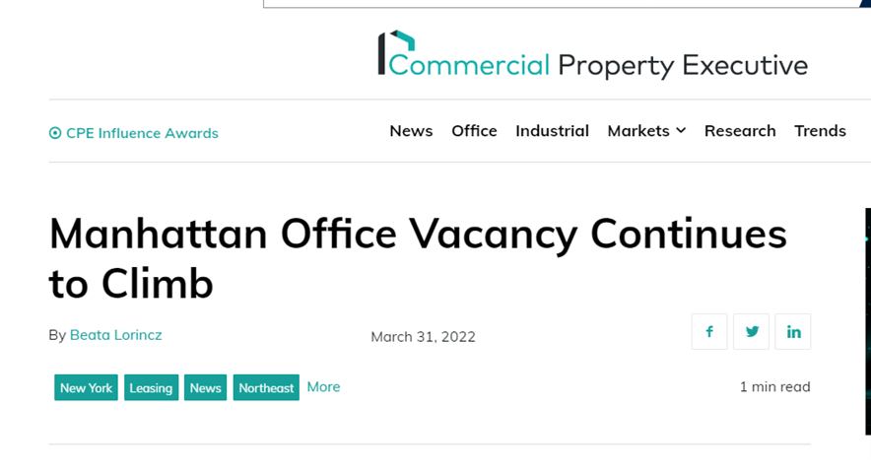

People want to be in high amenity locations regardless of where their workplaces are

Slide 44
Work from home freed people to move wherever they wanted

Slide 45
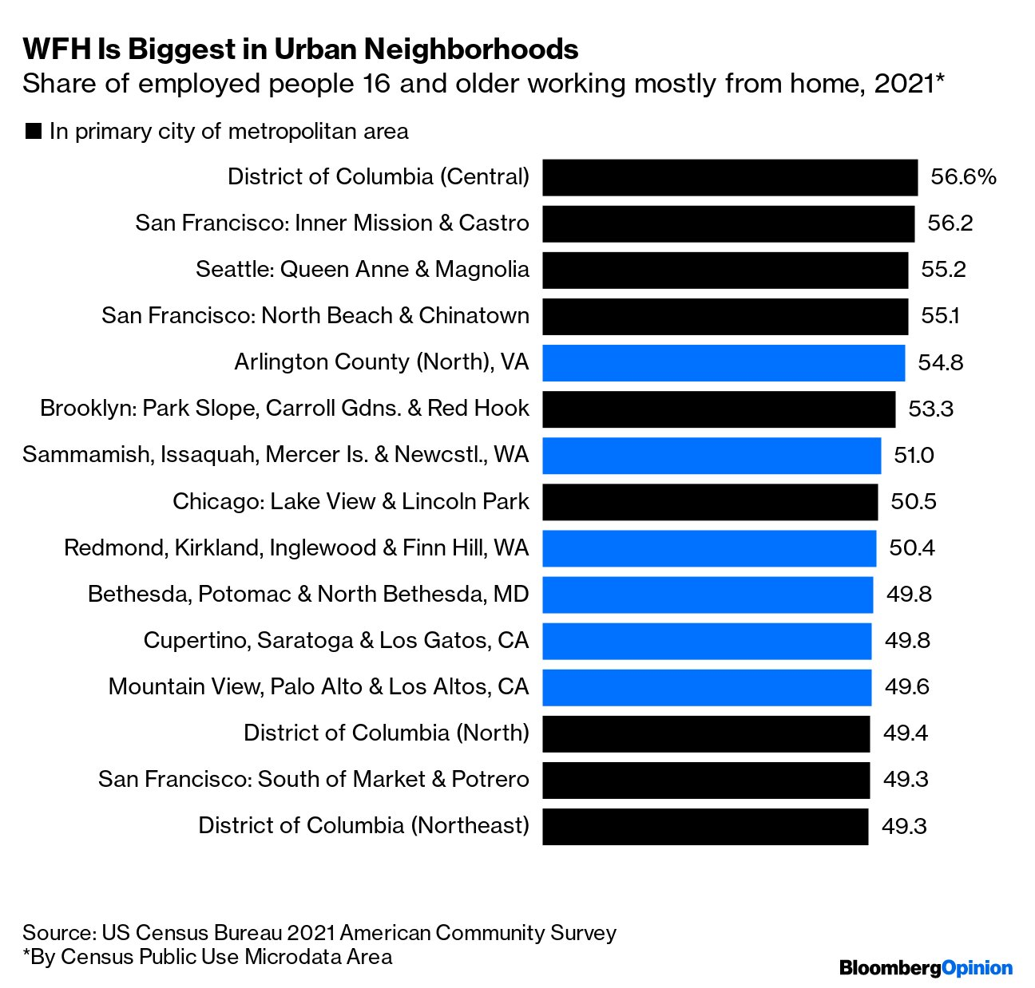
But people aren’t following jobs or low costs

Slide 46
Amazon HQ2
25,000 jobs with $150,000 avg. salary
Michigan offered $4b in incentives
Virginia beat us… they offered less than $2b with the bulk ($1.1b) being increased investment in transit and education
On the post-mortem call, they told Michigan, that we didn’t have the ‘talent’ they need, and that lack of transit and walkable urbanism meant we were unlikely to attract it.

Slide 47
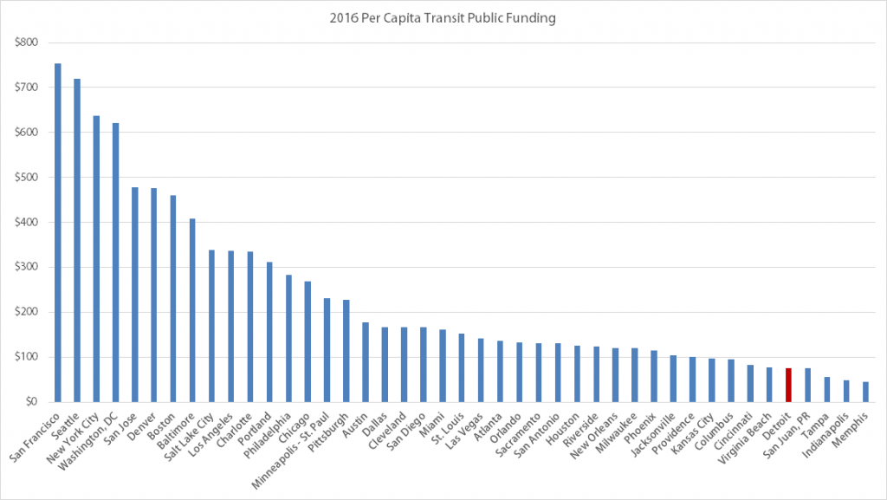
Large metro transit funding

Slide 48
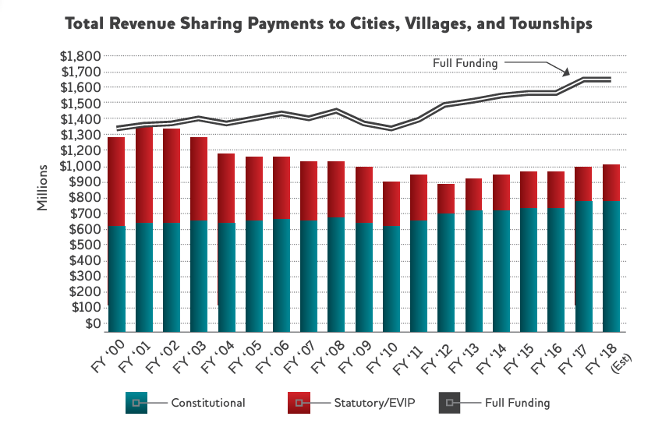
We’ve been cutting funding to cities

Slide 49
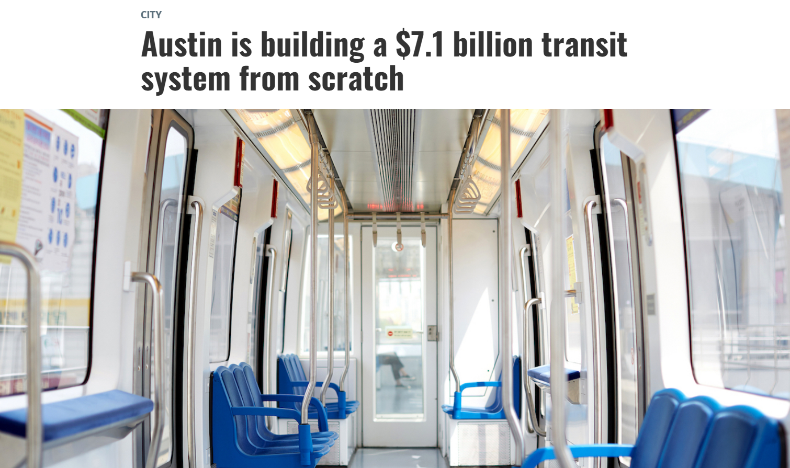

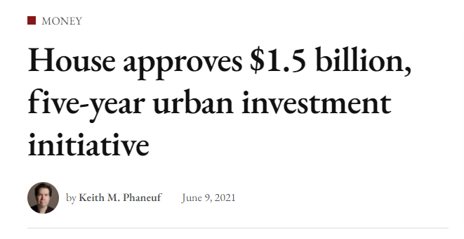
Meanwhile
Connecticut

Slide 50
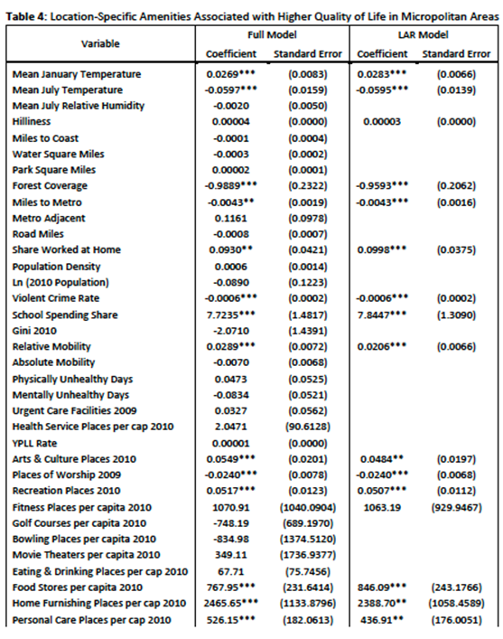
Not Just Big Cities
Home furnishing places per capita
Fitness places per capita
Food Stores per capita
Personal care places per capita
Movie theaters per capita
Eating and Drinking places per capita
School Spending Share
Health Services places per capita
Most Desired Factors

Slide 51
Some Good News
Investments in place are not just for retaining and attracting ‘talent’
Everyone gets to benefit from transit and walkable amenities
Politically it’s extremely popular

Slide 52


Slide 53
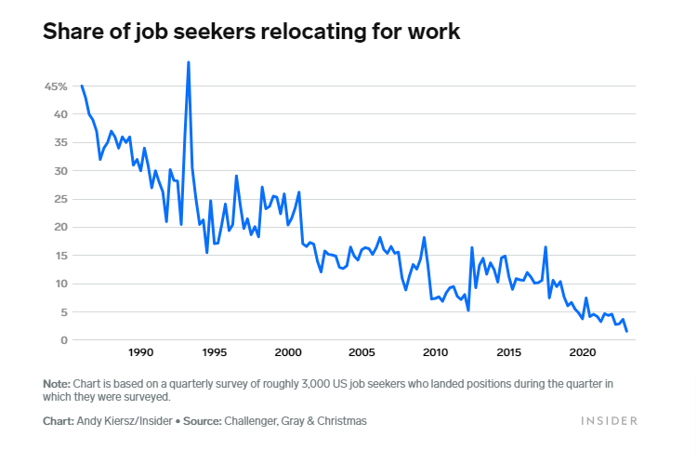

Slide 54
Michigan needs to
1
2
3
4
Develop real regional and inter-regional transit
  Flip Act 51 formula? Use federal $ for BRT along commercial corridors?
Invest in Cities
  Fully fund revenue sharing? Urban redevelopment credits? Split rate taxation?
Rebuild Public Infrastructure
  Roads, broadband, municipal water systems, MEDC RAP program
Refill commercial corridors with small businesses
  Regional small biz smartzones and BAF, licensing/permitting

Slide 55
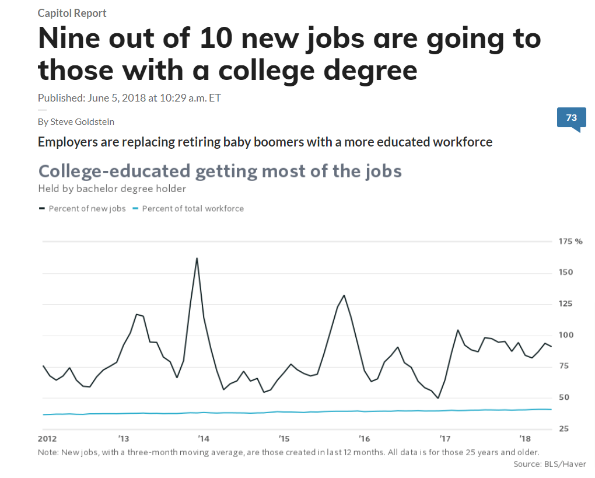
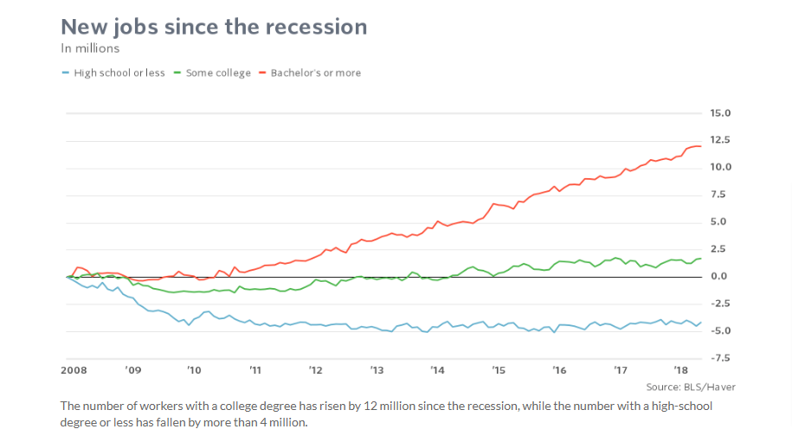
Employ is about jobs… and incentives

Slide 56
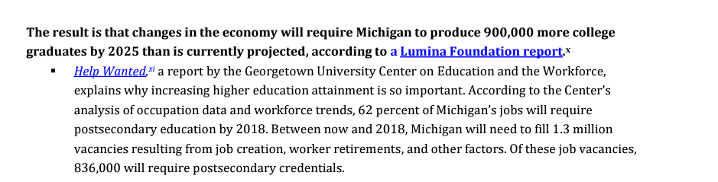
What we projected in 2013

Slide 57
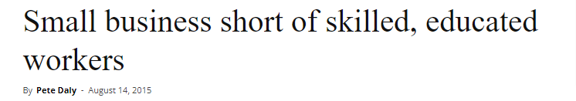
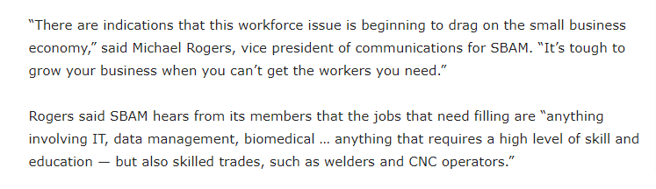

Same story in 2015

Slide 58
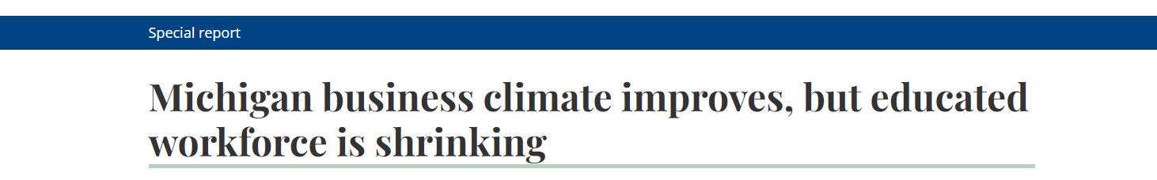
But we didn’t listen and by 2018

Slide 59
Adv Mfg | Shortage of high-skill workers
Manufacturing industry job postings in MI indicate lagging supply for BA+ degrees¹
36%
Relative share of BA/MA manufacturing functions driven by management and engineering/computation²
-11%
Sales and Related
25%
12%
Management
Business and Financial Operations
31%
13%
Top 5 mfg. functions
20%
Computer and Mathematical
24%
BA or MA degree
Architecture and Engineering
% of degree holders across MI residents
% of job postings requiring education level
1. Extrapolation based on Job Postings. Nov 2020 – Feb 2021 2. Based on Job postings in Michigan from Jan 1, 2020 – Dec 31, 2020 Source: Labor Insights (Burning Glass)

Slide 60




Slide 61
Healthcare | Shortage of high-skill workers
Healthcare industry job postings in MI indicate greater need for BA+ degrees¹
31%
Relative share of BA/MA job demand is primarily driver by practitioners in healthcare field²
Office and Administrative Support
Business and Financial Operations
-14%
Community & social services
4%
17%
11%
4%
14%
10%
-4%
Top 5 HC functions
Management ^{16%}
65%
Healthcare Practitioners and Technical
Bachelor’s degree
Master’s degree and higher
% of degree holders across MI residents
% of job postings requiring education level
1. Extrapolation based on Grand Rapid-Wyoming, Kalamazoo-Portage MSA Healthcare Job Postings. Nov 2020 – Feb 2021 2. Based on Job postings in Michigan from Jan 1, 2020 – Dec 31, 2020
Source: Labor Insights (Burning Glass)

Slide 62
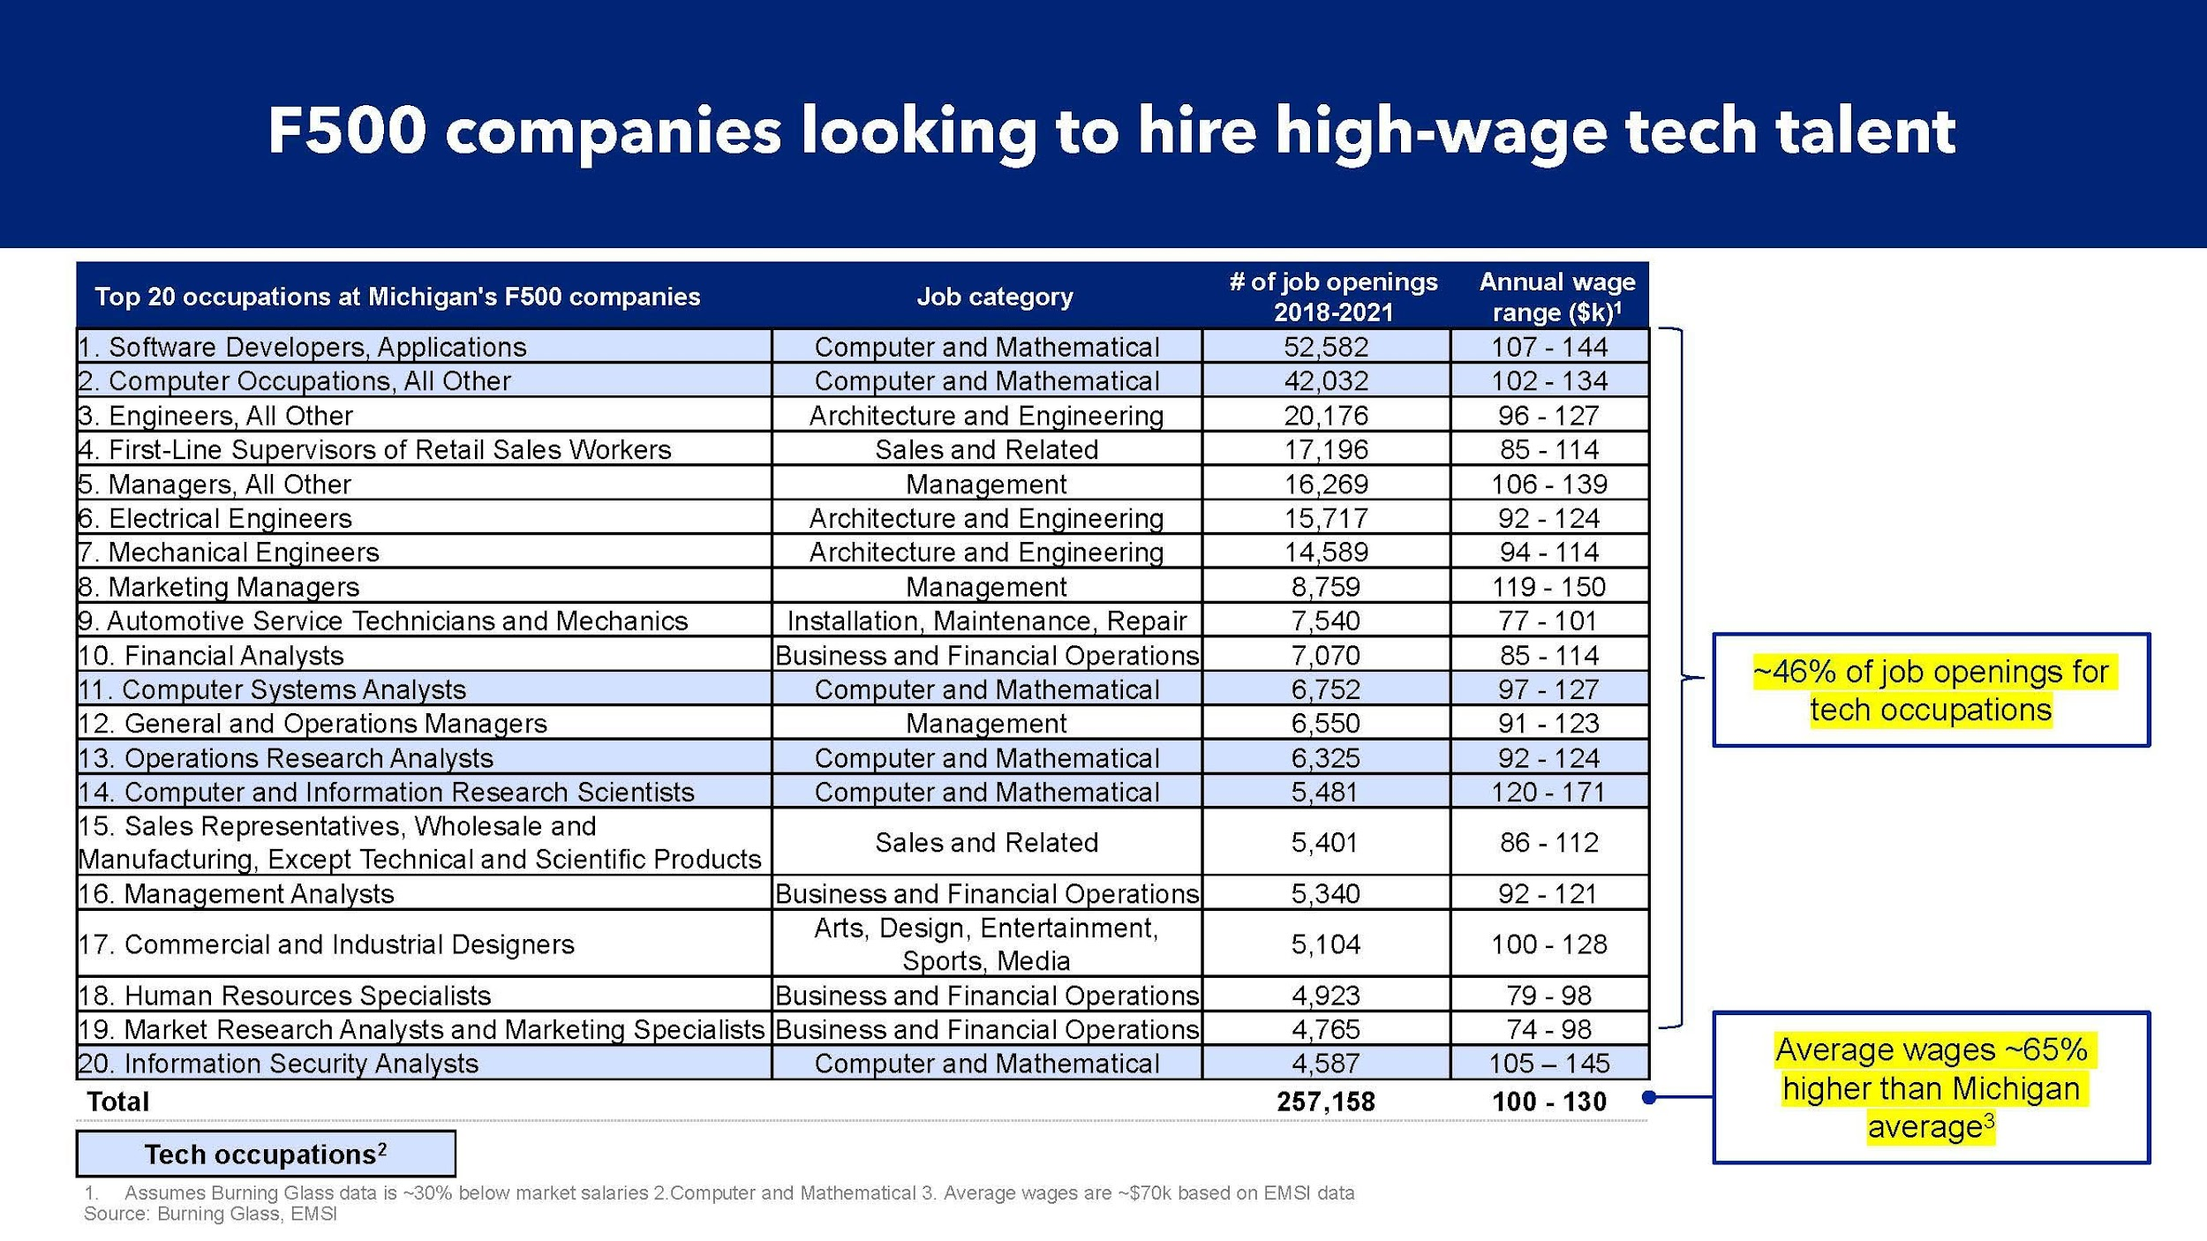

Slide 63
There are lots of jobs in Michigan

Slide 64
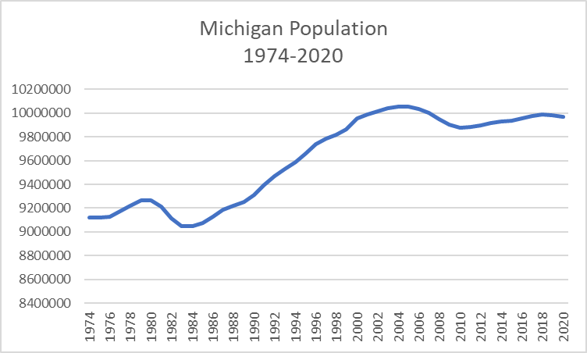

Slide 65
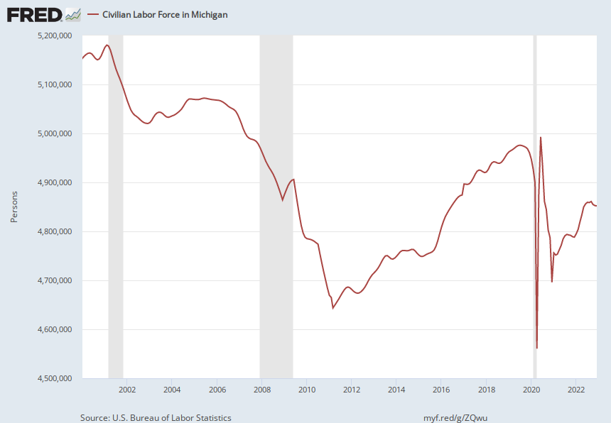
Notes:
Source:
U.S. Bureau of Labor Statistics
Release:
State Employment and Unemployment
Units:
Persons, Seasonally Adjusted
Frequency:
Monthly
U.S. Bureau of Labor Statistics,
Civilian Labor Force in Michigan [MILF],
retrieved from FRED,
Federal Reserve Bank of St. Louis;
https://fred.stlouisfed.org/series/MILF,
February 9, 2023.

Slide 66
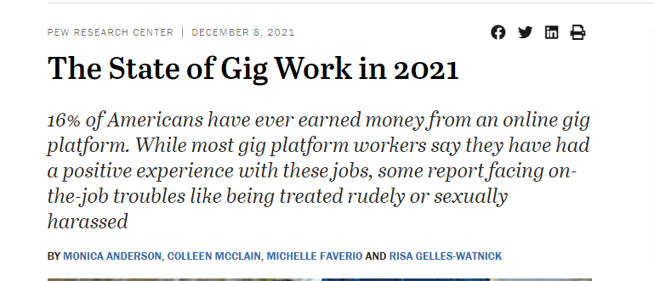
3% of U.S. adults overall say this has been their main job over the past 12 months.
Those shares are even higher for those who are less affluent: 7% of all adults with lower incomes say it has been their main job over the past year.

Slide 67
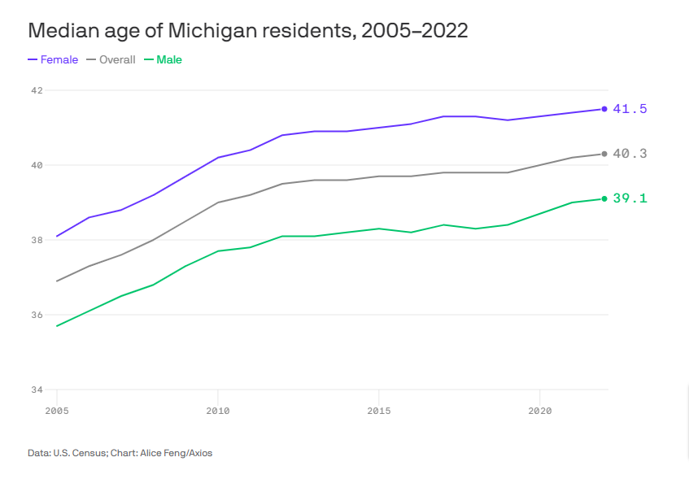

Slide 68
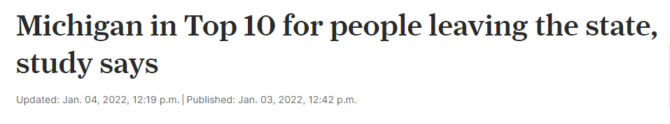



Slide 69







But we’ve been losing the important deals
Site Selected
Site Selected
Relocation
Slowed Hiring Growth
Northern Virginia
25,000 jobs
Avg. Salary $150,000
Columbus, Ohio
3,000 jobs
Avg. Salary $135,000
From Livonia to Irvine, CA
2,000+ HQ Tech jobs
Google opened in 2006 with plans to hire 1000 in Ann Arbor
Duo’s fastest growing office is in Austin.
Rivian CEO RJ Scaringe "believes California is a cool place to be and Detroit has an old technology image."

Slide 70



The next big one is upon us
Opportunity for Michigan
GM Hiring 8,000
Fuel cell engineers.
Software engineers
Computer engineers
Mechanical engineers
Electrical engineers.
Cybersecurity​.
Software development.
Location TBD?

Slide 71
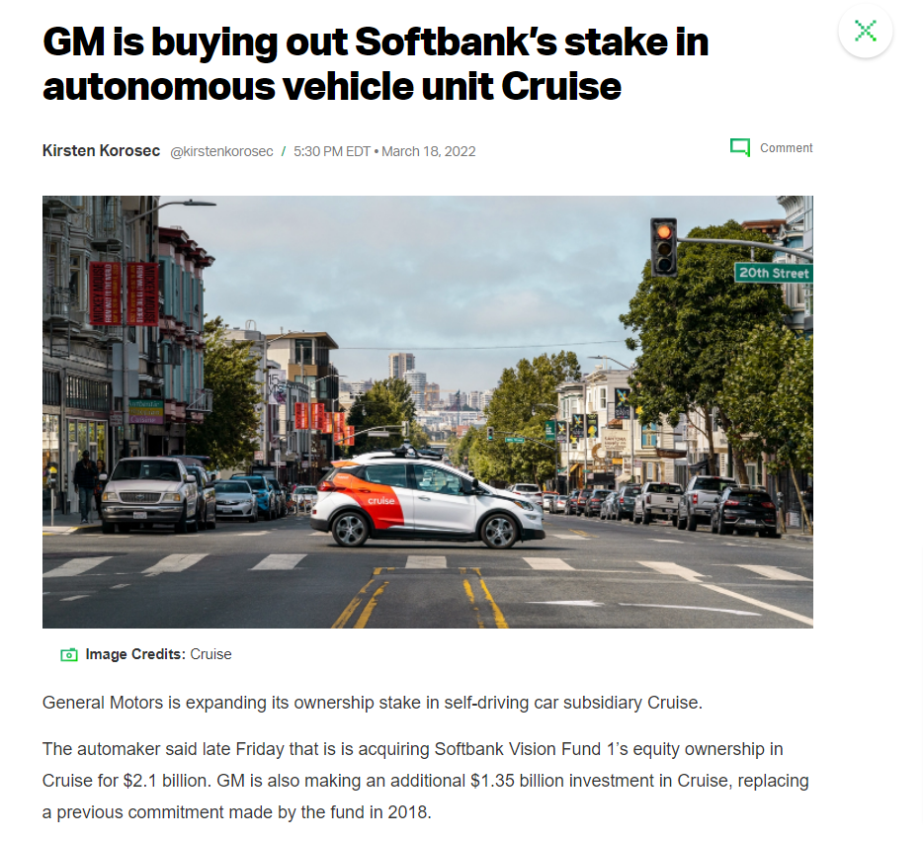

But will we win?

Slide 72
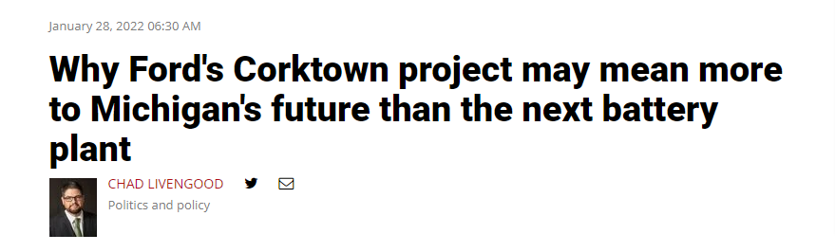
“If the train station doesn't work, it doesn't matter where Ford puts battery plants, because Ford's toast”
-Lou Glazer, Michigan Future

Slide 73
Michigan needs to: improve its incentives
1
2
3
4
Target knowledge jobs
Wages above median household wages
Short-term (3yr) front loaded but with clawbacks
Use right tool in right geography

Slide 74
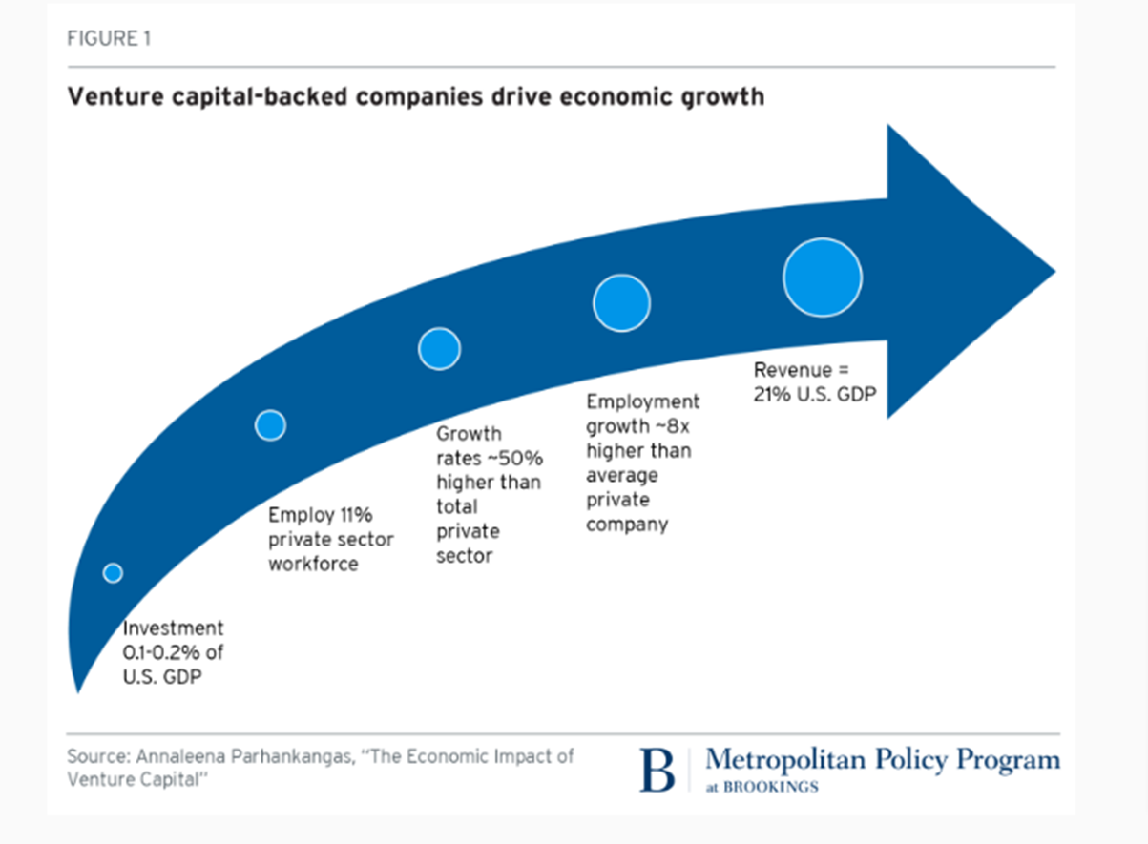
Unleash means entrepreneurship

Slide 75
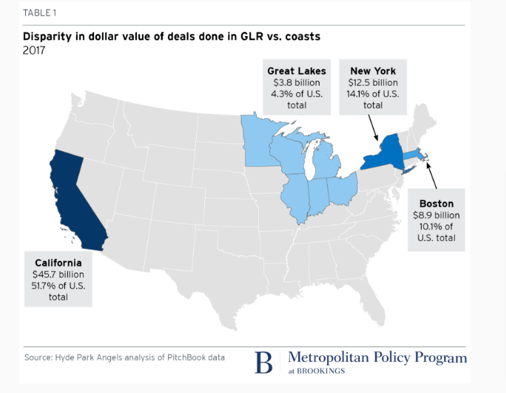
We’re Never Going to Be “the Valley”

Slide 76
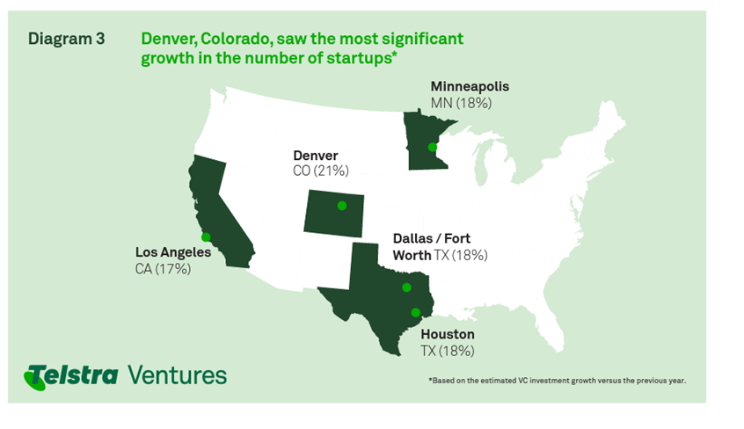
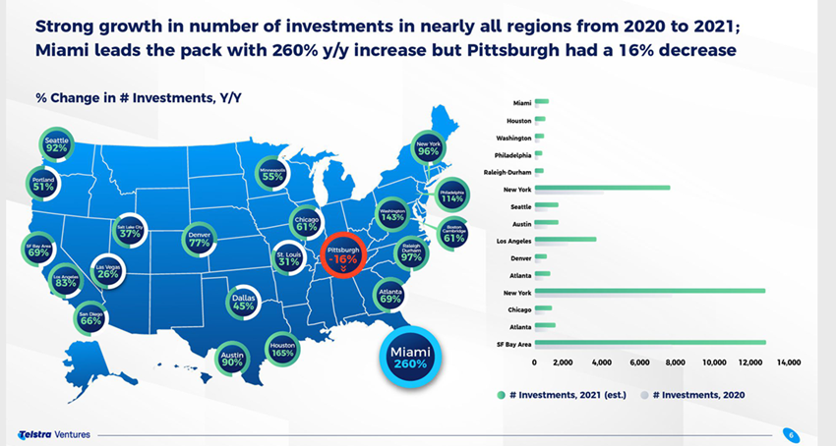
We need to compete with the next tier
2020
2021

Slide 77

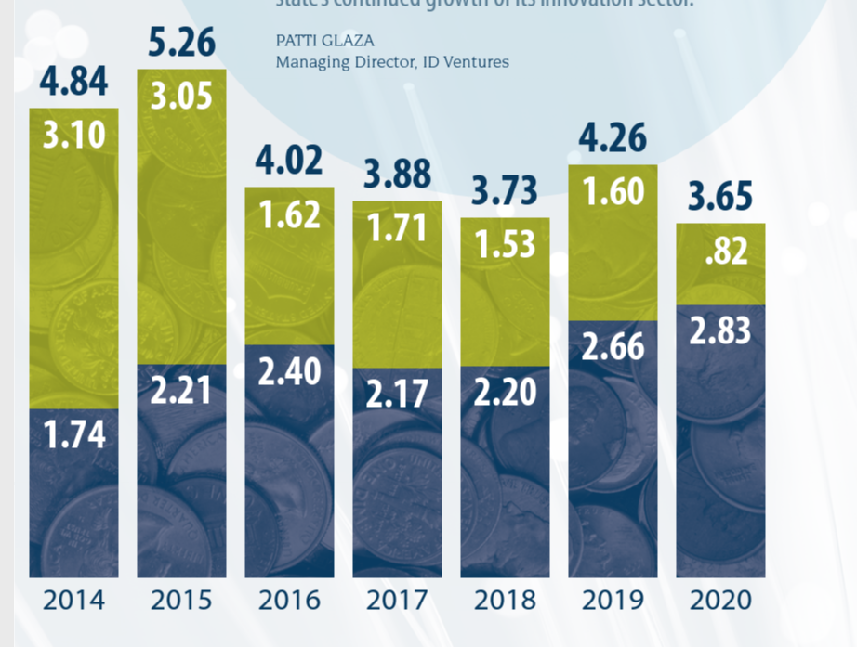
Unfortunately
There are 165 venture-backed startups in Michigan, an increase of only 17 percent over the last five years.
Total venture capital under management in Michigan is $3.7 billion, a decrease of 31 percent over the last five years.

Slide 78
Michigan needs to
1
2
3
Reinvest in Venture Capital ‘Fund of Funds’
Support the growth of angel networks
Provide technical assistance through SmartZones and fund them equitably

Slide 79
The New Economic Development Agenda
Develop
Retain/Attract
Employ
Unleash
  Make college affordable
  Restore higher education appropriation to 2000 level ($1b+)
  Require FAFSA completion
  Develop real regional and inter-regional transit
  Invest in Cities
  Rebuild Public Infrastructure
  Refill commercial corridors with small businesses
  Target knowledge jobs
  Wages above median household wages
  Short-term (3yr) front loaded but with clawbacks
  Use right tool in right geography
  Reinvest in Venture Capital ‘Fund of Funds’
  Support the growth of angel networks
  Provide technical assistance through SmartZones and fund them equitably

Slide 80
x

Slide 81
Maureen Krauss
x
President & CEO, Detroit Regional Partnership

Slide 82


Slide 83
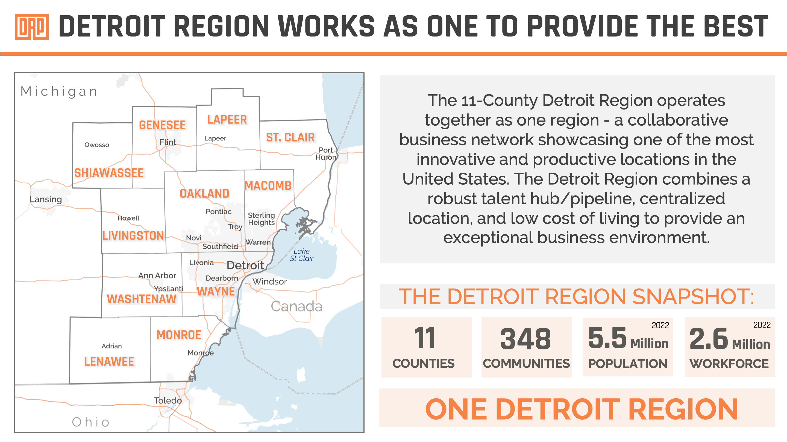

Slide 84
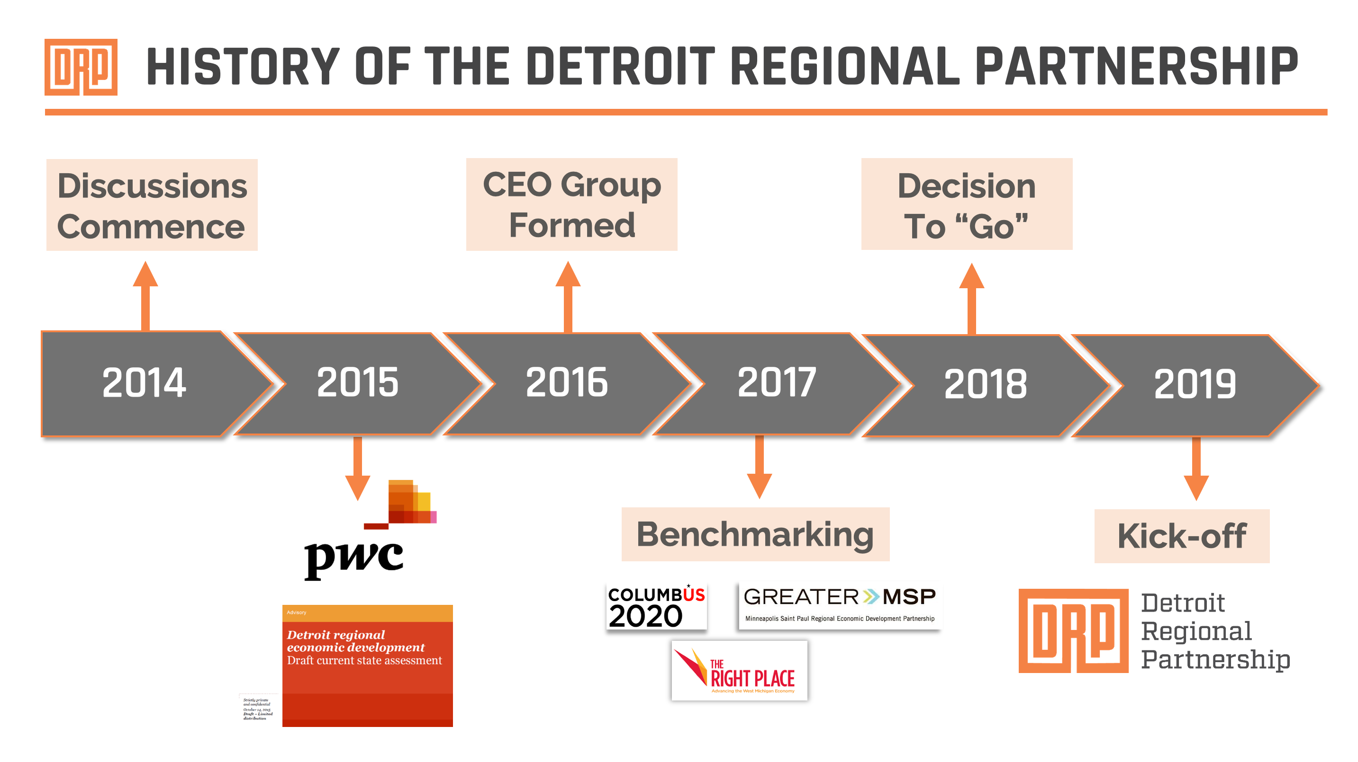

Slide 85
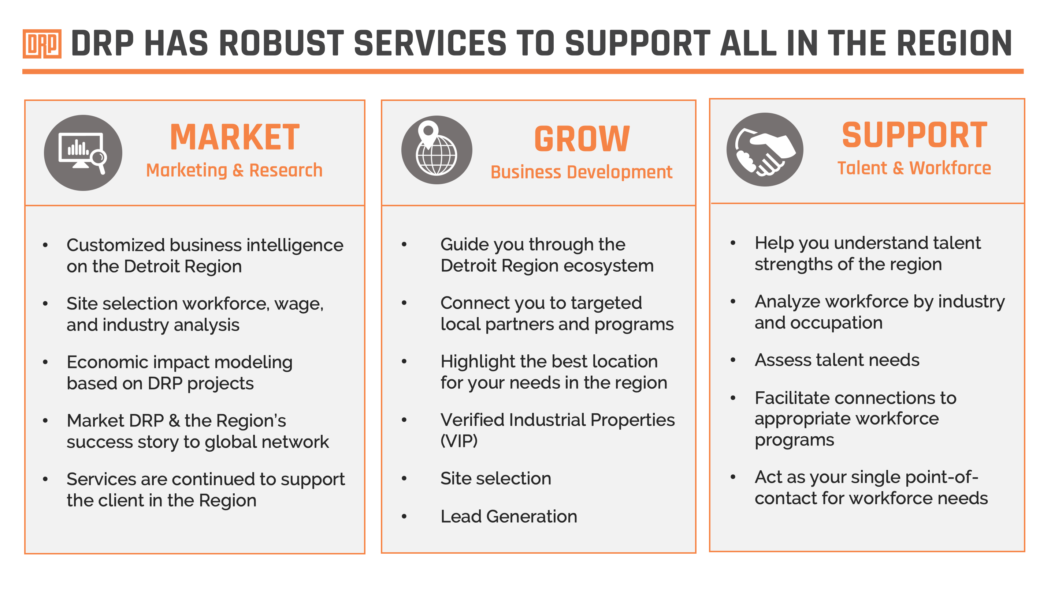

Slide 86
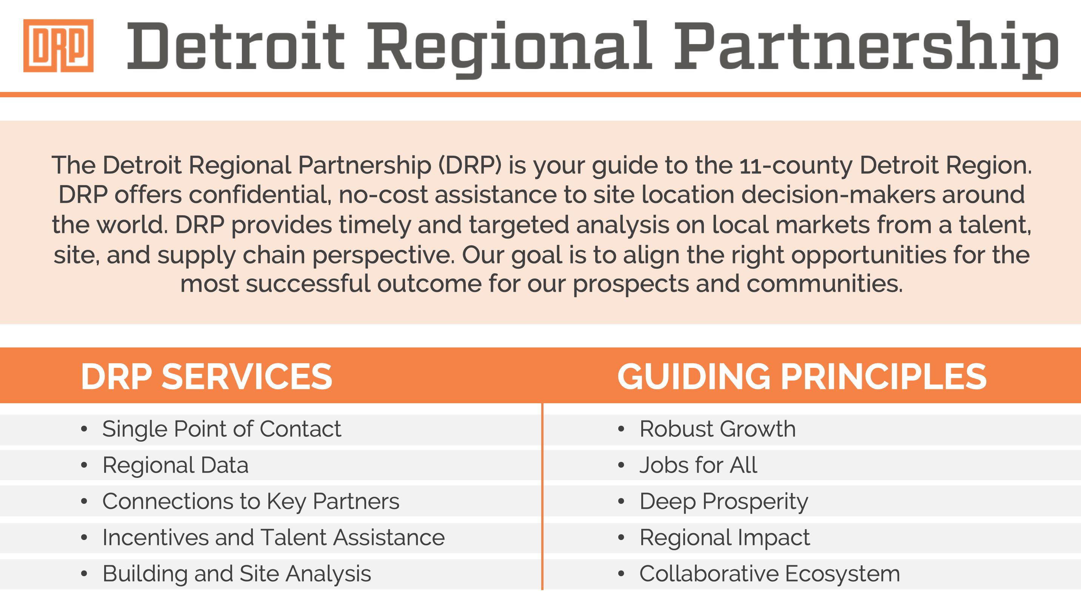

Slide 87
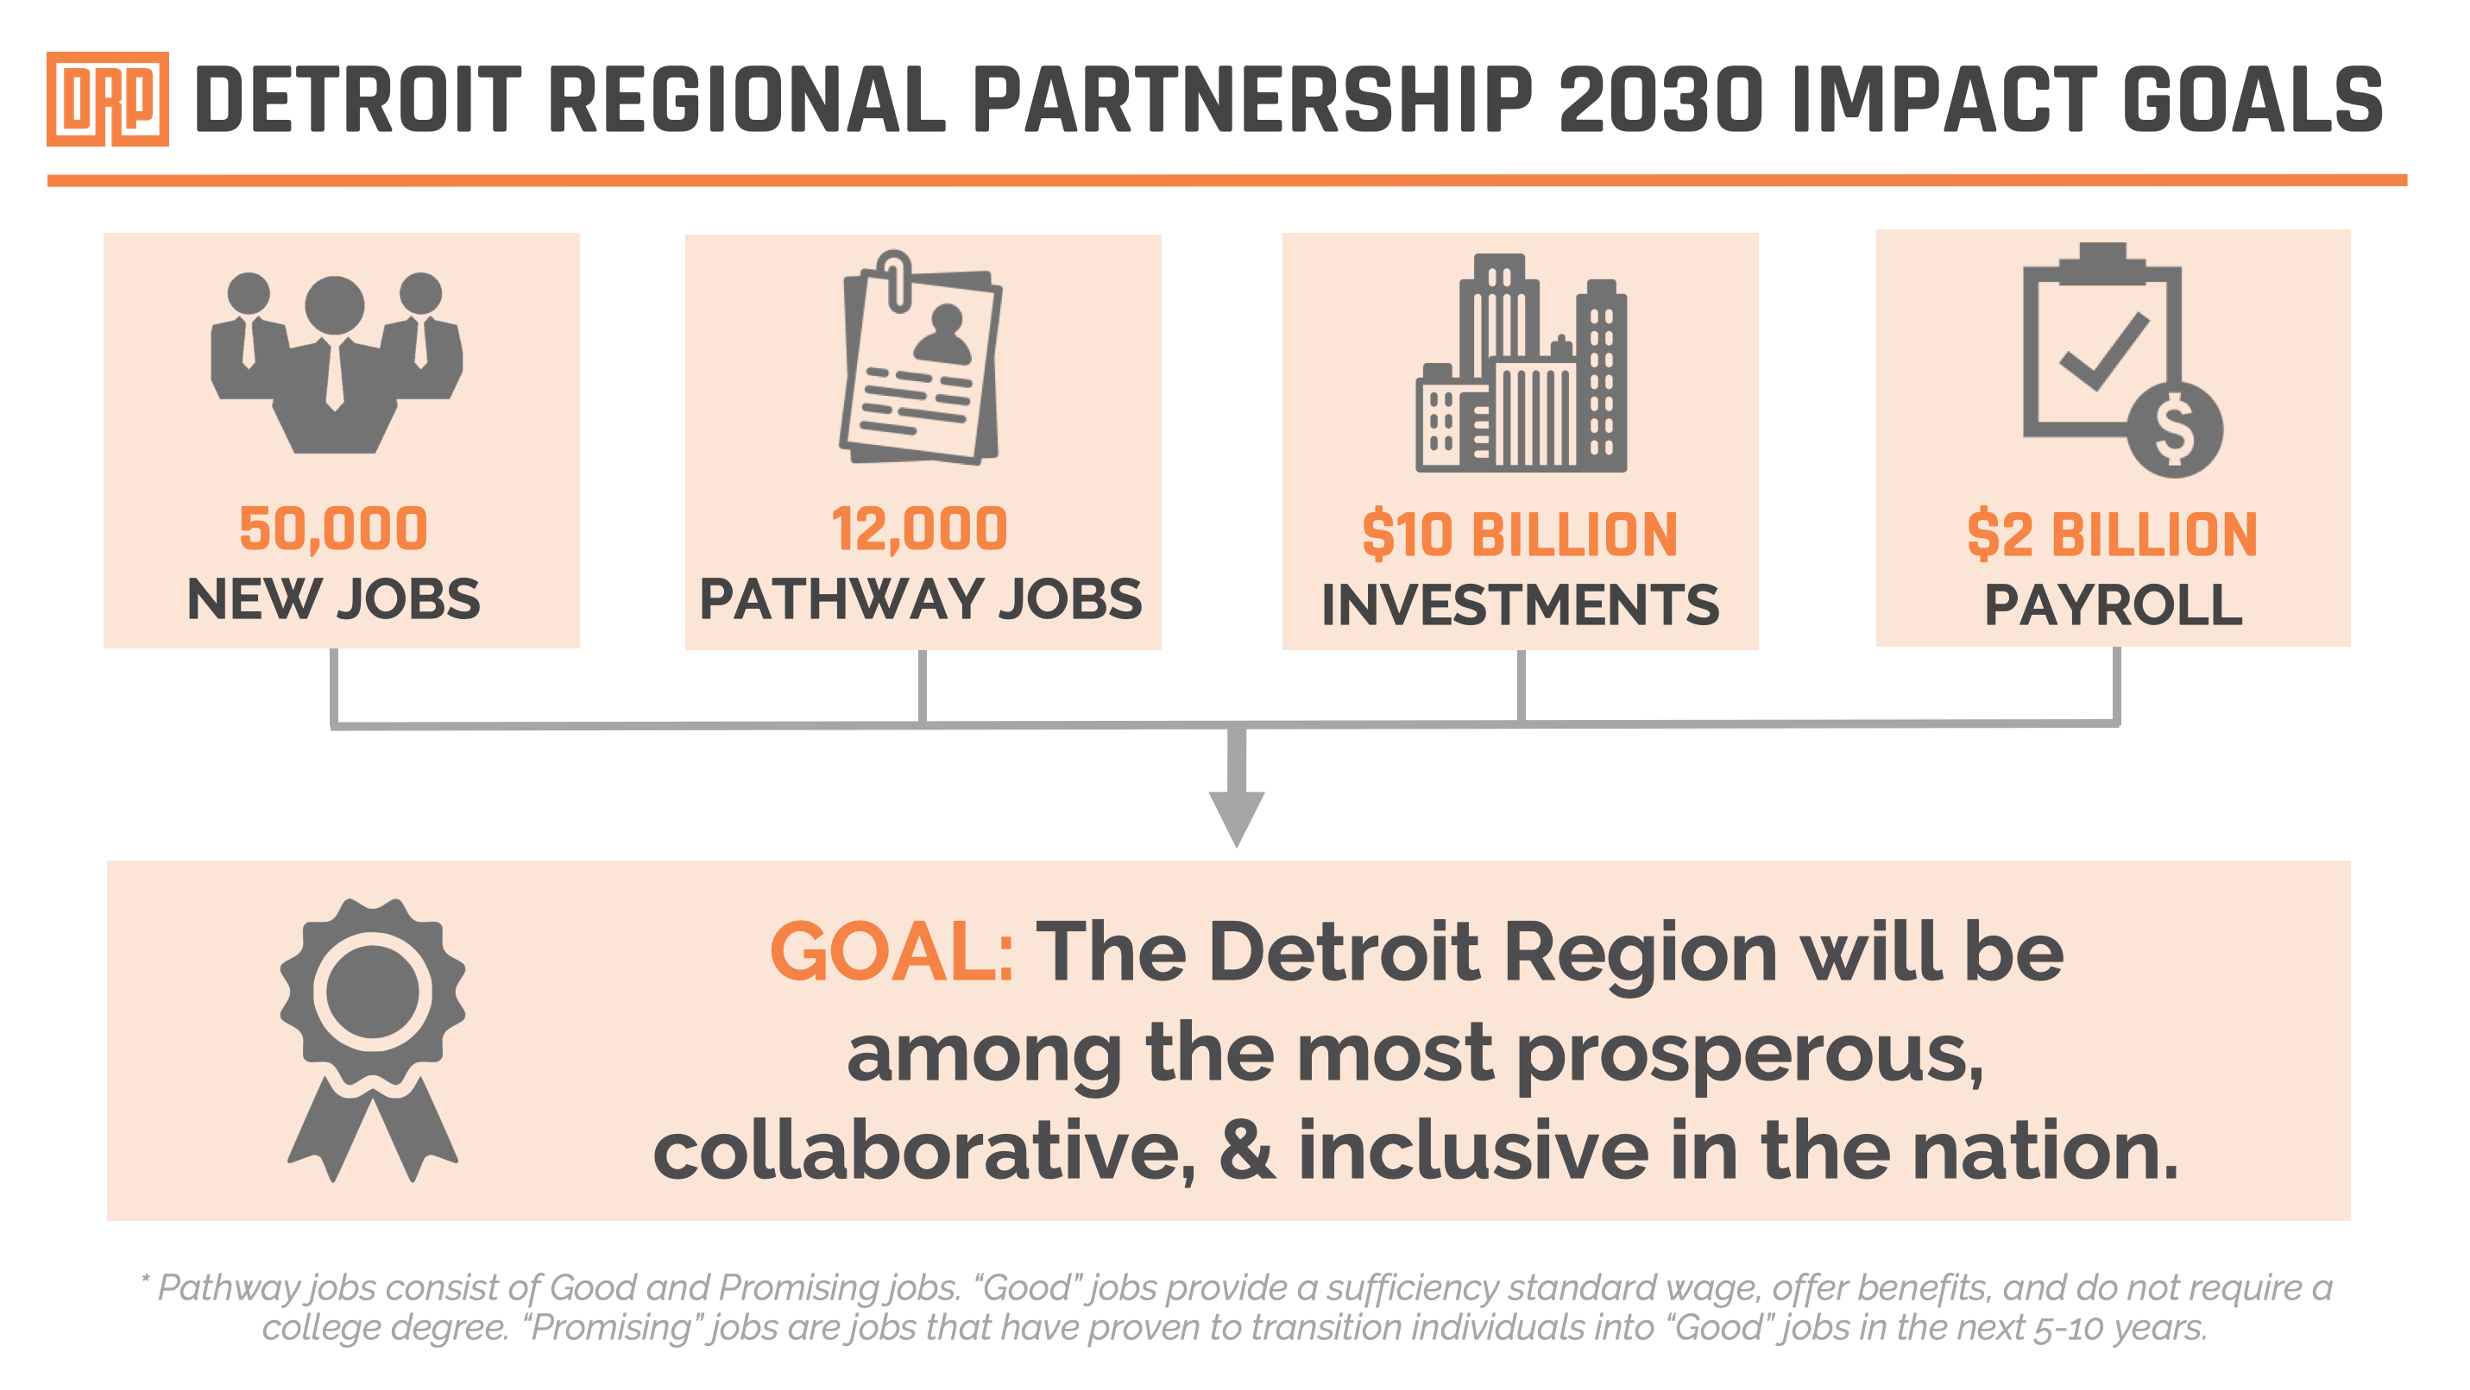

Slide 88
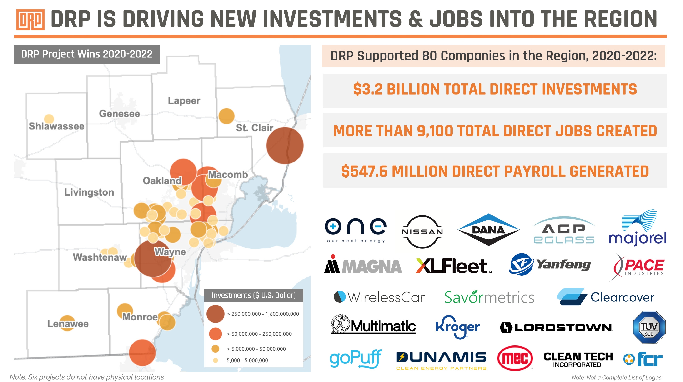

Slide 89
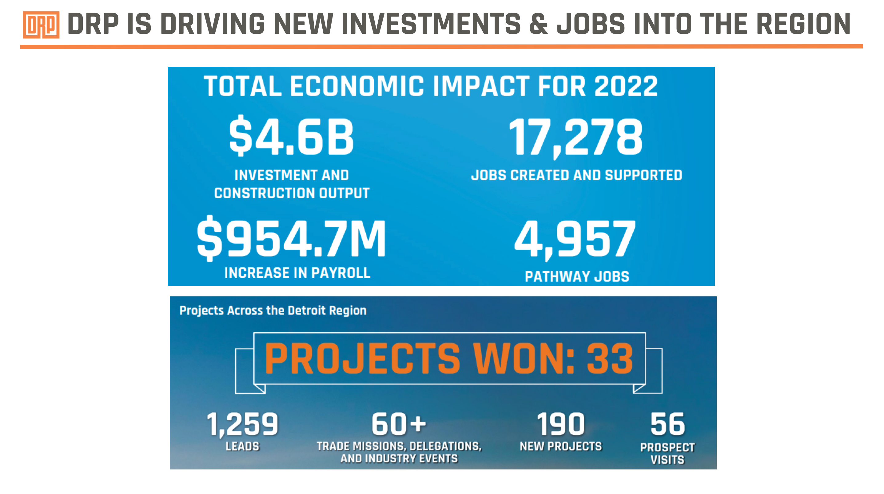

Slide 90


Slide 91


Slide 92


Slide 93


Slide 94


Slide 95


Slide 96


Slide 97


Slide 98


Slide 99
Defining Moments
x

Slide 100
Class Announcements
x
Next Session:
Health & Wellness
Thursday, December 14th
Pistons Performance Center

Slide 101
Class Announcements
x
Social Committee Holiday Toy Drive
Class Share Out: Events

Slide 102

bit.ly/LD44EconDev
x

Slide 103
Social Hour
x

Slide 104
x

