Slide 1



x

Slide 2

Devon O'Reilly
x
Senior Director, Community Engagement and Leadership Development, Detroit Regional Chamber

Slide 3
The Future of Health & Destination Grand
x
Robin Damschroder
Chief Financial & Business Development Officer
Henry Ford Health

Slide 4
x

Slide 5
Diversity, Equity, Inclusion, and Social Justice (DEIJ) in Healthcare
x
Dr. Kimberlydawn Wisdom,
Senior Vice President, Community Health & Equity
Chief Wellness & Diversity Officer
Henry Ford Health

Slide 6
Equity in Healthcare with
x
Dr. Martina Caldwell, Medical Director
Courtney Latimer, MSA, Manager, Community Health Programs and Strategies
Valencia Stoudamire, Vice President, Supplier Diversity

Slide 7

SUPPLIER DIVERSITY
OVERVIEW

Slide 8
AGENDA
Evolution of the Program
DEIJ
Supplier Diversity Defined
The Business Case
Targets and Goals
Strategy & Tactics

Slide 9

HENRY FORD HEALTH
SUPPLIER DIVERSITY EVOLUTION
Initiated in 1998 by Gail Warden, Henry Ford Health System CEO at the time
Supplier Diversity program managed within Supply Chain with dedicated resources
Established Transparent Sourcing Policy in 2011
Collaboration with strategic partners
Supplier Diversity Goals incorporated into DEIJ plan in 2021
Establishment of Supplier Diversity Champions

Slide 10

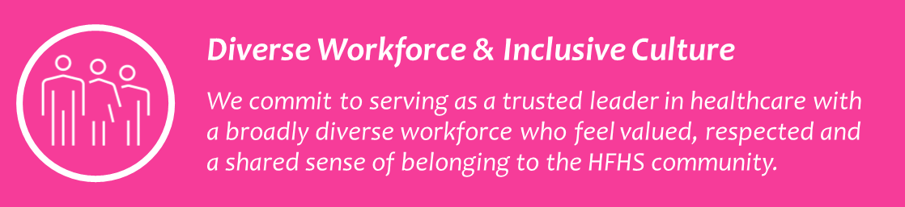

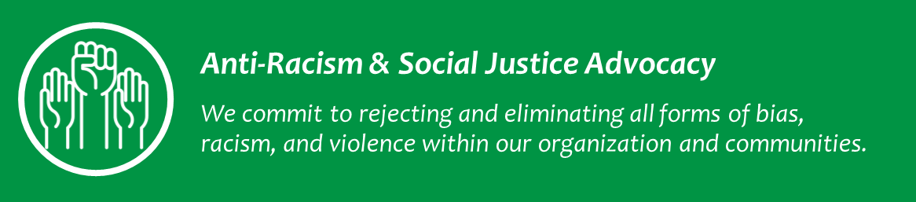



DIVERSITY, INCLUSION, EQUITY & SOCIAL JUSTICE
DEIJ Mission: Equity for All

Slide 11
DIVERSITY, INCLUSION, EQUITY & SOCIAL JUSTICE
Supplier Diversity
Social Determinants of Health
Community Investments

Slide 12
SUPPLIER DIVERSITY DEFINED
What is Supplier Diversity?
Supplier diversity is a strategic commitment to provide equitable access to purchasing and contracting opportunities/awards for diverse businesses including minority-owned, women-owned or historically disenfranchised organizations
Minority Business Enterprise (MBE)
  Black American
  Hispanic-American
  Native American” includes American Indians, American Eskimos, American Aleuts, and Native Hawaiians
  Asian Pacific American” includes United States citizens whose origins are from Japan, China, the Philippines, Vietnam, Korea, Samoa, Guam, the U.S Trust territories of the Pacific, Northern Marianas, Laos, Cambodia, and Taiwan
  Asian Indian American” includes United States citizens whose origins are India, Pakistan and Bangladesh.
  Source: National Minority Supplier Development Council (NMSDC): https://www.nmsdc.org/wp-content/uploads/How-To-2015edited.pdf and Minority Business Development Agency (MBDA):
Women Business Enterprise (WBE)
Veteran Owned Business (VOB
Service-Disabled Veteran-Owned Business (SDVB)
Lesbian, Gay, Bi-Sexual, Transgender, Queer Business Enterprise (LGBTQ)

Slide 13
THE BUSINESS CASE FOR SUPPLIER DIVERSITY
SUPPLIER DIVERSITY MISSION:
Our healthcare system will infuse supplier diversity into the strategic operation of our organization to provide equitable access to opportunities and contracts to enhance the wealth and health of the communities we serve.
Promotion of innovation, talent, experience & growth of diversity in business
Cost competitiveness achieved through inclusion and competition
Enhance the HFHS and HAP brands through supplier partnerships
Economic Impact to local and diverse communities:
                Job creation
                Increased spending in local community
                Revenue and tax generation
Market insights and perspective from diverse suppliers that can positively impact the patient experience and improve satisfaction scores
Innovation, agility and flexibility of diverse suppliers (which are often smaller and can accommodate client needs)

Slide 14

SUPPLIER DIVERSITY TARGET AREAS
OpEx Tier I Spend
Tier II Spend
Construction (Tier I and Tier II)
Diverse Supplier Inclusion
Diverse Supplier Awards (Contracts)

Slide 15






SUPPLIER DIVERSITY STRATEGY
Organizational Alignment
Supplier Diversity Growth
Supplier Development
Technology and Reporting
Strategic Partnerships
Diverse Supplier Pipeline
Marketing & Outreach

Slide 16

THANK YOU.

Slide 17
The Community Health Worker Hub
Innovation, Partnerships, and Lasting Impact
Courtney M. Latimer, MSA
Manager, CHW Hub; Program Manager WIN Network
Henry Ford Health
Office of Community Health Equity and Wellness

Slide 18
What is the CHW Hub?
Henry Ford Health’s Community Health Worker (CHW) Hub serves as the anchoring unit for the integration and deployment of CHWs throughout the System
The CHW Hub utilizes trained CHWs as change agents to help patients navigate their conditions and complex health systems, work collaboratively to develop discharge plans, and conduct home visits.
The CHW Hub recruits, hires, trains and deploys CHWs throughout the health system and works with departments to properly utilize CHWs, allowing other team members, such as social workers to work at the top of their license.
Notes:
Henry Ford Health’s Community Health Worker (CHW) Hub serves as the anchoring unit for the integration and deployment of CHWs throughout the System for the purpose of promoting a culture of wellness through enhanced care coordination that simultaneously addresses clinical factors and social determinants of health, ensuring CHWs are a valued part of the healthcare workforce, and taking a population-based approach to extend care beyond hospital walls.
Henry Ford Health’s Community Health Worker (CHW) Hub serves as the anchoring unit for the integration and deployment of CHWs throughout the System for the purpose of promoting a culture of wellness through enhanced care coordination that simultaneously addresses clinical factors and social determinants of health, ensuring CHWs are a valued part of the healthcare workforce, and taking a population-based approach to extend care beyond hospital walls.

Slide 19
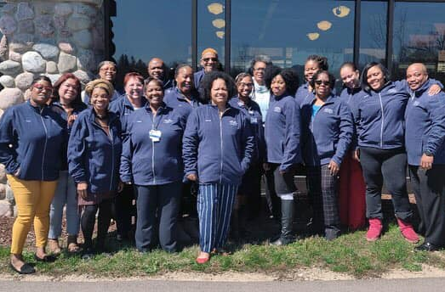
What is a Community Health Worker?
The American Public Health Association defines a community health worker as a person who:
Is a front-line public health worker who is a trusted member of and/or has an unusually close understanding of the community served.
Serves as a liaison/link/intermediary between health/social services and the community to facilitate access to services and improve the quality and cultural competence of service delivery.
Builds individual and community capacity by increasing health knowledge and self-sufficiency through a range of activities such as outreach, community education, informal counseling, social support and advocacy.
Educational background: High School Diploma/GED
  Trained specifically to be a community health worker
  120-Hour core competency curriculum administered by Michigan Community Health Worker Alliance
Notes:
In Michigan, Community Health Workers go by many titles including, but not limited to, promotore(a)
de salud, peer support specialist, recovery coach, community-based doula, outreach specialist, community
neighborhood navigator, family health advocate, maternal child outreach worker, peer navigator, and community
advocate.

Slide 20
What is a Community Health Worker?
The American Public Health Association defines a community health worker as a person who:
Is a front-line public health worker who is a trusted member of and/or has an unusually close understanding of the community served.
Serves as a liaison/link/intermediary between health/social services and the community to facilitate access to services and improve the quality and cultural competence of service delivery.
Builds individual and community capacity by increasing health knowledge and self-sufficiency through a range of activities such as outreach, community education, informal counseling, social support and advocacy.
Educational background: High School Diploma/GED
  Trained specifically to be a community health worker
  120-Hour core competency curriculum administered by Michigan Community Health Worker Alliance
Notes:
In Michigan, Community Health Workers go by many titles including, but not limited to, promotore(a)
de salud, peer support specialist, recovery coach, community-based doula, outreach specialist, community
neighborhood navigator, family health advocate, maternal child outreach worker, peer navigator, and community
advocate.

Slide 21
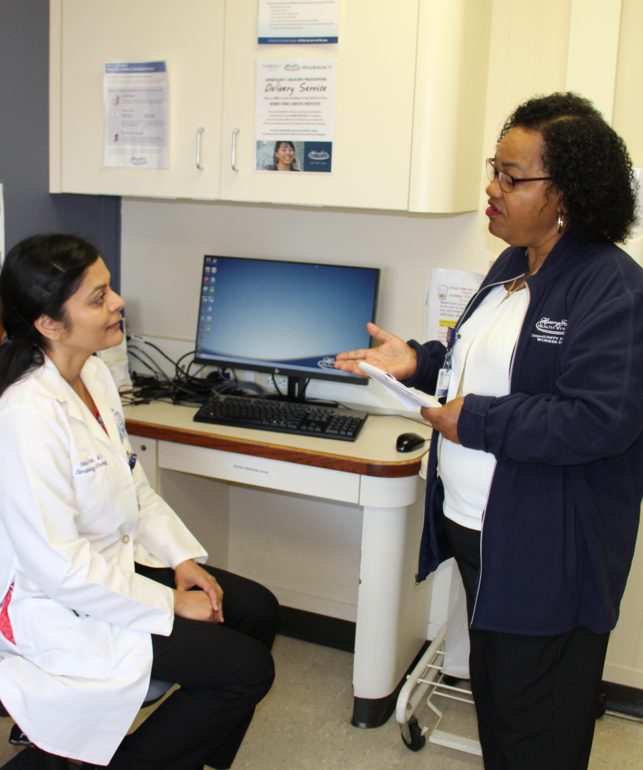
CHWs a Health Brokers
CHWs as culturally competent mediators (health brokers) between providers and the community has been widely documented
  Integrating CHWs into multidisciplinary health teams
  Reduction in patient cost
  CHW improvements in keeping appointments, compliance with prescribed regimens, risk reduction, blood pressure control, and related issues
  Numerous other documented cases of CHWs improving overall health and numbers
Notes:
The unique role of CHWs as culturally competent mediators (health brokers) between providers of health services and the members of diverse communities, as well as CHWs’ effectiveness in promoting the use of primary and follow-up care for preventing and managing disease, have been extensively documented and recognized for a variety of health care concerns, including asthma, hypertension, diabetes, cancer, immunizations, maternal and child health, nutrition, tuberculosis, and HIV and AIDS.
Evidence supporting the involvement of CHWs in the prevention and control of chronic disease continues to grow:
• Integrating CHWs into multidisciplinary health teams has emerged as an effective strategy for improving the control of hypertension among high-risk populations.12, 13
• The Community Outreach and Cardiovascular Health (COACH) trial, which paired nurse practitioners and CHWs together to manage cardiovascular disease, demonstrated a $157 reduction per patient in cost for every 1% drop in systolic blood pressure and $190 reduction in cost for every 1% drop in diastolic blood pressure.14
• A recent review that examined CHWs’ effectiveness in providing care for hypertension noted improvements in keeping appointments, compliance with prescribed regimens, risk reduction, blood pressure control, and related mortality.13
After two years, African American patients with diabetes who had been randomized to an integrated care group consisting of a CHW and a nurse case manager had greater declines in A1C (glycosylated hemoglobin) values, cholesterol triglycerides, and diastolic blood pressure than did a group receiving routine care or those led solely by CHWs or nurse case managers.6, 15
• The three-year Patient Navigation Research Program demonstrated a moderate benefit in improving timely cancer care for diagnosis and treatment of breast, cervical, colorectal, and prostate cancers.16
• A Colorectal Cancer Male Navigation Program designed for Hispanic men showed an increase in life expectancy by six months for participant as compared to non-participants with a health care savings of $1,148 per program participant.17
• In reviewing 18 studies of CHWs involved in the care of patients with diabetes, Norris and colleagues found improved knowledge and lifestyle and self-management behaviors among participants, as well as decreases in the use of the emergency department.18
• Interventions incorporating CHWs have been found to be effective for improving knowledge about cancer screening, as well as screening outcomes for both cervical and breast cancer (mammography).19
• Asthma control (i.e., symptom frequency) was reduced by 35% among adolescents working with CHWs, resulting in a savings of $5.58 per dollar spent on the intervention.20
C Mundorf, 2018: Reducing the Risk of Postpartum Depression in a Low-Income Community Through a Community Health Worker Intervention. Matern Child Health
H Balcazar, E.L. Rosenthal, J.N. Brownstein, C.H. Rush, S. Matos, and L. Hernandez, 2011: Community Health Workers Can Be a Public Health Force for Change in the United States: Three Actions for a New Paradigm, American Journal of Public Health 101, 2199_2203
M Heisler, M Spencer, J Forman, C Robinson, C Shultz, G Palmisano, G Graddy-Dansby, E Kieffer, 2009: Participants’ Assessments of the Effects of a Community Health Worker Intervention on Their Diabetes Self-Management and Interactions with Healthcare Providers, Am J Prev Med, 37(6SI)
M.S. Spenser, 2010: Community Health Workers and Their Value to Social Work. Social Work. 55(2). 169-180.
S Kangovi, N Mitra, D Grande, H Huo, R Smith, J Long, 2017: Community Health Worker Support for Disadvantaged Patients With Multiple Chronic Diseases: A Randomized Clinical Trial, AJPH, 107(10)

Slide 22
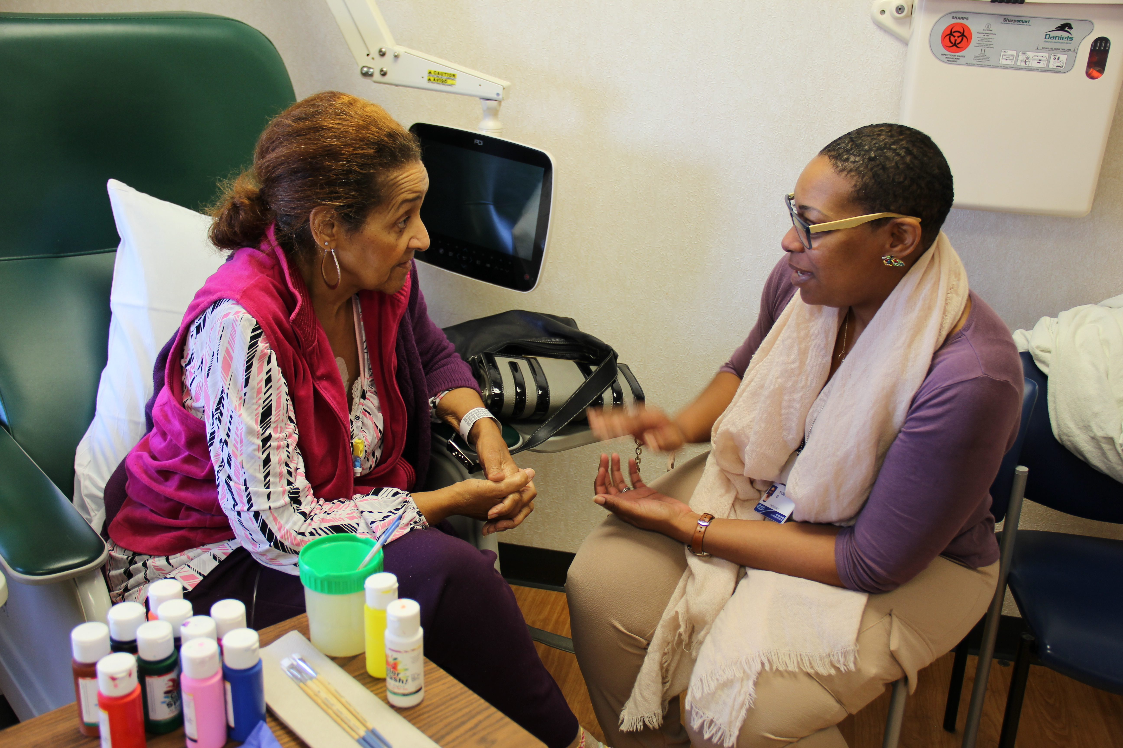
What Do CHWs Do on a Team?
Enhances team effort, allowing professionals to work at top of their license, by activating CHWs to execute on community/public health strengths
Bridge between the community and the clinic
Address SDOH uniquely, different from other care team members
Builds trust and convey patient backgrounds, restraints and preferences in a culturally appropriate way
Identify patient barriers including housing, transportation, food, income, etc.
Provide follow-up and quality assurance, documenting patient encounters in Epic.

Slide 23
What Do CHWs Do at Henry Ford Health?
Academic Internal Medicine – Health coaching with patients with type 2 diabetes to bring A1C levels below 6 as well as resource connections as needed
WIN Network – Co-facilitates an enhanced model of group prenatal care with women’s health providers and focuses on SDoH outside of clinic
Home Visiting Physicians – CHW conducts SDoH screenings with homebound patients, addresses needs through 1-on-1 contacts and home visits.
Research Enterprise to Advance Children’s Health (REACH) – CHW works with research team to help develop recruitment strategies to include more minority voices in research

Slide 24
What Do CHWs Do at Henry Ford Health?
Henry Ford Cancer Institute – Address SDoH needs through screening, 1-on-1 visits, resource connections to cancer assistance programming, social and caregiver support
Seniors Tracking Exercise for Pain Self-management (STEPS) – In partnership with University of Michigan, CHWs implement curriculum-based health coaching with patients who suffer from chronic pain.
Generation with Promise – Curriculum-based health coaching through recruitment and implementation of Diabetes Prevention Program (DPP) in Detroit.

Slide 25
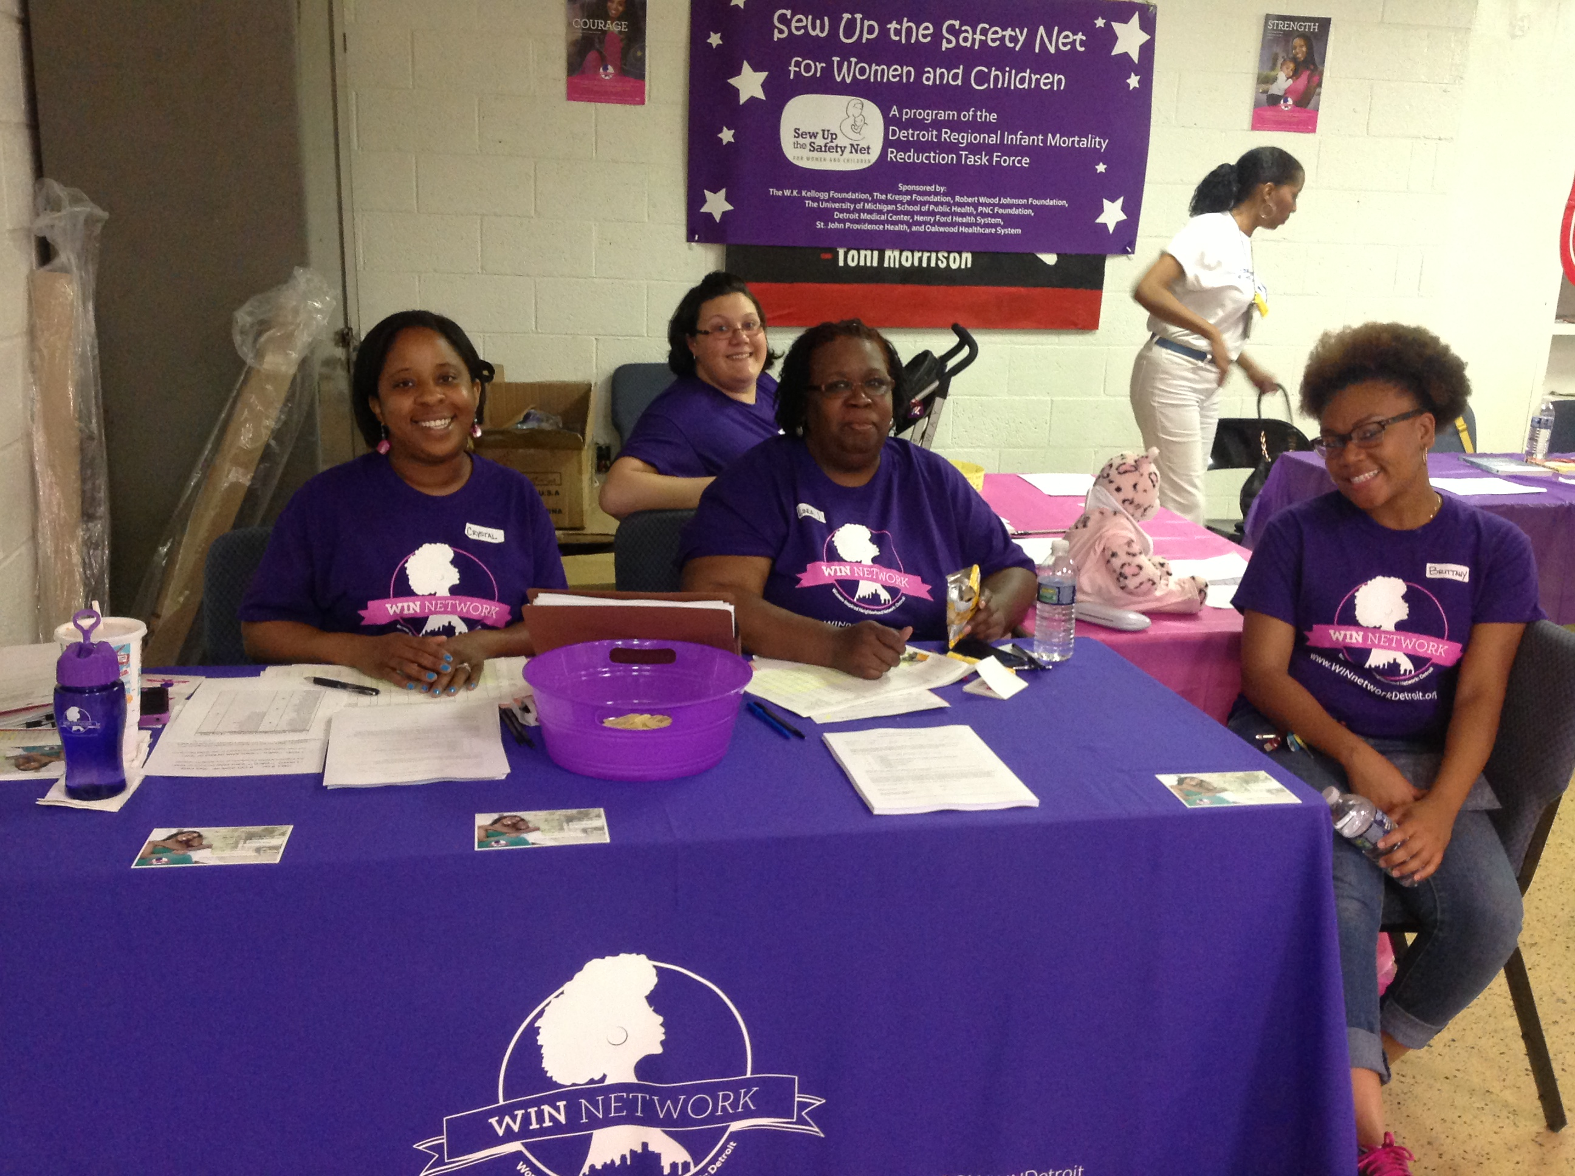
SPOTLIGHT ON:

Slide 26

The Impetus for Action
Poor infant mortality rates and high disparities in Detroit
High clinic no show rates
Low breastfeeding rates
Source: Michigan Department of Health and Human Services

Slide 27
WIN Network: Detroit: Cohort 1
323 African American pregnant moms with singleton pregnancies, aged 18-34 were paired with a Community Health Worker
Recruited mothers from three high-need neighborhoods
Community Health Workers worked with moms 1-on-1 in their communities to assist with:
    Housing Care Navigation
    Employment Accessing healthcare
    Transportation Food and nutrition
    Goal Setting
When compared to controls, participants were less likely to need a NICU stay, had fewer preterm births and low birthweight births

Slide 28
Cohort 2:
Enhanced Group Prenatal Care
In 2016, WIN Network: Detroit partnered with Henry Ford Hospital’s Women’s Health Services team to design and implement an enhanced model of group prenatal care (GPC).

Slide 29
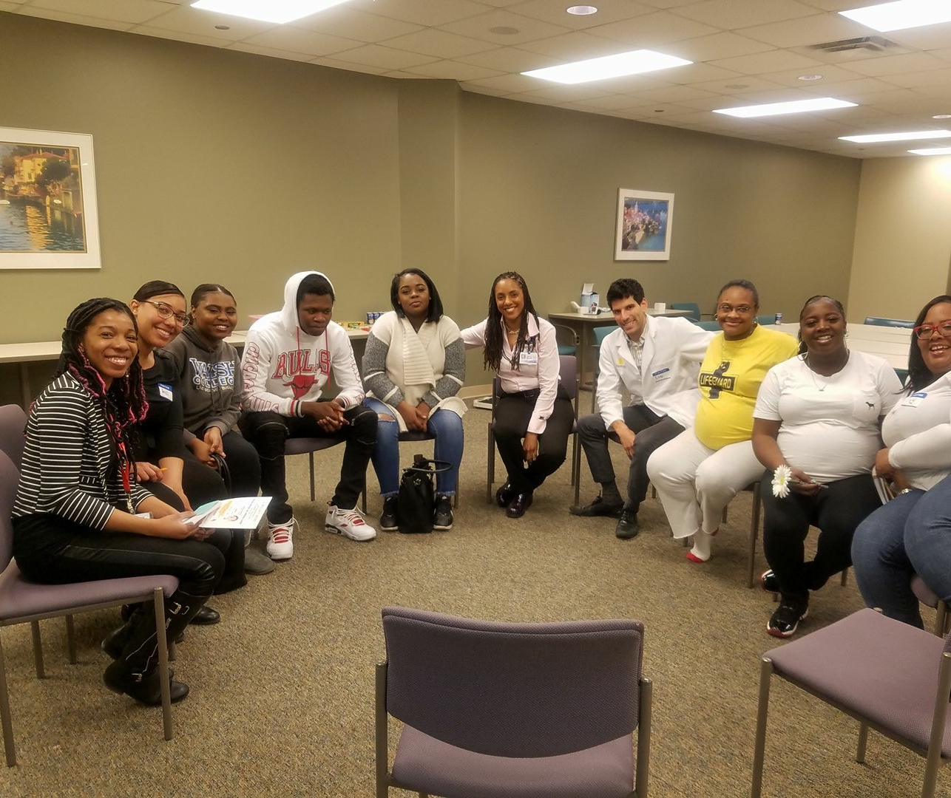

What is Group Prenatal Care (GPC)?
Pregnant moms of similar gestational age are put into groups to receive prenatal care together in 10 two-hour sessions
GPC allows for more time with a provider
Ample time to ensure moms and support partners are prepared for pregnancy, birth, and a new baby
Traditionally facilitated by a healthcare provider and a nurse, medical assistant, or health educator

Slide 30
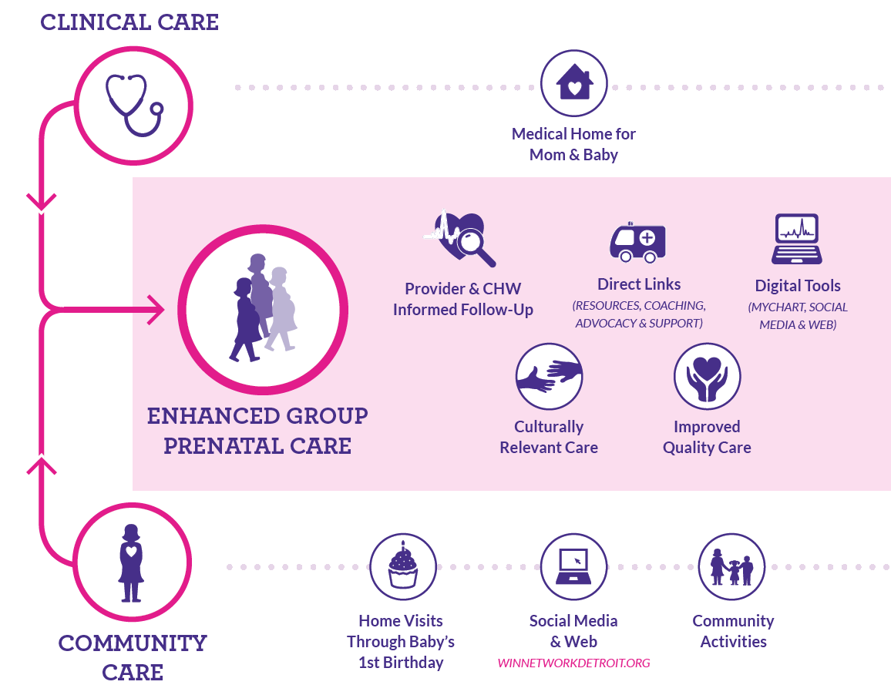
WIN Network: Detroit’s enhanced model of group prenatal care is tailored for Black moms and is focused on the social determinants of health.
Notes:
Char’ly
We based our program on the CenteringPregnancy model and added a few disctinct features which enhance that approach; including the fact that the group visits are co-facilitated by Community Health Workers
We are still maintaining the integrity of Centering's key principles and provide 10 group sessions aligned with ACOG standards but
We’ve added in a more robust focus on SDoH by integrating the CHWs to walk through the journey with women through babies’ first birthdays
The WIN Network team developed a complementary home visiting curriculum as well as added some SDoH-themed activities and conversation to the Centering sessions
CNMs primarily-lead more traditional, clinically-based conversations (e.g. nutrition, how to handle the discomforts of pregnancy, etc.) while CHWs tend to take the lead on dissecting more of the socially-themed elements (e.g. domestic violence, preparing to bring baby home, etc.).
The CNMs and CHWs meet in advance of every session to discuss how the session will run and who will take on which parts
CHWs and CNMs are able to relay key info to one another to enhance the patient experience and ensure better outcomes
During groups, some of our opening activities are more focused on social determinants of health and help create direct linkages to local community resources for the women. We invite community-based guest speakers to certain sessions to drive some of the messaging further as well.
The CHWs also provide home visits throughout the pregnancy and through the babies' first birthdays.
Ten, 2-hour group visits using CenteringPregnancy®
Each group visit includes
Self-care activities
Individual physical assessments
90-minute facilitated discussion
Digital engagement tools
WIN Network website and social media channels
MyChart patient portal
Home visits from CHW
Community-based activities

Slide 31
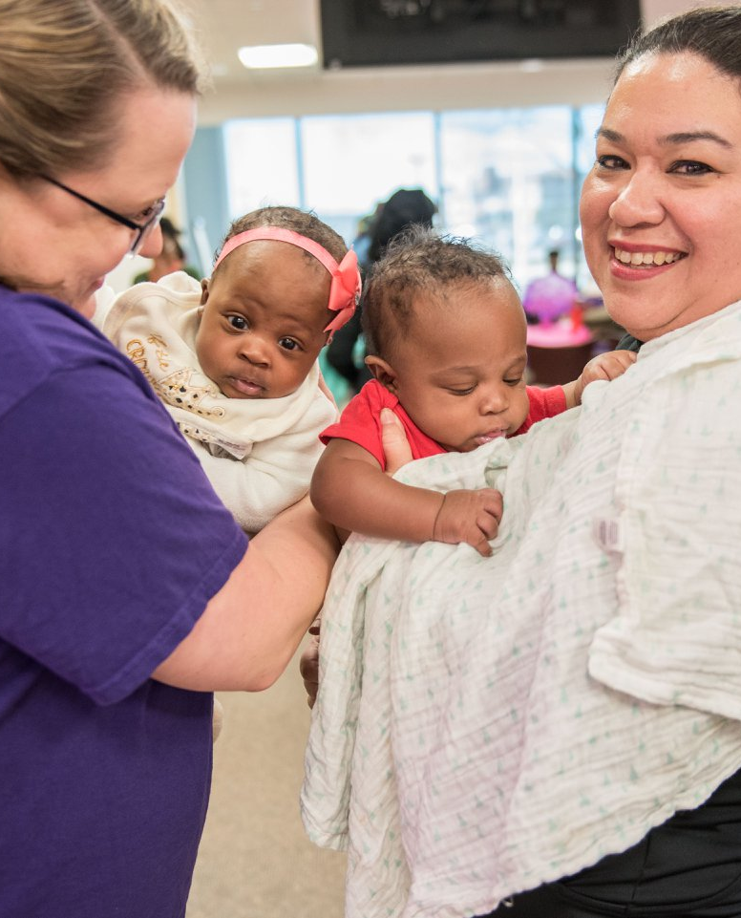

Group Prenatal Care Enhancements
Community Health Workers (CHWs) as co-facilitators with Certified Nurse Midwives
Focus on social determinants of health (SDOH) during groups
Guest speakers at group sessions from local community & social service organizations
CHW 1-on-1 visits (at home or neutral location) during pregnancy and until baby turns 1
CHWs follow up with moms between sessions
Labor & Delivery group tour
Information sharing between clinic and community
Warm handoffs from CHWs to SDOH resources for moms
Digital engagement strategy
Notes:
Video Linked here – What is GPC?

Slide 32

CHW Home Visiting Curriculum
Adapted from CenteringPregnancy®
Guides content of CHW’s 1:1 visits during pregnancy and until baby turns one
Reinforces topics covered during group sessions
Addresses SDOH
MY BABY perinatal health messages

Slide 33

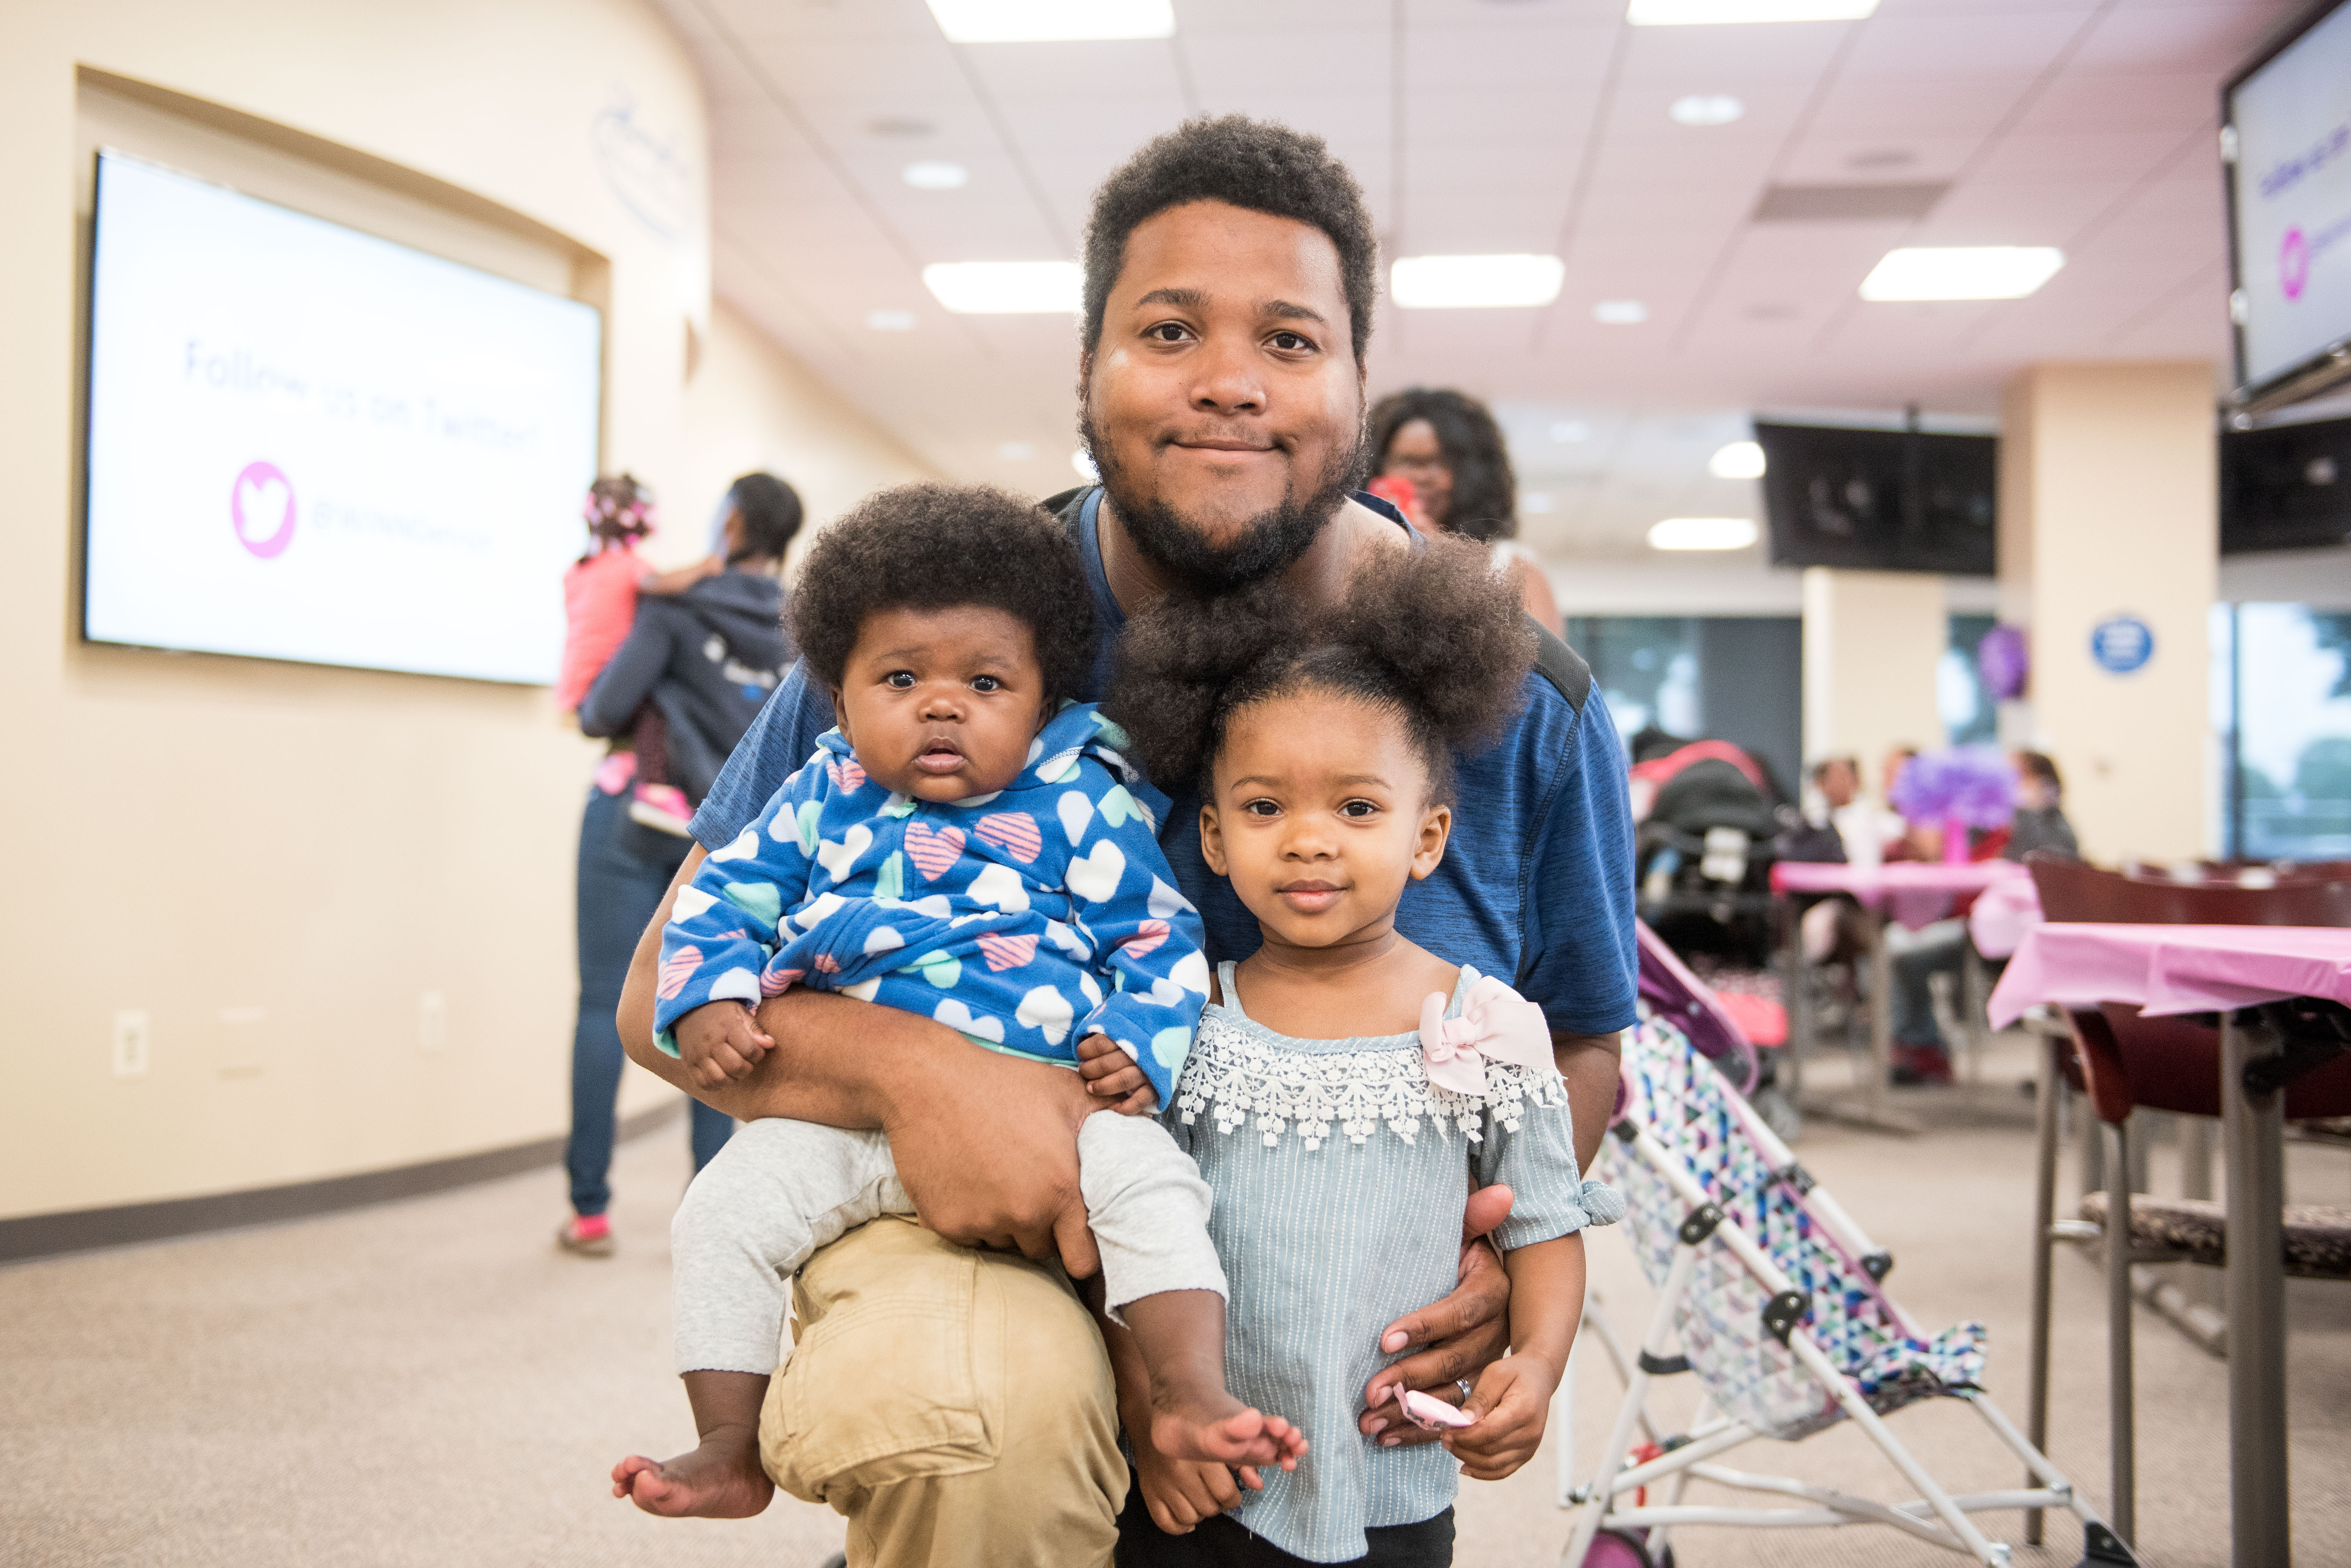
Group Prenatal Care Birth Outcomes
46 Groups running beginning April 2016
Over 200 fathers attended at least one session
381 Babies born
Average Birth Weight: 6.89 lbs (as of 12/01/2023)
Average GA: 38.5 weeks (as of 12/01/2023)
Vaginal Births: 74.7%
96% of mothers-initiated breastfeeding upon birth of baby

Slide 34
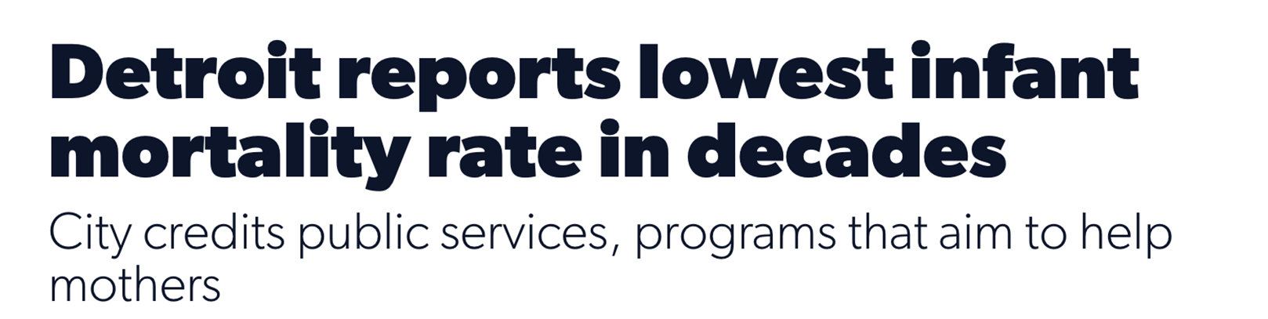
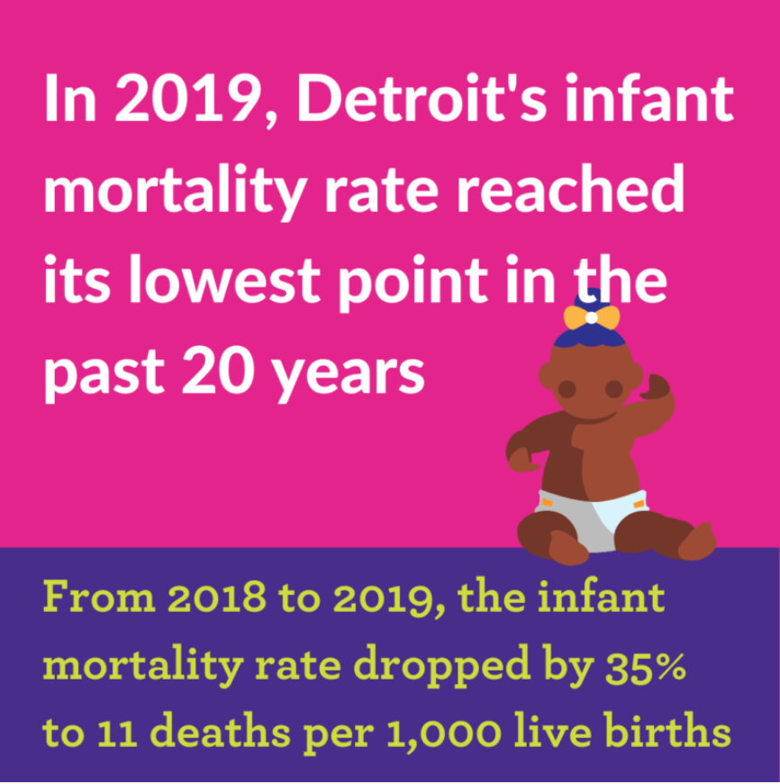

Slide 35
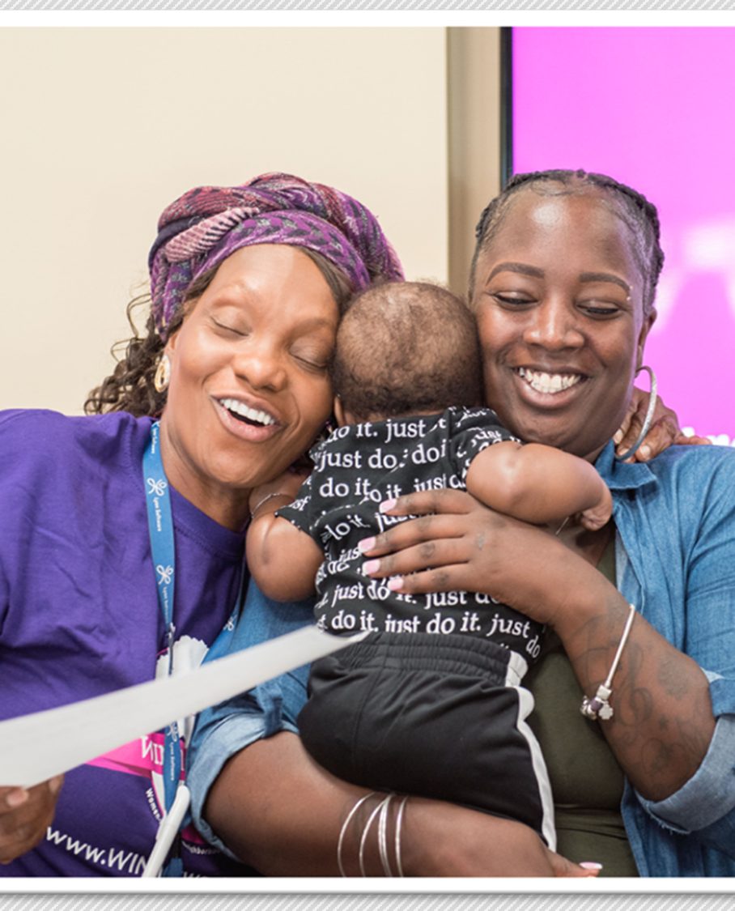
When WIN Network moms are asked what is the most helpful aspect of having a CHW, many describe the social support they provide.
“I was less scared when I became a mother. I had the necessary tools and resources to not only help myself, but other mothers as well.”
“Having someone to check in on us and make sure we’re doing alright.”
“Linda would call everyone and check on me for my postpartum depression.”
“Her nurturing personality. She made it seem like it was going to be OK.”

Slide 36
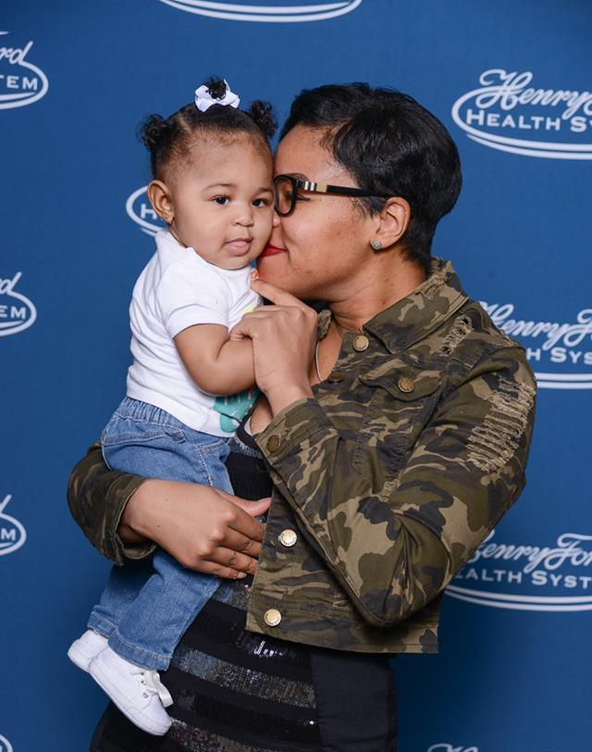
CHW Impact on Birth Outcomes is Multi-Faceted
Higher prenatal care utilization
Support for social determinants that have detrimental impacts on moms’ and babies’ health
CHWs engage with support partners
CHWs continually provide education and reinforcement on topics such as good nutrition, breastfeeding, and safe sleep
CHWs help moms feel prepared for birth
  Labor & Delivery Unit tour
  Creating a birth plan
  CHWs are trained as doulas
Social support provided helps moms reduce stress during pregnancy

Slide 37
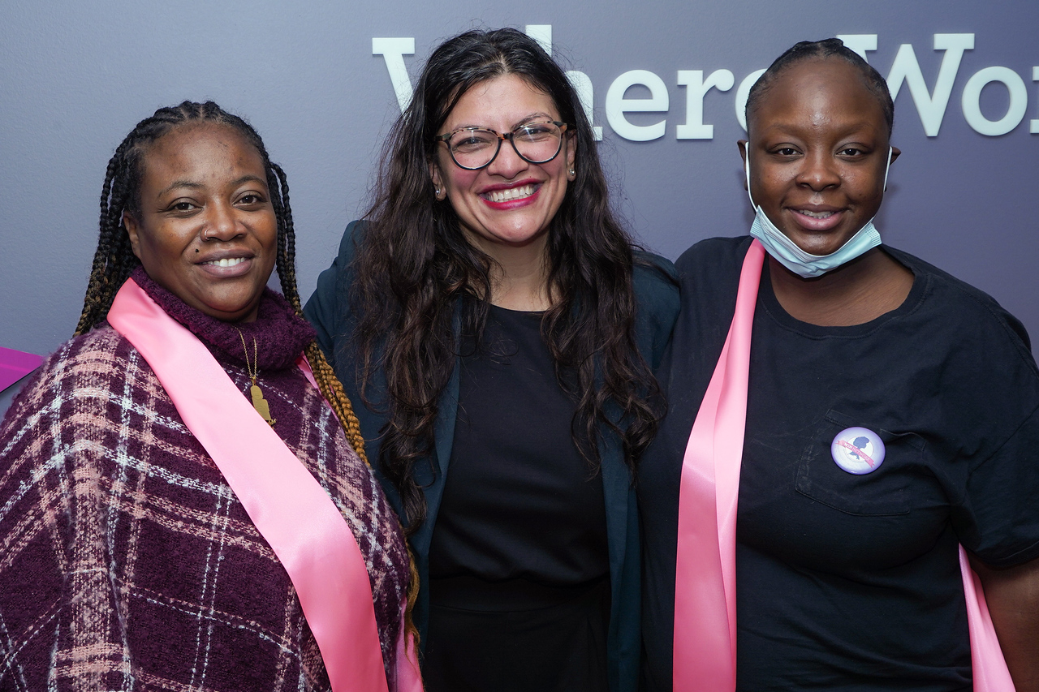
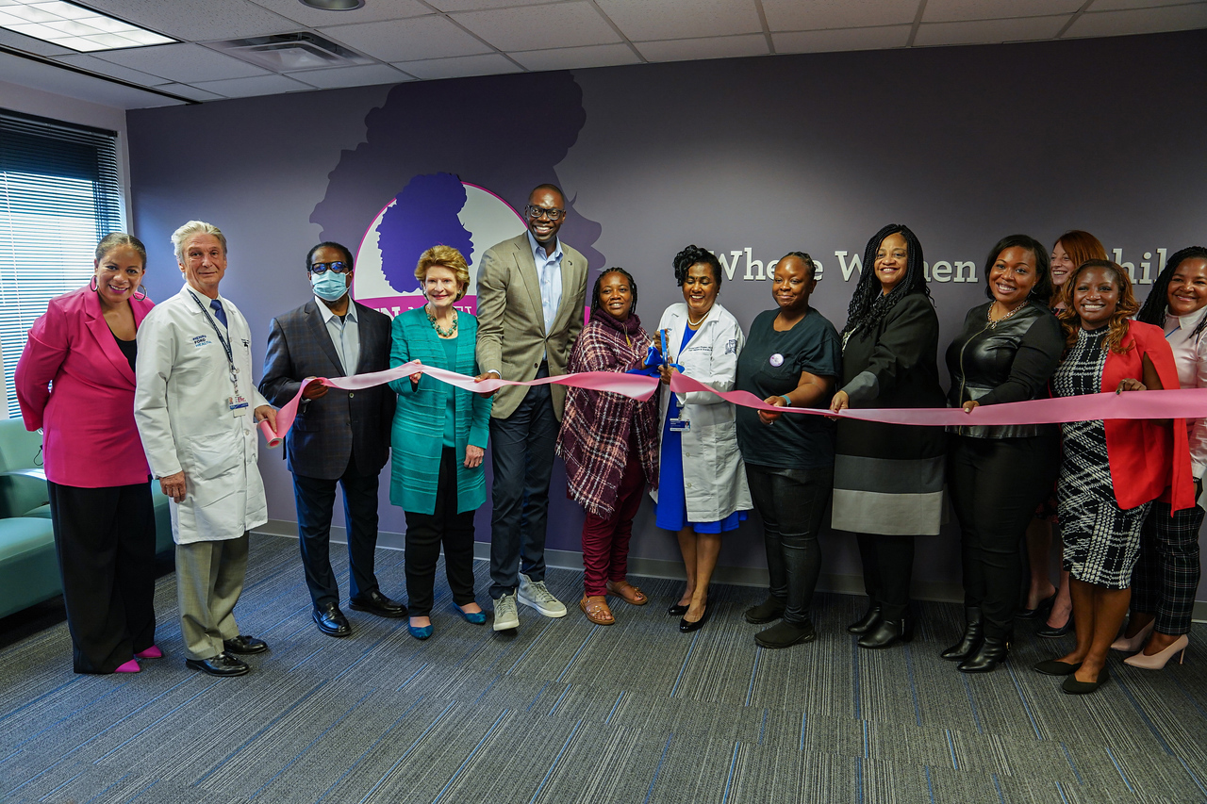
Growth and Expansion
In October 2022, WIN Network held a ribbon-cutting attended by local and national attention including Lt. Governor Gilchrist and Senator Stabenow as well as the U.S Dept of Health and Human Services
Continued partnerships with organizations like the Detroit Health Department, UnitedWay Southeastern Michigan and Black Mothers Breastfeeding Association to provide quality resources for WIN Network families to prevent infant and maternal mortality
Incorporating unconscious bias training and trauma informed care for all providers including CHWs
Notes:
October 24, 2022 we welcomed the US Department of Health and Human Services, Michigan Lieutenant Governor Garlin Gilchrist II and US Senator Debbie Stabenow, as well as state and local governments Officials
The new center will increase the number of families who can participate in this program from around 100 per year to more than 250 per year. The aim is to expand the WIN Network to other locations and cities.
The US Department of Health and Human Services recently announced a $4.5 million commitment to hire, train, certify and compensate community doulas in areas with high rates of adverse maternal and child health outcomes.
Also present were: US Representatives Debbie Dingell and Rashida Tlaib; Denise Fair-Razo, Detroit City Chief Public Health Officer; Janine Boyd, US Department of Health and Human Services – Regional Director, Region 5; Bishop Edgar Vann, Second Ebenezer Church and member of the Henry Ford Health Board of Directors; dr D’Angela Pitts, Henry Ford Health – Physician of Maternal Fetal Medicine and Director of Maternal Health; Kiddada Green, Black Mothers’ Breastfeeding Association – Founding Director; dr Marijata C. Daniel-Echols is Program Officer at the WK Kellogg Foundation
LaShawn McIver MD, Director, Office of Minority Health, Centers for Medicaid and Medicare Services and Rev. Que English, US Department of Health & Human Services – Director of Neighborhood & Faith-based Partnerships spoke about deepening and expanding the White House’s efforts to improve the lives of women and babies impacted by health inequalities and the social determinants of health. They also endorsed research and data-driven efforts like WIN Network: Detroit as ways to save more babies and mothers and improve the US infant mortality rate.

Slide 38
Questions/Comments
Courtney Latimer clatime1@hfhs.org

Slide 39
Lunch
x
Plum Market Catering

Slide 40
x

Slide 41
Mark Ostach
x

Slide 42
Healthcare Technology
x
Javier Evelyn, Founder, Alerje
Dr. Phillip Olla, Chief Executive Officer, Audacia Bioscience
Hassan Saad, Chief Executive Officer, DMI Advisory

Slide 43
Class Announcements
x
Next Session:
Race & Diversity
Wednesday, January 24- Thursday, January 25
Guardian Building

Slide 44
Detroit Policy Conference
x
Thursday, January 11th, 2024
Motor City Casino
Free Registration for LD44 Class
Email Pilar pdoakes@detroitchamber.com to register

Slide 45
Toys for Tots Distribution
x
Tomorrow @ Eastern Market Shed 5
Russell Street parking lot reserved for volunteers
Shift 1: 7:30 AM- 12:30 PM
Shift 2: 11:30 AM- 5:00 PM

Slide 46

Holiday Social Hour
x
Eastern Market Brewing Company 5:00 PM
2515 Riopelle St, Detroit, MI 48207
Class members (and a plus one) are welcome to attend even if they are unable to volunteer!

Slide 47

https://bit.ly/LD44Health
x

Slide 48
Social Hour
x
Northern Lights Lounge
660 W Baltimore St

Slide 49
x

