Slide 1



Mentorship and Talent
Session Sponsor:
Presenting Sponsor:

Slide 2

Devon O'Reilly
x
Senior Director, Community Engagement & Leadership Development, Detroit Regional Chamber

Slide 3
Armen Hratchian
x
Executive Director, Teach for America Detroit

Slide 4
Scott Rutterbush
x
Owner, The Norwood

Slide 5
Dream Table Exercise
x

Slide 6
Corporate Mentorship Programs
x
Sara Berisha, Assistant Director, Corporate Mentor Program,
Mike Ilitch School of Business
Talias DeBerry, Information Security Analyst,
Blue Cross Blue Shield of Michigan
Jake Roberts, Consultant, Shift Digital

Slide 7
Lunch
x
Yum Village

Slide 8
Fostering a Culture of Mentorship
x
Cynthia Bowman, Chief Diversity & Inclusion Officer, Chief Corporate Social Responsibility Officer,
Bank of America

Slide 9
Empowering Young Women
Through Mentorship
x
Rhonda Walker
Anchor, WDIV
Founder, Rhonda Walker Foundation

Slide 10
Tackling the Talent Questions
x
Peter Quigley
Chief Executive Officer
Kelly Services

Slide 11
Defining Moments
x

Slide 12
Let’s Detroit
x
Jenny Orletski-Dehne
Manager, Let’s Detroit Engagement
Detroit Regional Chamber

Slide 13
Class Announcements
x
Next Session:
Arts & Culture
Thursday, March 14
College for Creative Studies - Taubman Center

Slide 14
Class Announcements
x
Mackinac Future Leaders
Application is Open

Slide 15
Class Announcements
x
Leadership Detroit Class 45
Application is Open

Slide 16
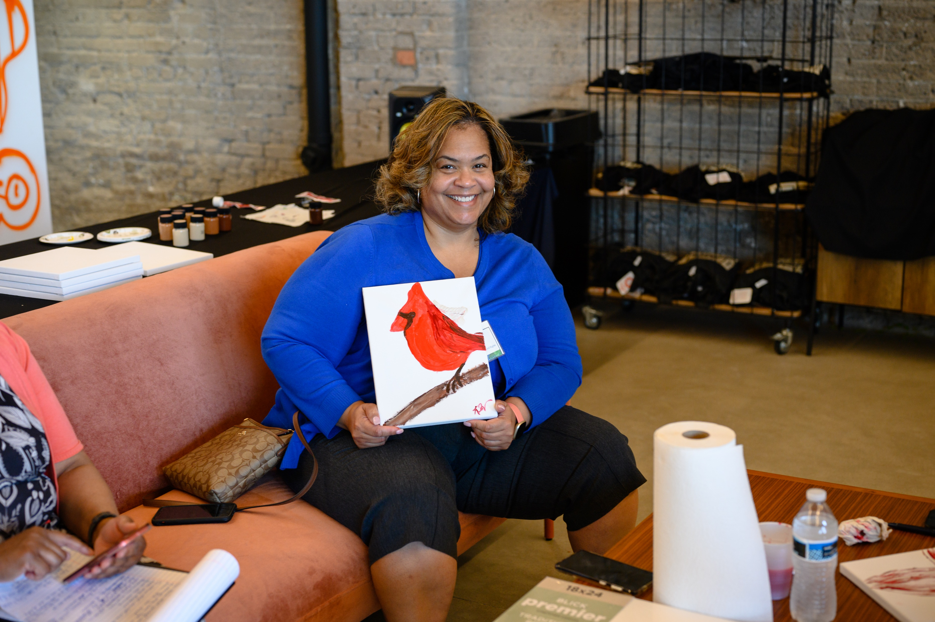
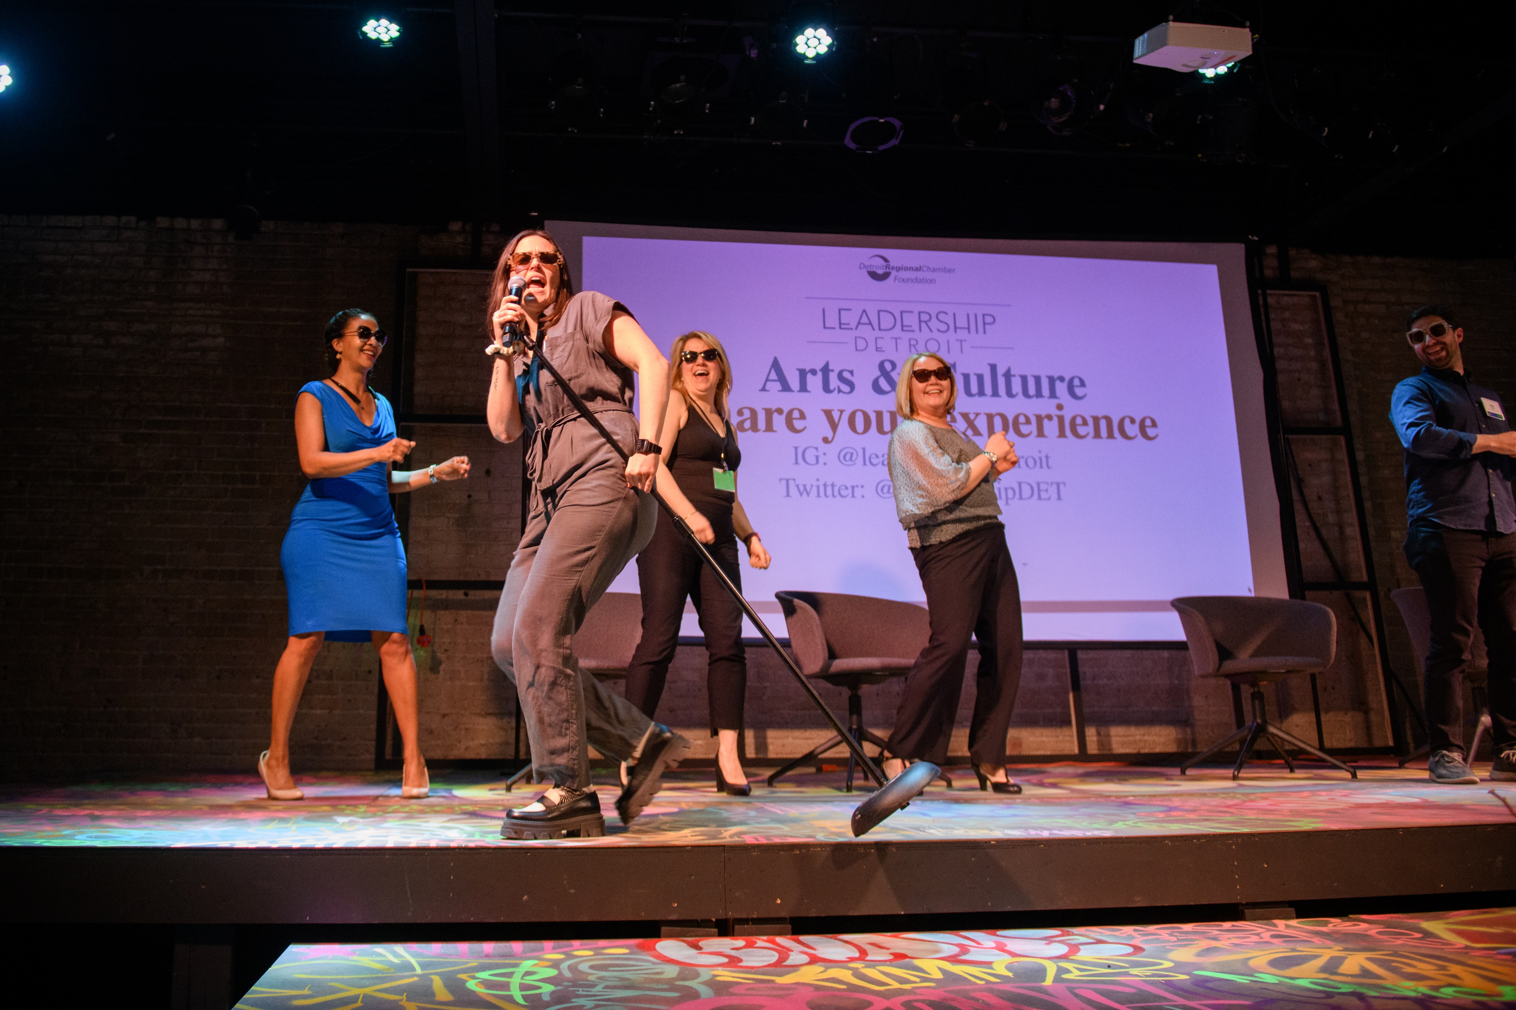
x
Arts & Culture Showcase

Slide 17
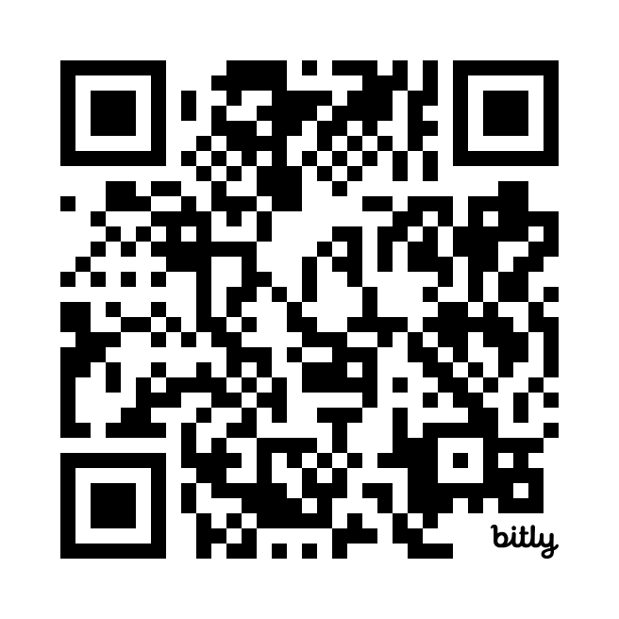
https://bit.ly/ld44arts
x
Arts & Culture Showcase

Slide 18
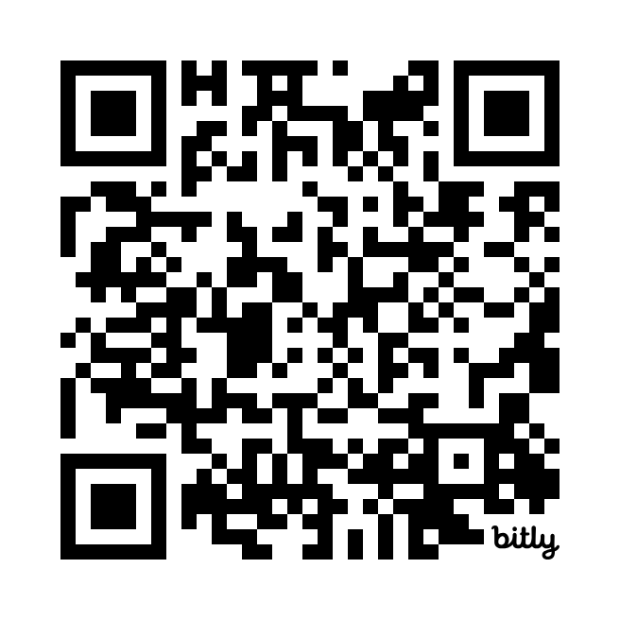
https://bit.ly/ld44events
x
Pistons Game & Day in Lansing

Slide 19
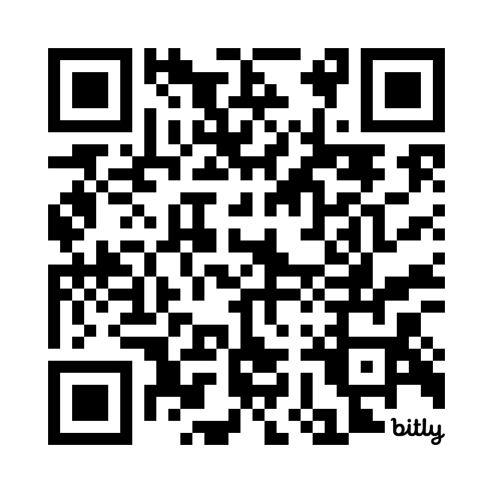
https://bit.ly/ld44mentorship
x
Session Survey

Slide 20
Mentorship and Talent
Session Sponsor:
Presenting Sponsor:

