Slide 1

Education and Mentorship

Slide 2
Breakfast
Orientation Day 1
Full Course Catering

Slide 3
Welcome
Dorian Grey, Senior Director Leadership, Entrepreneurship, and Innovation Detroit Regional Chamber
Orientation Day 1

Slide 4
K-12 Overview and Reinventing The Education System
Dr. Venessa Keesler, Ph.D., President and Chief Executive Officer
Launch Michigan

Slide 5
Rebuilding Traditional Public Education and Providing Michigan a Reform Model of Improvement
Dr. Nikolai Vitti, Ph.D., Superintendent Detroit Public Schools

Slide 6
Rebuilding Traditional Public Education and Providing Michigan a Reform Model for Improvement
Leadership Detroit
Dr. Nikolai Vitti, Superintendent, Detroit Public Schools Community District

Slide 7
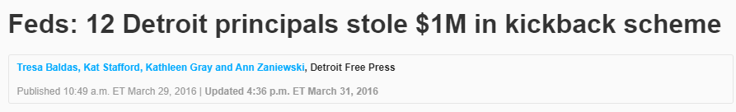
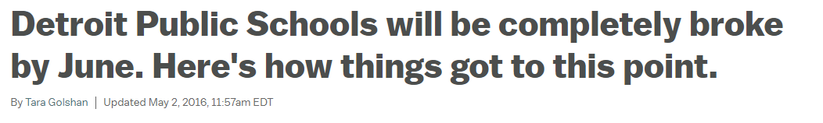
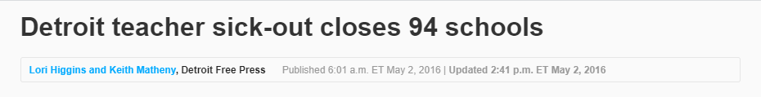
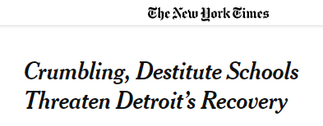
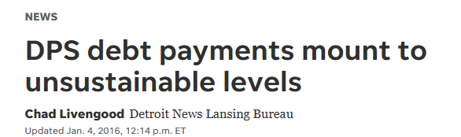

7

Slide 8
DPSCD’s Demographic Makeup Varies Greatly From the State of Michigan
8

Slide 9


DPSCD School Funding Challenges
DPSCD receives less per pupil from the core Foundation Allowance than most surrounding districts?
DPSCD receives $10,050 per pupil, which is $1,090 less* per pupil compared to 20 key surrounding districts
Ann Arbor
Birmingham
Center Line
Dearborn
Farmington
Grosse Ile Township
South Lake
Southfield
Troy
Walled Lake
Warren Consolidated
Warren Woods
West Bloomfield
Grosse Pointe
Lamphere
Melvindale-North
River Rouge
Romulus
Royal Oak
DPSCD
Surrounding
Districts
DPSCD receives $3,464 less* per pupil compared to 3 key surrounding districts, equivalent to $168M annually in recurring funding
Birmingham, Bloomfield Hills and Southfield
FOUNDATION ALLOWANCE INEQUITY
9
*Average of the FY26 per pupil foundation Allowance for the identified school districts

Slide 10





VISION
MISSION
The Future We Want
The Work We Do
All students will have the knowledge, skills and confidence necessary to thrive in our city, our nation, our world.
We educate and empower every student, in every community, every day, to build a stronger Detroit.
Students First
Excellence
Integrity
Equity
Service
Tenacity
Transformative Culture
Outstanding Achievement
Whole Child Commitment
Exceptional
Talent
Responsible Stewardship
Notes:
Talking point ideas (2023):
“When the Board and I started the journey of rebuilding the district in the summer of 2017, we worked with staff, students and community member to cast a vision for the future we wanted in our schools and the work we would do each day to move closer toward it. The five priorities we established through our first strategic plan, and that we have extended over the past six years were drawn from the experience, aspirations, hopes and expectations of our community – people like each of you. Today, I am honored to provide you with an update on the progress we have made in three crucial areas – attendance, achievement and facilities – areas of focus that span all five of these priorities and areas that I have heard from every constituent are essential for our district’s future. This presentation is all about how far we have come – and how we will continue to rise to new heights.

Slide 11
The District's Core Actions that Led to Improved Student Achievement
Budget & Human Capital
Curriculum & Assessment
Accountability
Established School Allocation Plan Tied to Student Enrollment, Equal Distribution of Positions
Empowered School Leaders with More Staff, More Hiring Authority
Investment in Teacher Salaries, Achieving Fully Staffed Status
Aligned Curriculum with Standards
Aligned Assessments
Defined Tiered Student Intervention Models in Literacy
Created Data Dashboard with Single Letter Grade System
Established DataCom Process
Tied School Performance to Leader Evaluation
Training, Coaching & Human Capital Development
Wraparound Student Services
Deepened Training on Standards
Ongoing Monitoring, Coaching, and Problem Solving around Instruction and Student Performance
Ongoing Investment in Pipeline Development for Leaders and Teachers
Launched Health Hubs
Instituted Loved, Challenged, and Prepared Student Surveys
Restored Music, Art, and PE at All Schools
Expanded Cultural Experiences
Core Reforms
11

Slide 12
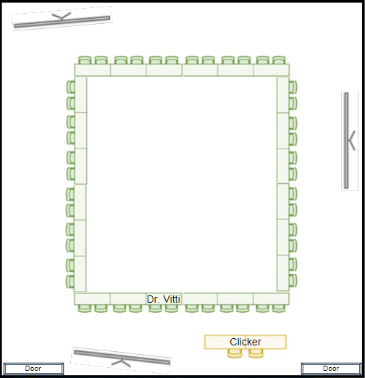
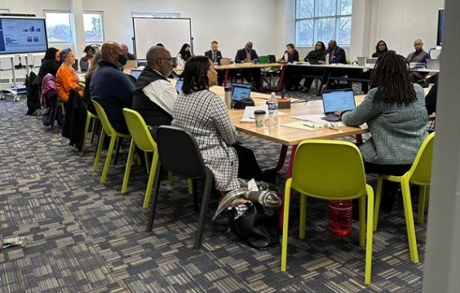
Accountability Through DataCom: Convenings
Key Features
DataCom is part of the District’s school improvement cycle; convened 4 times per year
Attended by principals, cabinet officials, and key central office team members focused on school support
Principals receive between three to six minutes to present; the presenting principal guides the conversation by narrating appropriate data visualizations from the dashboard
Cabinet leads questioning; Superintendent drives follow up and drives home key messages

Slide 13
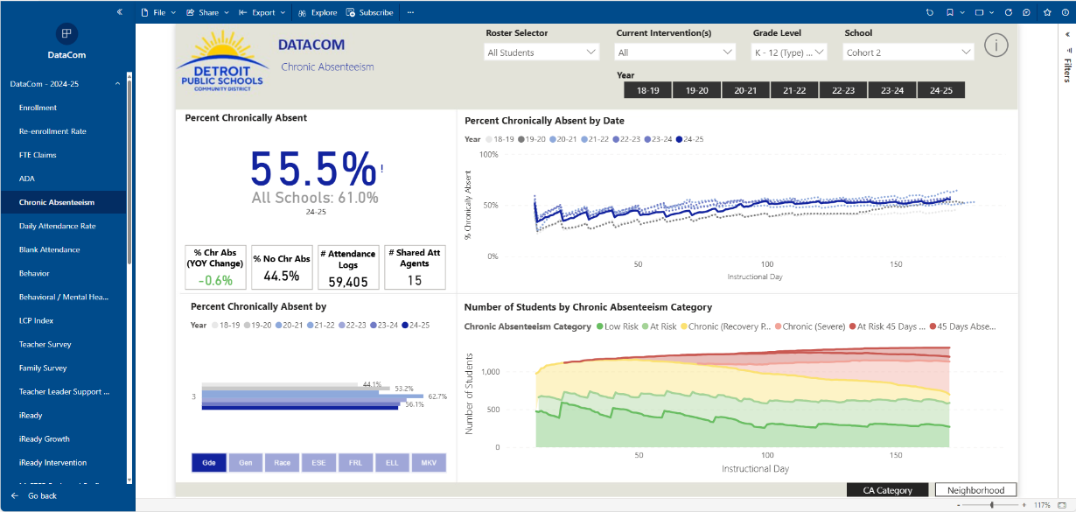
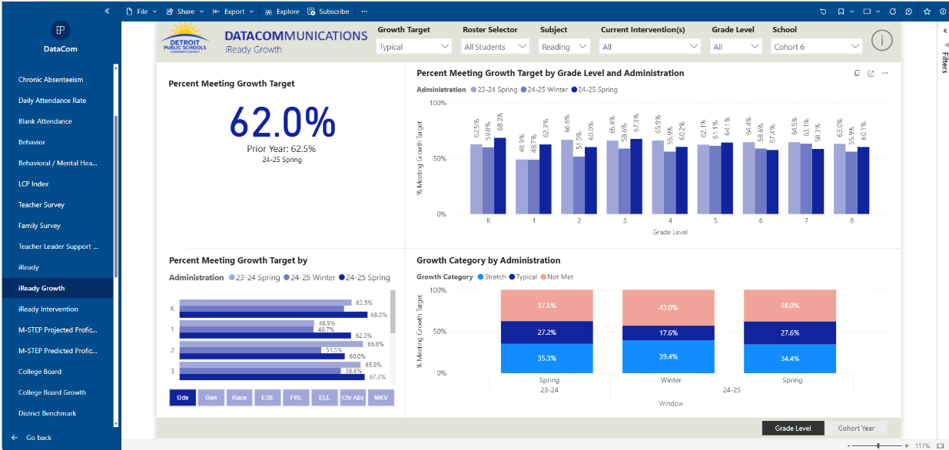
Accountability through DataCom
Key Features
Visualizations fully aligned to school grade calculations, including roster selectors to look at specific groups isolated in the school grades (e.g. Full Academic Year students)
Clear comparisons to past performance and visualizations that emphasize change over time
Sliceable by a variety of subgroups and student characteristics like grade, ELL status, attendance rates, etc.

Slide 14
Performance on ELA State Assessments has improved across all grade levels
M-STEP 8 Reading
*In 2019, the PSAT8 replaced M-STEP in 8th grade. Years 2015-2017 include DPS and EAA test performance.
Note: State assessments were cancelled in the 2020SY and made optional in the 2021SY.
14

Slide 15
DPSCD is narrowing the gap between the State in Grades 3-7 ELA
DPSCD
11%
15%
+4
Grade 3-7 MSTEP/PSAT Reading
2016-17
Grade 3-7 MSTEP/PSAT Reading
2024-25
35
26
State of MI
46%
-5
41%
Grade 3-7 MSTEP/PSAT Reading
2016-17
Grade 3-7 MSTEP/PSAT Reading
2024-25
15
*Note: 2016-17 District data includes both EAA and DPS test performance

Slide 16
This trend continues in Grade 11 SAT EBRW
DPSCD
32%
36%
+4
Grade 11 SAT ERBW
2016-17
Grade 11 SAT ERBW
2024-25
28
19
State of MI
60%
55%
-5
Grade 11 SAT ERBW
2016-17
Grade 11 SAT ERBW
2024-25
16

Slide 17
This trend continues with performance on Math state assessments
M-STEP 8 Math
*In 2019, the PSAT8 replaced M-STEP in 8th grade. Years 2015-2017 include DPS and EAA test performance.
Note: State assessments were cancelled in the 2020SY and made optional in the 2021SY.
17

Slide 18
In Grades 3-7 Math, DPSCD is also narrowing the gap between the State
DPSCD
7%
12%
+5
Grade 3-8 MSTEP/PSAT
Math
2016-17
Grade 3-8 MSTEP/PSAT Math
2024-25
31
24
State of MI
38%
-2
36%
Grade 3-8 MSTEP/PSAT
Math
2016-17
Grade 3-7 MSTEP/PSAT Math
2024-25
18
*Note: 2016-17 District data includes both EAA and DPS test performance

Slide 19
This trend continues in Grade 11 SAT Math
DPSCD
11%
14%
+3
Grade 11 SAT Math
2016-17
Grade 11 SAT Math
2024-25
26
14
State of MI
37%
28%
-9
Grade 11 SAT Math
2016-17
Grade 11 SAT Math
2024-25
19

Slide 20
Grades 3-8
Post Pandemic State Assessment Comparisons
Change from 2021-22 to 2024-25 | ELA | Math | Social Studies* | Science
DPSCD | +5.0 | +5.5 | +11.6 | +6.5
DPSCD (Exam and Application Schools Only) | +10.7 | +11.4 | +19.6 | +11.2
Detroit Charters | +3.3 | +2.3 | +9.8 | +4.7
State | +0.9 | +1.2 | +17.4 | +3.4
Grade 11
Change from 2021-22 to 2024-25 | ELA | Math | Social Studies* | Science
DPSCD | +9.2 | +6.2 | +14.6 | +1.0
DPSCD (Exam and Application Schools Only) | +15.6 | +10.4 | +17.6 | +0.9
Detroit Charters | +6.3 | +1.9 | +5.4 | +0.5
State | +3.8 | -2.5 | +6.2 | -3.1
20
*M-STEP Social Studies Assessment was realigned in 2025 with revised content standards and new cut scores were determined.
Notes:
**SS and Science not updated. ELA and Math are

Slide 21
iReady Reading: Before and After View of Literacy Performance
33,202
Fall
32,451
Spring
2018-2019
2024-2025
21
*Includes high school students taking relevant intervention courses.

Slide 22
iReady Math: Before and After View of Mathematics Performance
32,926
Fall
31,917
Spring
2018-2019
2024-2025
22
*Includes high school students taking relevant intervention courses.

Slide 23
Improvements in 4-Year Graduation Rates are Outpacing the State
78%
DPSCD
64%
+14%
4-yr Grad Rate
2020-21
4-yr Grad Rate
2023-24
16
5
State of MI
83%
80%
+3%
4-yr Grad Rate
2020-21
4-yr Grad Rate
2023-24
23

Slide 24

Since 2017, Avg. Teacher Salary Has Increased, while Teacher Vacancies have Decreased

Slide 25
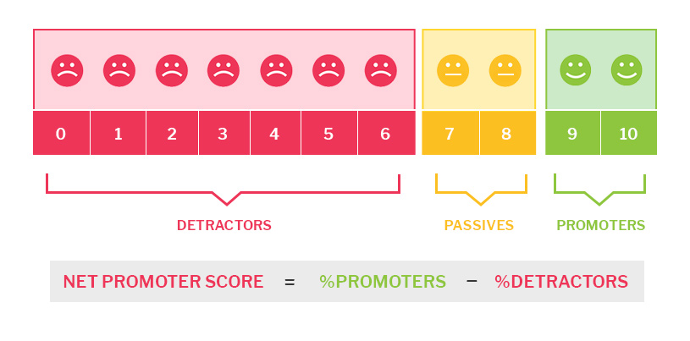
Net Promoter Score A Metric For Relationships, Not Transactions
Overall, how likely are you to recommend DPSCD to a friend or family member?

Slide 26
Net Promoter Scores Across All Employee Groups Have Improved
Survey | NPS for 2024-25 | Difference from 2023-24 | Difference from 2022-23 | Difference from 2021-22 | Difference from 2017-18
Teachers | -3 | +20 | +18 | +15 | +35
School Support Staff | 16 | +7 | +13 | +15 | +24
Instructional Leaders | 38 | +17 | +20 | +15 | +38
Central Office Staff | 6 | +8 | +14 | +10 | +50
All School Staff | 6 | +17 | +17 | +17 | +31
All Staff | 6 | +15 | +16 | +15 | +33
26

Slide 27
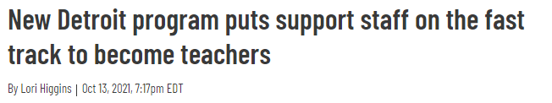
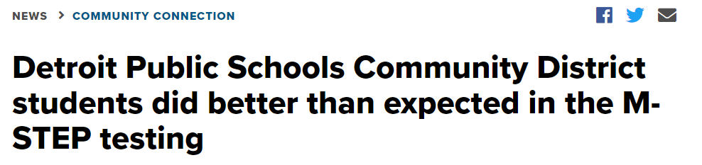
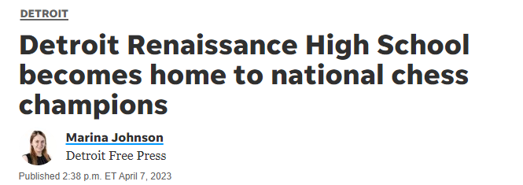
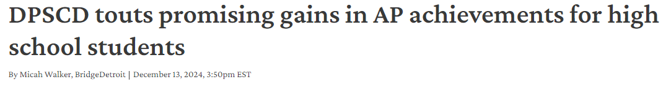
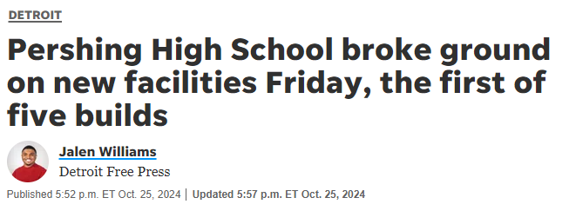
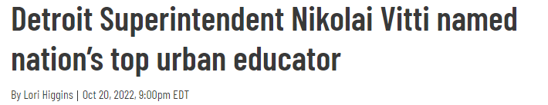
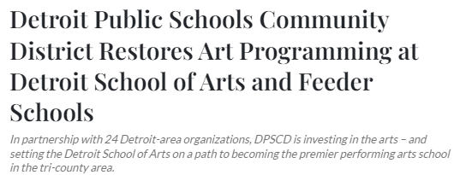
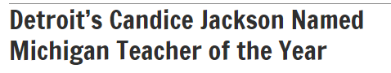
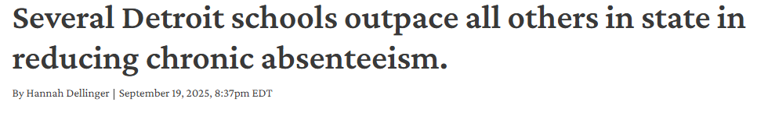
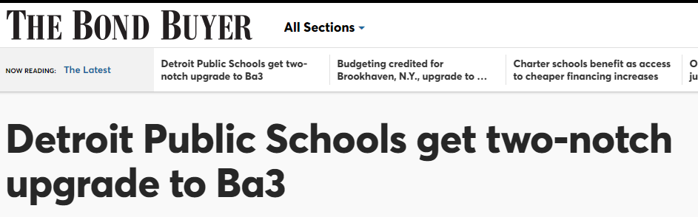

27
Notes:
We’ve shown that we know how to put our resources to good use - and I am excited to think about the future of our work from here, including where we can go with more equitable funding. The headlines about DPSCD have changed since 2016 – and the results have changed too.
Tonight I kept going back to our tag line “When students rise, we all rise” to recognize all of you – and others who have supported our Districts work. That’s because I believe in this tagline and strive to lead our District with this in mind. I believe that improving our schools is crucial to the health and vibrancy of Detroit as a city – and I am honored to have been appointed by the Board to be DPSCD’s first superintendent. We still have significant work to do, but our students are rising – and together, we are all rising, too. Thank you!

Slide 28








What’s Next?
Improving Exceptional Student & English Learner Education
High School Redesign
Refining Literacy and Mathematics Intervention
Continuing to Improve
Student
Attendance
Continued Teacher & Principal Effectiveness
Continuing to Invest in Human Capital in All Areas
Complete Investment in School Facilities
Achieve Equitable Funding
28

Slide 29




What Needs to Change in Michigan to Improve K-12 Education?
Real equitable funding, including facilities.
Aggressive and funded plan to recruit and develop leaders and teachers, including superintendents
and school board members.
Coherence and a commitment to reform between the governor, legislature, State Board, and Michigan superintendent.
Clear standards of student achievement accountability, and a coherent system to grade districts and schools fairly based on achievement and improvement.
Clear standards and accountability for parents.
29

Slide 30
Networking Break

Slide 31
Fixing Michigan's K-12 Education System
Mike Duggan, Mayor, City of Detroit

Slide 32
Journey Walk/Community College Adult Learner Experience/Midnight Golf Tour
Melissa Hamann, Partner/Executive Director, Diploma Equity Project, LD 35
Allysa Cole, Director, Media and Public Relations, College Career and Beyond
Winston Coffee, Director of College, Corporate and Community Partnerships, College Career and Beyond

Slide 33
State of Education and Talent
Greg Handel, Chief Education Officer, TalentEd Detroit Regional Chamber, LD 22

Slide 34


Slide 35
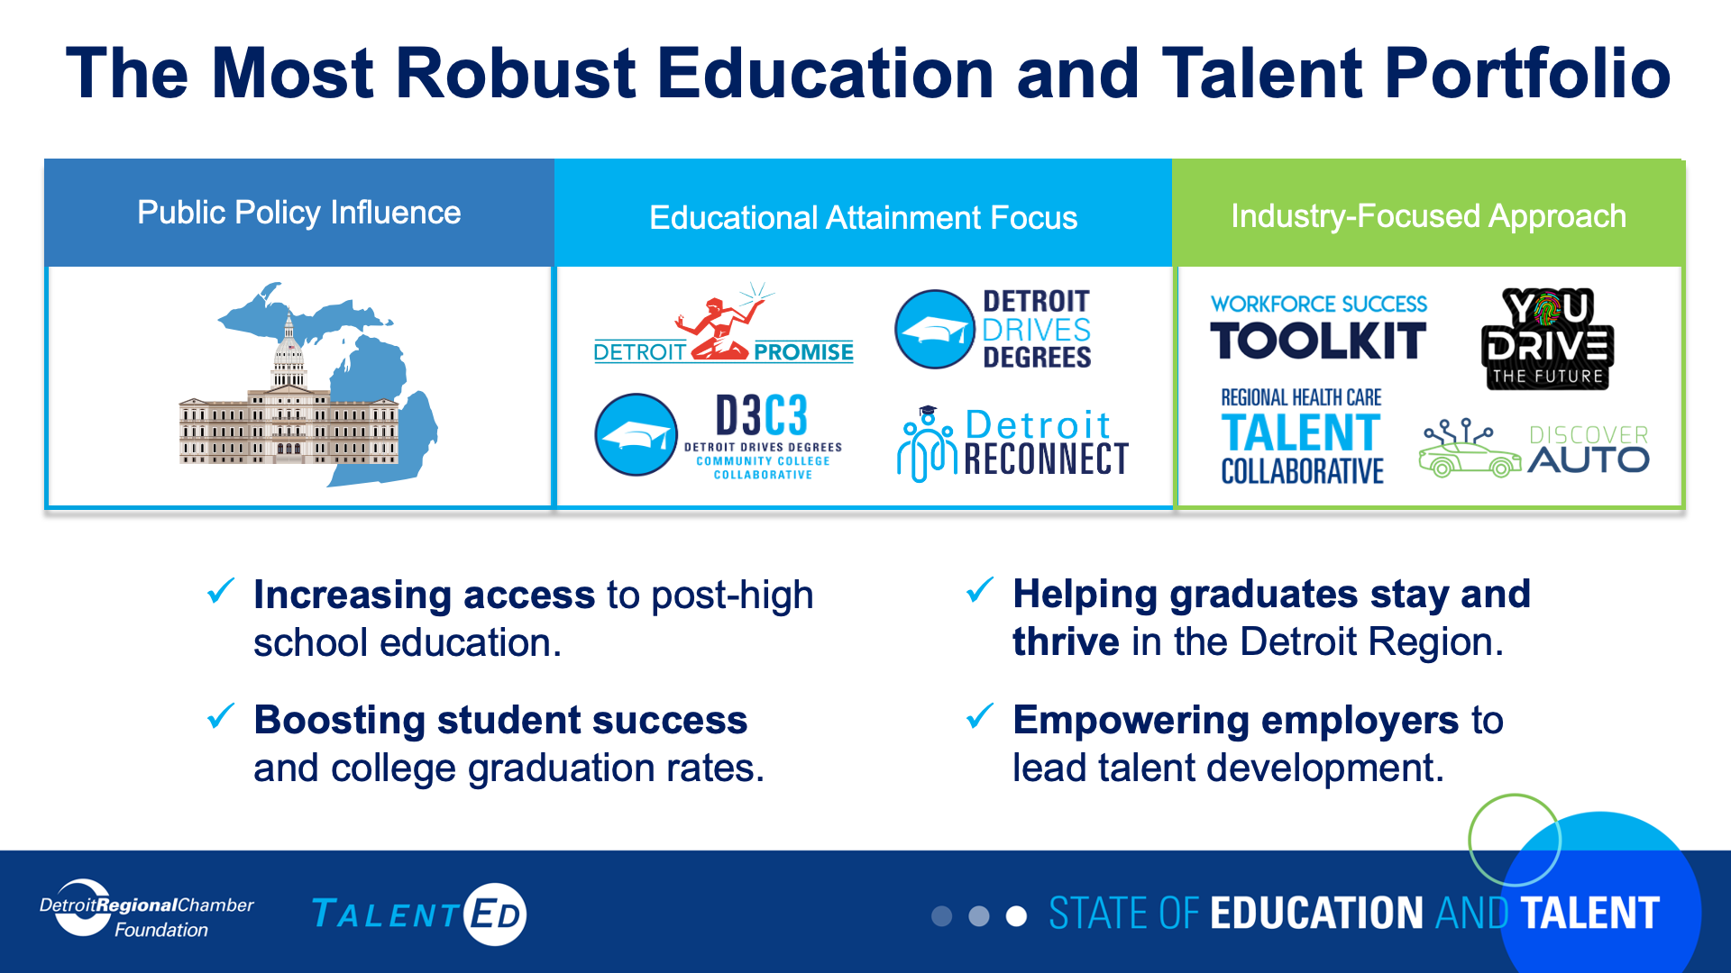

Slide 36
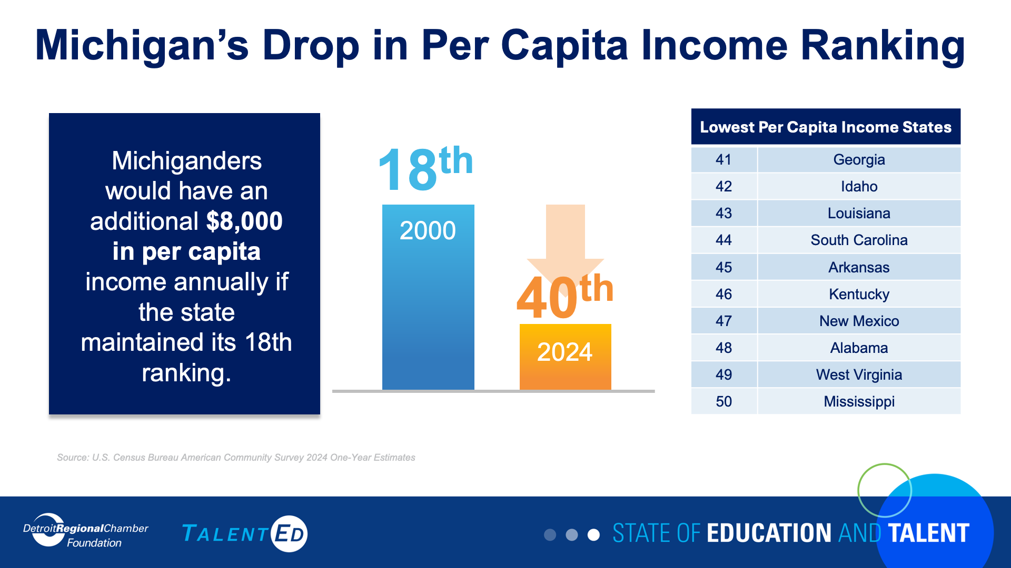

Slide 37
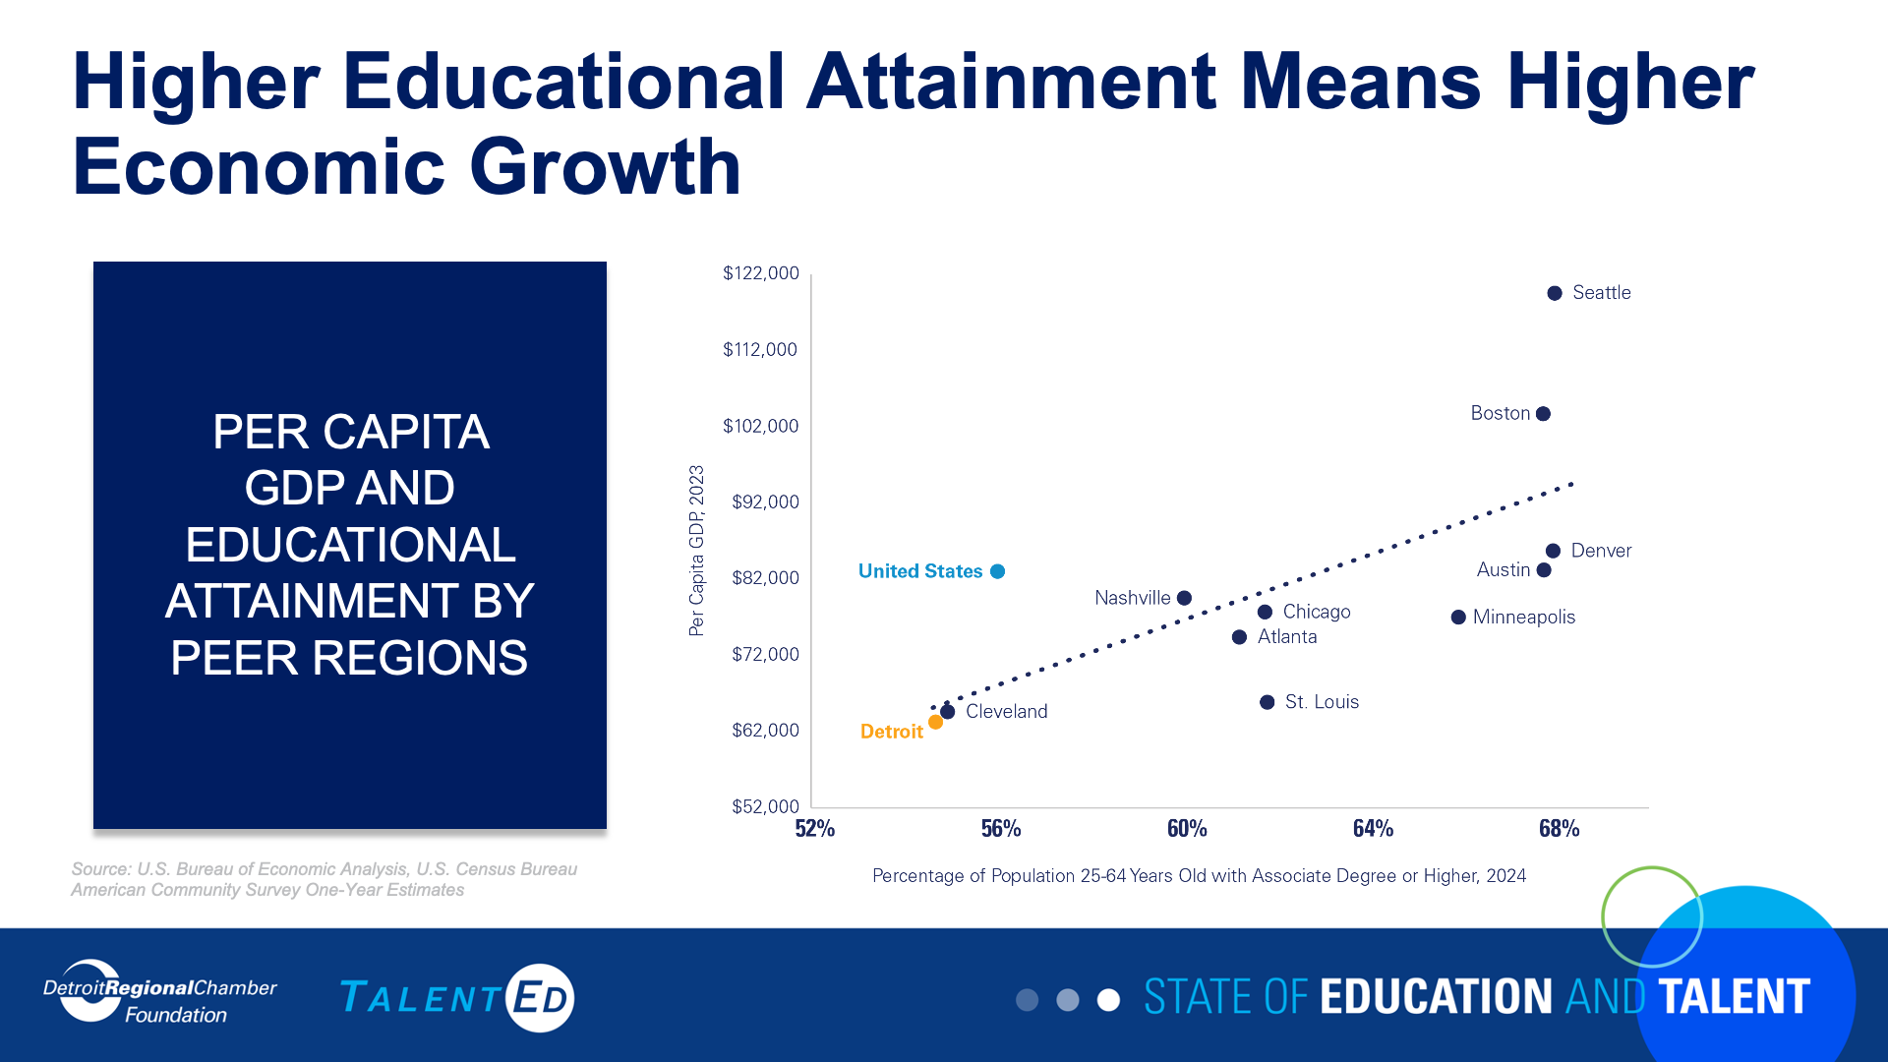

Slide 38
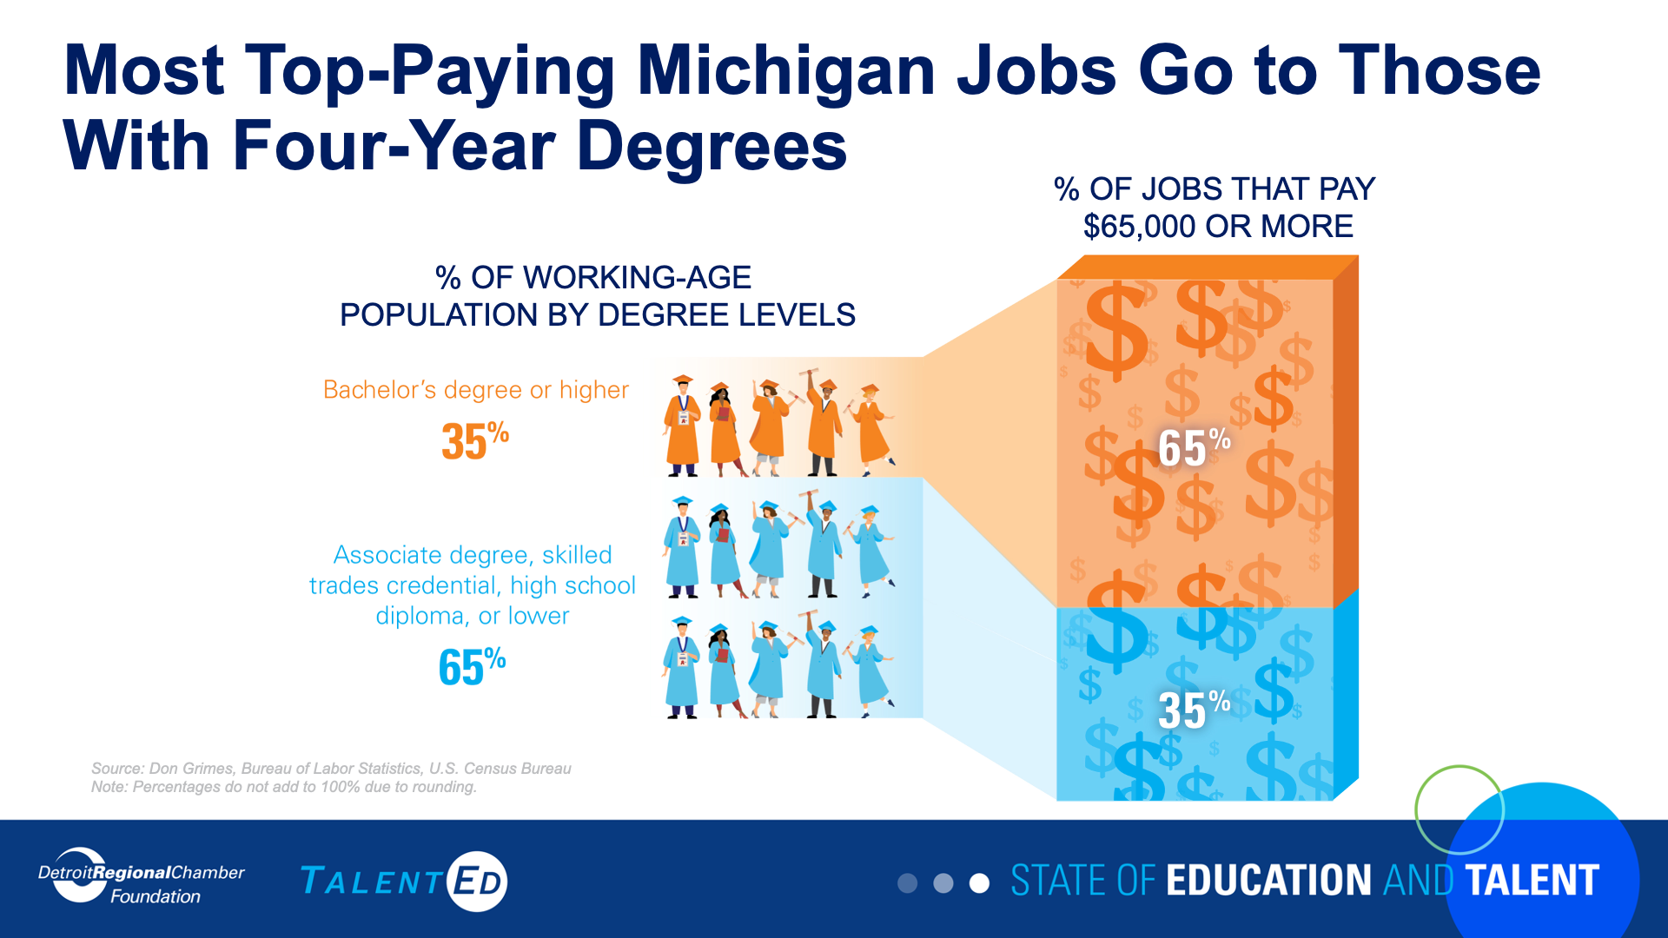

Slide 39
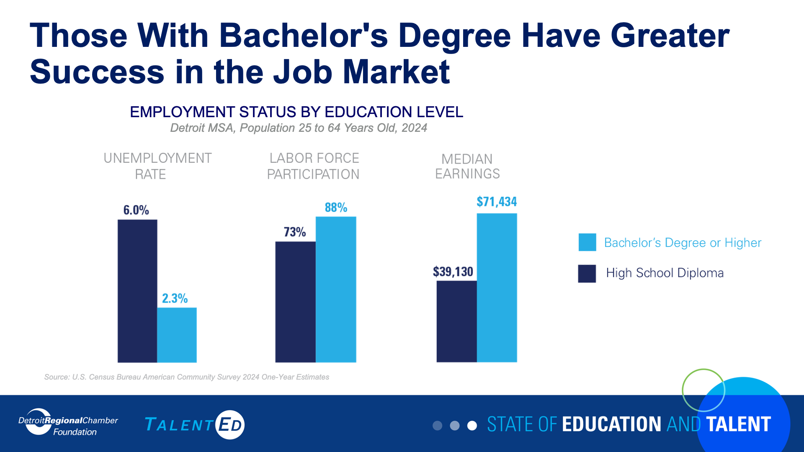

Slide 40
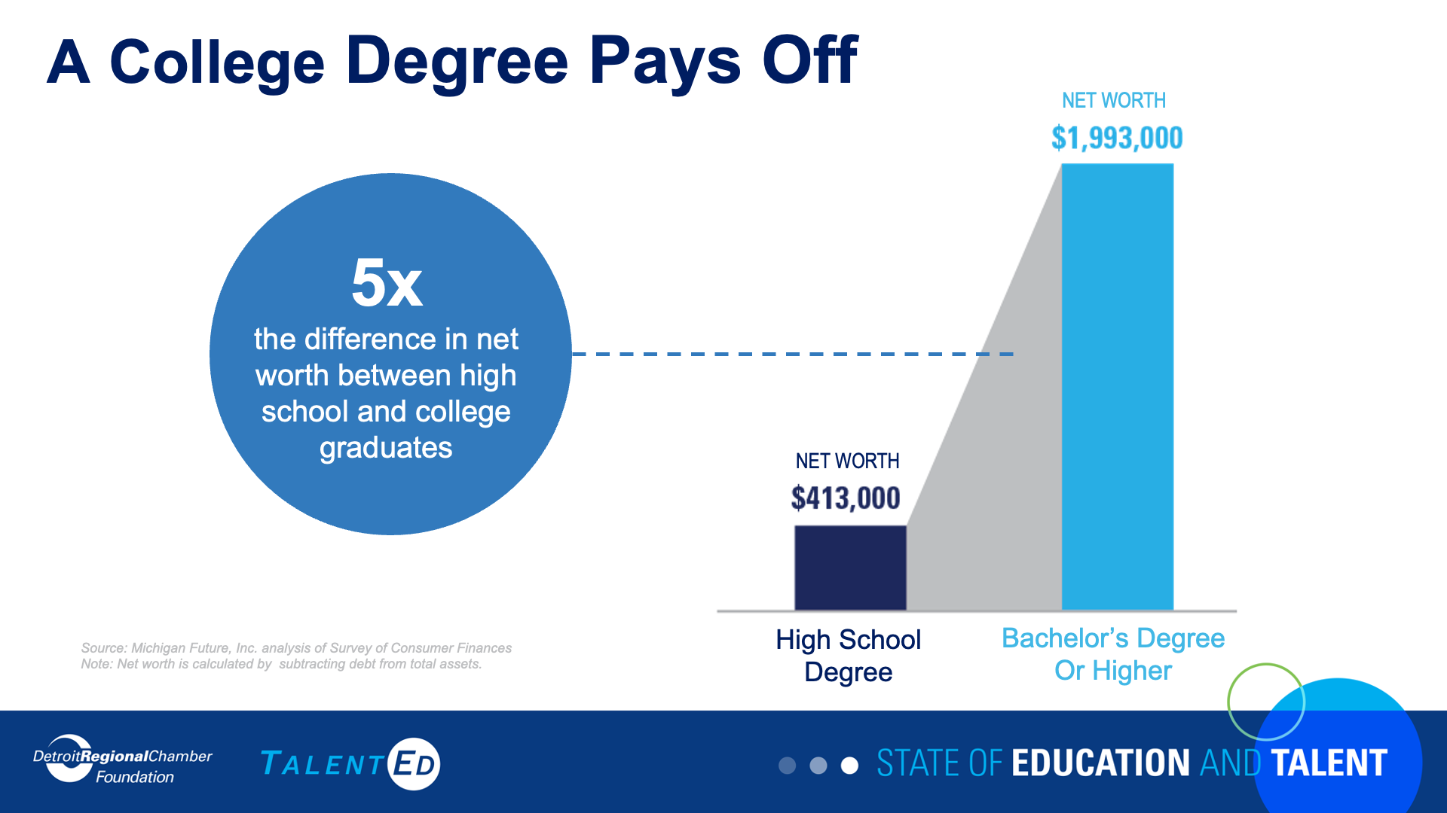

Slide 41
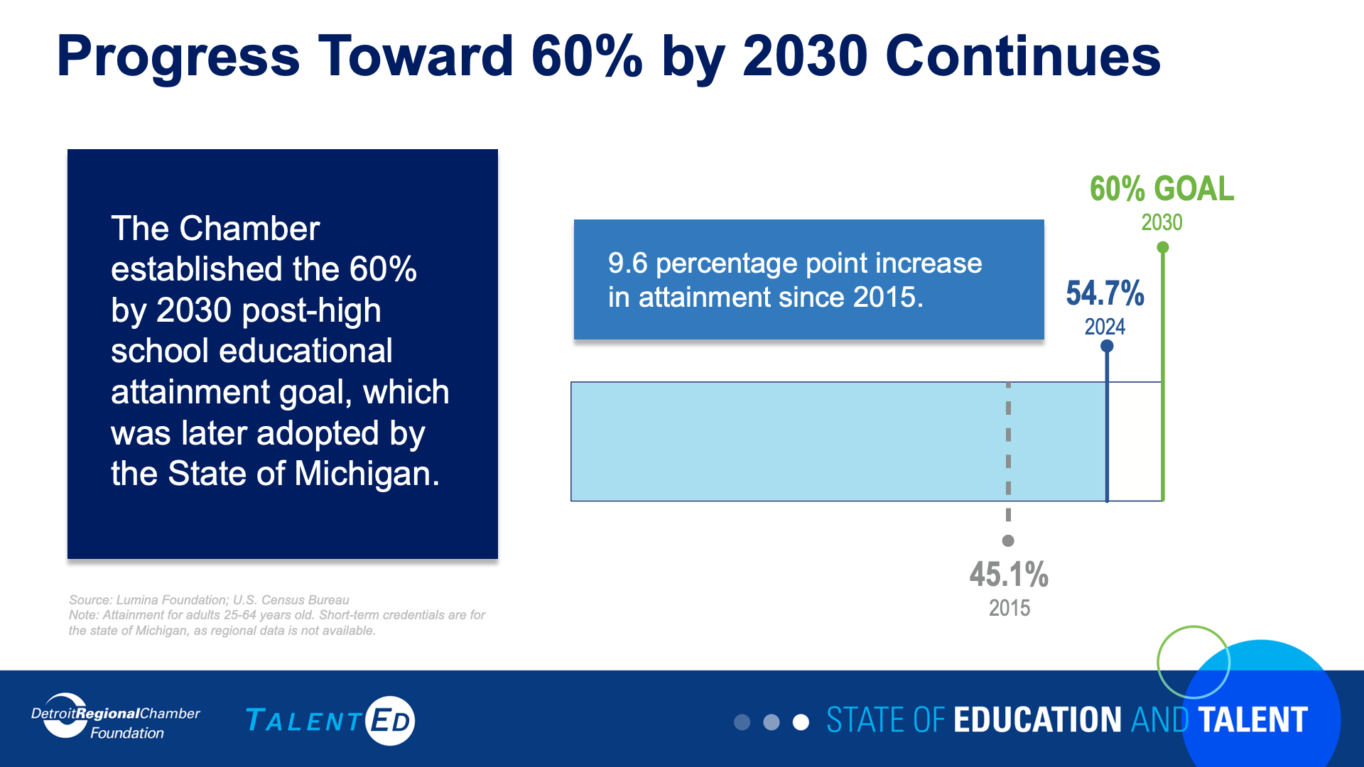

Slide 42
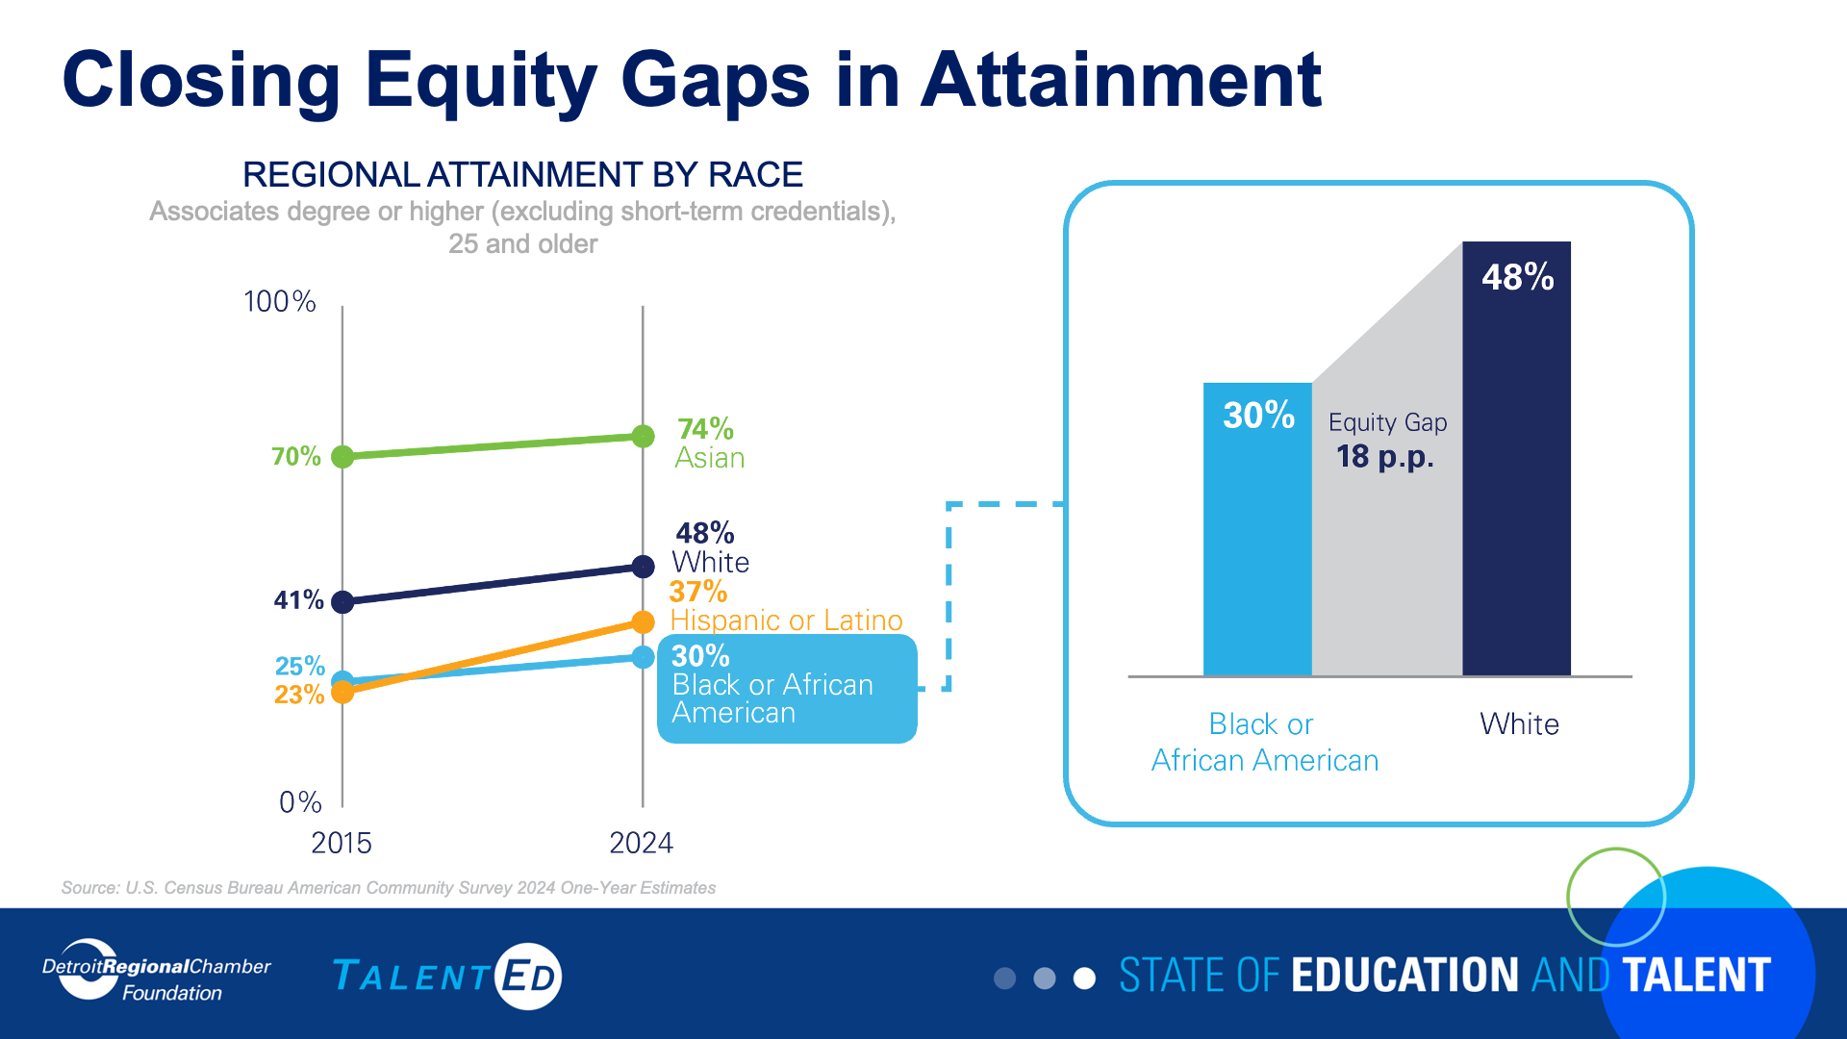

Slide 43
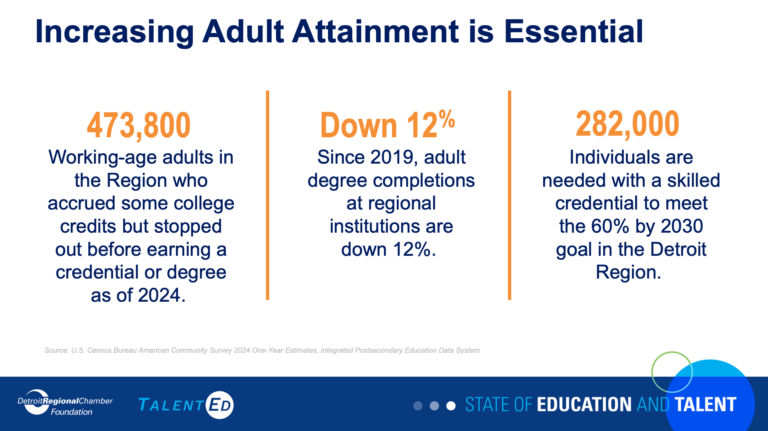

Slide 44
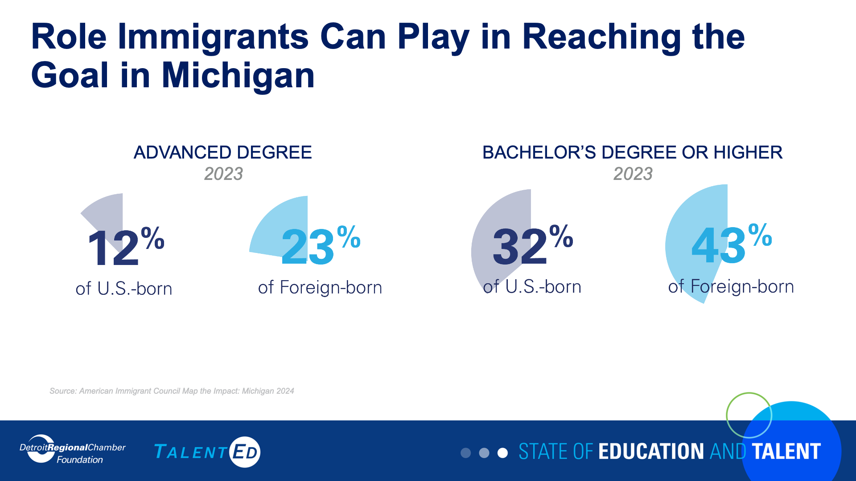

Slide 45
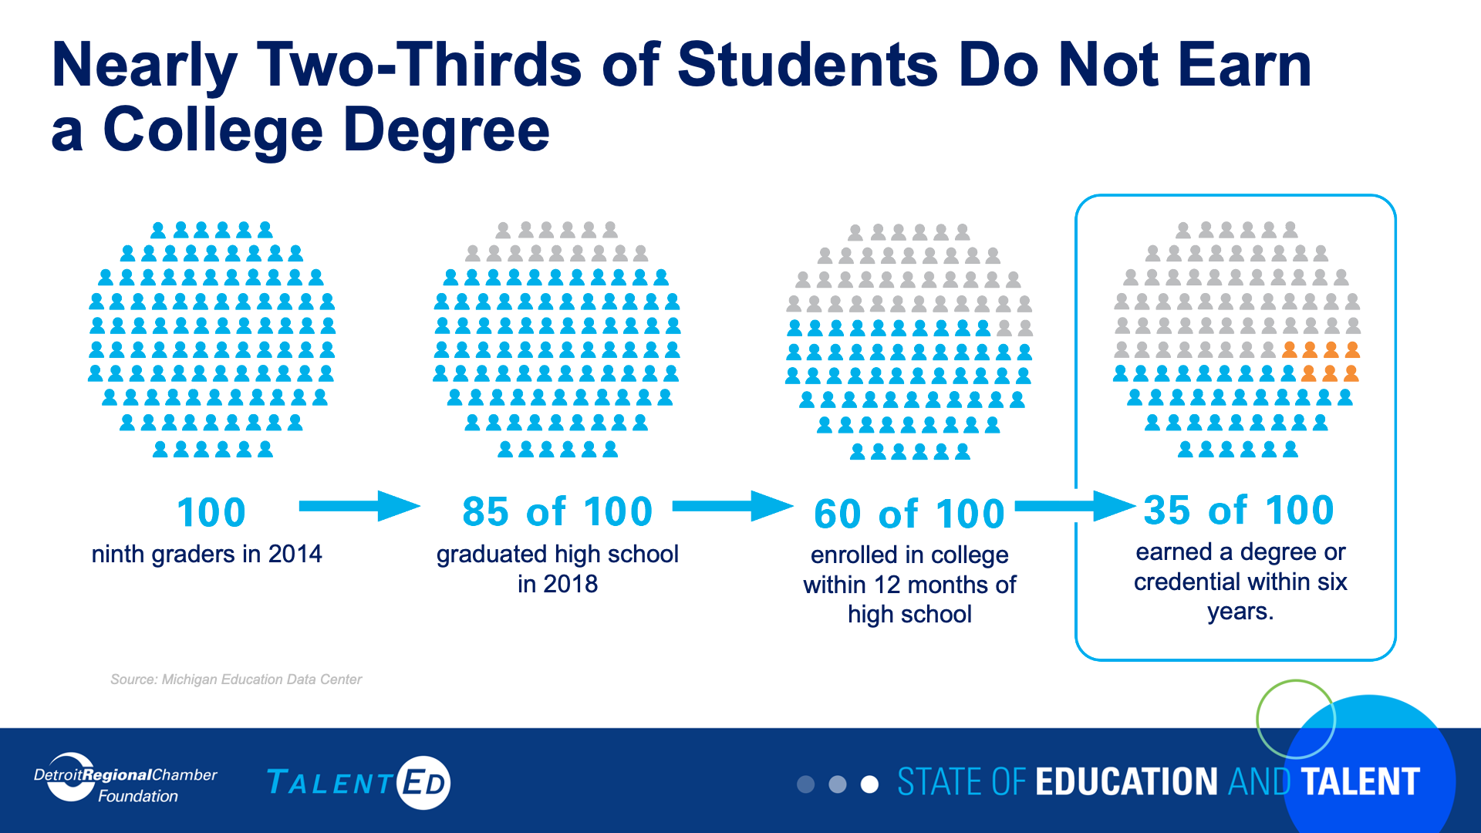

Slide 46
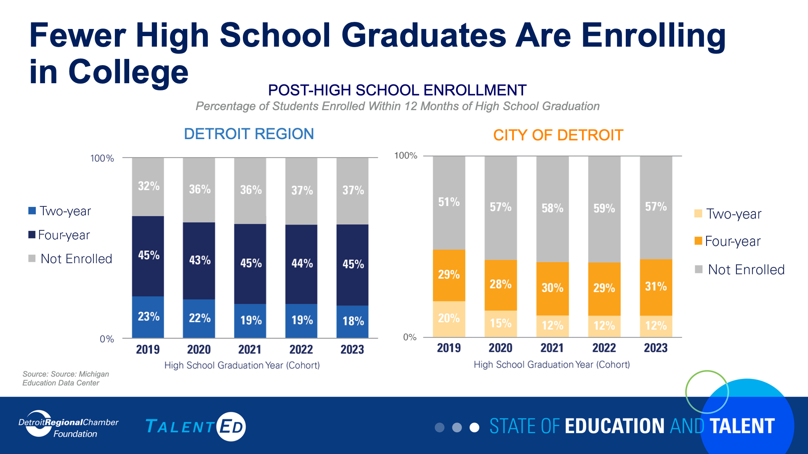

Slide 47
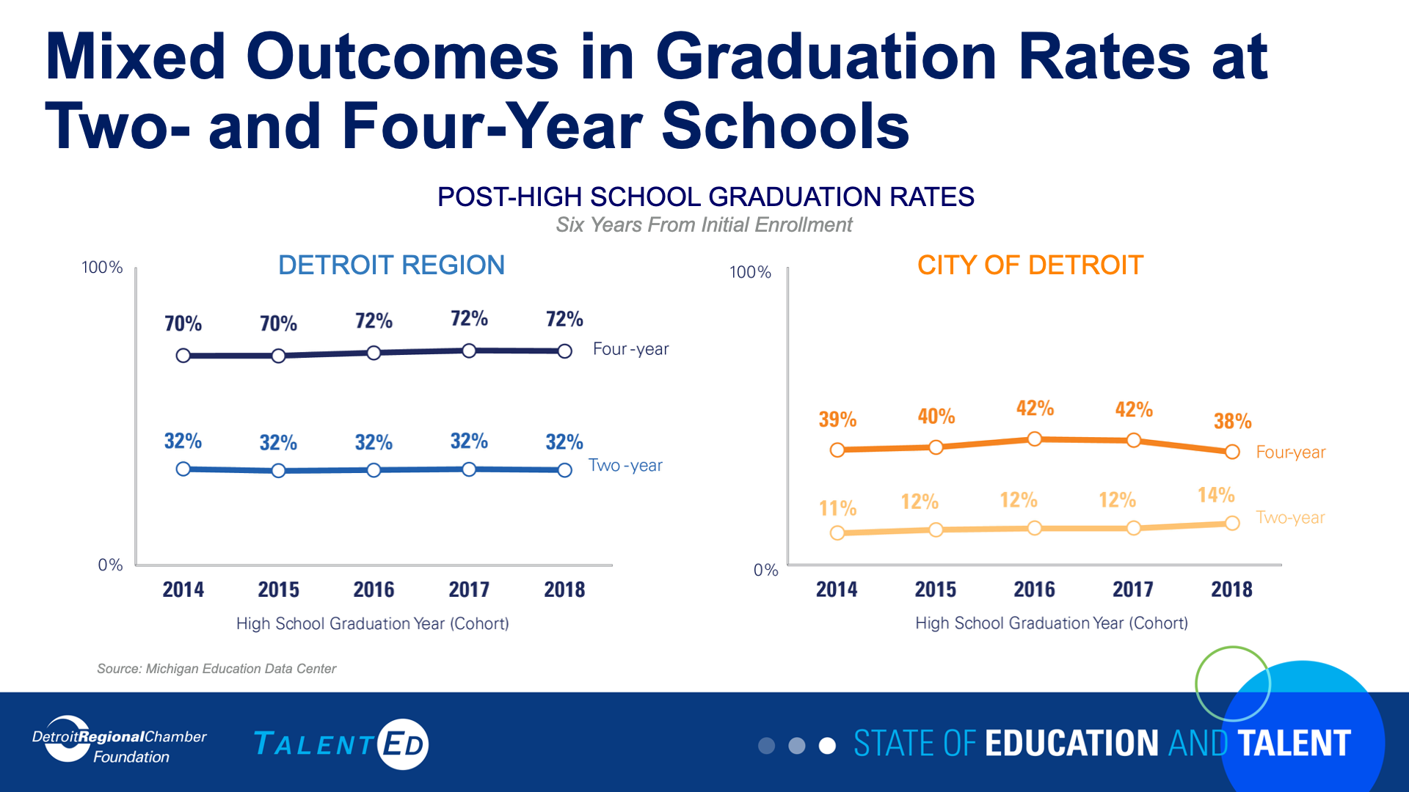

Slide 48
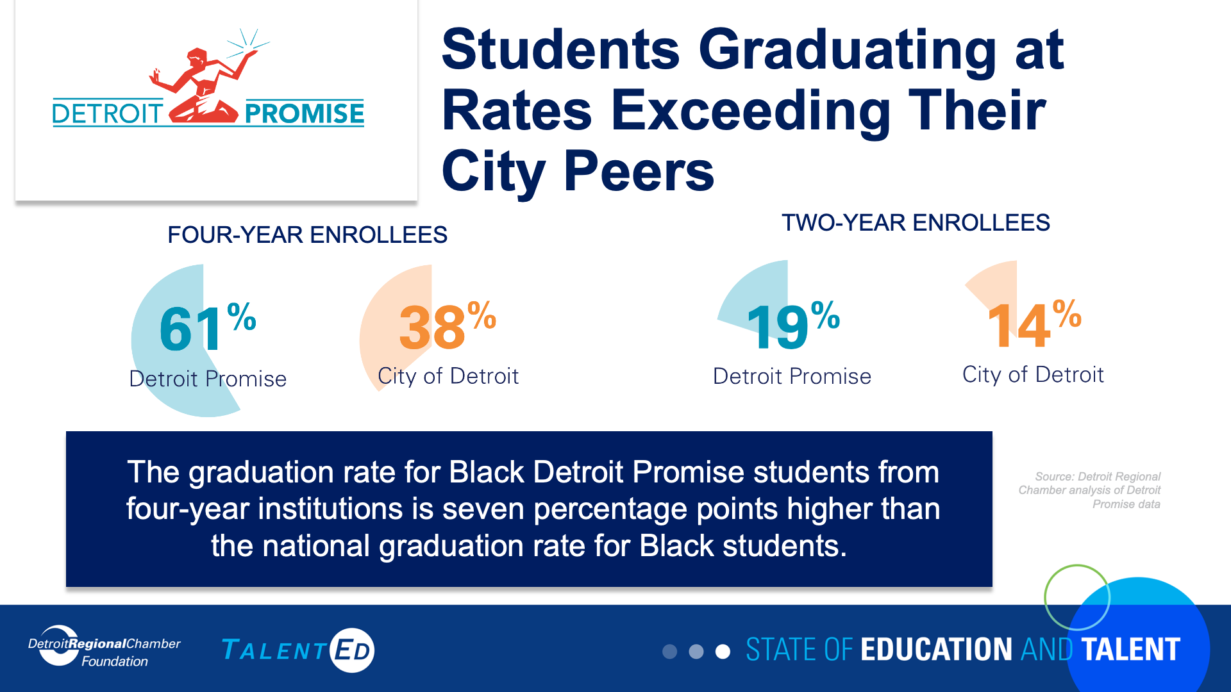

Slide 49
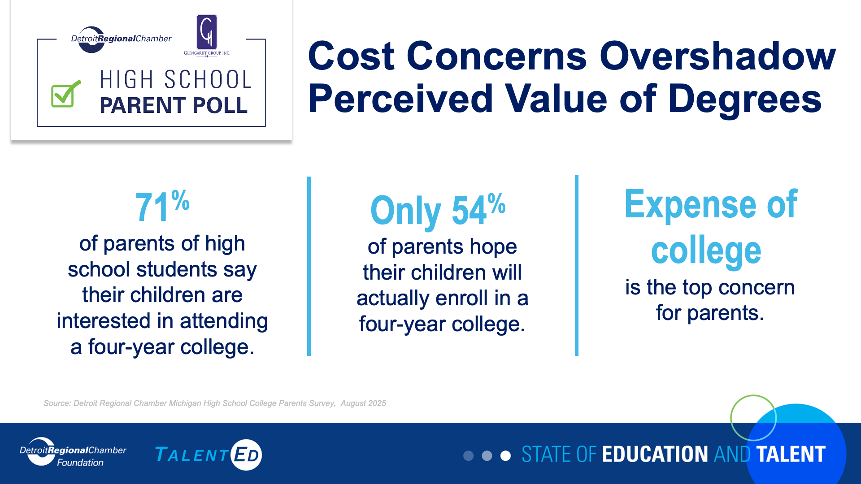

Slide 50
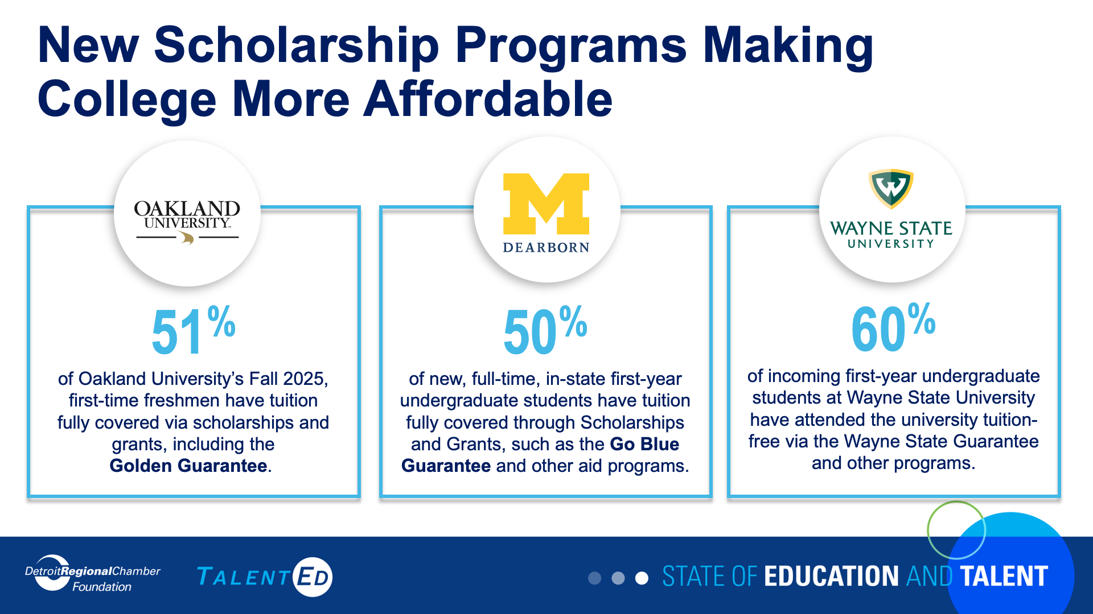

Slide 51
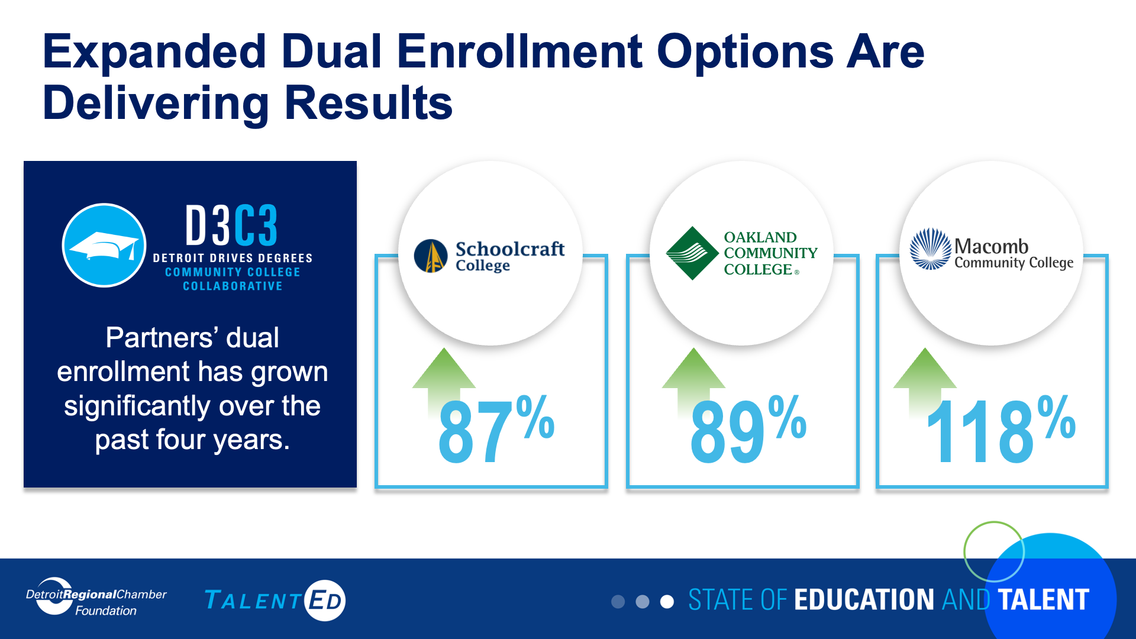

Slide 52
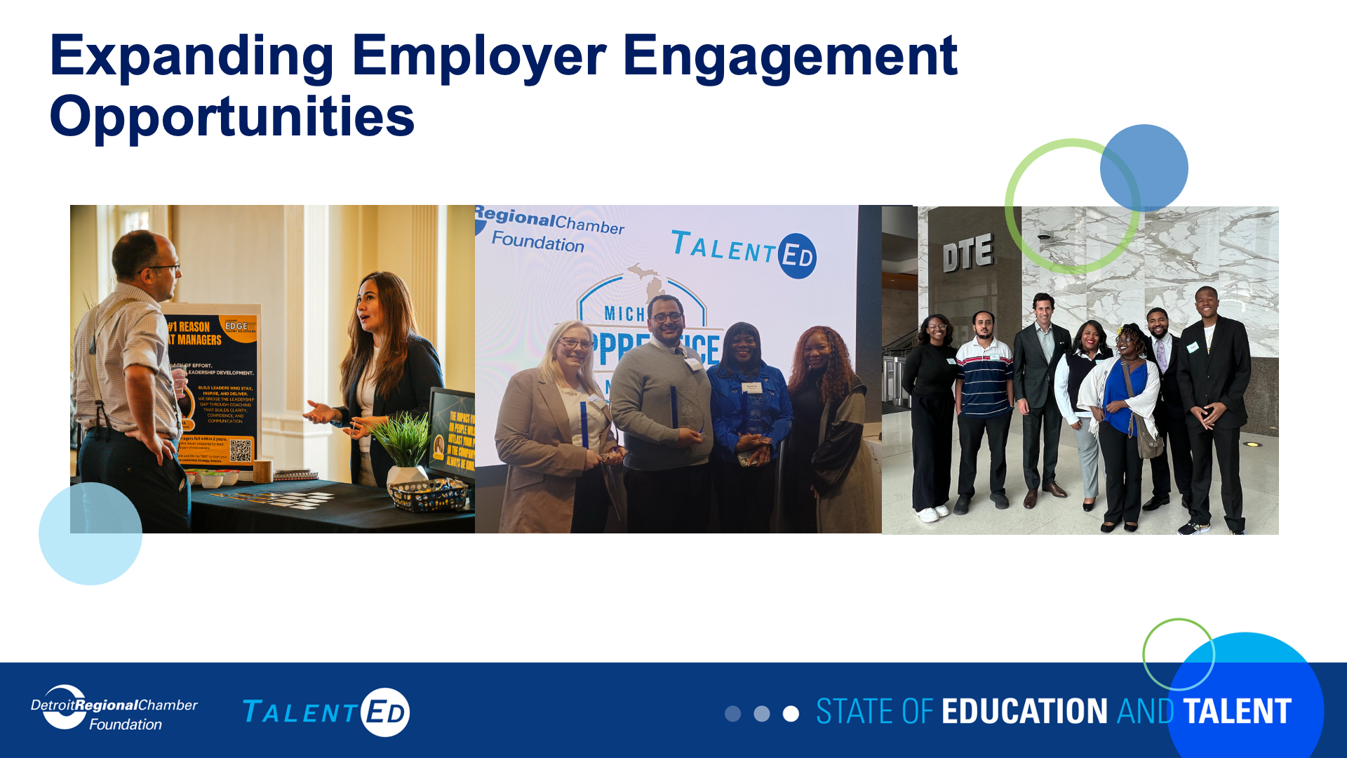

Slide 53
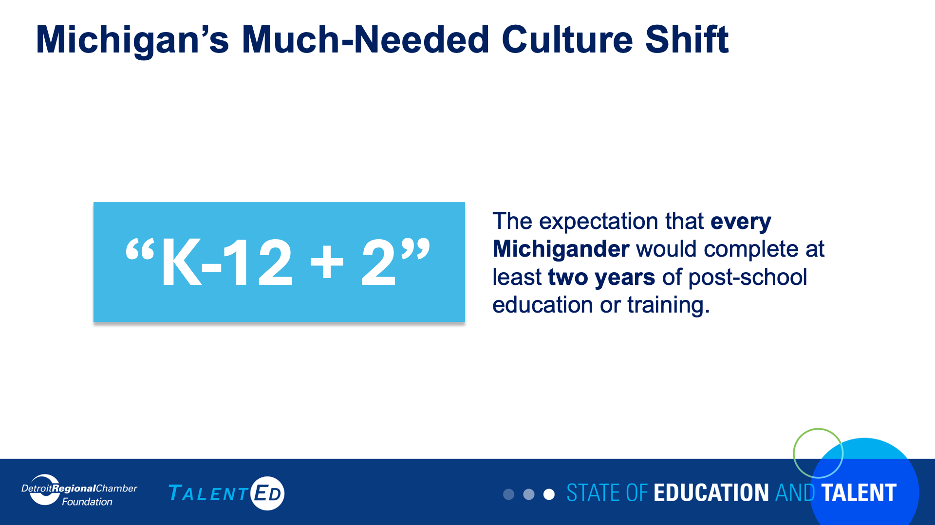

Slide 54
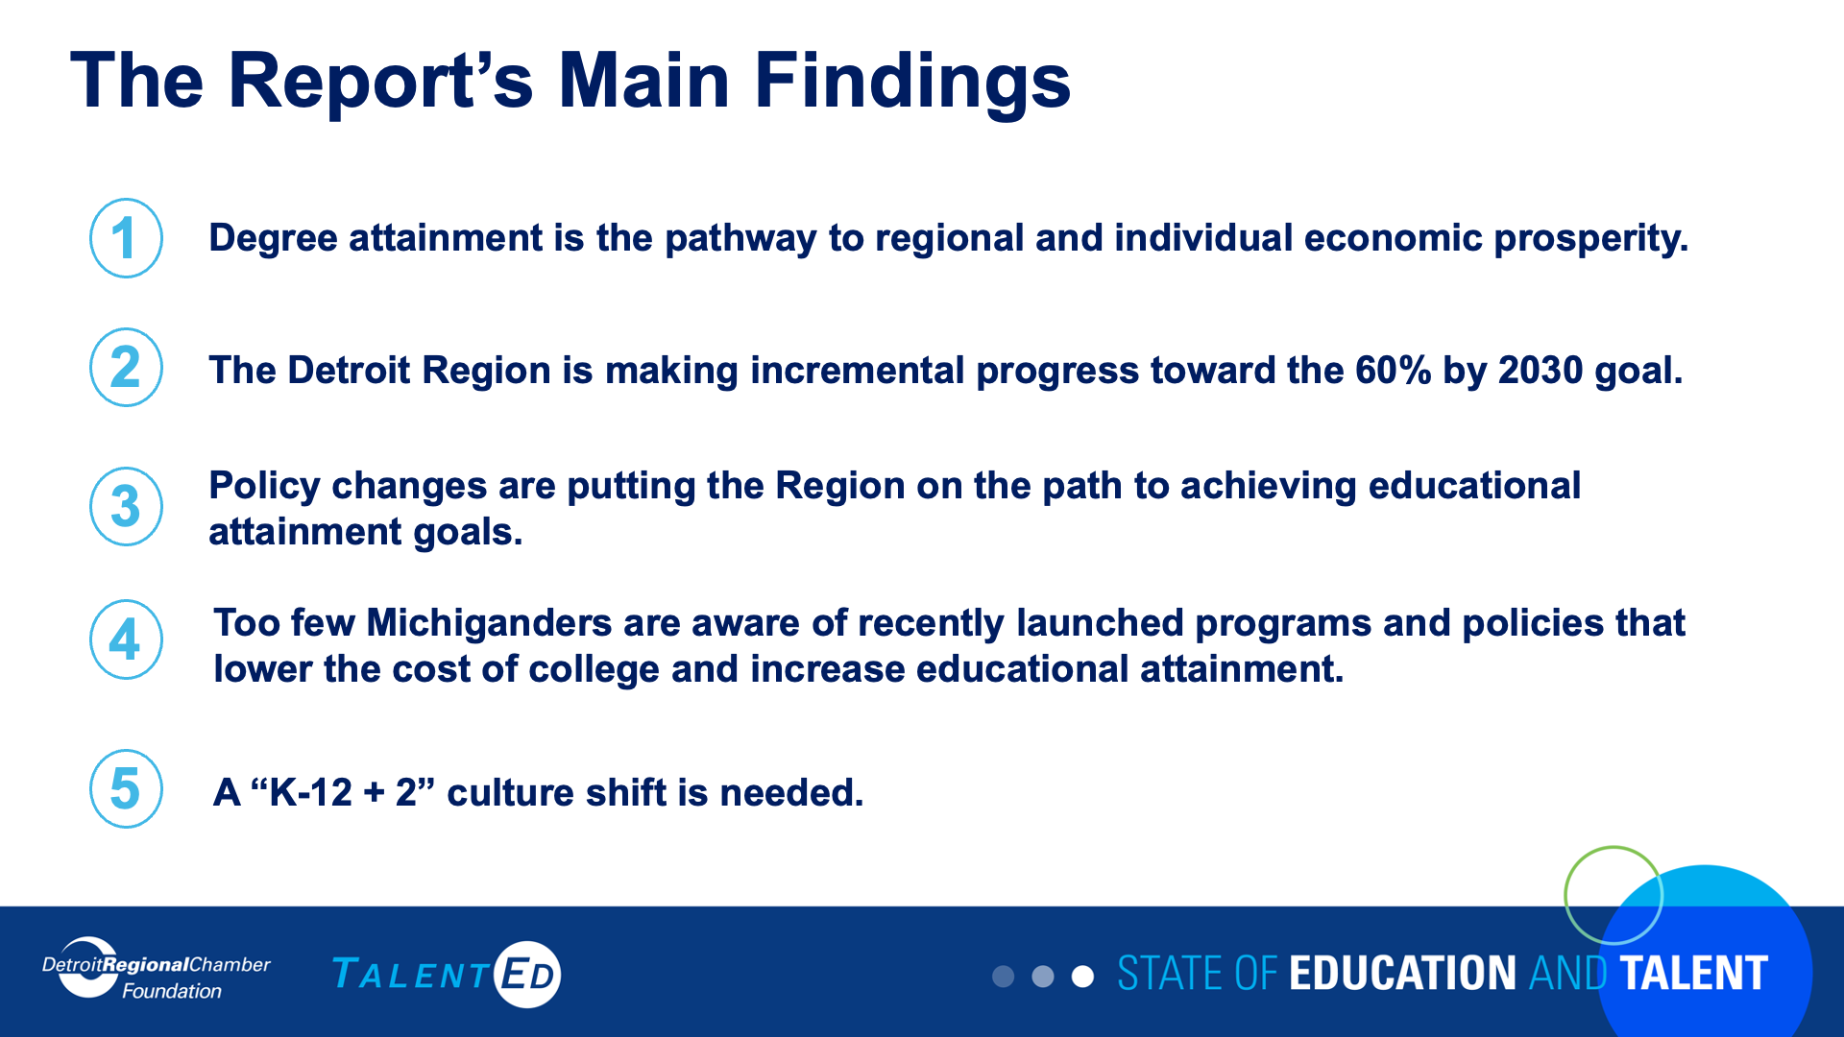

Slide 55


Slide 56
Lunch
Orientation Day 1
Full Course Catering

Slide 57
Making College More Accessible
Cyekeia Lee, Executive Director, Detroit College Access Network
Sarah Szurpicki, Deputy Director, MiLEAP
Dr. Darryl Gardner, Ph.D., Vice Provost for Student Success, Support, and Engagement, Wayne State University, LD 44
Moderator: Wytrice Harris, Senior Director, Detroit Promise, LD 44

Slide 58
Regional Health Care Talent Collaborative
Catherine Susko, Vice President of HR Planning, Development, and Belonging, Henry Ford Health, LD 45
Philip E. Strong, Ph.D., Associate Professor, Family and Community Medicine, College of Osteopathic Medicine, Michigan State University
Tanya McFadden, Ed.D., Executive Director of Health Professions and Dean of Nursing, Oakland Community College
Moderator: Chrisi Taylor, Senior Director, Employer Engagement, Detroit Regional Chamber

Slide 59
Networking Break

Slide 60
College Career and Beyond
Allysa Cole, Director of Media and Public Relations College Career and Beyond

Slide 61

Allysa Cole
CCB | MGP Alumna
Class of 2011
Director of Media & Public Relations
Winston Coffee
Director of College, Corporate & Community Partnerships

Slide 62
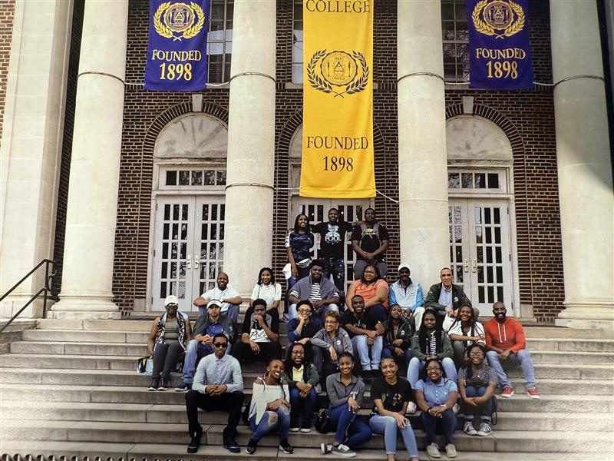

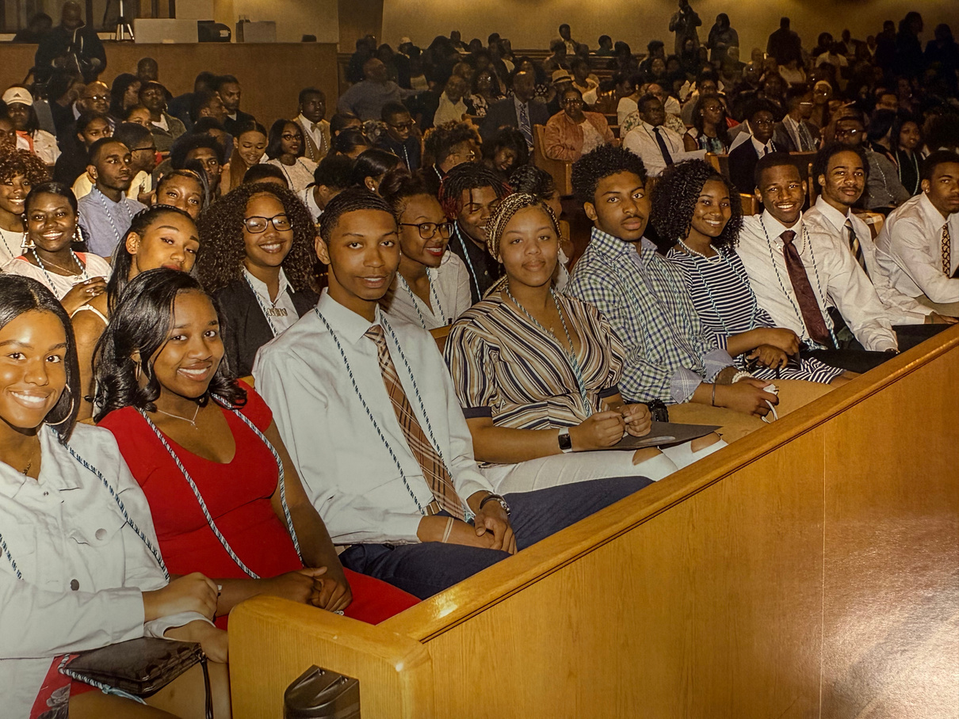
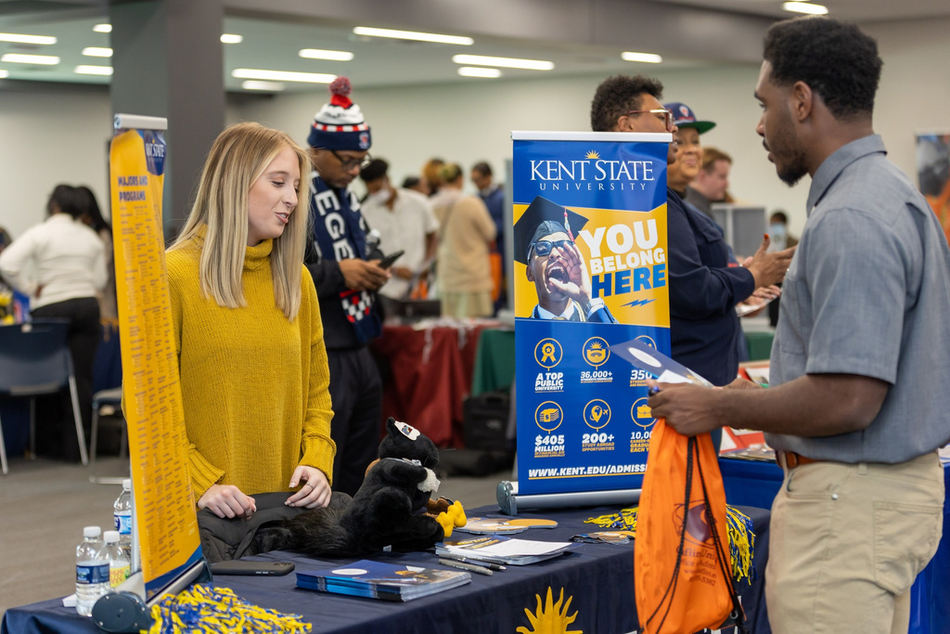

Slide 63
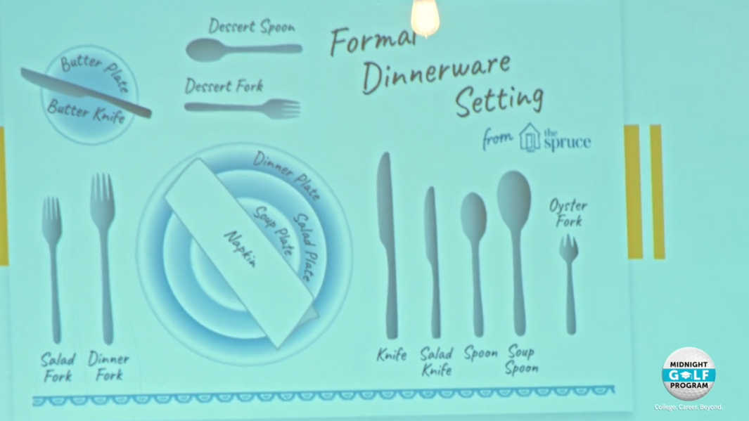

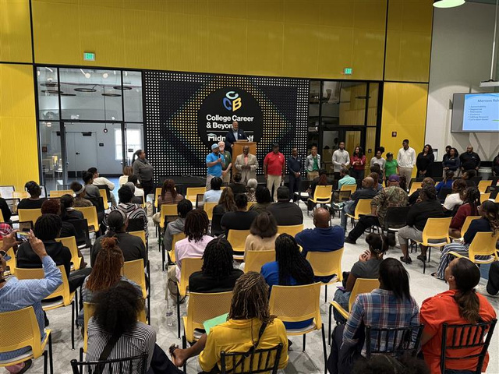
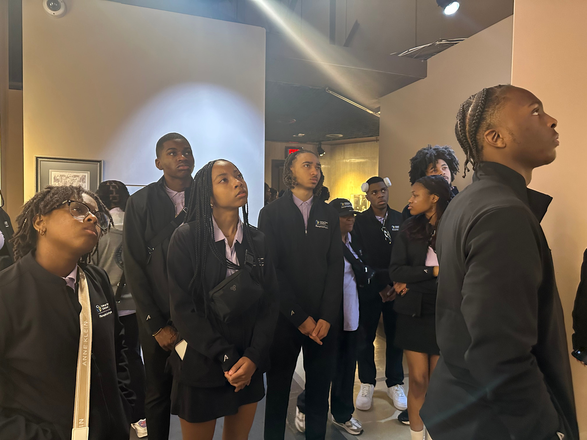
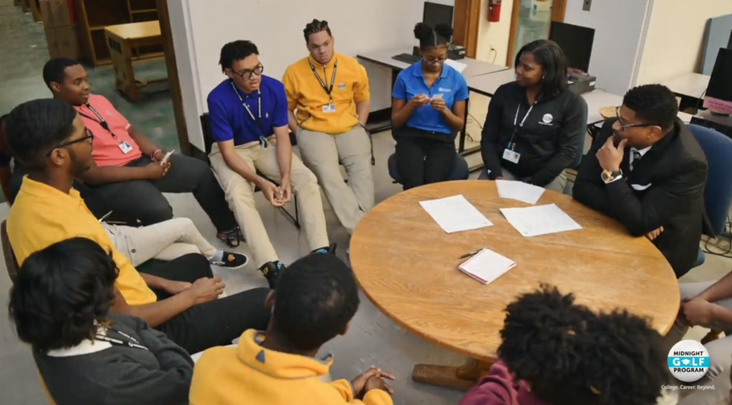
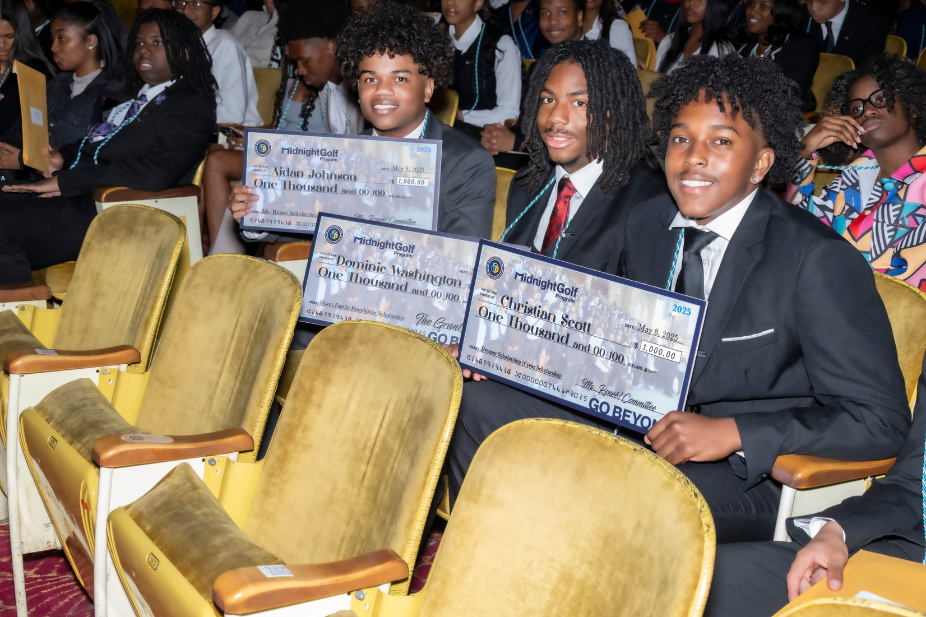

Slide 64
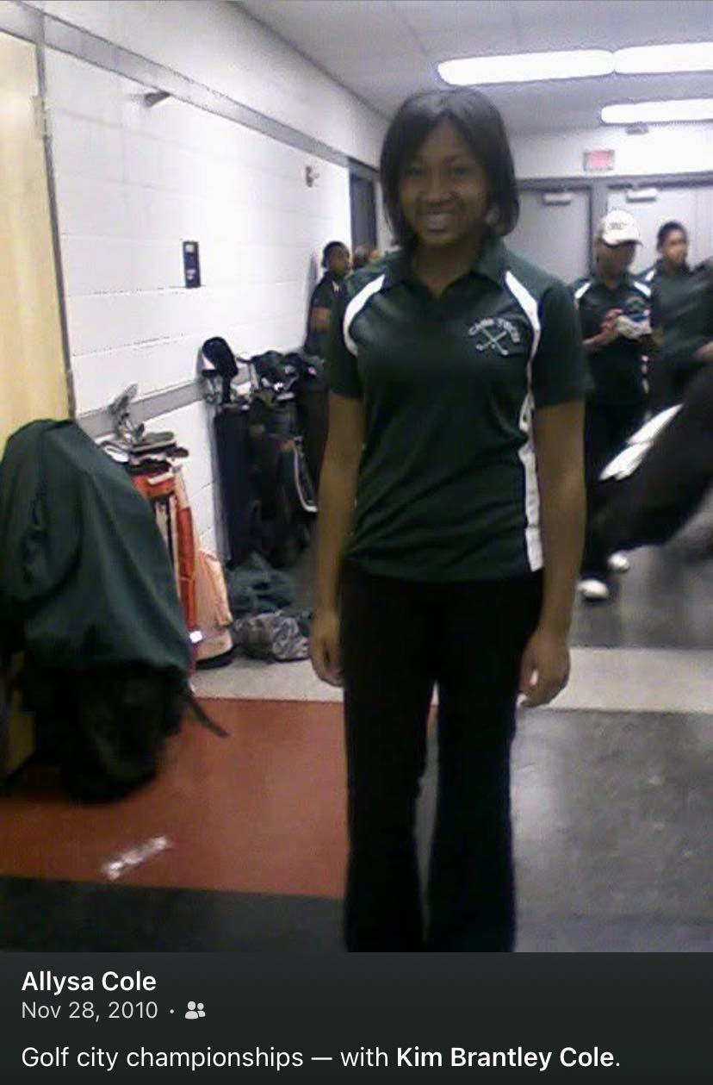
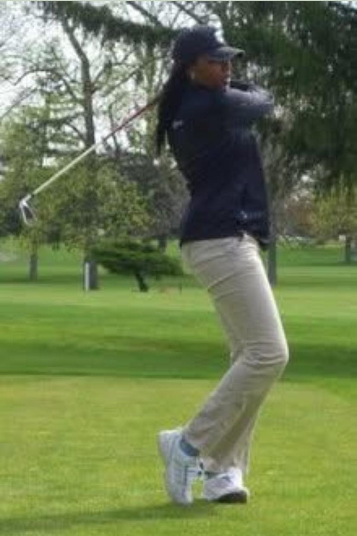

Slide 65


Slide 66


Slide 67









Slide 68









Slide 69
Corporate Affinity Group Mentorship Panel
Kevin Heard, Sr. Manager, Engagement Programs and Partnerships, USA Today Co.
Brittanie Chin-Merkerson, Vice President, Diversity, Equity and Inclusion, Rocket
Megan Williams, Senior Vice President and Chief People, Culture and Human Resources Officer, AAA – The Auto Club Group
Moderator: Marnita Harris, Vice President, Economic Equity and Inclusion, Detroit Regional Chamber, LD 36

Slide 70
Group Discussion
Discuss takeaways. How can we get LD 46 involved in student mentorship opportunities?
Orientation Day 1

Slide 71
Details for Next Session: Media and AI
Date: Friday, Dec. 12
Location: WDIV and DoubleTree Suites Fort Shelby
Time: 8:30 a.m. to 5 p.m.

Slide 72

Accept Your Complimentary Registration 2026 Detroit Policy Conference
January 29, 2026
8 a.m. to 5 p.m. The Department at Hudson's Detroit
Scan the QR code or email Pilar Doakes at pdoakes@detroitchamber.com to register.

Slide 73

Wrap-up
Missing a session? Fill out the absence form:
Orientation Day 1

Slide 74
Wrap-up
Social Hour
Tenacity Craft
8517 2nd Ave, Detroit, MI 48202

Slide 75

Wrap-up
Complete the session survey below:

Slide 76
Education and Mentorship

