Slide 3
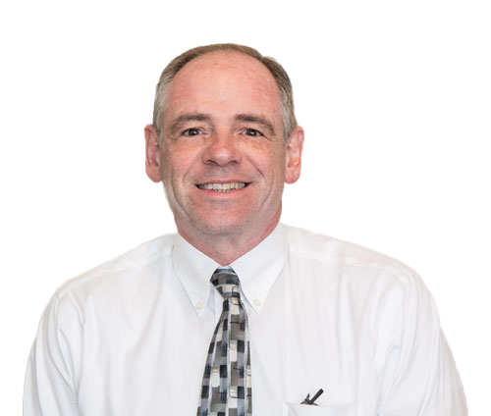
Greg Handel
Chief Education and Talent Officer,
Detroit Regional Chamber
Notes:
Add a headshot – and cut the three dots. Also – TalentEd logo should not appear in this presentation until after Sandy ”unveils” it in animated slide …. Also – all the circles are falling off the slides, maybe a compression issue?

Slide 4

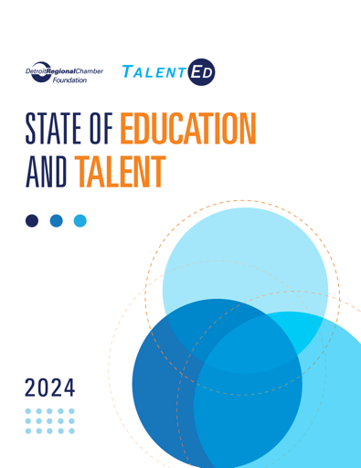


Thank You, Partners
Funding Partner:
Research Partner:

Slide 5








The Most Robust Education and Talent Portfolio
Public Policy Influence
Educational Attainment Focus
Industry-Focused Approach
Increasing access to post-high school education.
Helping graduates stay and thrive in the Detroit Region.
Boosting student success and college graduation rates.
Empowering employers to lead talent development.

Slide 6
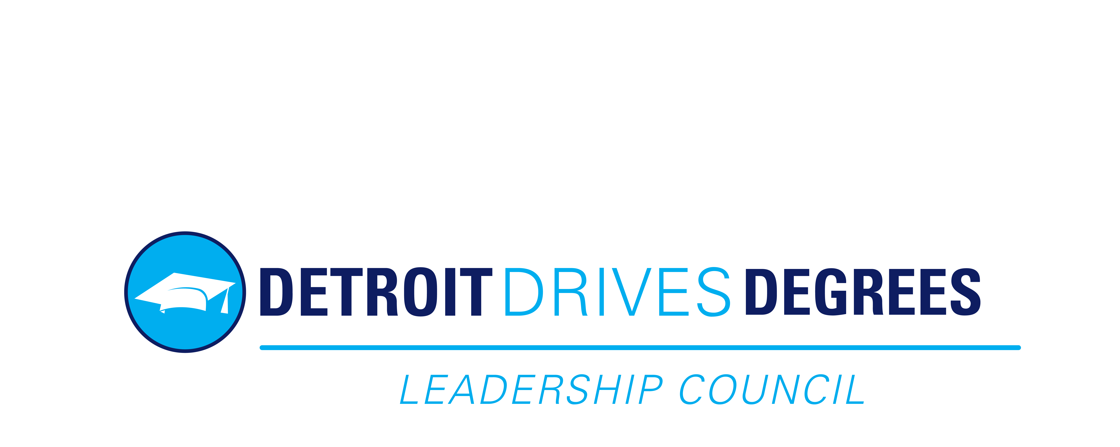


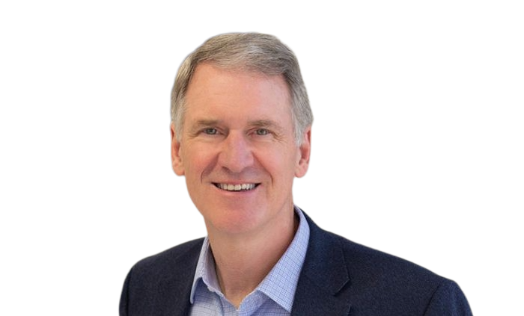
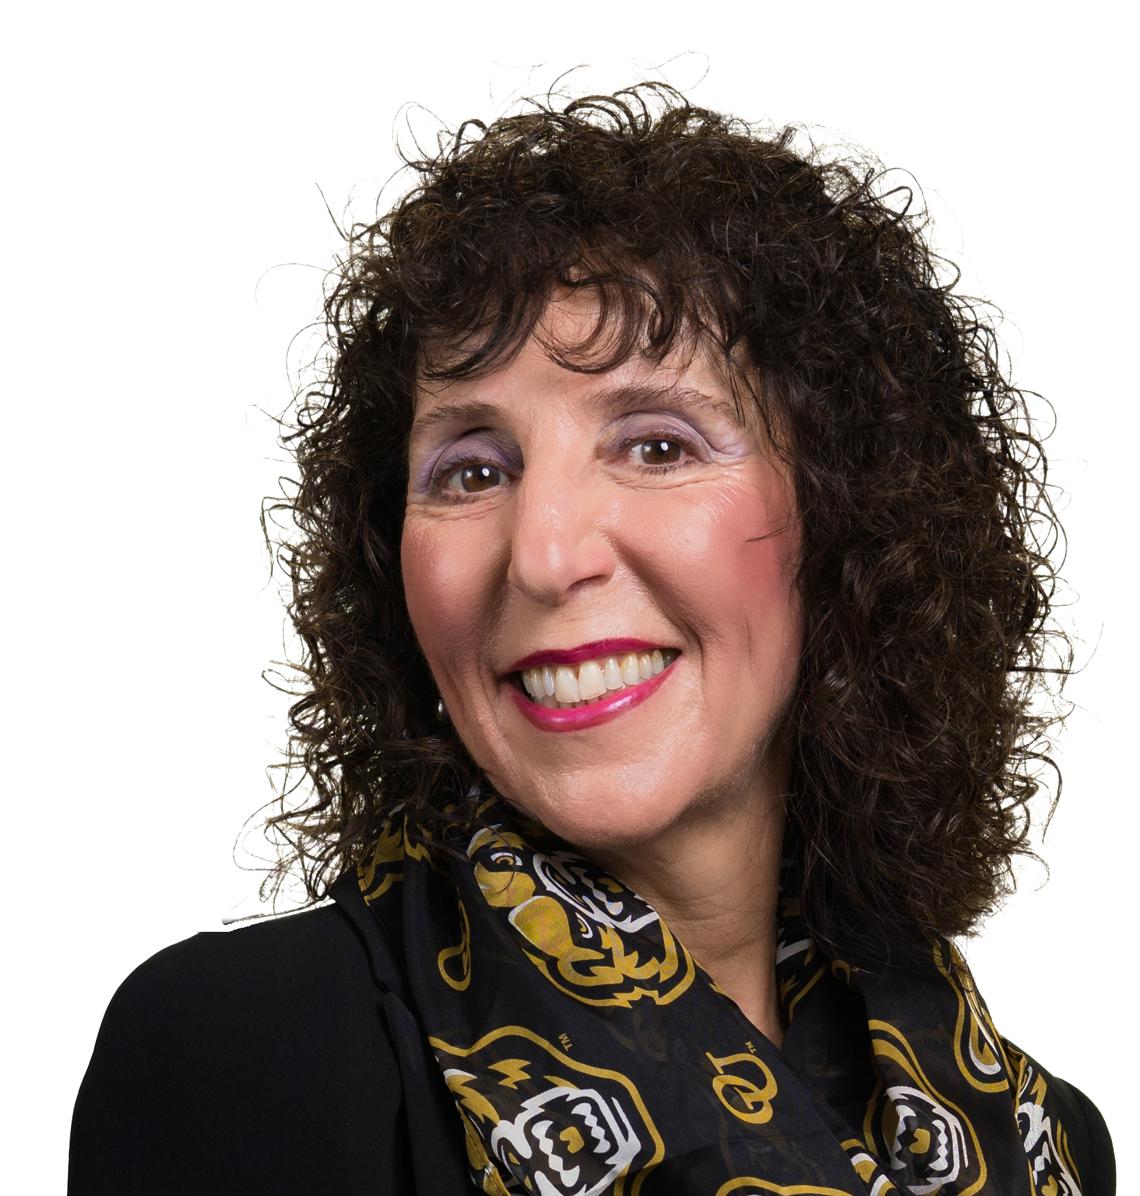
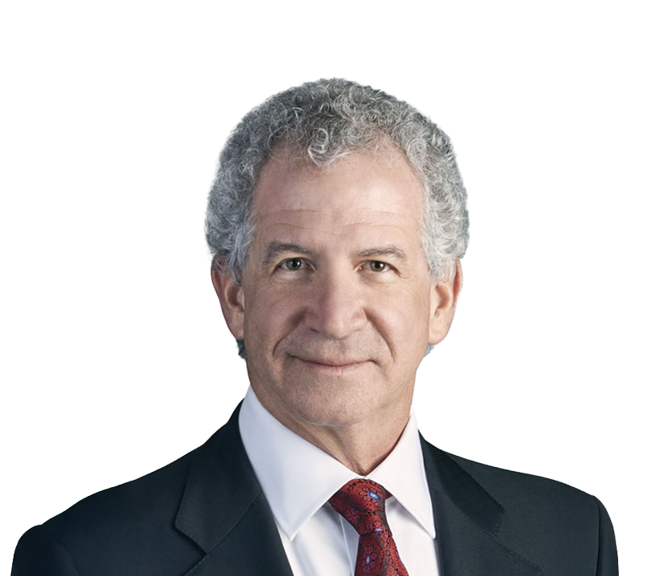
Thank You, Partners
Peter Quigley
Strategic Advisor and Board Member, Kelly;
Chair, Board of Directors and CEO Talent Council, Detroit Regional Chamber
Co-Chairs
Ora Hirsch Pescovitz
President, Oakland University
Chaired by Quigley, the CEO Talent Council’s 23 C-suite leaders provide strategic direction for the Chamber’s education and talent work.
The Detroit Drives Degrees Leadership Council brings together leaders to achieve educational attainment and racial equity goals.
Jamie Jacob
Chief Executive Officer,
Ajax Paving

Slide 7
Michigan’s Drop in Per Capita Income Ranking
Lowest Per Capita Income States
41 | Georgia
42 | Idaho
43 | Louisiana
44 | South Carolina
45 | Arkansas
46 | Kentucky
47 | New Mexico
48 | Alabama
49 | West Virginia
50 | Mississippi
Michiganders would have an additional $8,000 in per capita income annually if the state maintained its 18th ranking.
18th
2000
40th
2024
Source: U.S. Census Bureau American Community Survey 2024 One-Year Estimates

Slide 8
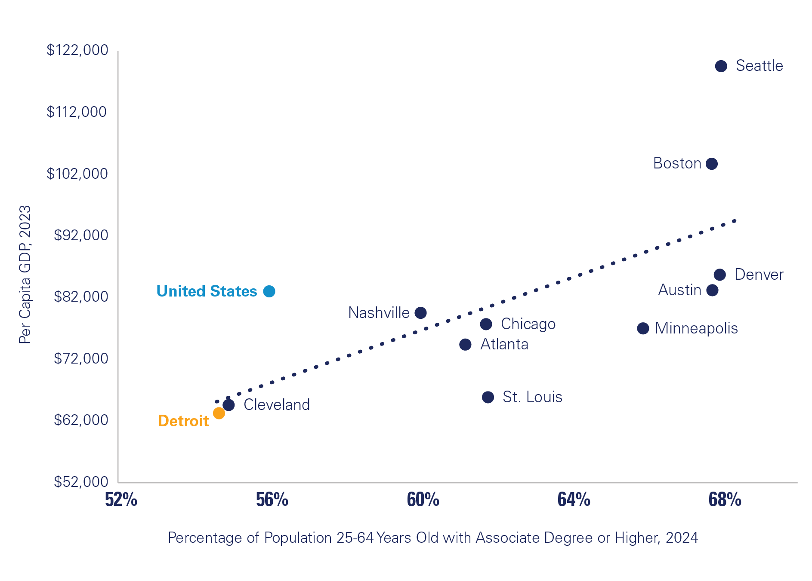
Higher Educational Attainment Means Higher Economic Growth
PER CAPITA
GDP AND EDUCATIONAL ATTAINMENT BY PEER REGIONS
Source: U.S. Bureau of Economic Analysis, U.S. Census Bureau American Community Survey One-Year Estimates

Slide 9
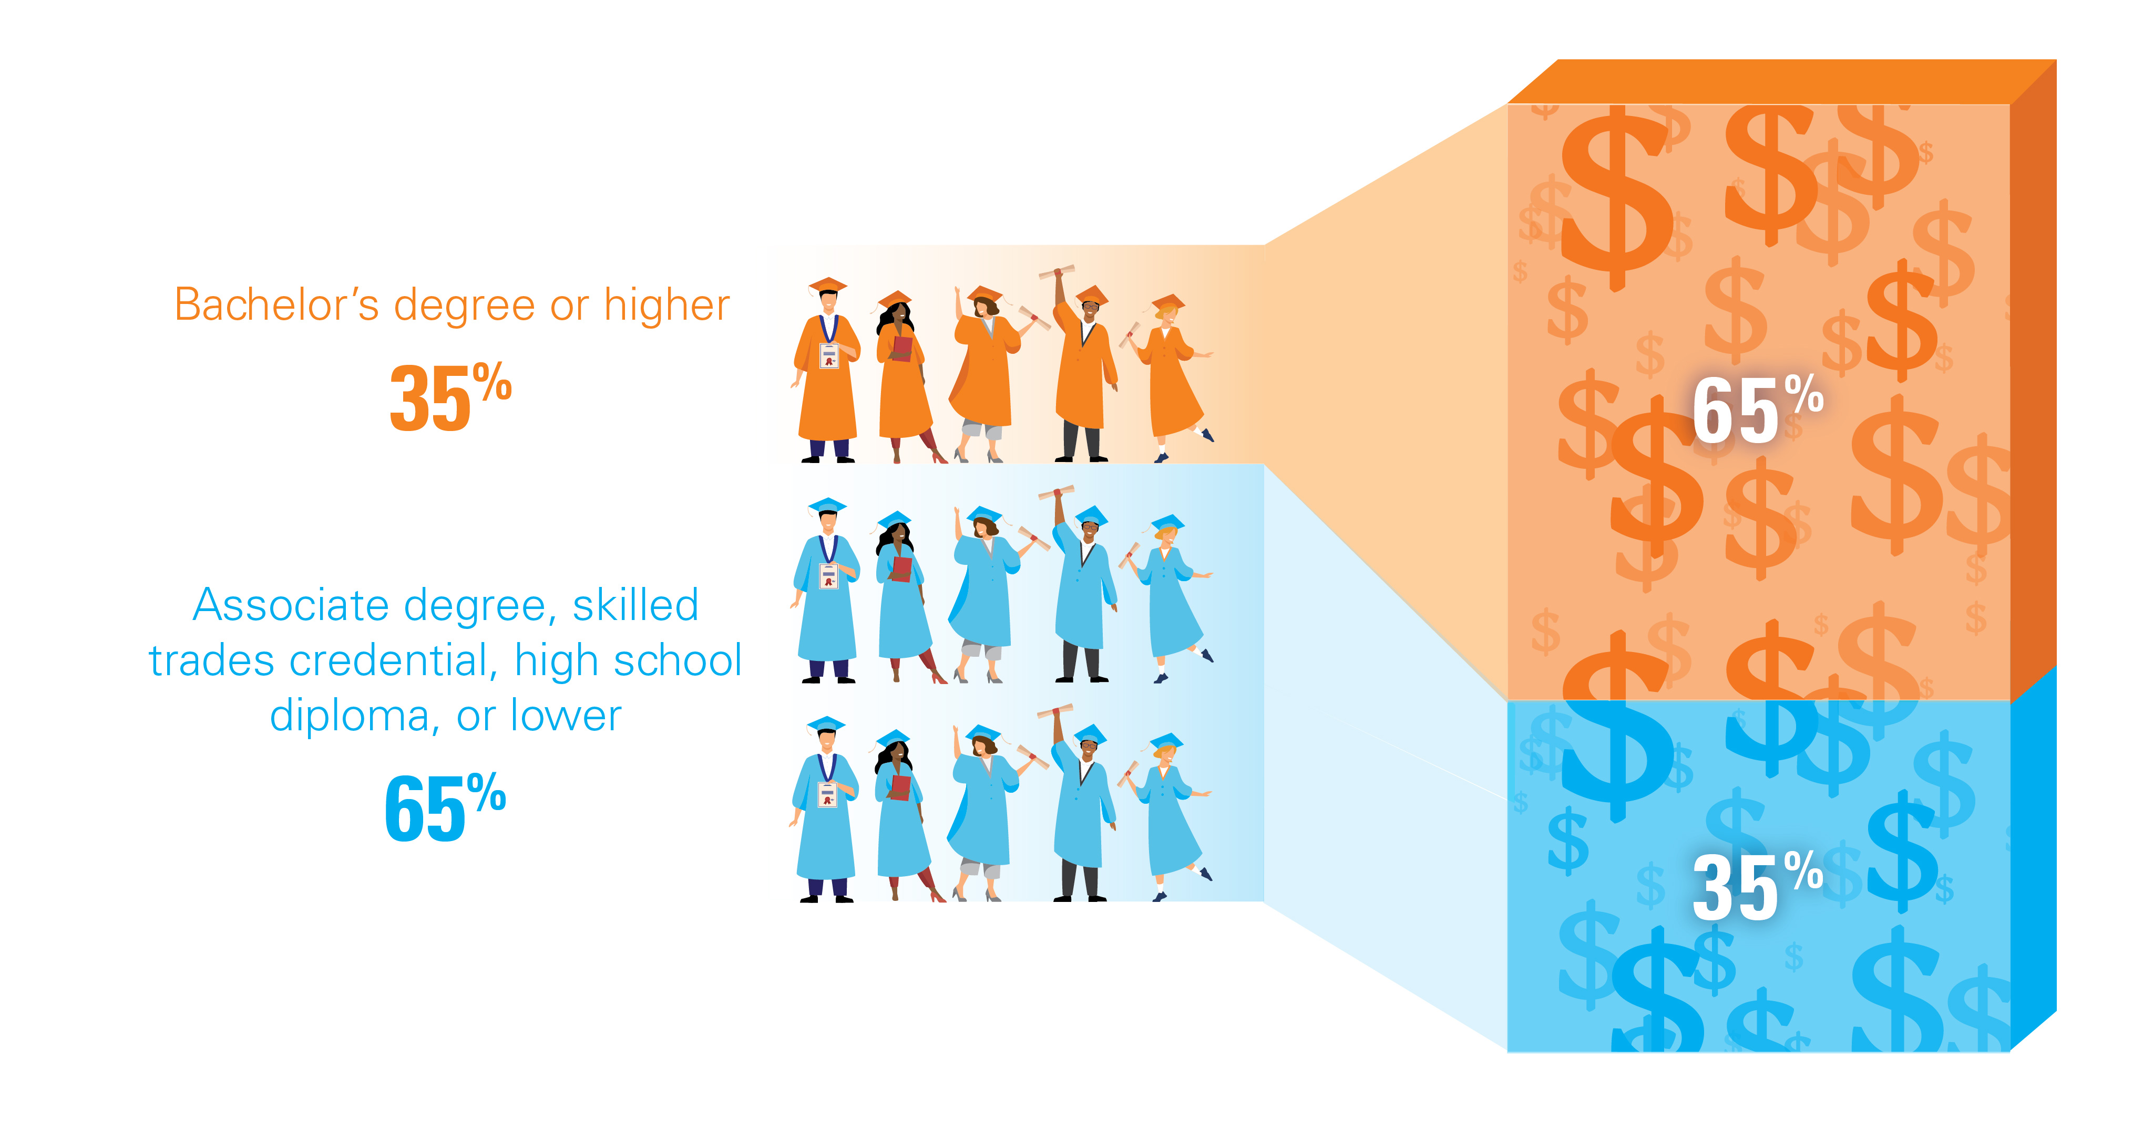
Most Top-Paying Michigan Jobs Go to Those With Four-Year Degrees
% OF JOBS THAT PAY
$65,000 OR MORE
% OF WORKING-AGE
POPULATION BY DEGREE LEVELS
Source: Don Grimes, Bureau of Labor Statistics, U.S. Census Bureau
Note: Percentages do not add to 100% due to rounding.

Slide 10
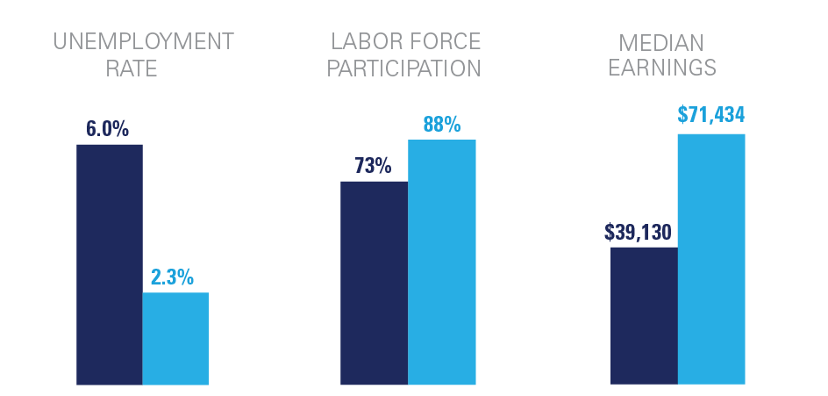


Those With Bachelor's Degree Have Greater Success in the Job Market
EMPLOYMENT STATUS BY EDUCATION LEVEL
Detroit MSA, Population 25 to 64 Years Old, 2024
Source: U.S. Census Bureau American Community Survey 2024 One-Year Estimates

Slide 11
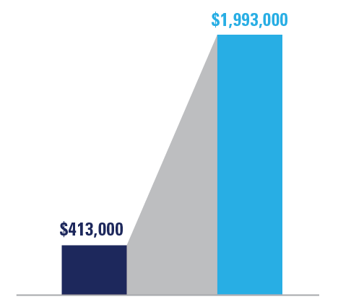
A College Degree Pays Off
NET WORTH
5x
the difference in net
worth between high
school and college
graduates
NET WORTH
High School
Degree
Bachelor’s Degree
or Higher
Source: Michigan Future, Inc. analysis of Survey of Consumer Finances
Note: Net worth is calculated by subtracting debt from total assets.

Slide 12
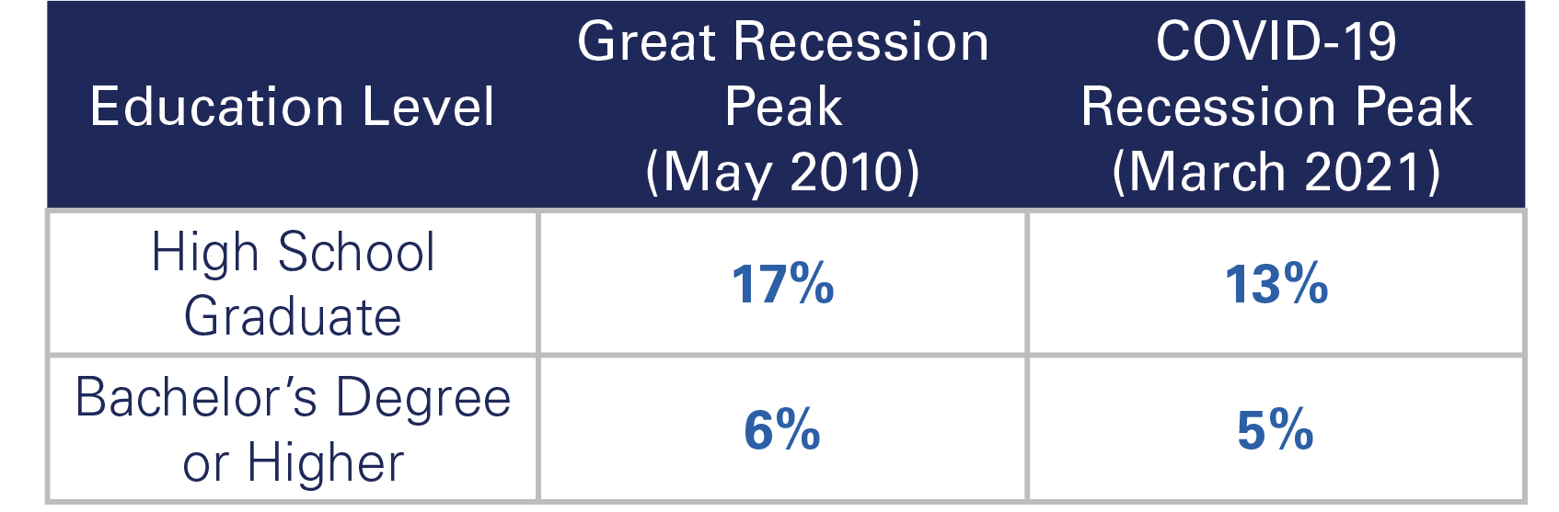
Bachelor’s Degree Holders Fare Better During Tough Economic Times
MONTHLY UNEMPLOYMENT RATE
Michigan
Source: U.S. Census Bureau American Community Survey 2024 One-Year Estimates, Michigan Center for Data and analysis

Slide 13
Progress Toward 60% by 2030 Continues
60% GOAL
2030
The Chamber established the 60% by 2030 post-high school educational attainment goal, which was later adopted by the State of Michigan.
9.6 percentage point increase in attainment since 2015.
54.7%
2024
45.1%
2015
Source: Lumina Foundation; U.S. Census Bureau
Note: Attainment for adults 25-64 years old. Short-term credentials are for the state of Michigan, as regional data is not available.

Slide 14
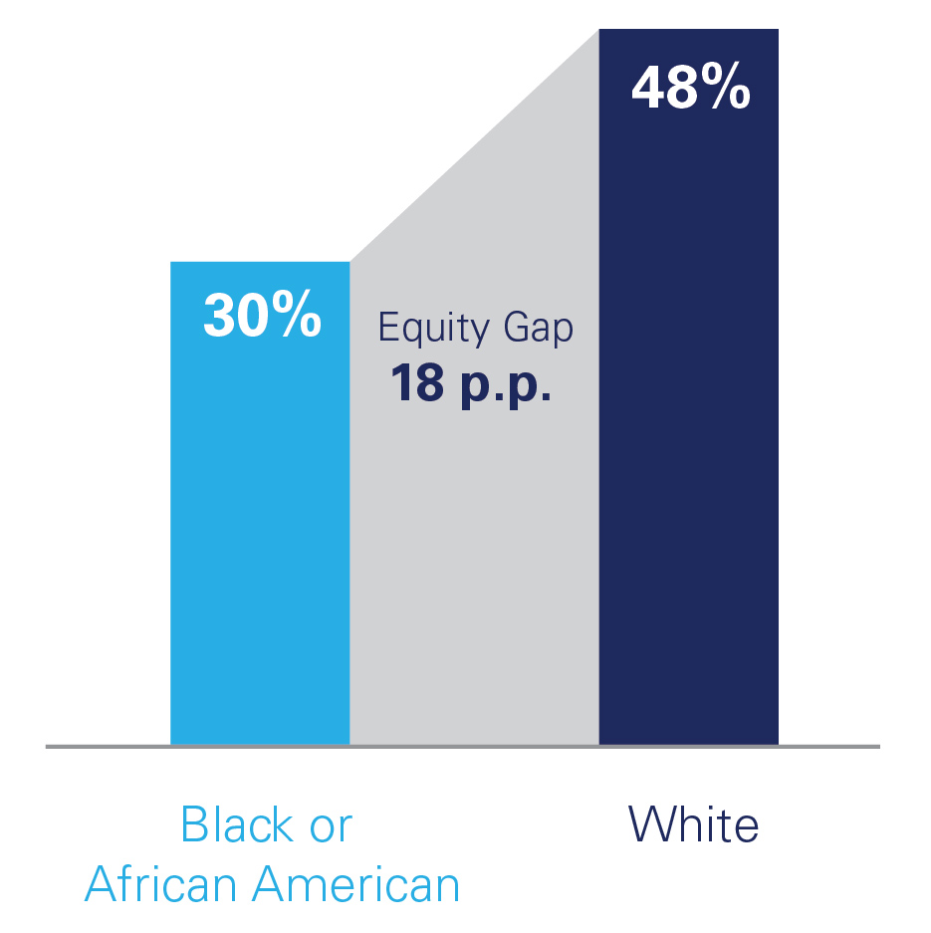
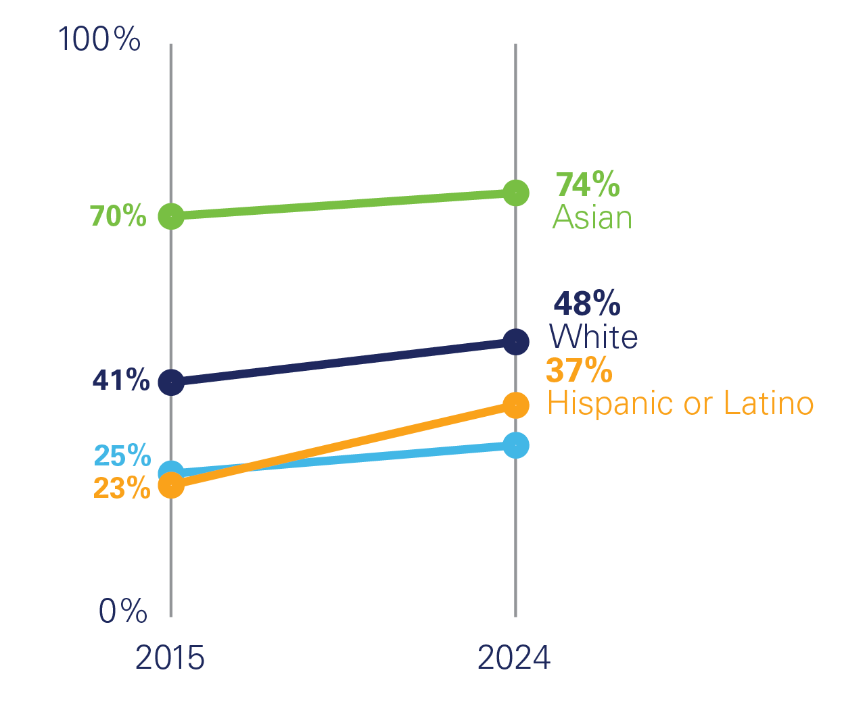
Closing Equity Gaps in Attainment
REGIONAL ATTAINMENT BY RACE
Associates degree or higher (excluding short-term credentials),
25 and older
Source: U.S. Census Bureau American Community Survey 2024 One-Year Estimates

Slide 15
Increasing Adult Attainment Is Essential
473,800
Working-age adults in the Region who accrued some college credits but stopped out before earning a credential or degree as of 2024.
Down 12%
Since 2019, adult degree completions at regional institutions are down 12%.
282,000
Individuals are needed with a skilled credential to meet the 60% by 2030 goal in the Detroit Region.
Source: U.S. Census Bureau American Community Survey 2024 One-Year Estimates, Integrated Postsecondary Education Data System

Slide 16
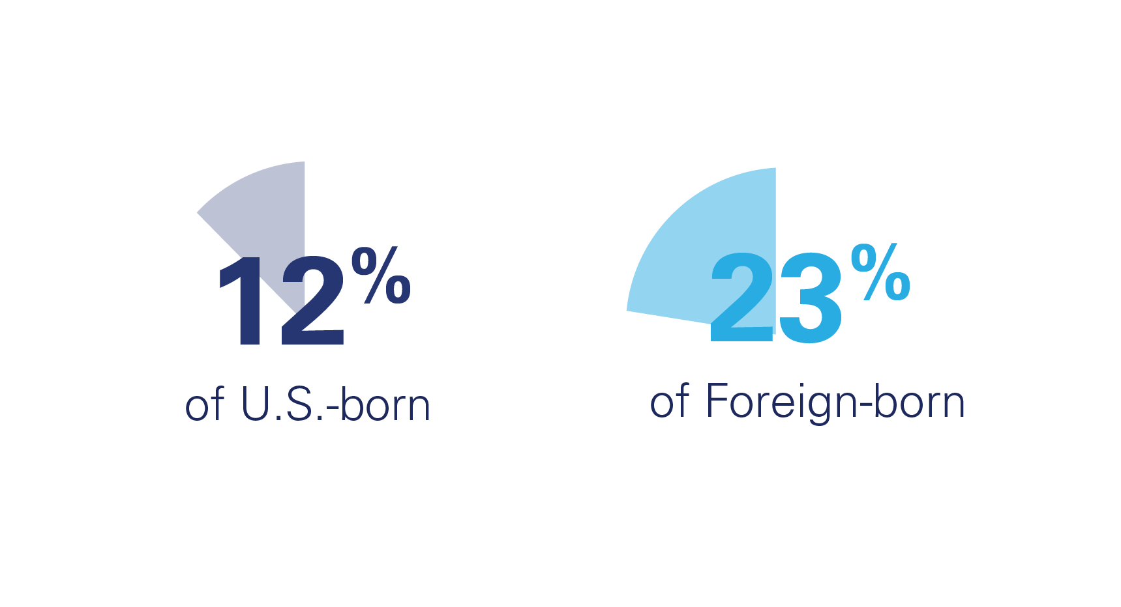
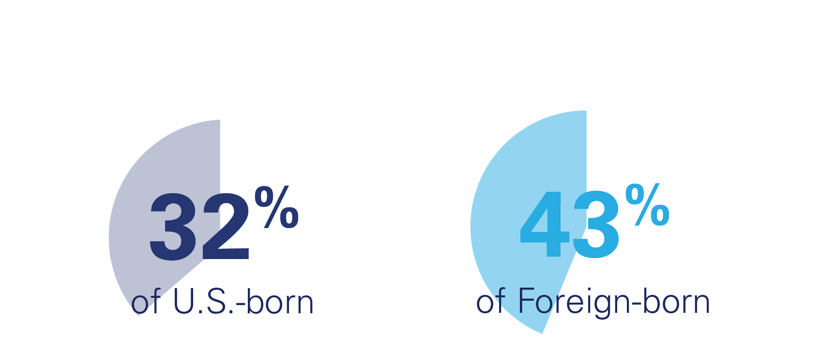
Role Immigrants Can Play in Reaching the Goal in Michigan
ADVANCED DEGREE
2023
BACHELOR’S DEGREE OR HIGHER
2023
Source: American Immigrant Council Map the Impact: Michigan 2024

Slide 17
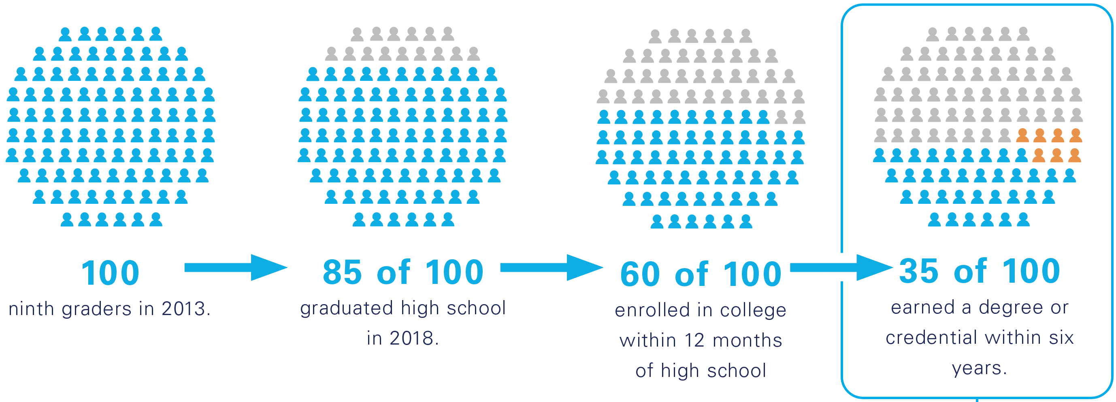
Nearly Two-Thirds of Students Do Not Earn a College Degree
ninth graders in 2014
graduated high school in 2018
enrolled in college within 12 months of high school
earned a degree or credential within six years.
Source: Michigan Education Data Center

Slide 18
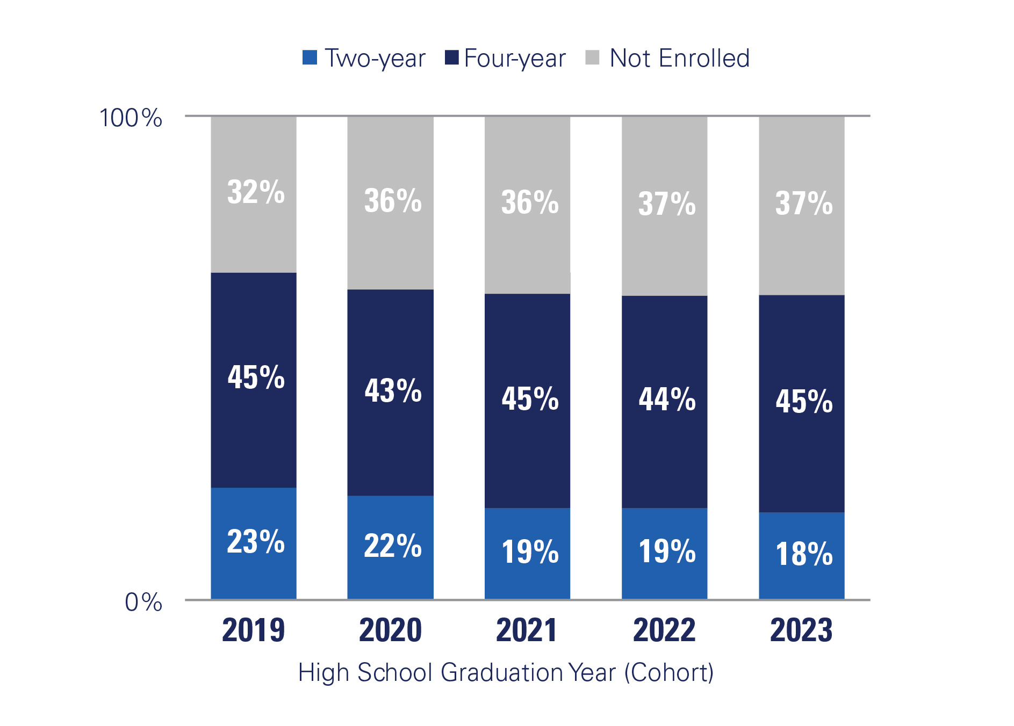
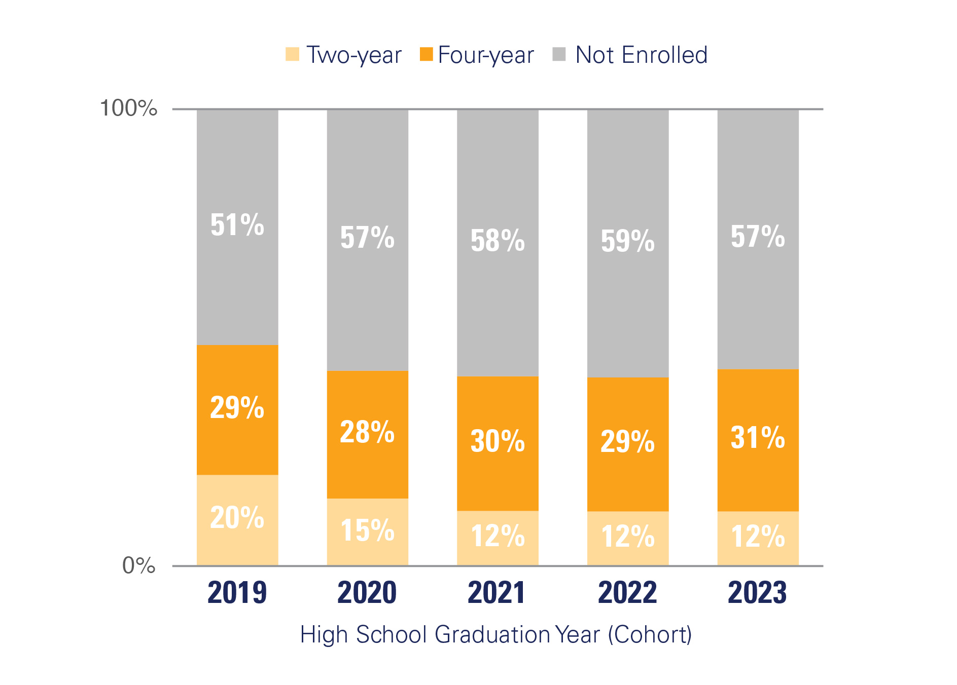
Fewer High School Graduates Are Enrolling
in College
POST-HIGH SCHOOL ENROLLMENT
Percentage of Students Enrolled Within 12 Months of High School Graduation
DETROIT REGION
CITY OF DETROIT
Source: Source: Michigan
Education Data Center

Slide 19
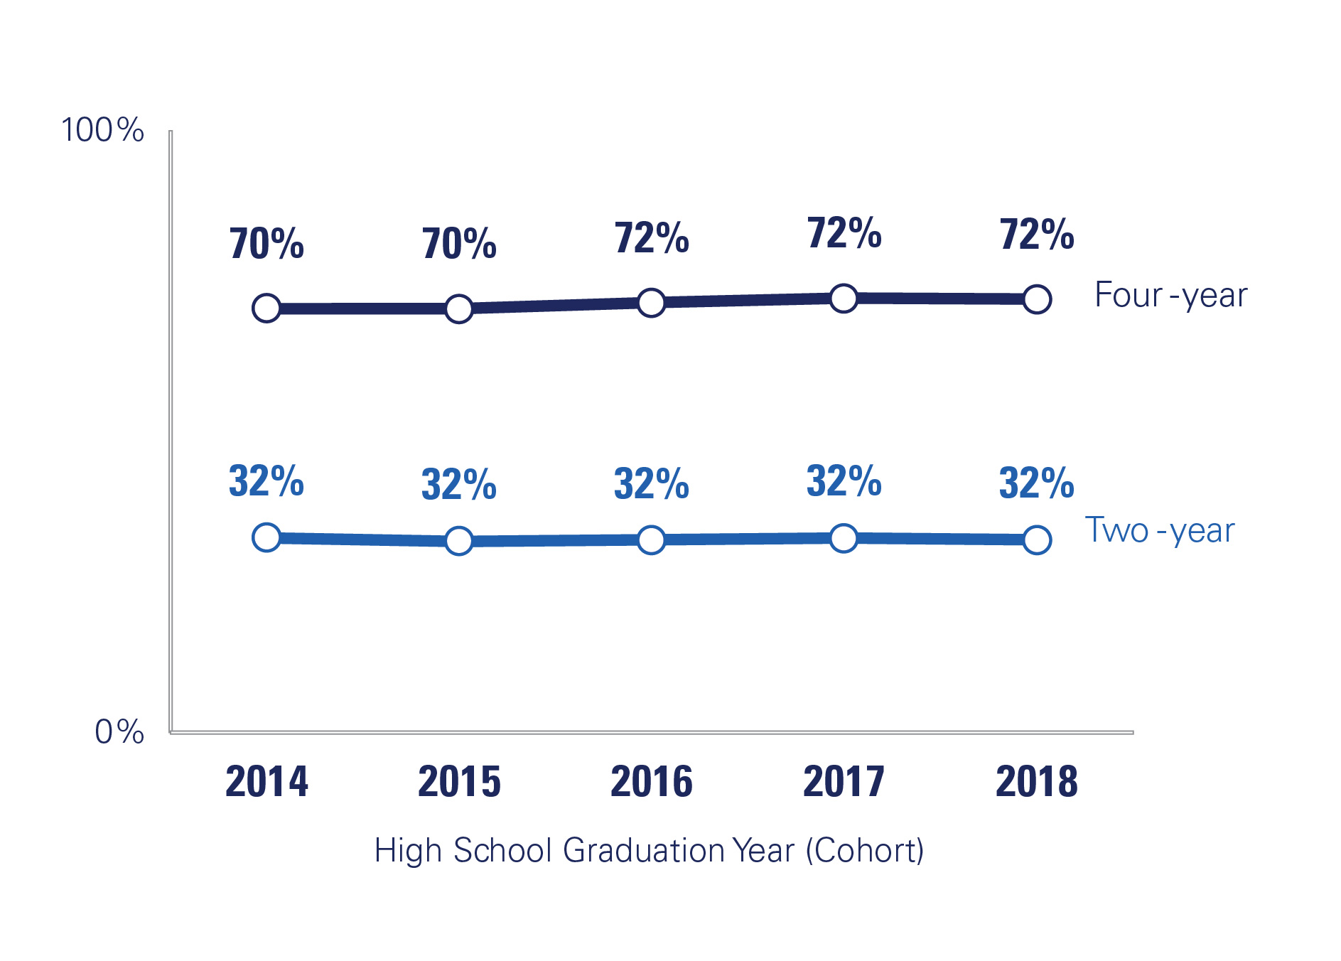
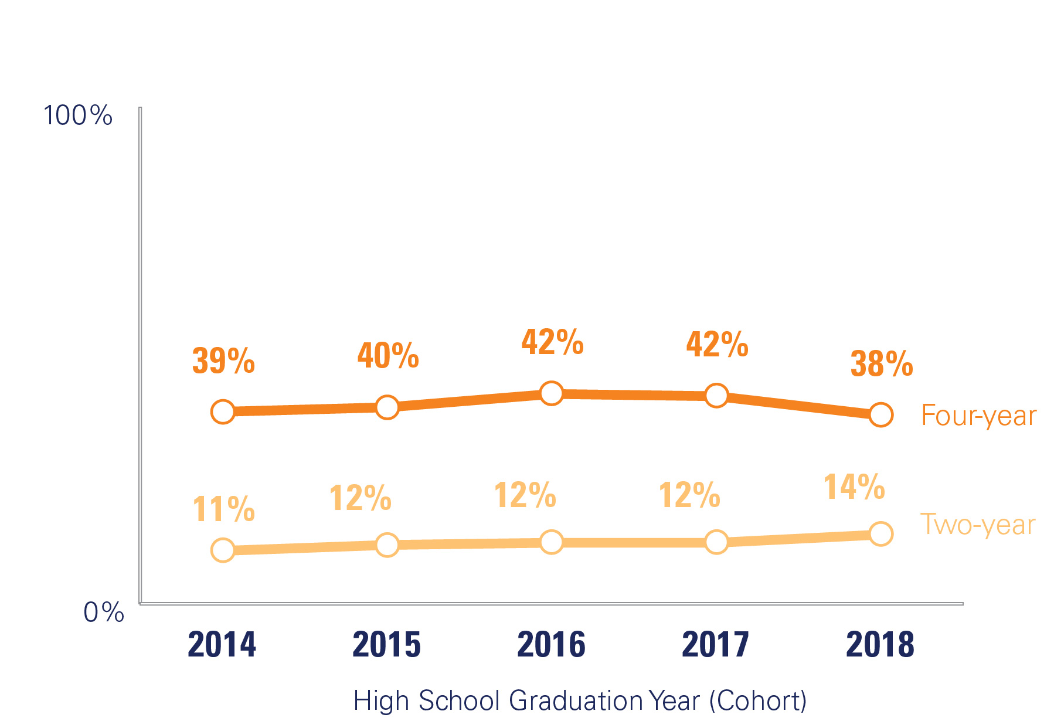
Mixed Outcomes in Graduation Rates at
Two- and Four-Year Schools
POST-HIGH SCHOOL GRADUATION RATES
Six Years From Initial Enrollment
DETROIT REGION
CITY OF DETROIT
Source: Michigan Education Data Center

Slide 20
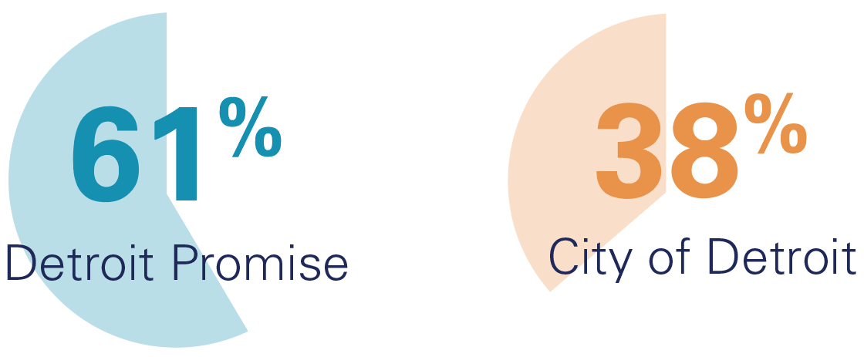
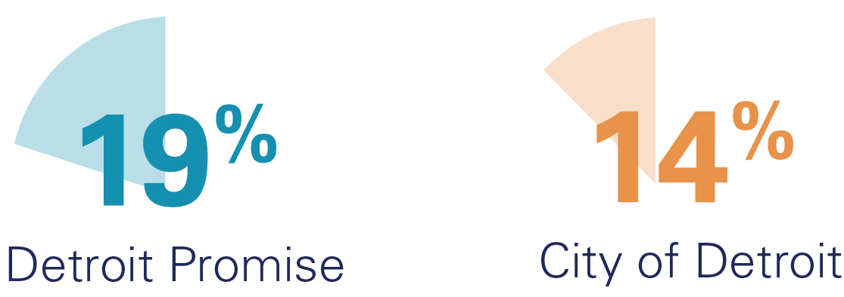
Students Graduating at Rates Exceeding Their City Peers
FOUR-YEAR ENROLLEES
TWO-YEAR ENROLLEES
The graduation rate for Black Detroit Promise students from four-year institutions is seven percentage points higher than the national graduation rate for Black students.
Source: Detroit Regional Chamber analysis of Detroit Promise data

Slide 21
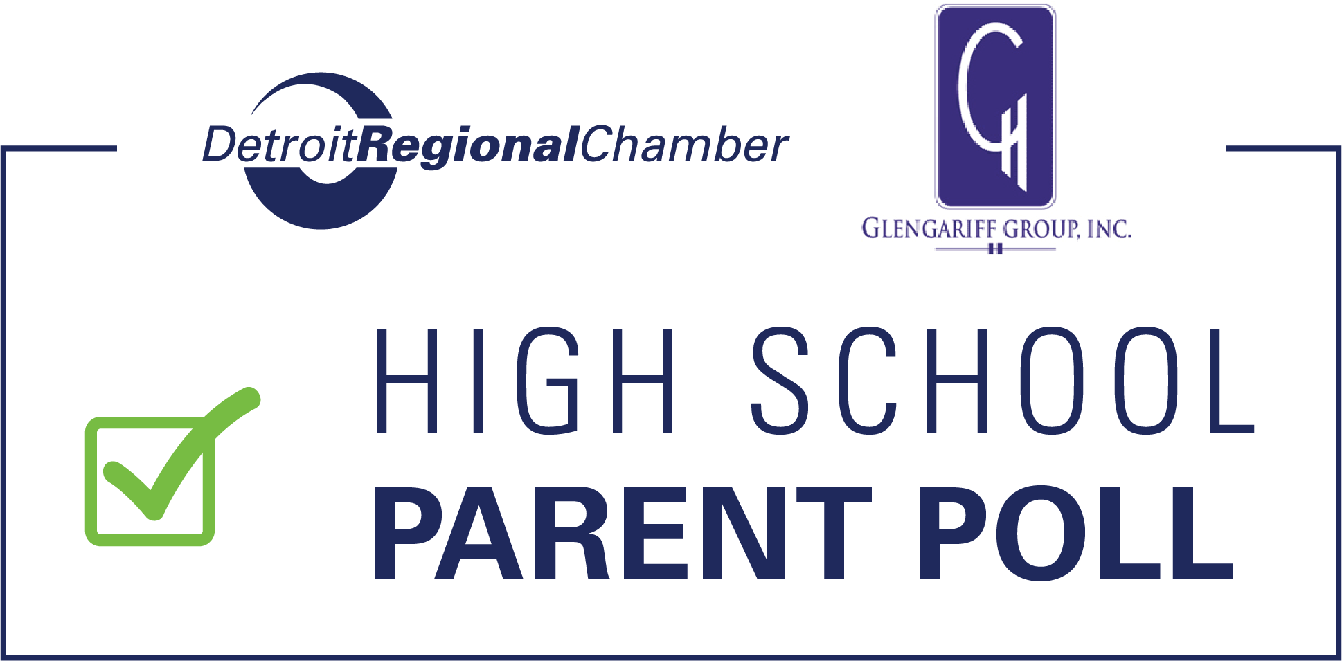
Cost Concerns Overshadow
Perceived Value of Degrees
71%
of parents of high school students say their children are interested in attending a four-year college.
Only 54%
of parents hope their children will actually enroll in a four-year college.
Expense of college
is the top concern for parents.
Source: Detroit Regional Chamber Michigan High School College Parents Survey, August 2025

Slide 22
New Scholarship Programs Making College More Affordable
51%
of Oakland University’s Fall 2025, first-time freshmen have tuition fully covered via scholarships and grants, including the Golden Guarantee.
50%
of new, full-time, in-state first-year undergraduate students have tuition fully covered through Scholarships and Grants, such as the Go Blue Guarantee and other aid programs.
60%
of incoming first-year undergraduate students at Wayne State University have attended the university tuition-free via the Wayne State Guarantee and other programs.

Slide 23



Expanded Dual Enrollment Options Are Delivering Results
Partners’ dual enrollment has grown significantly over the past four years.
87%
89%
118%

Slide 24
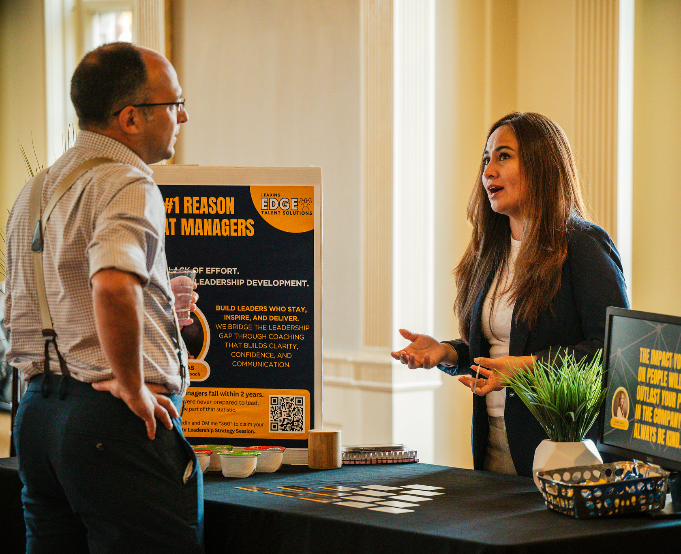
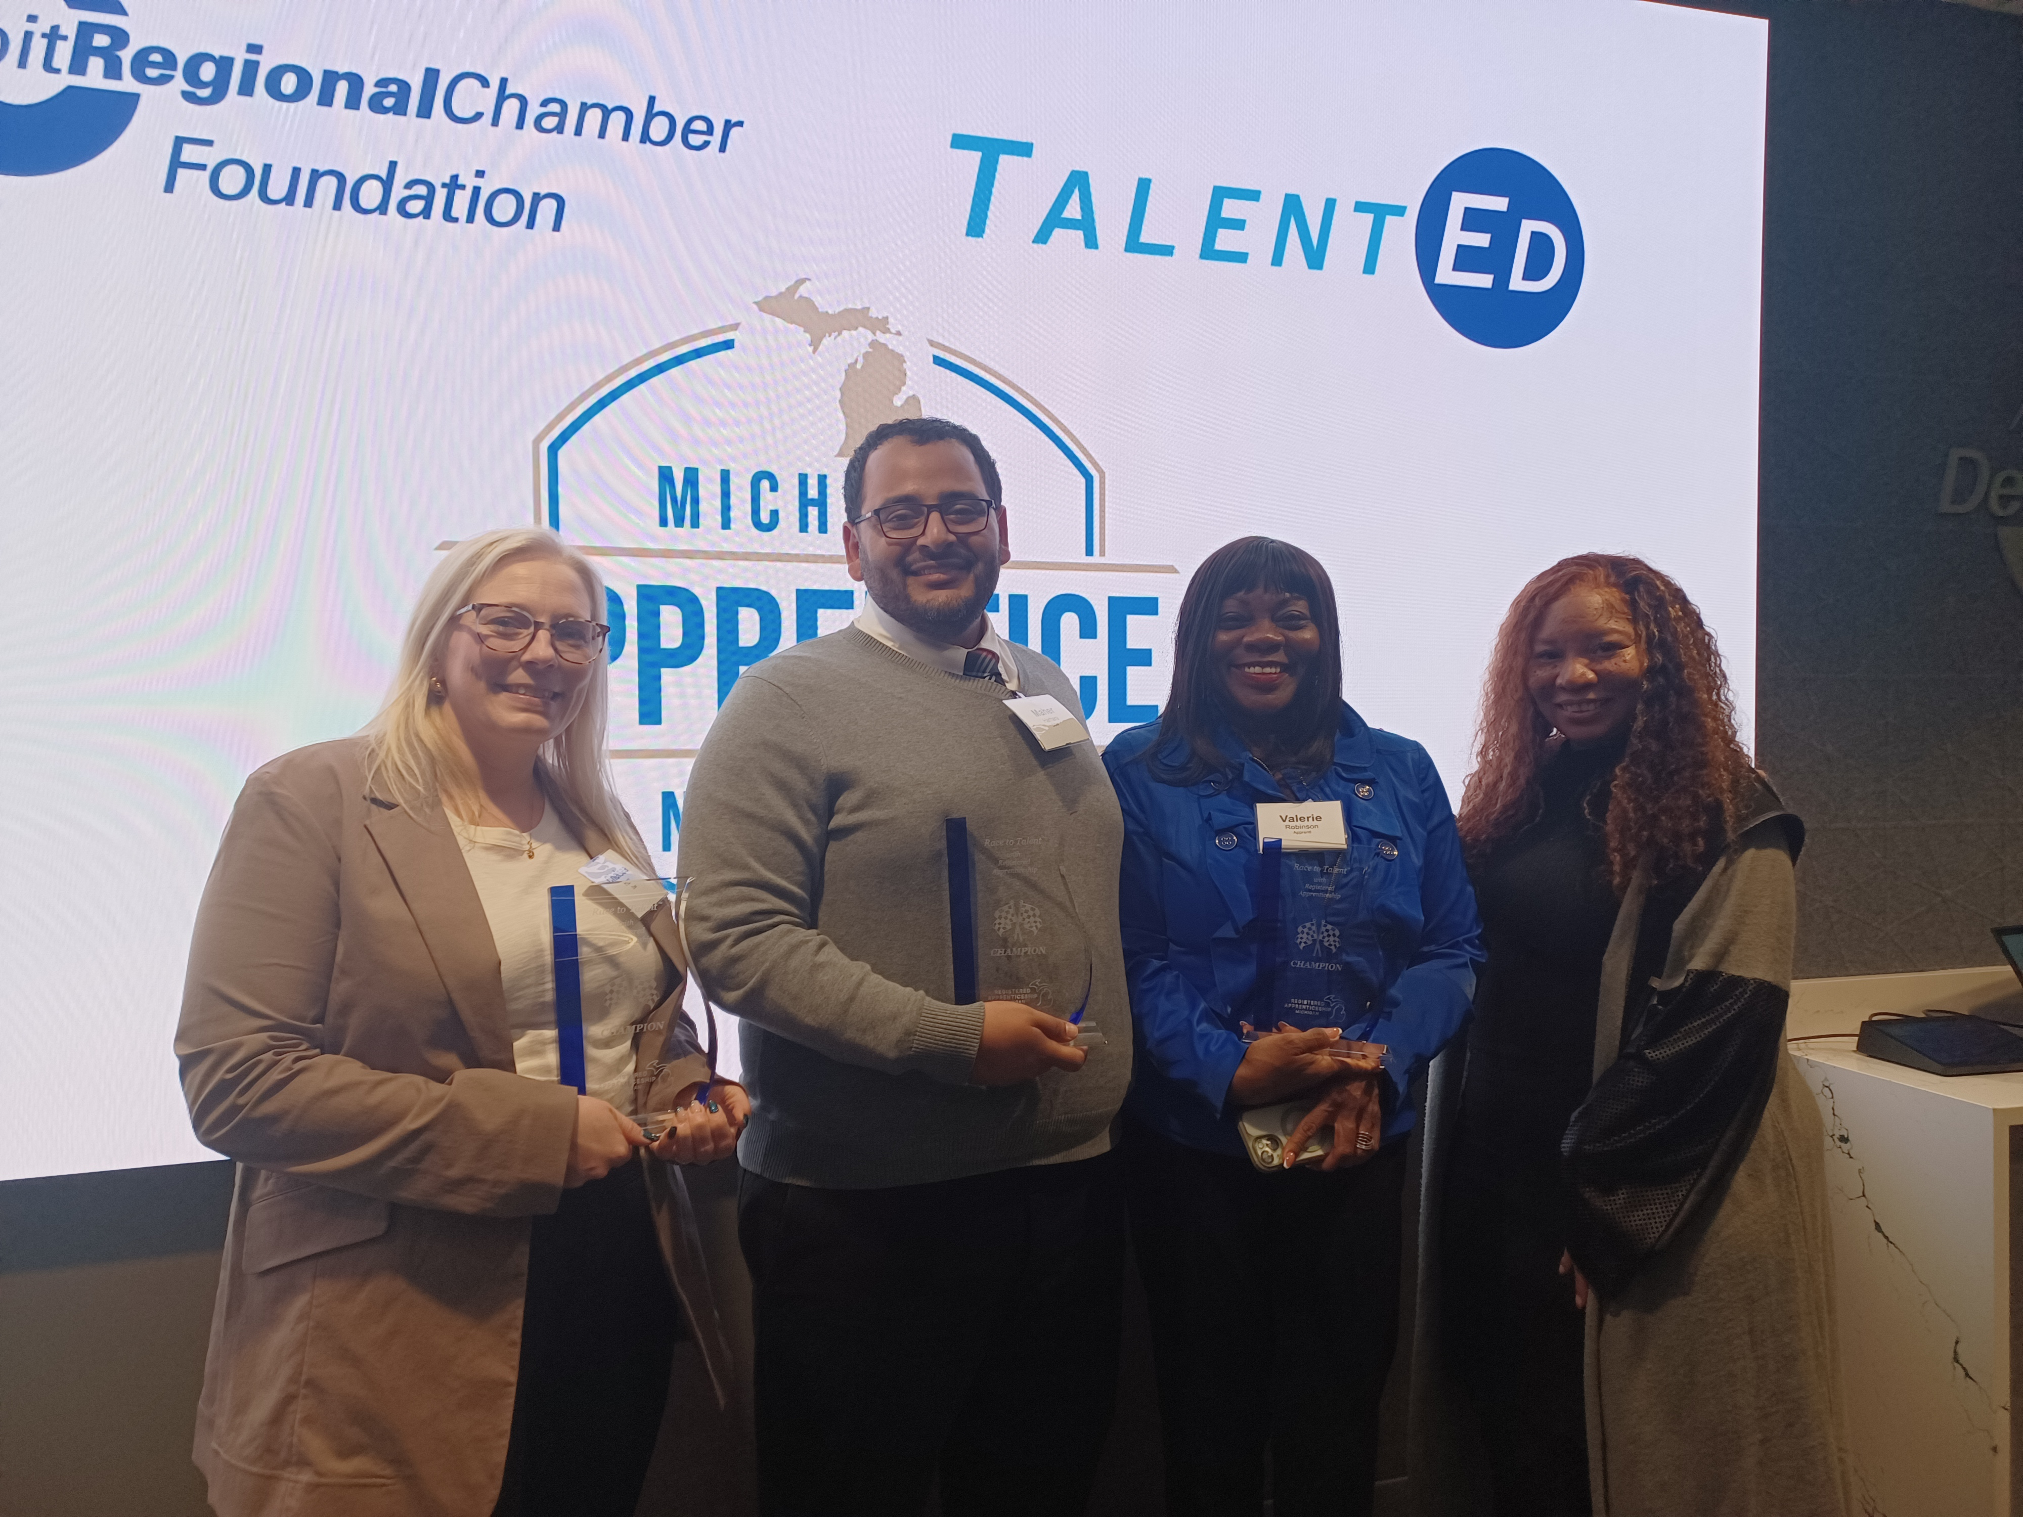
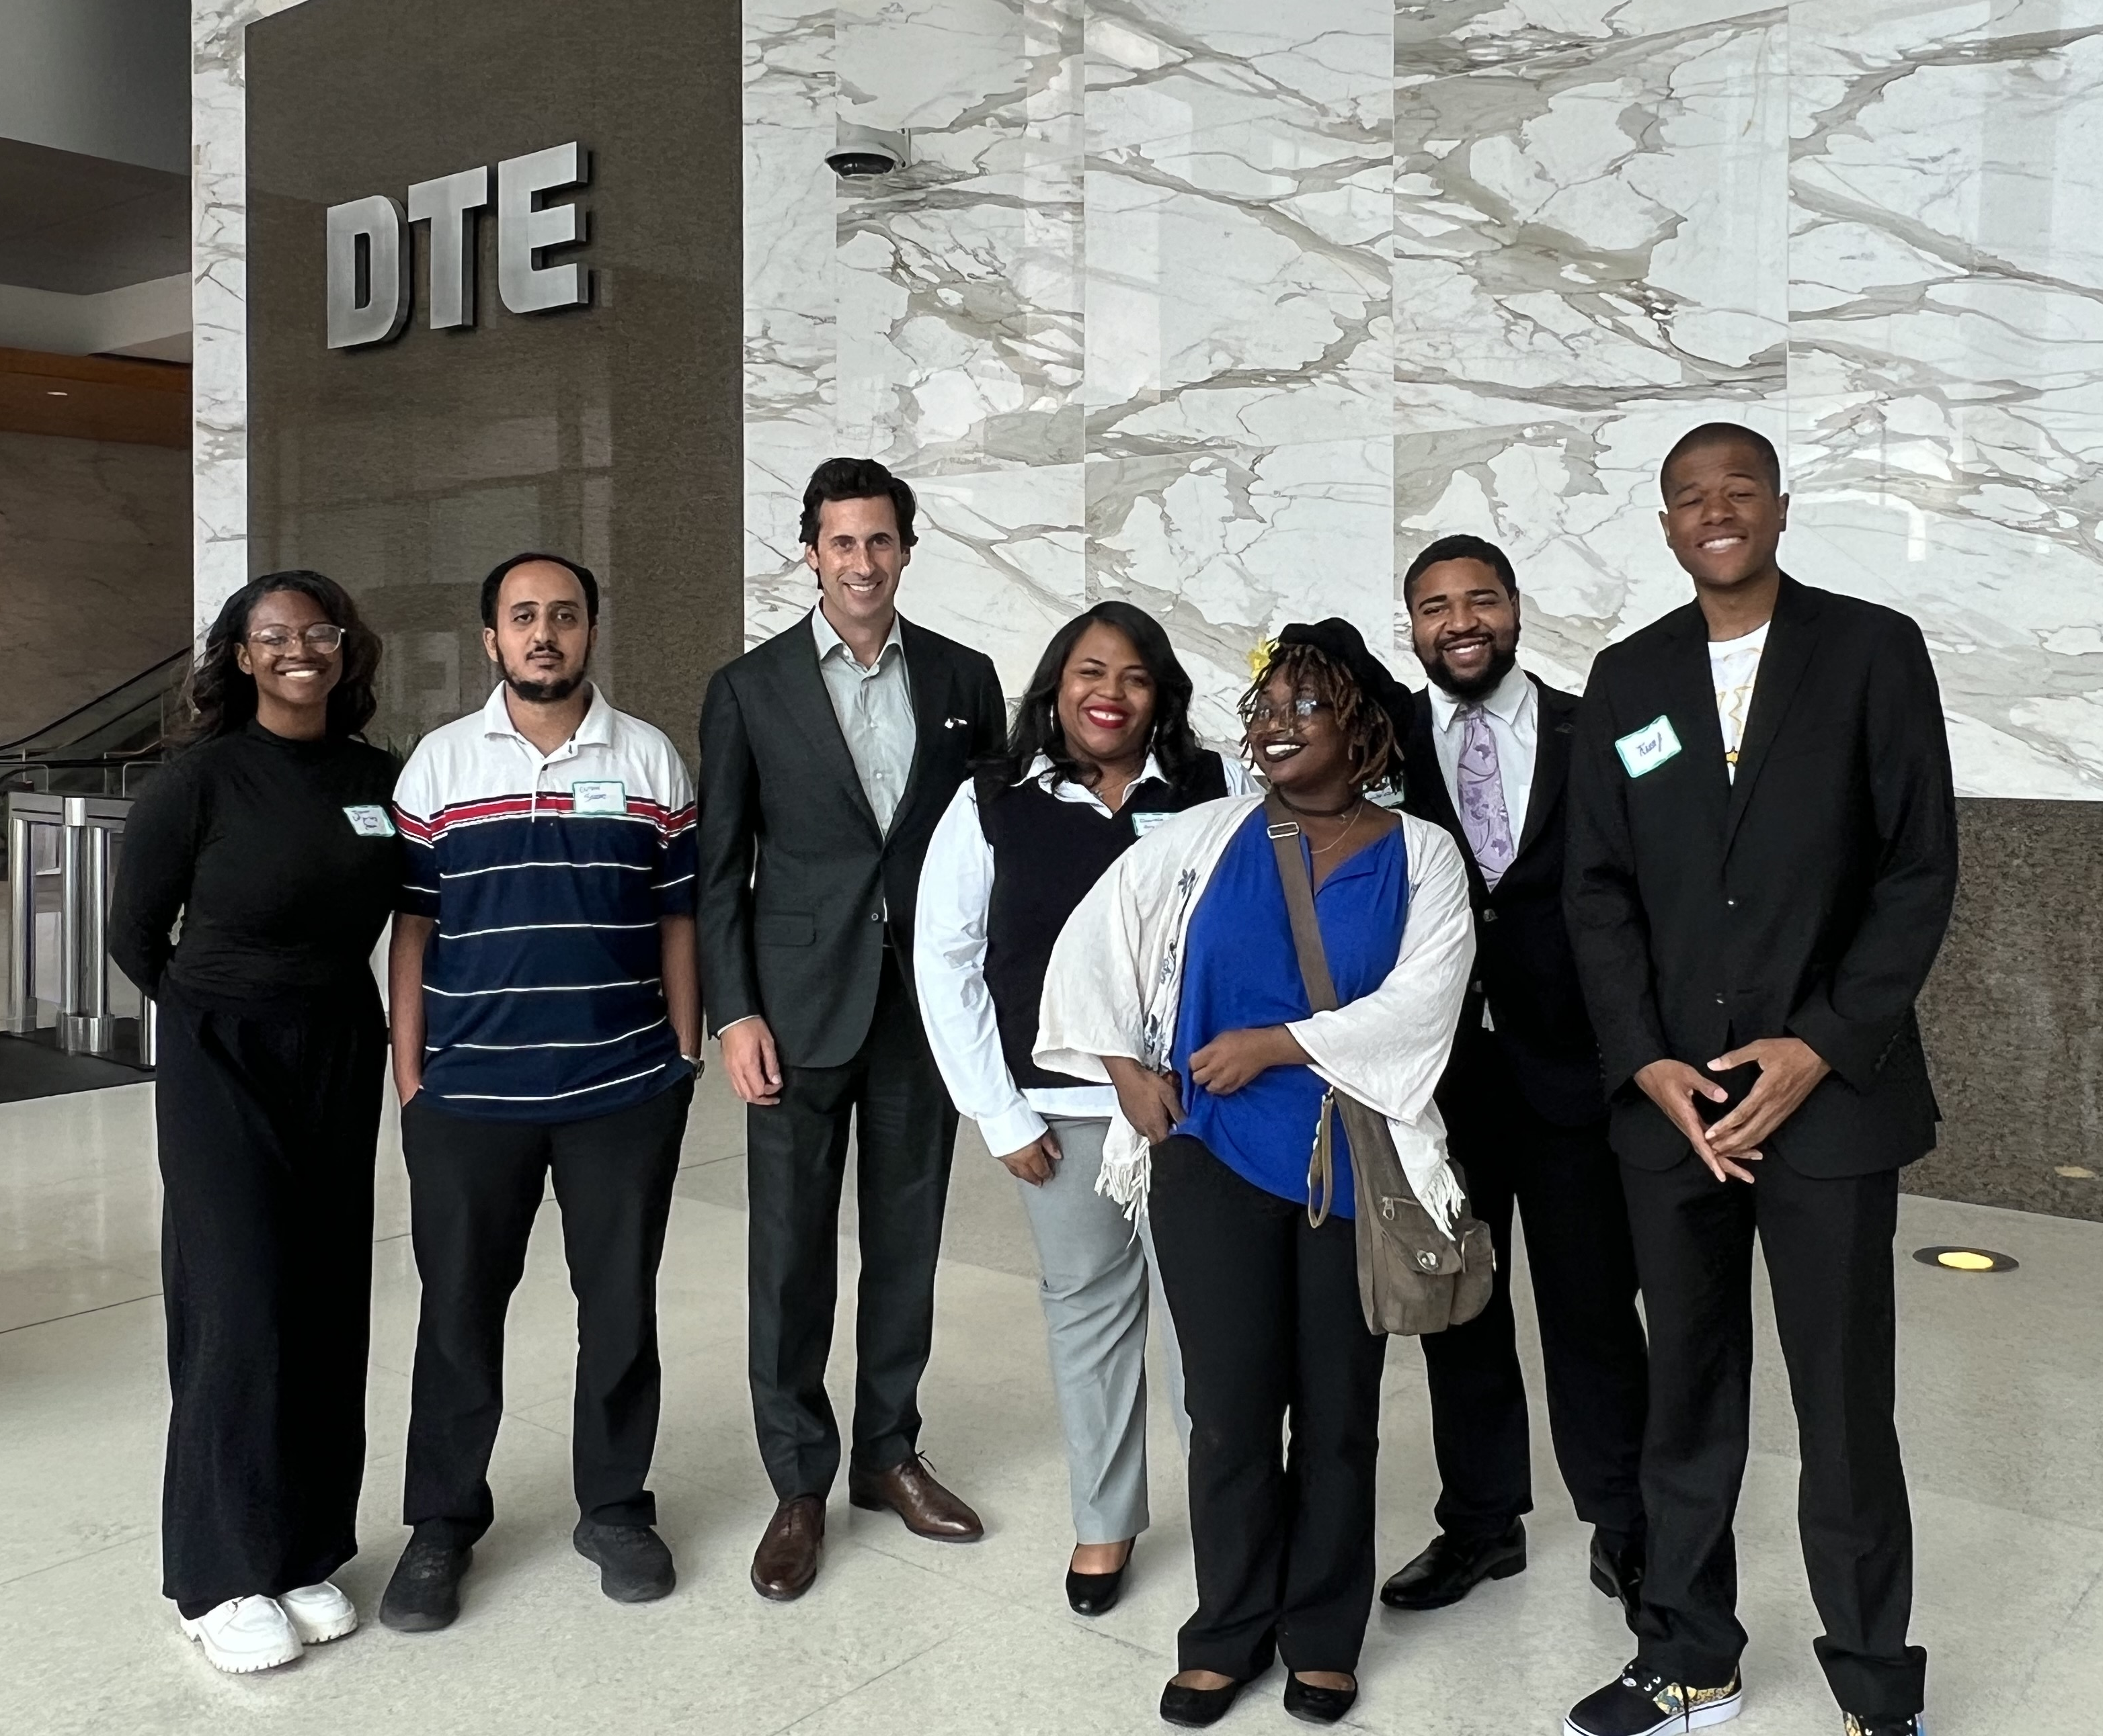
Expanding Employer Engagement Opportunities

Slide 25
Michigan’s Much-Needed Culture Shift
The expectation that every Michigander would complete at least two years of post-high school education or training.
“K-12 + 2”

Slide 26
The Report’s Main Findings
1
Degree attainment is the pathway to regional and individual economic prosperity.
2
The Detroit Region is making incremental progress toward the 60% by 2030 goal.
3
Policy changes are putting the Region on the path to achieving educational attainment goals.
4
Too few Michiganders are aware of recently launched programs and policies that lower the cost of college and increase educational attainment.
5
A “K-12 + 2” culture shift is needed.

Slide 27

Richard Czuba
Michigan’s Top Pollster
Founder,
The Glengariff Group
Notes:
Add a headshot – and cut the three dots. Also – TalentEd logo should not appear in this presentation until after Sandy ”unveils” it in animated slide …. Also – all the circles are falling off the slides, maybe a compression issue?

Slide 28

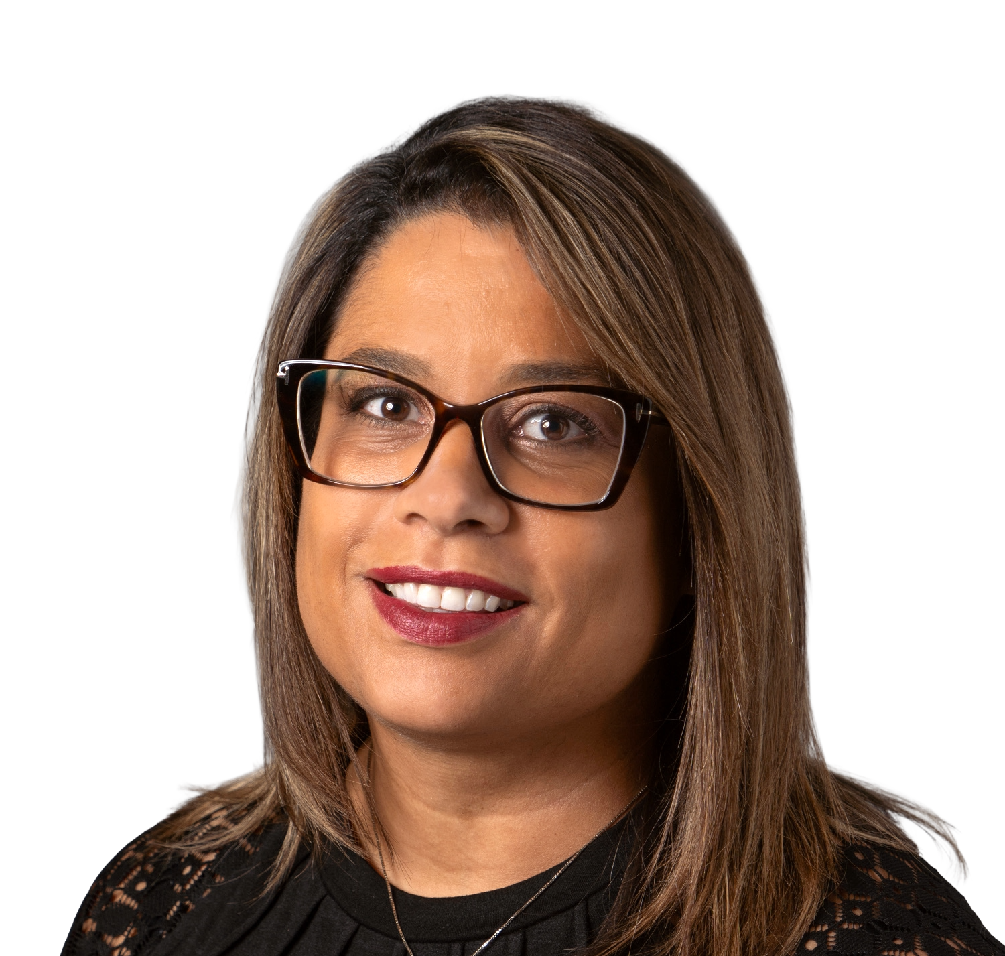
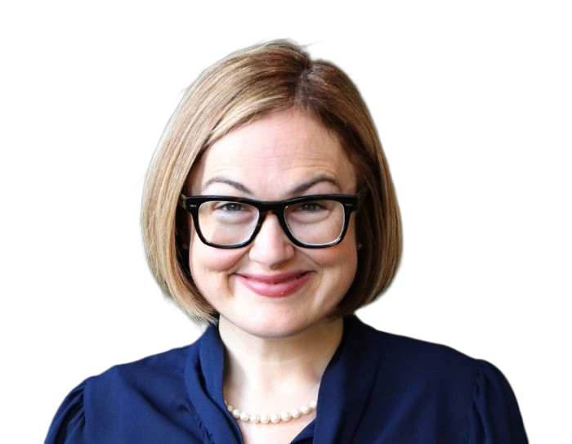
The Conversation Continues
Ora Hirsch Pescovitz
President,
Oakland University
Peter Provenzano
Chancellor,
Oakland Community College
Zoe Clark
Political Director,
Michigan Public
Moderator
Catherine Susko
Vice President, HR Planning, Development, and Belonging,
Henry Ford Health

Slide 29
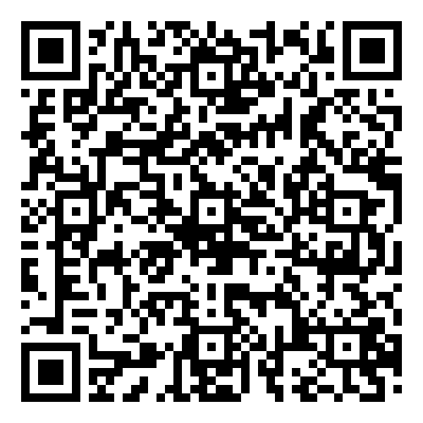
View
the report:

