Slide 1
Mobility and Innovation

Slide 2
Welcome
Orientation Day 1
Dorian Grey
Senior Director, Leadership, Entrepreneurship, and Innovation Detroit Regional Chamber

Slide 3
Overview of Automotive Mobility Industry in Michigan
Glenn Stevens, Jr., Executive Director, MichAuto Chief Automotive and Innovation Officer, Detroit Regional Chamber, LD 31

Slide 4
Networking Break

Slide 5
Sandy Baruah
President and Chief Executive Officer
Detroit Regional Chamber

Slide 6

















Ann Arbor-Detroit Innovation Corridor

Slide 7



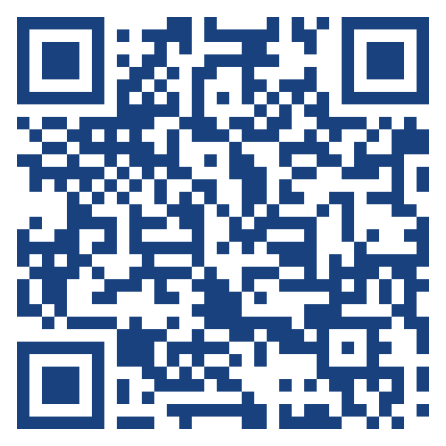
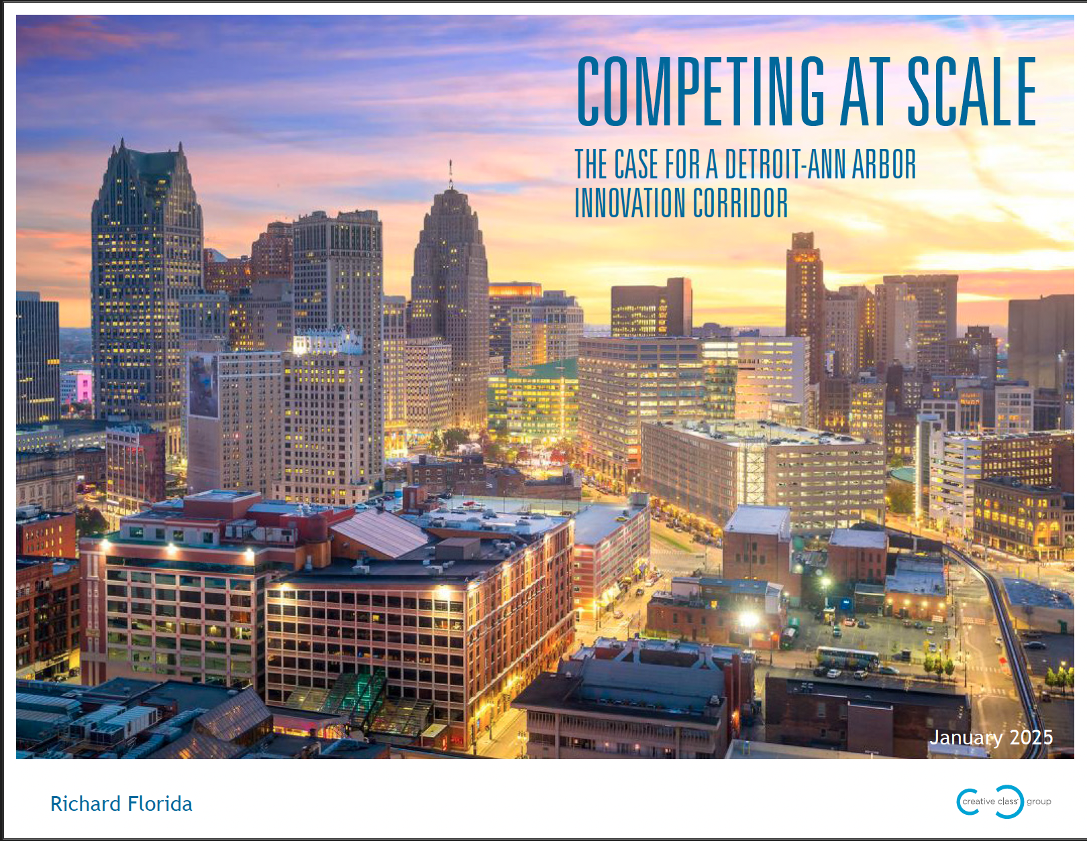
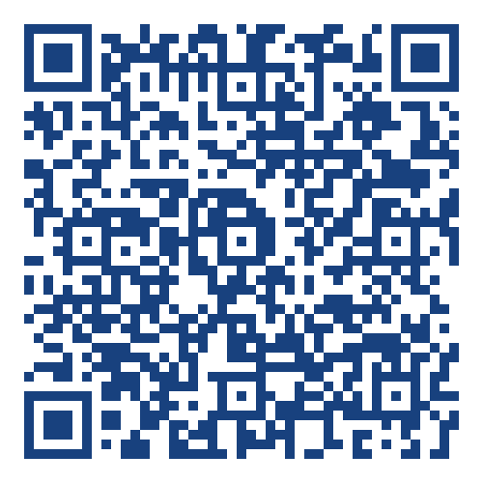
Learn more about the Ann Arbor-Detroit Innovation Corridor:
View the Competing at Scale report:

Slide 8
Ann Arbor to Detroit Innovation Corridor
Lisa Prada, Vice President and Chief Innovation Officer, Henry Ford Health
Scott Shireman, Director, University of Michigan Center for Innovation
Moderator: Ned Staebler, President and Chief Executive Officer, TechTown Detroit

Slide 9
Networking Break and Activities

Slide 10
Lunch
Orientation Day 1
Hightower Catering

Slide 11
Downtown Detroit Parnership Overview

Slide 12
Networking Break

Slide 13
Conversation with Mark de la Vergne
Mark de la Vergne, Director, Economic Innovation and Policy
Michigan Central

Slide 14
Powering Detroit's Mobility and Energy Startups: From Innovation to Implementation
Ron Butler, Chief Executive Officer, Energy Safety Storage Products International (ESSPI)
Brittney McGee, Chief Executive Officer, OptimizeEV
Kristin Shaw, Program Manager, Smart Cities, NextEnergy
Moderator: Drew Coleman, Senior Director, MichAuto, Detroit Regional Chamber

Slide 15
Networking Break

Slide 16
LD 46 Led Topic Class Discussion
Janelle Arbuckle-Michael, Associate Director, Talent Development, PK-12 Initiatives, Michigan Central
Paul Johnson III, Community Relations Ombudsperson, SMART

Slide 17
Conversation with Industry Innovation Professionals
Johnnie Turnage, Founder, Black Tech Saturdays
Michael Healander, President and Chief Executive Officer Airspace Link, Inc.

Slide 18
Group Discussion
Discuss key takeaways from today's session.

Slide 19
Wrap-Up
Complete the session survey below:

Slide 20
Details for Next Session: Race and Diversity - Day 1
Date: Wednesday, Feb. 11
Location: Durfee Innovation Society
Time: 8:30 a.m. to 5 p.m.

Slide 21
Details for Next Session: Race and Diversity - Day 2
Date: Thursday, Feb. 12
Location: Charles H. Wright Museum of African American History
Time: 8:30 a.m. to 5 p.m.

Slide 22
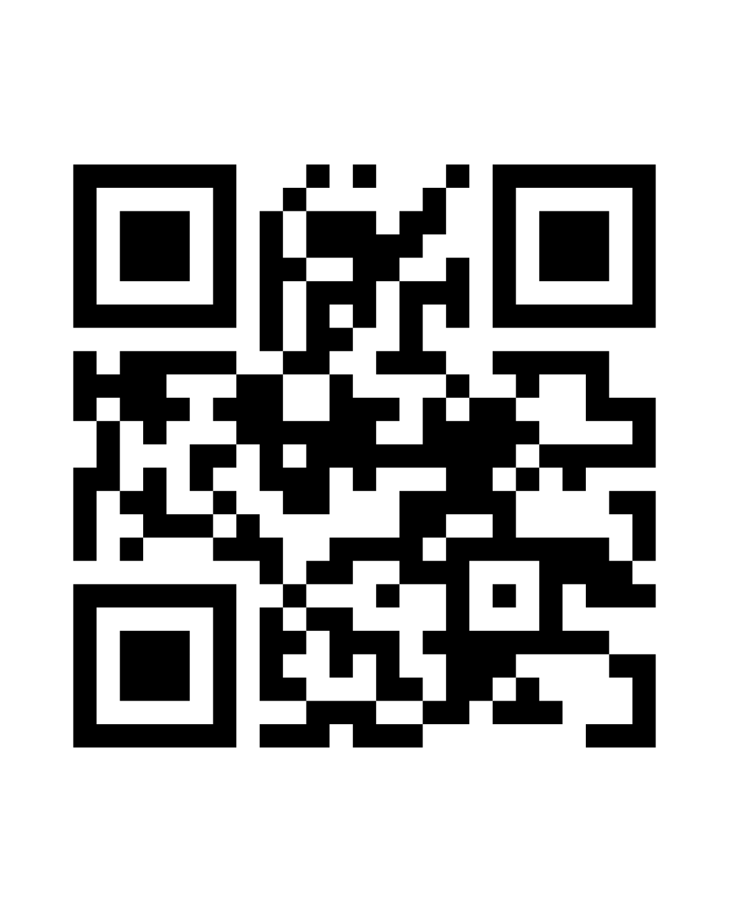
Accept Your Complimentary Registration 2026 Detroit Auto Show
January 14, 2026 |Huntington Place
Visit the Show Floor​
10 a.m. to 3 p.m. ​
Private Programming – Sam Klemet​​
2 – 2:30 p.m.​​
Private Reception – MichAuto
3:30– 5:30 p.m.​​
Scan the QR code or email Pilar Doakes at pdoakes@detroitchamber.com to register.

Slide 23
Accept Your Complimentary Registration 2026 Detroit Policy Conference
January 29, 2026
8 a.m. to 5 p.m. The Department at Hudson's Detroit
Scan the QR code or email Pilar Doakes at pdoakes@detroitchamber.com to register.

Slide 24

Wrap-Up
Missing a session? Fill out the absence form:
Orientation Day 1

Slide 25
Mobility and Innovation

