Slide 1
Race and Diversity

Slide 2
Welcome
Orientation
Day 1
Dorian Grey
Senior Director, Leadership, Entrepreneurship, and Innovation
Detroit Regional Chamber

Slide 3
The Ground We Stand On: Race, Diversity, and Detroit's Lived History
Rima Meroueh, Director, National Network for Arab American Communities
Angela Reyes, MPH, Founder and Executive Director Emeritus, Detroit Hispanic Development Corporation
Ira A. Rutherford, III, Retired, Superintendent, Flint and Beecher Community Schools, and PACE Academy
Dr. Brandon Shamoun, Ed.D., Assistant Dean of Students, Wayne State University; Commissioner, Stonewall Sports Detroit
Moderator: Glenn Wilson, President & CEO, Communities First, Inc.

Slide 4
Break

Slide 5
Robyn Brown-Manning
Senior Associate Dean
Silberman School of Social Work, Hunter College

Slide 6
Mayra López-Humphreys
Associate Professor
Silberman School of Social Work, Hunter College

Slide 7
Leadership Detroit
Race and Equity

Slide 8
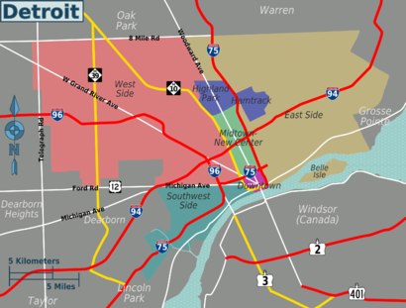
Session Assumptions
Detroit’s inequities are not accidental, historical artifacts, or the result of individual failure. They are the predictable outcomes of leadership decisions—many still being made today.
This Photo by Unknown Author is licensed under CC BY-SA

Slide 9

Session Assumptions
Participants hold or influence power
Discomfort is expected and necessary
Silence, neutrality, and delay are forms of harm
‘DEI’ without structural change is performative

Slide 10
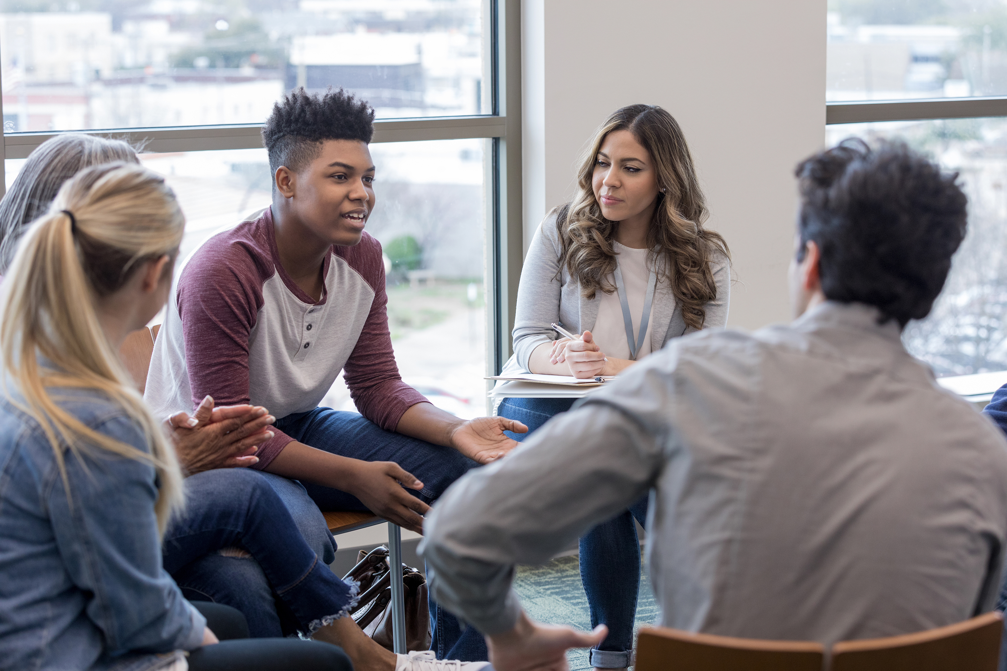
Framing Statements
This is not a safe space. It is a brave space with boundaries.
Do what you need to do to take care of yourself
Intentions will not be centered. Impact will.
No one will be asked to confess. Everyone will be asked to account.

Slide 11
Community Principles
Ask questions of each other—be curious.
Listen to understand.
Speak with Intention
Ask for what you need/Give what you can
Not knowing is welcomed.
Speak in draft form.
We will trust that people are always doing their best.
Lean into and speak your discomfort.
Keep confidentiality. We will not discuss each other’s sharing outside of this session
Move up, Move Back.
Stay present when defensive

Slide 12
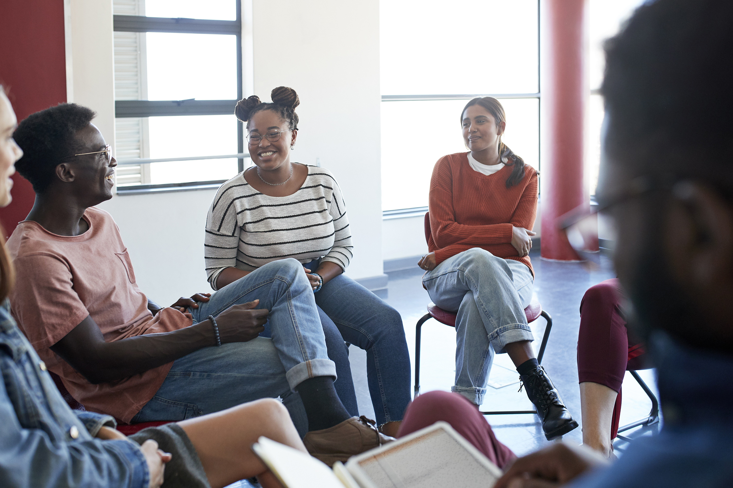
Leadership Story Circles
Recall a moment in your leadership when you knew something wasn’t right, but you didn’t intervene

Slide 13
Race and Diversity

Slide 14
Lunch
Orientation
Day 1
Kandies Food, Chef Que

Slide 15
Tour of the Durfee Innovation Society

Slide 16
Race and Diversity

Slide 17
What made it hard to act?
What were you protecting?
What did your institution reward in that silence?

Slide 18
Details for Next Session:
Race and Diversity - Day 2
Date: Thursday, Feb. 12
Location: Charles H. Wright Museum of African American History
Time: 8:30 a.m. to 5 p.m.

Slide 19
Honoring Robyn Brown-Manning Reception
Date: Wednesday, Feb. 11
Location: The Vinyl Society
Time: 5 p.m. to 7 p.m.

Slide 20
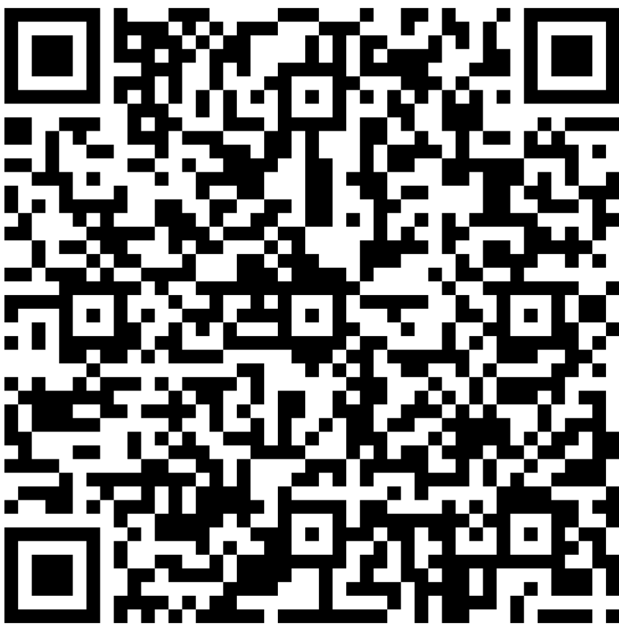
LD Day at the Capitol Sign-Up
Thursday, April 23|Public Sector Consultants
*Participants have the option to ride together on a chartered bus.

Slide 21
Race and Diversity

Slide 22
Welcome
Orientation
Day 1
Dorian Grey
Senior Director, Leadership, Entrepreneurship, and Innovation
Detroit Regional Chamber

Slide 23
KimArie Yowell
Chief Talent, Diversity, Equity, and Inclusion Officer
Rocket Companies; LD 36

Slide 24
Neil A. Barclay
President and Chief Executive Officer
Charles H. Wright Museum of African American History

Slide 25
Race and Diversity

Slide 26
Tour of the Charles H. Wright Museum of African American History

Slide 27
Lunch
Orientation
Day 1
Jackson's Five Star Catering

Slide 28
Race and Diversity

Slide 29
LD 46 Class-Led Discussion
Angela Gabridge, Executive Director, MiGen – Michigan LGBTQ+ Elders Network
Asa Zuccaro, Executive Director, Latinx Technology and Community Center
Moderator: Dorian Grey, Senior Director, Leadership, Entrepreneur, Innovation, Detroit Regional Chamber

Slide 30

Facilitated by the Detroit Regional Chamber, Leadership Detroit is a premier leadership enrichment program designed to deepen participants’ understanding of the key challenges and opportunities affecting the Detroit Region, and to foster informed and engaged leadership that drives positive change.
Notes:
Given how I spend my time and what I think about daily in terms of intersectionality and equity, surprised at the number of folks who have not or do not regularly engage in these sorts of spaces and conversations
Exploration and acknowledgment of our humanity
Part of leadership and innovation is being challenged to think differently whether that is a scientific concept, a design element, a policy position, etc.
Mission statement for leadership Detroit and our charge going forward as participants
Systems working exactly as they were designed to, but not at all sure who they were designed for. Organizations we heard from on the panel yesterday, the two Asa and I are going to tell you about today. Why do they even need to exist?
Who we are, what we do, data and statistics. How to get involved: MiGen, LatinxFlint
Generative questions

Slide 31
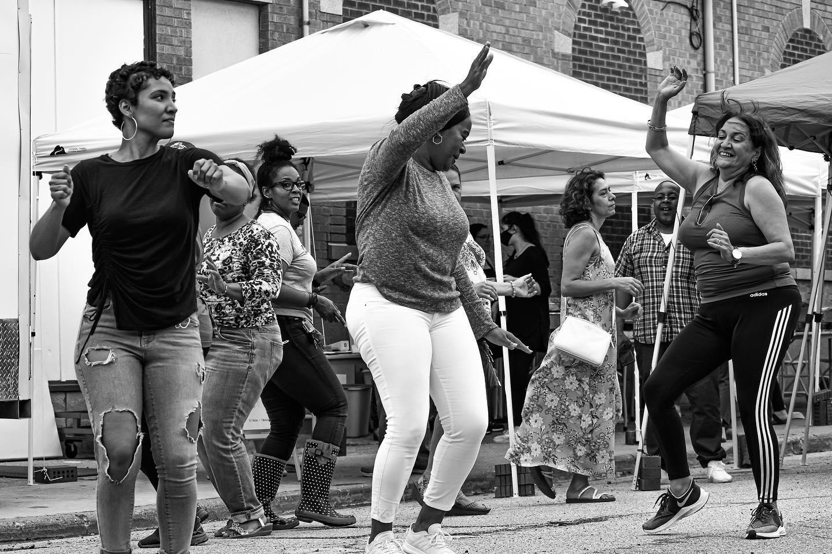

LATINX TECHNOLOGY &
COMMUNITY CENTER
Established in 2001
Dr.Hector Garcia | Sixto Olivo | Domingo Berlanga
& Mott Community College
2025

Slide 32
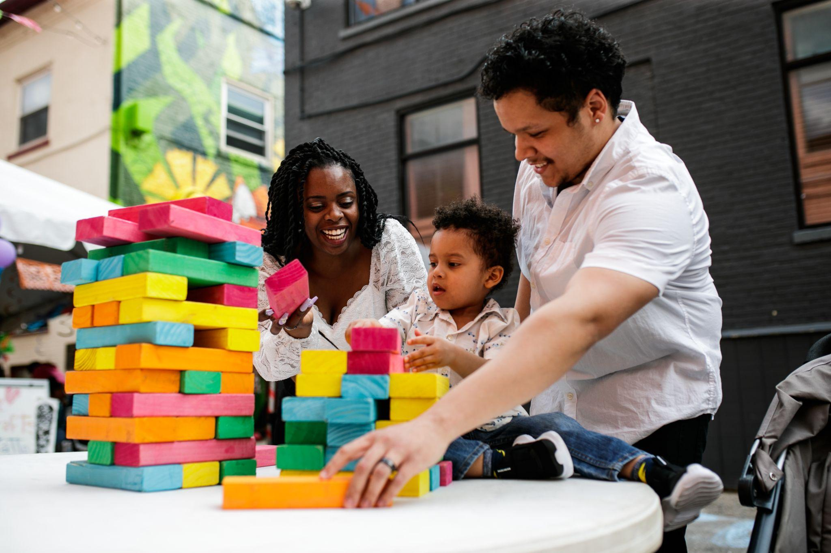
NON-PROFIT
501(c)3
MISSION STATEMENT
VISION STATEMENT
The mission of the Latinx Technology and Community Center is to enhance the dignity and quality of life for the Flint & Genesee County Latinx community and other cultures.
A healthy multi-cultural community in Flint & Genesee County that is empowered through education and cultural awareness to understand their rights and realize economic opportunity.
2025

Slide 33
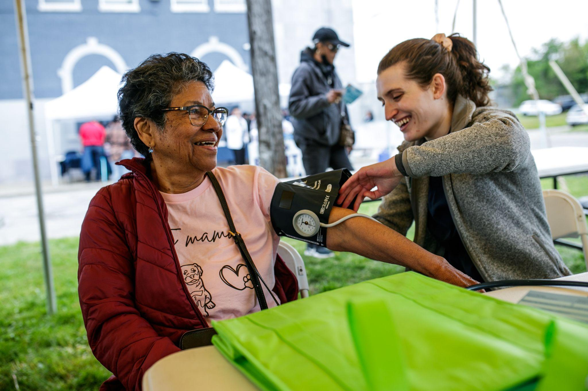
HEALTH &
FAMILY SERVICES
Support with health care enrollment, school enrollment, systems navigation and resource referrals.
3,732
252
238
92%
Visitors Resource Center
Health Care
Enrollments
Food Assistance Enrollments
Satisfactory or Better
2025

Slide 34
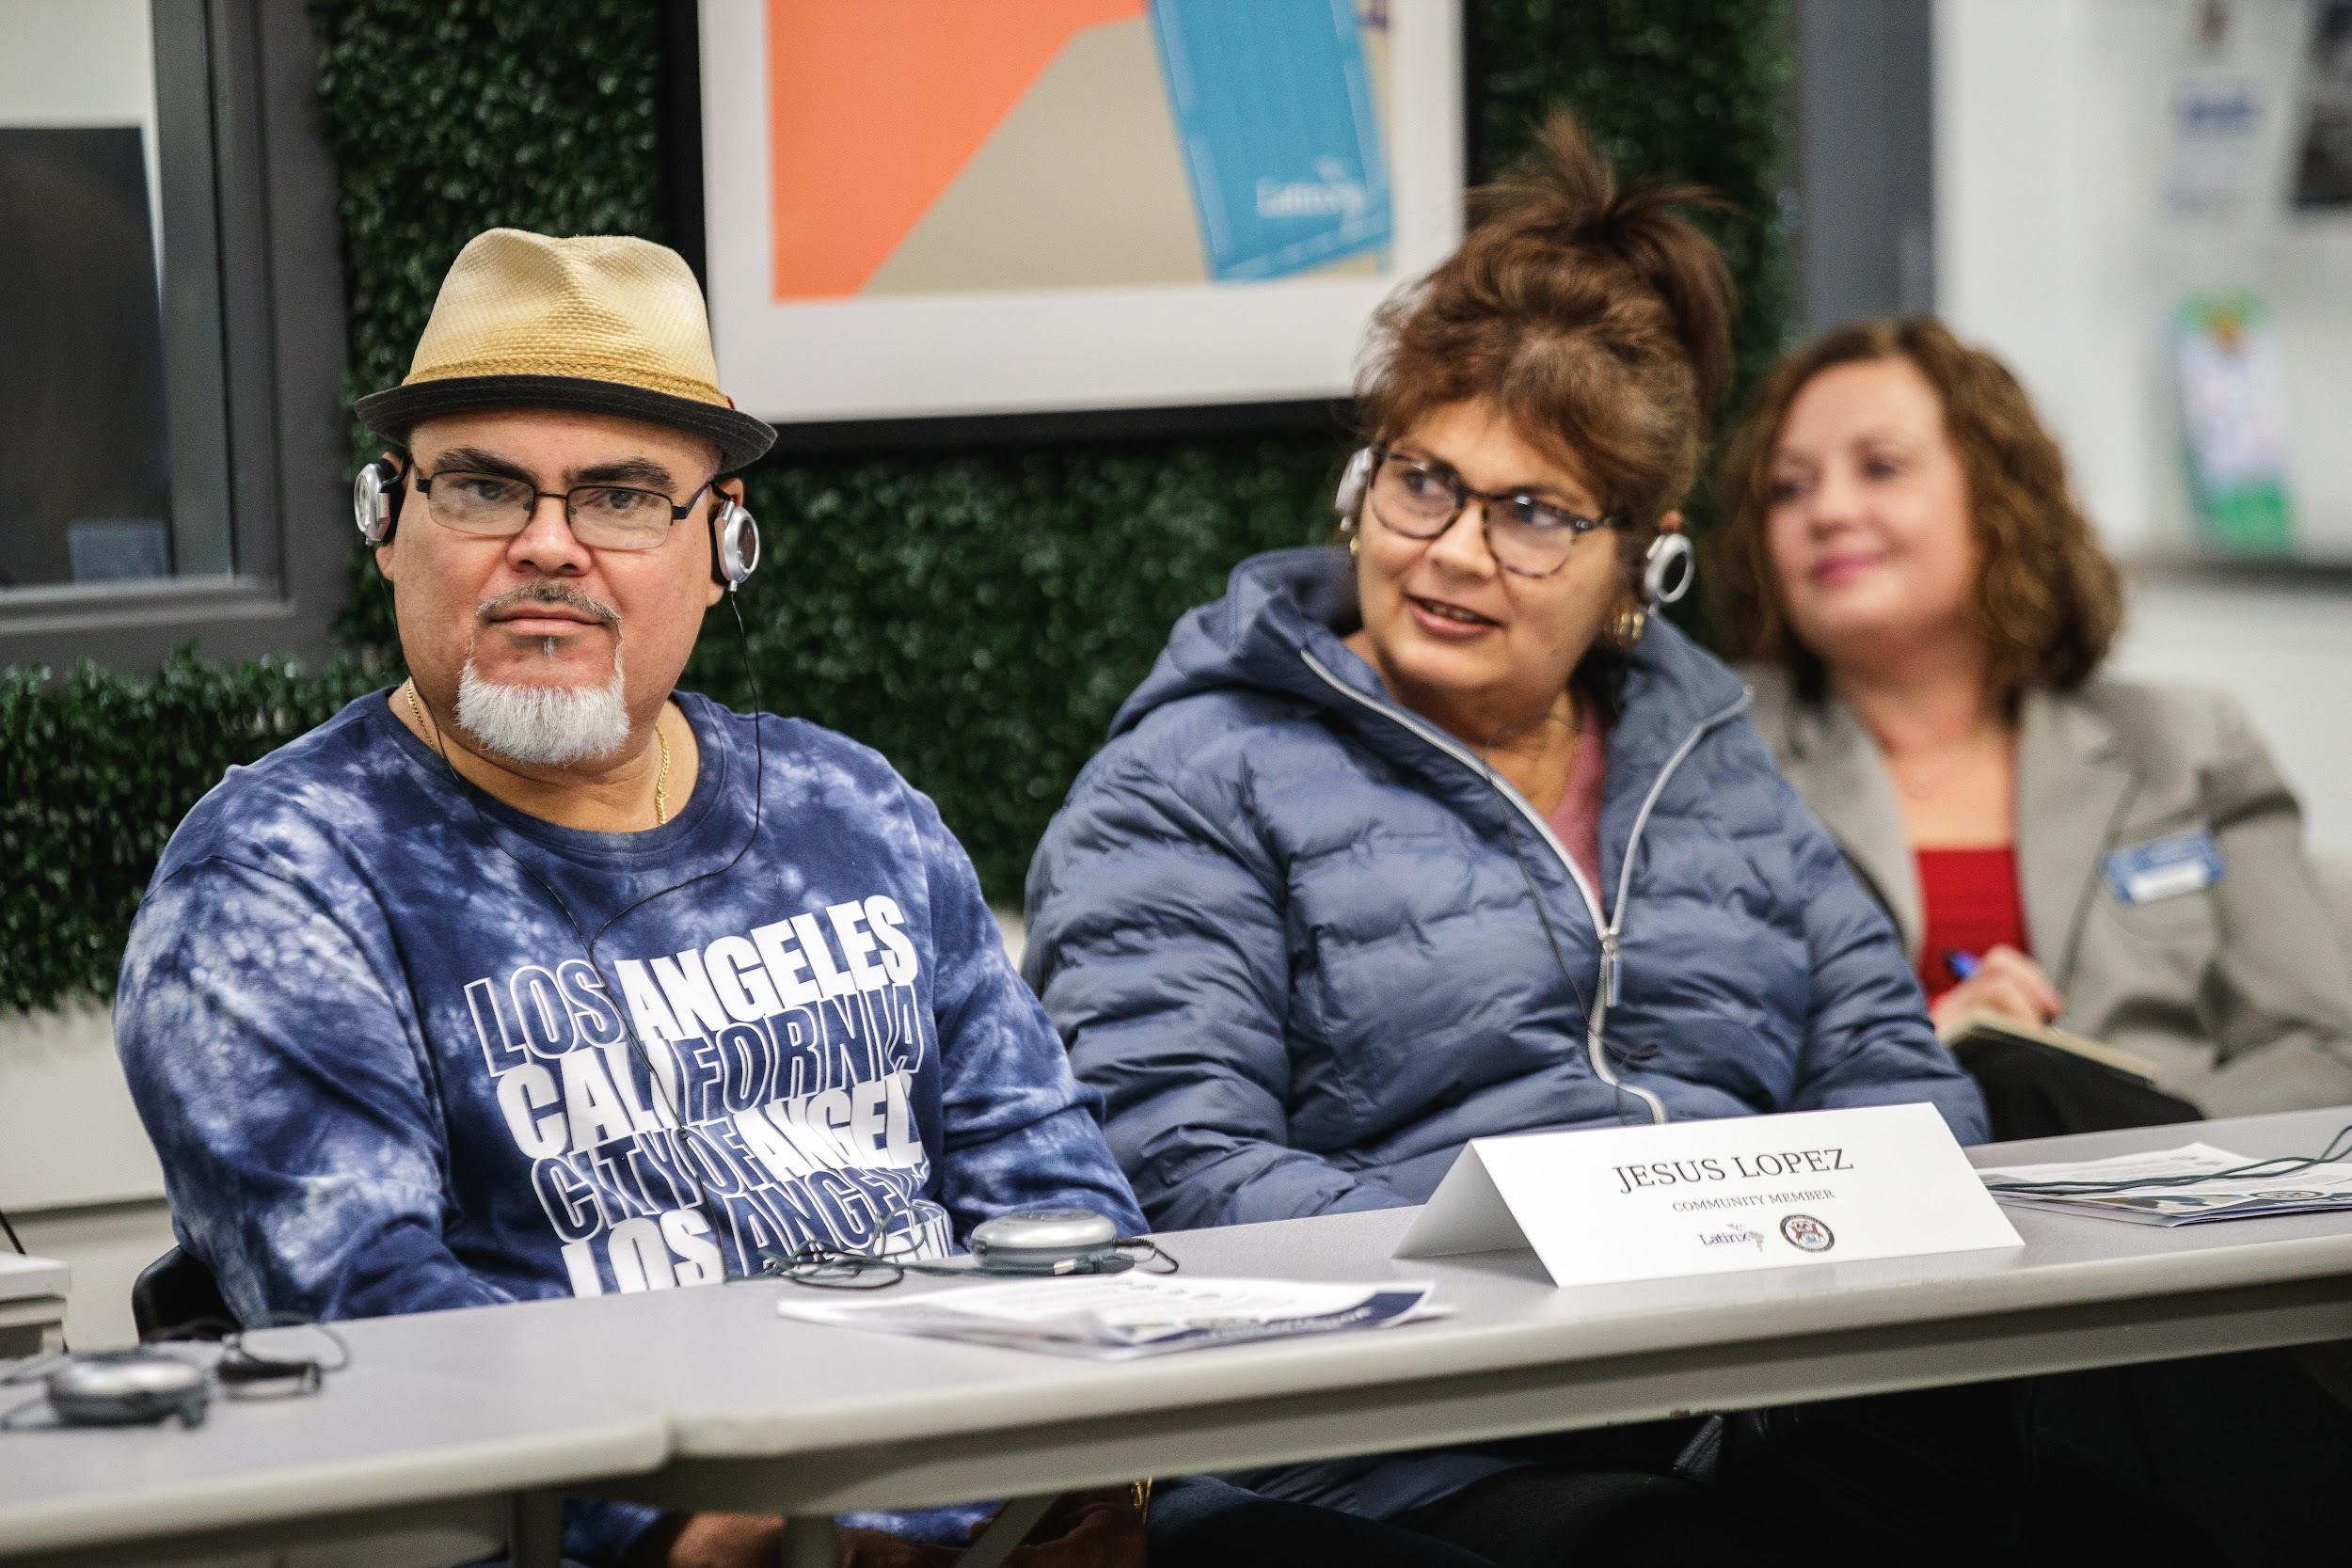
LANGUAGE
SERVICES
Document Translation, Consecutive Interpretation, Simultaneous Interpretation and Over-the-Phone Interpretation Services
285
94,601
61
99%
Hours of Interpretation
Words Translated
Business Partners
Satisfactory or Better
2025

Slide 35
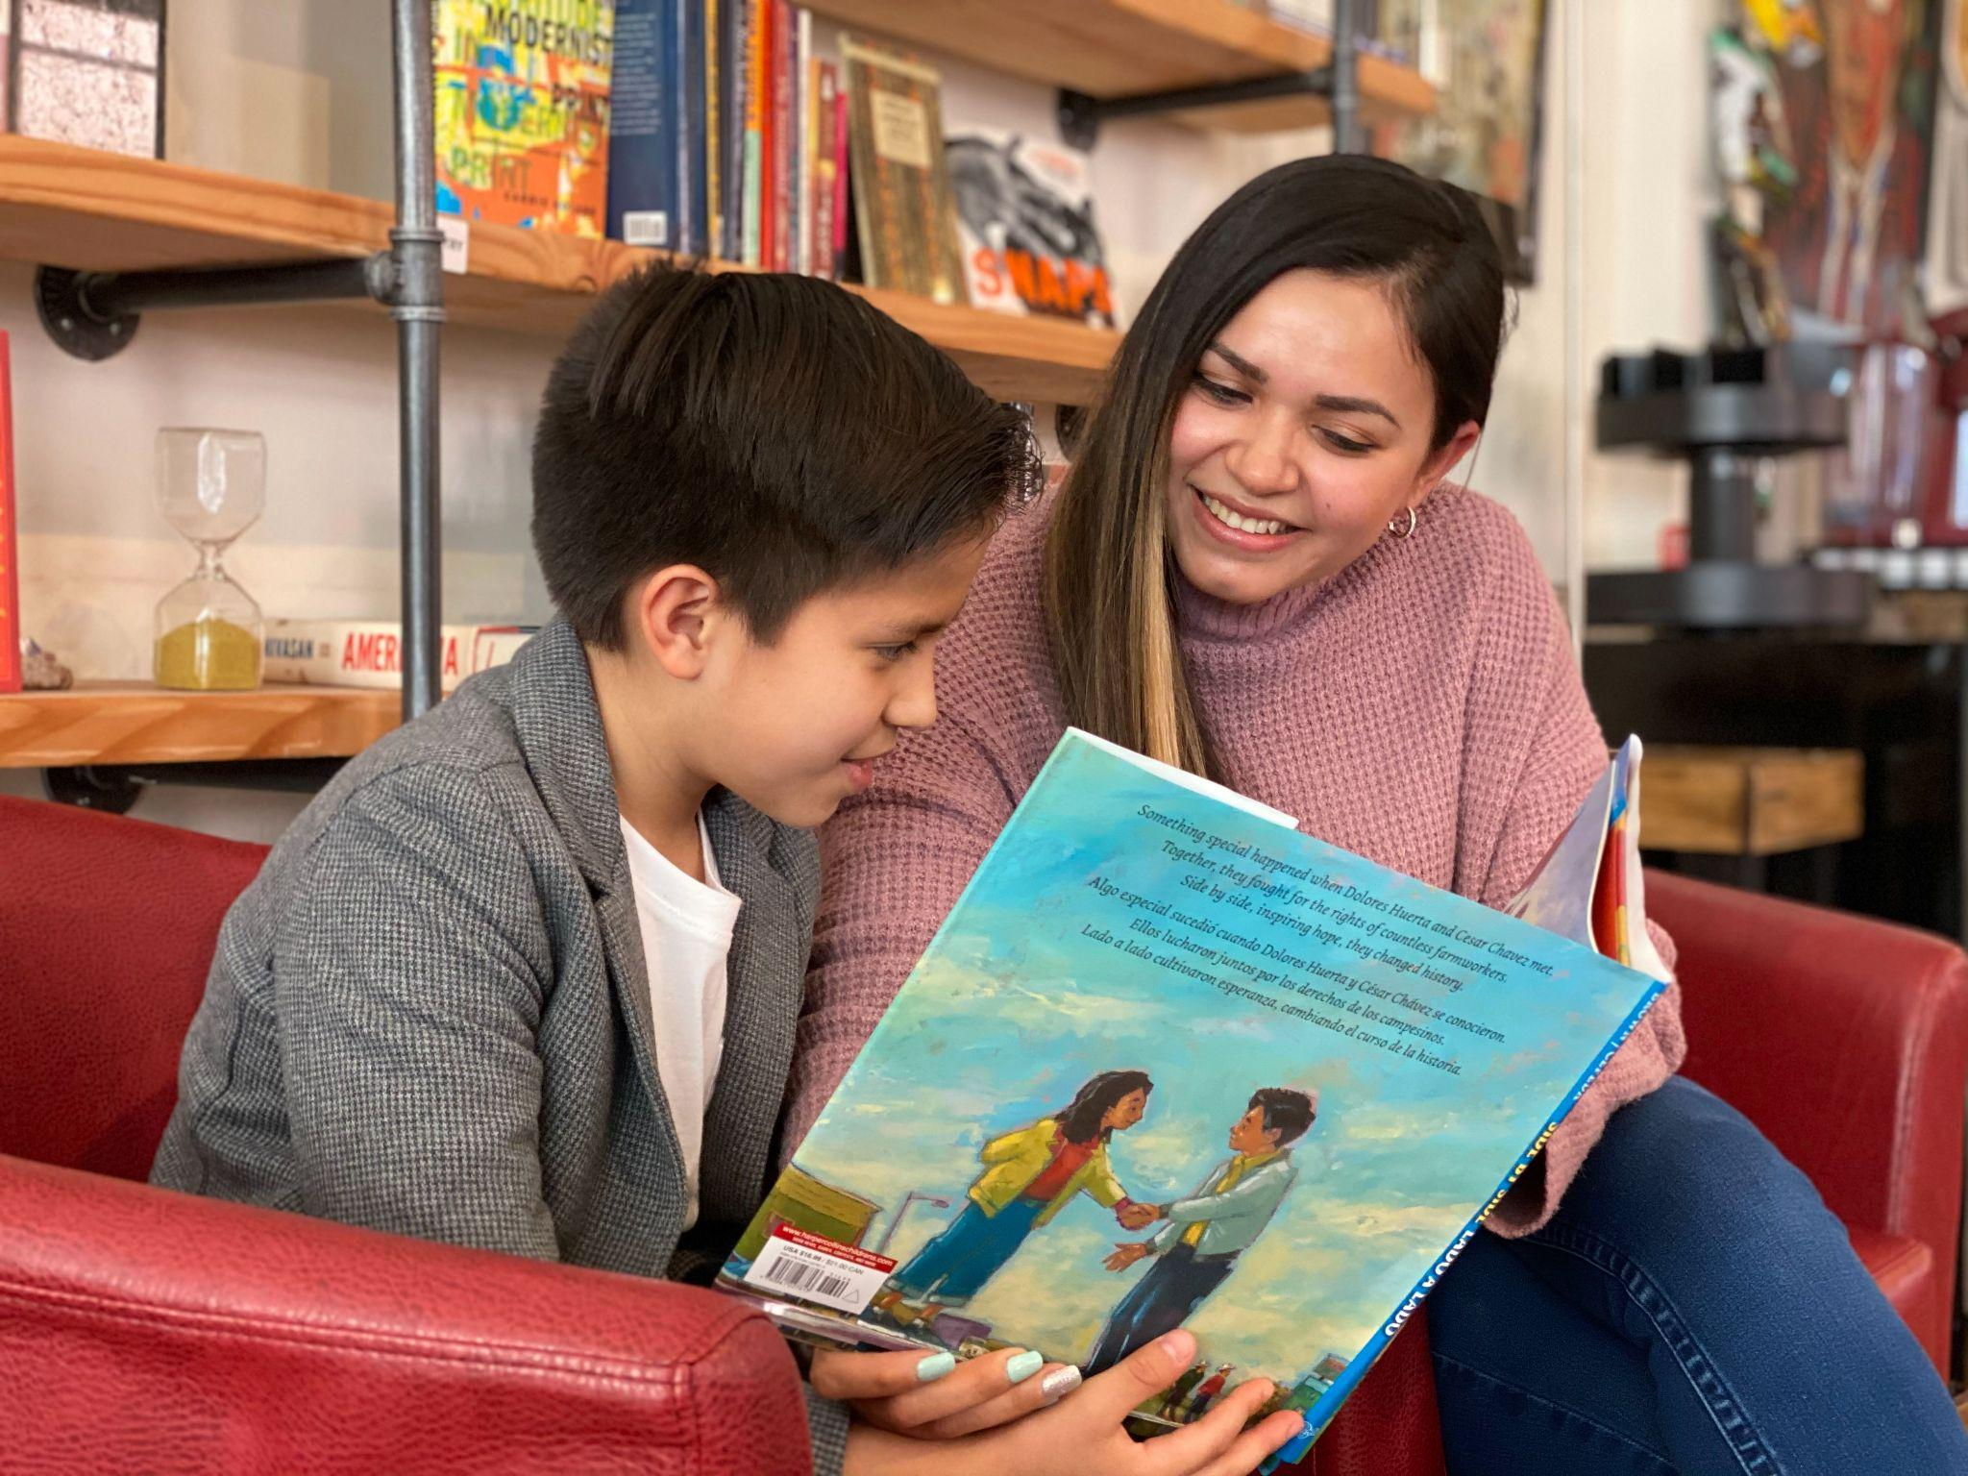
LITERACY &
YOUTH PROGRAMS
English as a Second Language, Spanish as a Second Language, Academic Tutoring and Summer Youth Programs
686
41
75
19
Hours of Tutoring
Tutoria
Participants
ESL
Participants
Summer Youth Employees
2025

Slide 36
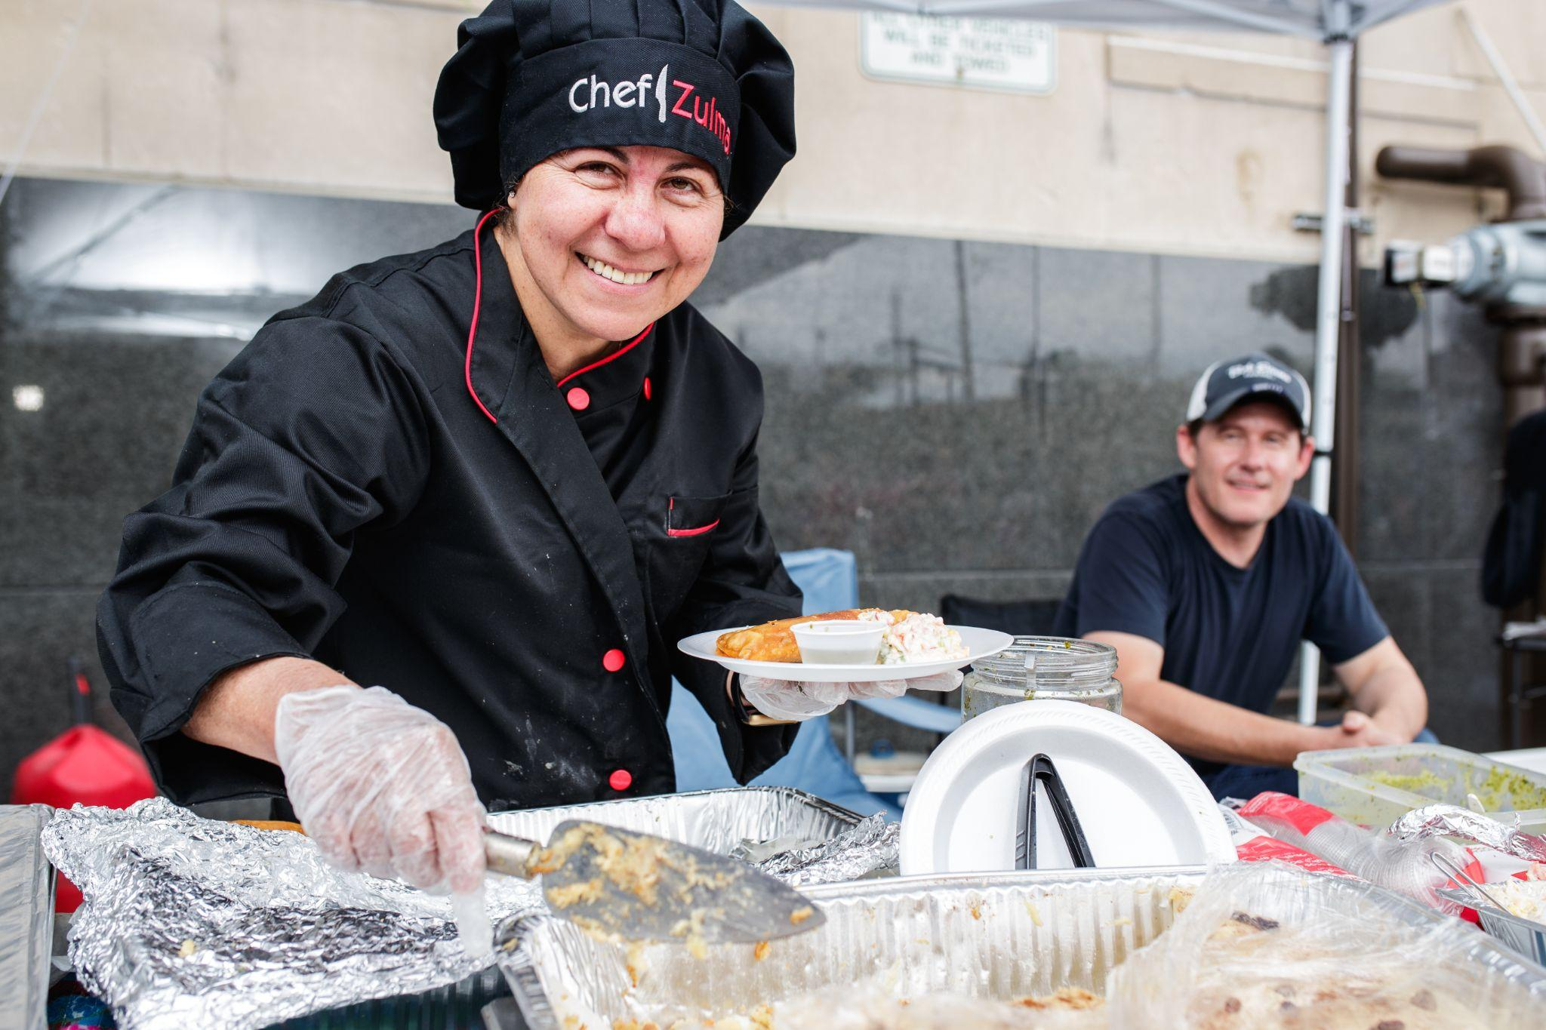
WORKFORCE & ECONOMIC DEVELOPMENT
Resume Building, Job Search, Business Creation, Business Supportive Services, FASFA & College Enrollment Support
48
42
171
95%
Businesses Supported
New
LLC’s
Gainfully
Employed
Satisfactory or Better
2025

Slide 37
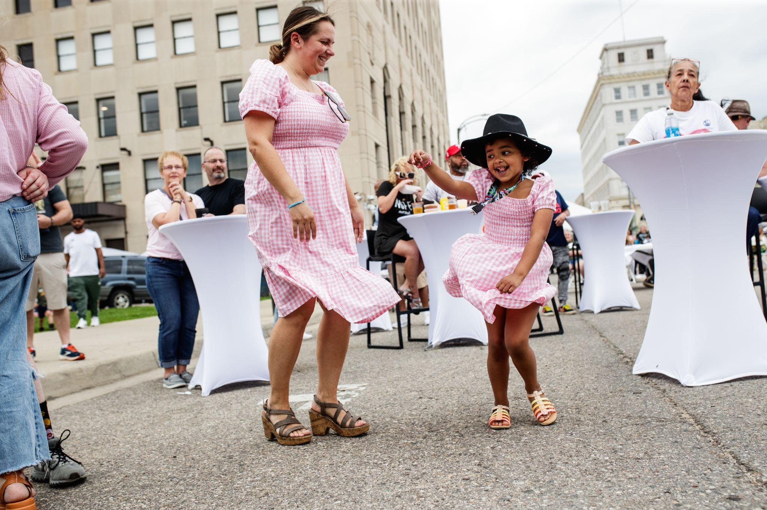
COMMUNITY BUILDING &
SPECIAL EVENTS
Celebrating cultural events fosters a vibrant sense of belonging by inviting neighbors to share in rich traditions, effectively weaving a stronger, more connected community through the joy of collective experience.
220
1500+
250
2500+
350
Cesar Chavez Luncheon
Downtown Cinco de Mayo
Latin Summer Celebration
Trick-or-Treat on Lewis St.
Dia de Muertos
2025

Slide 38
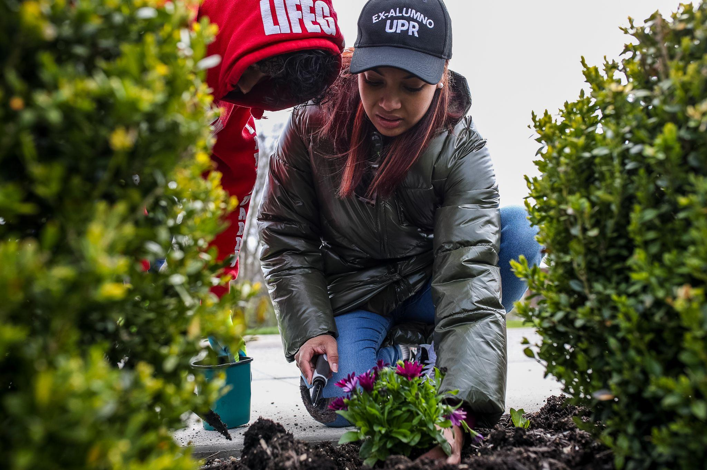
NEIGHBORHOOD
REVITALIZATION
Strategic efforts to repair past harm from historic racial discrimination, urban renewal, economic disinvestment and displacement.
6,066 sq ft
9,835 sq ft
30,473 sq ft
Community Resource Center - Renovations Completed 2023
Bilingual Early Childhood Education Center
Under Construction
Mixed Use Commercial & Residential Units
Pre-Development
2025

Slide 40




Slide 41
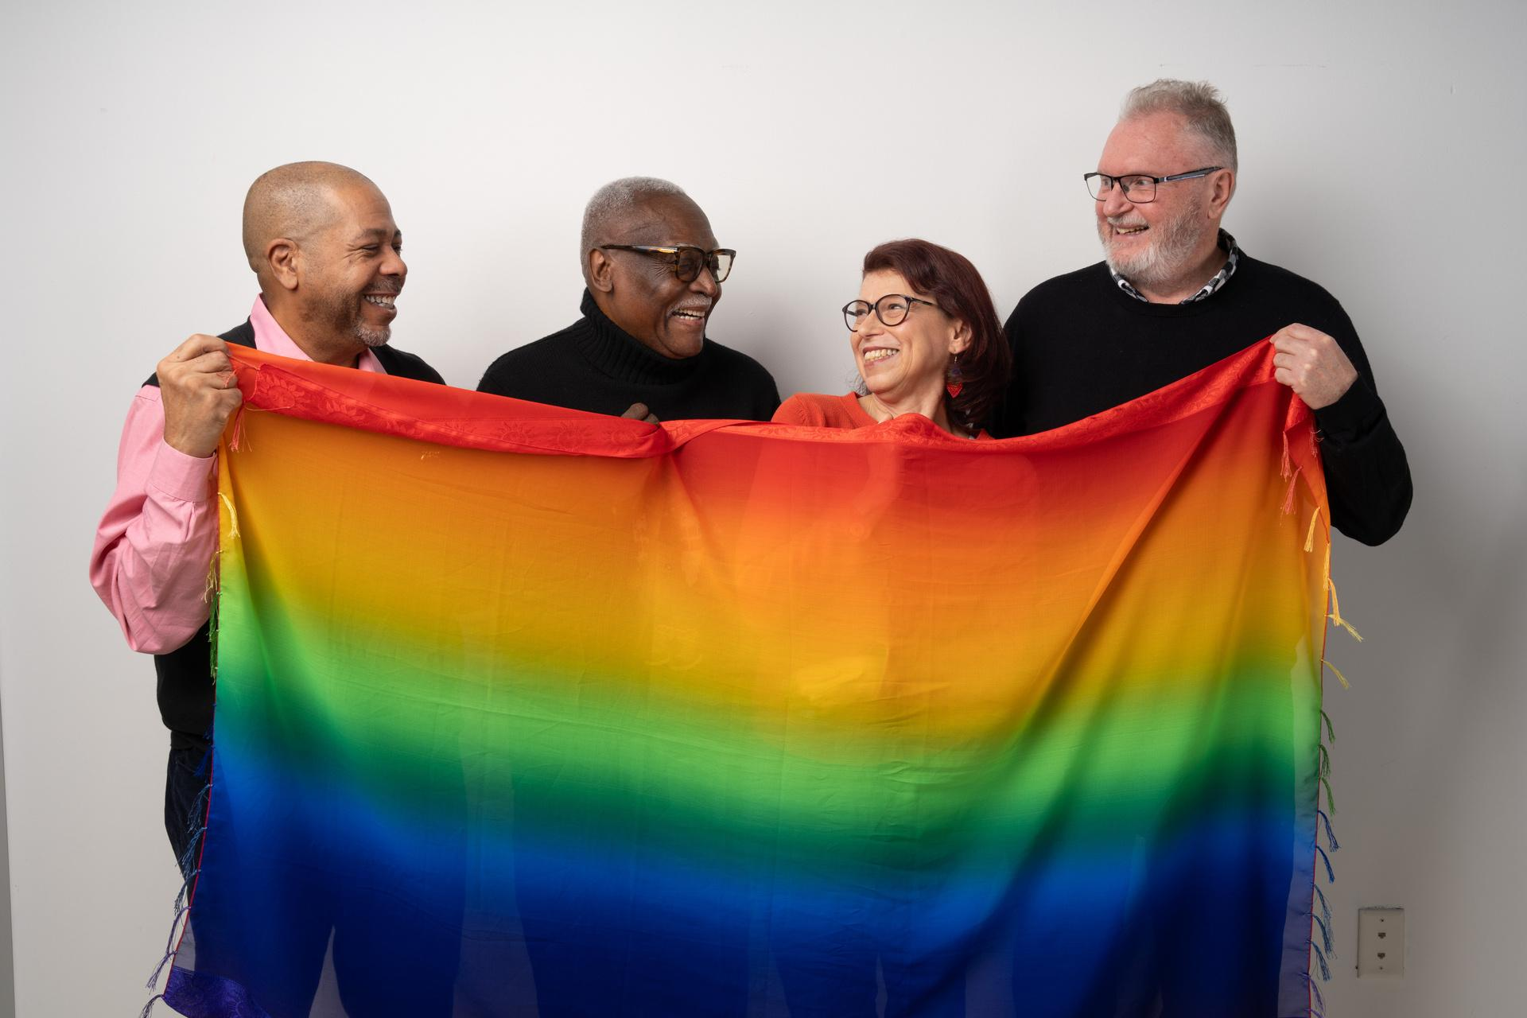
MICHIGAN LGBTQ+ ELDERS NETWORK
ABOUT US
MiGen provides services, advocacy, fun, and connection to LGBTQ+ folks ages 45+, and those who care for them, across the State of Michigan. At MiGen, we believe in vibrant, authentic lives at any age, safe spaces and connected communities.

Slide 42
Establishing the Need for Full Inclusion for LGBTQ+ Older Adults

Slide 43
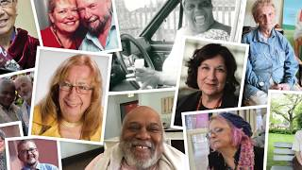
MICHIGAN LGBTQ+ ELDERS NETWORK

Slide 44
MICHIGAN LGBTQ+ ELDERS NETWORK
Michigan’s population is just over 10M
Approximately 7%, or just over 700,000 Michiganders, are LGBTQ+
The population of the City of Detroit is currently approximately 650,000
There are nearly 316,000 LGBTQ+ persons in Michigan ages 45+
There are 310,000 Middle Eastern or North African (MENA) persons in Michigan
As with all aging populations in Michigan, the LGBTQ+ aging population is forecasted to more than double by 2030
Notes:
Universality of Queer Community; other issues that cut across all racial, religious, ethnic groups: poverty, addiction, abuse, education, “invisible” or non-apparent disabilities, generational trauma.
One off vs systemic design and challenges

Slide 45
MICHIGAN LGBTQ+ ELDERS NETWORK
9 out of 10 LGBTQ+ older adults have no children to help care for them as compared to 2 out of 10 heterosexual older adults
7 out of 10 LGBT older adults live alone as compared to 3 out of 10 heterosexual older adults
LGBQ+ older adults are nearly 3x as likely to live in poverty as heterosexual and cisgendered older adults

Slide 46
MICHIGAN LGBTQ+ ELDERS NETWORK
LGBTQ+ older adults who have lived through a lifetime of discrimination and social stigma, family rejection, and the aging and deaths of their support networks, experience minority stress.
  As a result, the LGBTQ+ population is at a higher risk for substance use, sexually transmitted diseases (STDs), cancers, cardiovascular diseases, diabetes, Alzheimer’s and other dementias, obesity, bullying, isolation, rejection, anxiety, depression, and suicide as compared to the general population.
  However, LGBT older adults report a high level of distrust and/or avoidance of medical providers out of fear of discrimination, so they are more likely to need medical assistance and less likely to seek it out.

Slide 47
What Does This Look Like in Practice?

Slide 48

MICHIGAN LGBTQ+ ELDERS NETWORK
Michigan’s First LGBTQ+ Senior Centers
Affirmations,
Ferndale
Corktown Health,
Detroit

Slide 49

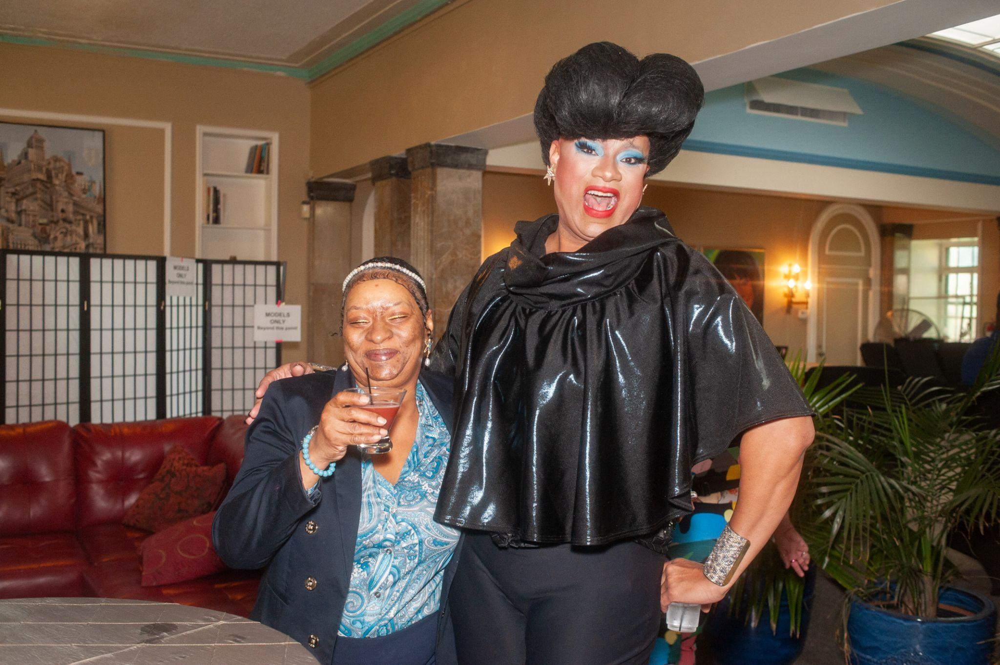
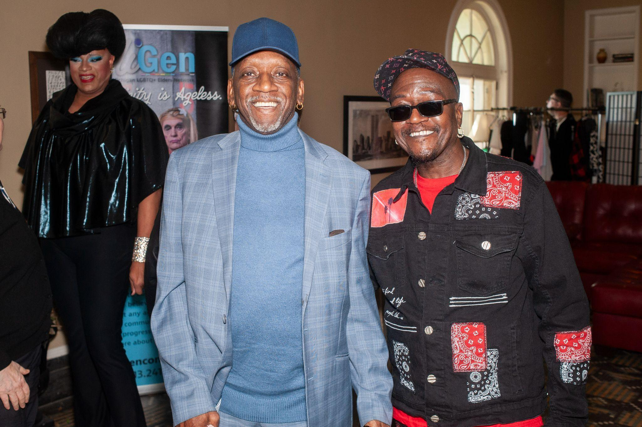
MICHIGAN LGBTQ+ ELDERS NETWORK
Programs and Services
  Community Navigation
  Second Sunday Arts Program
  MiStory
  Caregiver Support Group
  Speaker Series
  Monthly Potlucks
  Friendly Caller Program
  Food Box Delivery
  Monthly Book Clubs
  Senior Meeting Groups
  Rainbow Resilience: An Ageless Fashion Affair
  Community Presentations
  Washtenaw County Senior Group

Slide 50
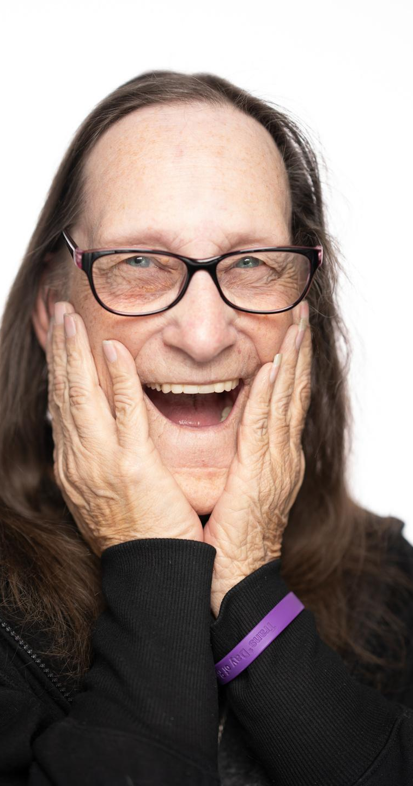
MICHIGAN LGBTQ+ ELDERS NETWORK
Community Navigation
  SNAP applications
  Housing concerns, including eviction/landlord issues
  Legal issues
  Utility payments
  Medicare/Medicaid (MMAP Counseling)
  Emergency Transportation
  Emergency Food Support
  Vaccination
  + more

Slide 51
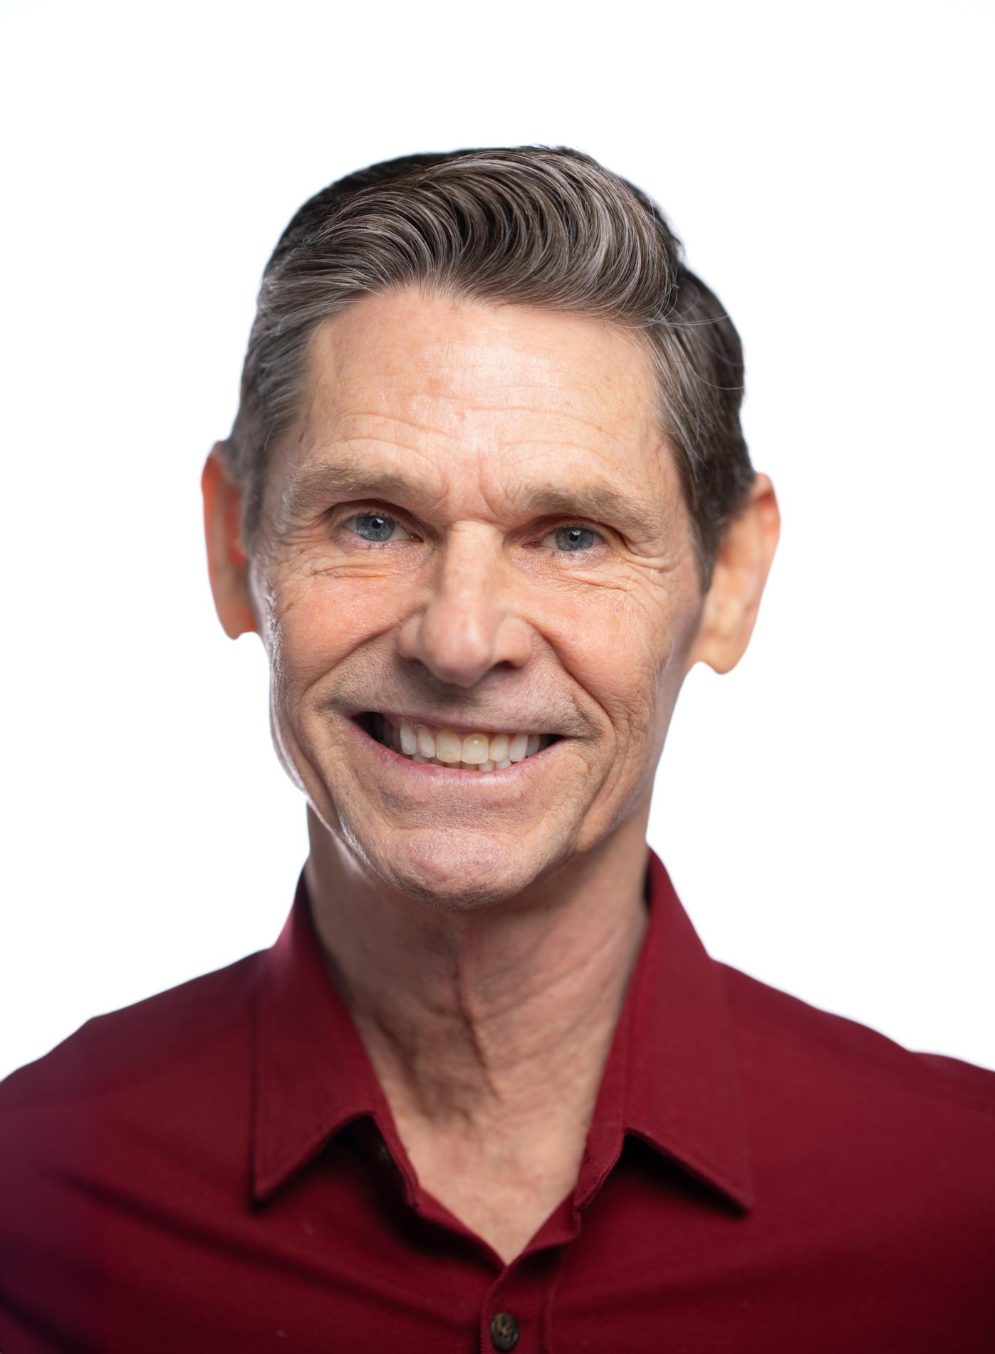

Training Offerings
Instructor-Led Training
Act. Reflect. Commit. (A.R.C.) Learning Modules
Credentialing Services

Slide 52
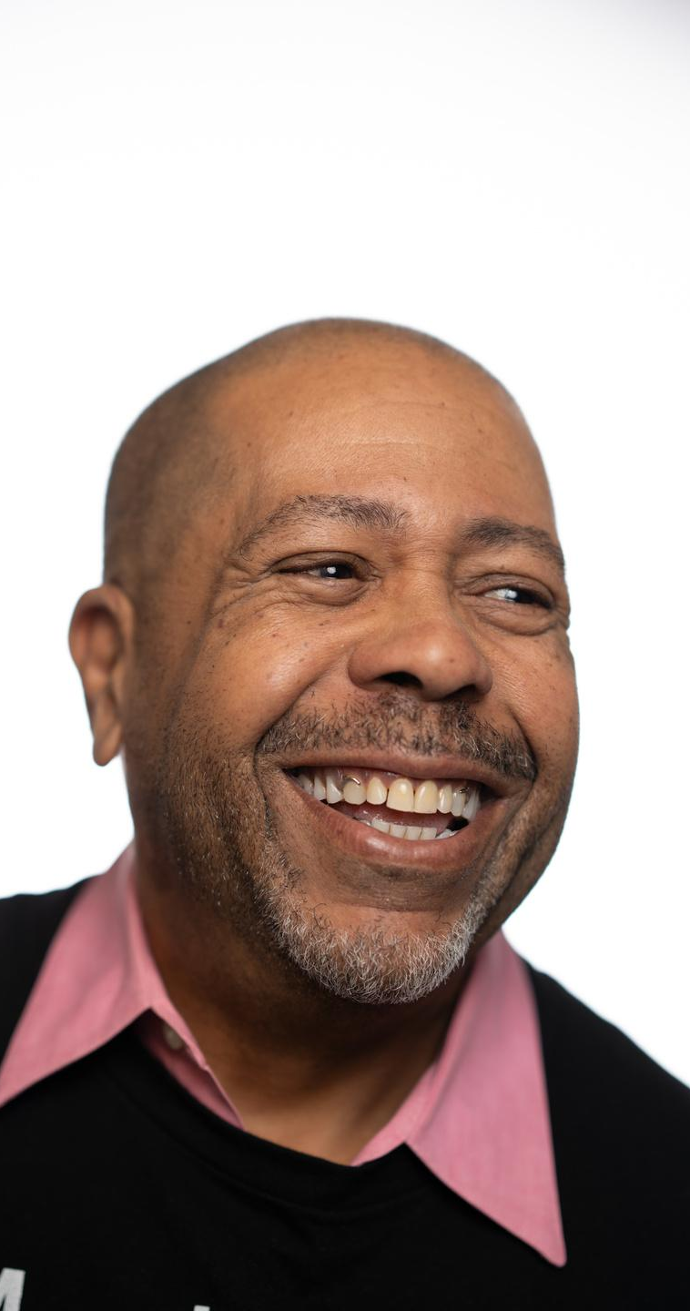
MICHIGAN LGBTQ+ ELDERS NETWORK
Who Are We Training?
In 2023, we trained/credentialed folks at LTC facilities, medical schools, hospital groups, health insurance organizations, Area Agencies on Aging, churches, hospice workers, medical professional groups, Office of Senior Services, non-profit organizations, home-based care providers, and many more groups and individuals from all across Michigan.

Slide 53
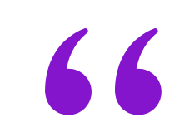
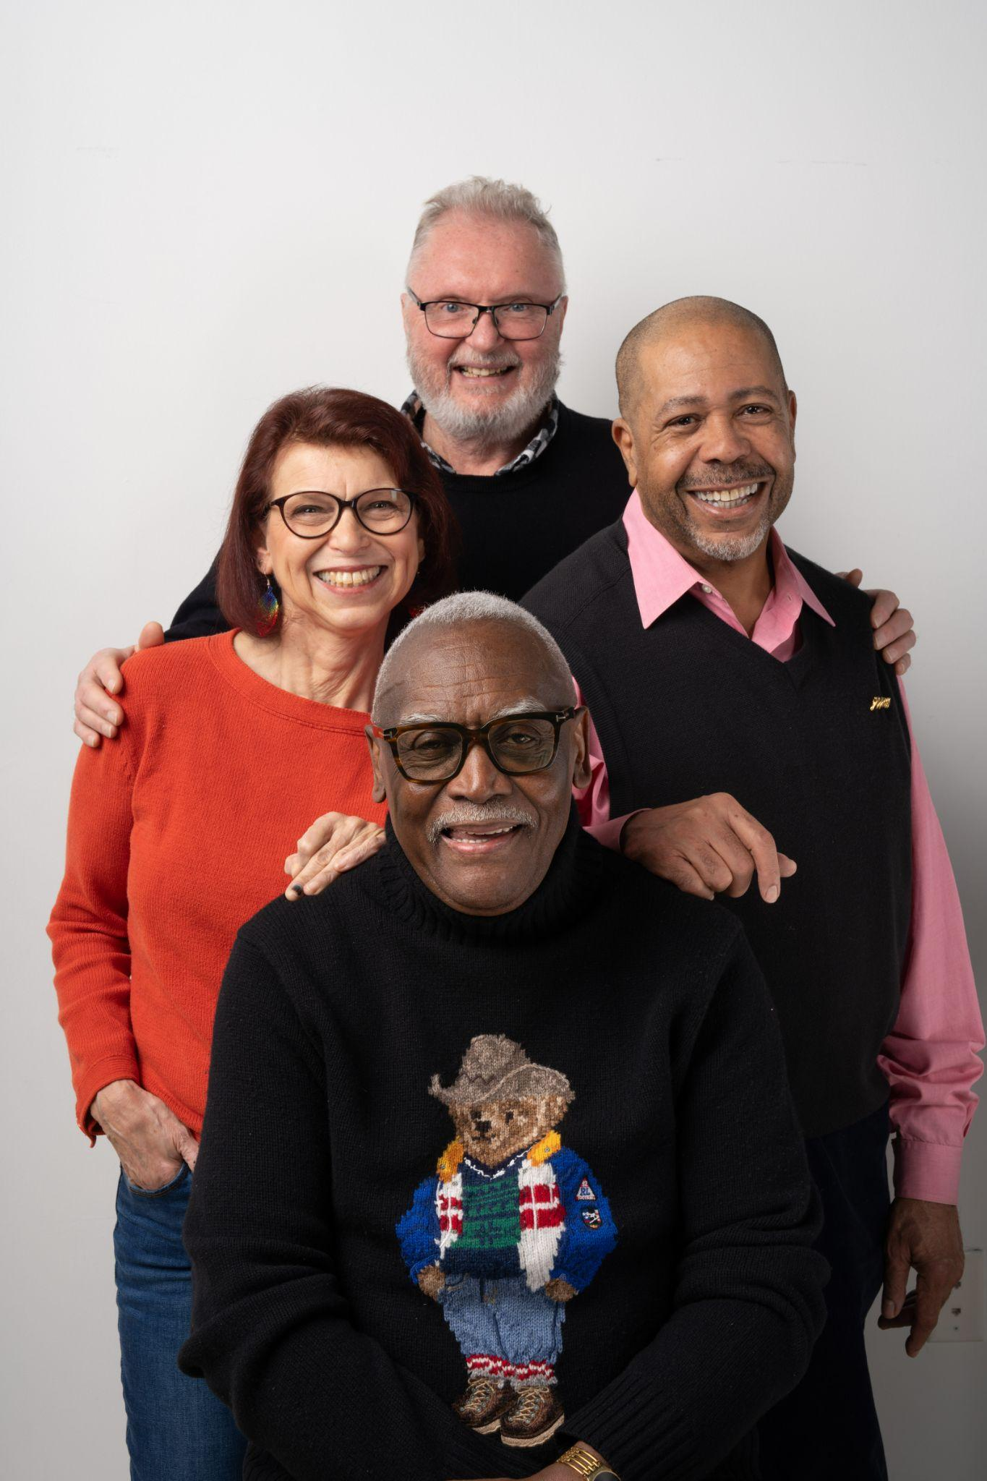
MICHIGAN LGBTQ+ ELDERS NETWORK
"We can go anywhere, but that doesn't mean we belong or feel comfortable. Having our own space means I can relax."
- D.B. (CLIENT)

Slide 54

Notes:
Generative Questions:
What does the existence of, or need for, targeted services for marginalized groups bring up for you?
What does/can/should White engagement or acknowledgement look like in these spaces and conversations?
As leaders, what can we take back to our organizations and areas of influence that move these ideas forward?
How may scarcity mindset (perceived or otherwise) be impacting the way we engage with one another, make decisions or allocate resources?
Share an example of an actionable, perhaps duplicable, strategy or tactic you have deployed within your organization since January 2025 that preserves, protects or promotes diversity.
What is your take on what growing population centers across the US all have in common? (My hot take: they are located in states with pro-business policies on the books and are centered around metropolitan areas with progressive and diverse social policies, institutions and cultures) How do we look or act differently or the same in the Southeast Michigan region?

Slide 55
Share your first memory of when did you first realize that your race/ethnicity/gender/sexuality
mattered?

Slide 56
Share a story about a time in your life when you wanted/needed to feel seen, heard, or
understood—and you were. What did this allow you to do and/or be?

Slide 57
www.migenconnect.org

Slide 58
Networking Break

Slide 59
Race and Diversity

Slide 60

Rainbow Song

Slide 61
LD 46 "Holiday" Party
Date: Thursday, Feb. 12
Location: Michigan Science Center
Time: 5-7 p.m.

Slide 62
Details for Next Session:
Small Business and Local Government
Date: Thursday, March 12
Location: Detroit Athletic Club
Time: 8:30 a.m. to 5 p.m.

Slide 63
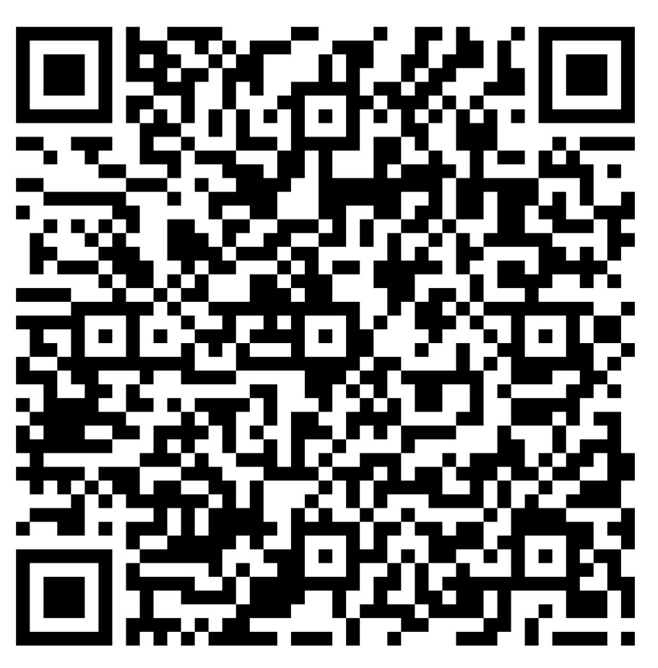
Wrap-Up
Absence Policy Reminder:
Absences are reported in half-day increments. Missing even a portion of a session will equate to one half-day missed.
Excused absences are offered. Participants must fill out an absence form (https://forms.office.com/r/NcDT835Pzt) and notify the Leadership Detroit team by email at ld@detroitchamber.com at least seven days in advance to receive an "excused" absence. Otherwise, it will be considered an "unexcused" absence
Having at least one "unexcused" absence in a program year or missing more than two session days ("excused" or "unexcused") will affect your ability to graduate from Leadership Detroit.
Missing a session? Fill out the absence form:
Orientation
Day 1

Slide 64
LD Day at the Capitol Sign-Up
Thursday, April 23|Public Sector Consultants
*Participants have the option to ride together on a chartered bus.

Slide 65
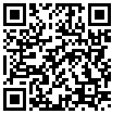
Wrap-Up
Complete the session survey below:

Slide 66
Race and Diversity

