Slide 1
Health and Wellness
Session Title

Slide 2
Breakfast and Networking
Signature Plating Catering

Slide 3
Welcome
Dorian Grey, Senior Director, Leadership, Entrepreneurship, and Innovation

Slide 4
Hospital 101: Understanding the Healthcare Landscape in Michigan
Elizabeth Kutter, Vice President and Deputy General Counsel, Michigan Health and Hospital Association

Slide 5
Hospital 101: Understanding the Healthcare Landscape in Michigan

Slide 6
Standard Disclaimer
Politics is not a spectator sport
Local, state and federal elected officials make decisions that impact you
Get to know candidates for local office, as well as your local elected officials
Election on November 3rd

Slide 7
The Importance of Healthcare Leaders Engaging in Advocacy
Government is a large percentage of payor mix for healthcare providers and healthcare systems, demanding stronger relationships.
Competing public policy priorities necessitate that healthcare is visible and actively engaged.
Nonprofit healthcare in general is under attack.
Many public policy issues have a direct impact on our work.
Protect and expand access to coverage.
Term limits in Michigan Legislature.
Lack of healthcare experience in the Legislature.

Slide 8
About the MHA
Established in 1919; Nonprofit – 501(c)(6)
100+ employees
Locations: Okemos (HQ); downtown Lansing Capitol Advocacy Center (CAC)
Primary membership: hospitals/health systems
Governance: 21-member board; five-member executive committee
Mission: We advance the health of individuals and communities.

Slide 9
Michigan hospitals serve patients 24 hours a day, 365 days a year
4.4 million people treated in emergency departments
37.9 million outpatient visits conducted
5.2 million inpatient care days
977,800+ patients admitted for care & treatment
94,300 babies delivered
Avg. length of stay – 5.3 day

Slide 10
Economic & Community Impact of Hospitals

Slide 11
Hospital Financing
Government payors
  Medicare
  Medicaid
Commercial insurance
Self-pay/private pay
Uncompensated care

Slide 12
Hospital Spending

Slide 14
Policies Impacting Hospitals

Slide 15
OBBBA: Topline Impacts to Michigan

Slide 16
Policies Impacting Hospitals
Certificate of Need
Workforce
State Budgeting and Funding
Investments in Primary Care
Medical Liability
Scope of Practice
Employer Requirements
Insurer Practices
Affordability
Durable Medical Equipment
Licensing and Regulatory Requirements
Drug Prices
Unemployment Compensation
Auto Insurance
Environmental Regulations

Slide 17
What Do We Need to Do?

Slide 18
Break

Slide 19
Rethinking the Model: Innovation, Access, and Community-Based Care
Paul Thomas, Chief Executive Officer and Chief Medical Officer, Plum Health Direct Primary Care
Anthony Williams, President and Chief Executive Officer, Corktown Health

Slide 20
Rethinking the Model:
Innovation, Access, and Community-Based Care
Paul Thomas, M.D., CEO & CMO, Plum Health DPC
Anthony Williams, President and CEO, Corktown Health

Slide 23
What's Broken in Primary Care in 2026
A Non-Exhaustive List

Slide 25
Long Wait Times to See the Doctor
Average Wait Times by Specialty
  Dermatology: ~36.5 days
  Cardiology: ~33 days
  OB-GYN: ~41.8 days
  Family Medicine: ~23.5 days
  Rheumatology: 6 months to 1 year in some areas
  Emergency Department (In-Office Wait): Over 2 hours

Slide 26
Low Primary Care Spend
The United States spends approximately 5% to 7% of its total health care expenditures on primary care
Other wealthy nations dedicate 12% to 15% of their health care budgets to primary care, more than double the U.S. rate.

Slide 27
Health Professional Shortage Areas

Slide 29
Persistent Health Inequity
With Wayne County as an example:
The average life expectancy at birth in the City of Detroit is 69 to 72.1 years
The average life expectancy in Michigan is 78.3 years
The average life expectancy in Grosse Pointe is 82 years

Slide 35
Other Health Ecosystem Problems
20% primary care provider shortage by 2038, exacerbated by payment gaps and burnout.
About 35% of adults delay or avoid primary care due to cost, high deductibles, and co-inurance, while 26% of insured adults carry medical debt.
38% of people to skip routine checkups and force patients to bypass the "front door" of healthcare in favor of costlier urgent care centers or emergency rooms.

Slide 37
How Plum Health Improves Primary Care in 2026
A Non-Exhaustive List

Slide 40
DPC Doctors focus on value, not volume.

Slide 42
DPC Doctors guarantee a same-day or next day appointment.

Slide 44
Patients can call, text, email, or message their DPC doctor.

Slide 48
DPC Doctors take the time to dispense medications from the office.

Slide 49
DPC Doctors Prevent Emergency Department Visits

Slide 51
DPC doctors work to eliminate red tape and bureaucracy.

Slide 54
DPC doctors save patients money on medications.

Slide 57
DPC doctors save patients money on lab services.

Slide 61
DPC doctors save patients money on imaging services.

Slide 69
Break

Slide 70
Healthcare at the Crossroads: Balancing and Bridging Perspectives, Priorities, and Solutions on Access, Affordability, and Community Needs
Alisha Cottrell, Associate Vice President, Government Affairs, Henry Ford Health
Sonny Hoogendoorn, Director, Government Relations, Corewell Health
Paul Thomas, Chief Executive Officer and Chief Medical Officer, Plum Health Direct Primary Care
Anthony Williams, President and Chief Executive Officer, Corktown Health
Phil Yeiter, Senior Director, Government Relations, Corewell Health
Moderator: Elizabeth Kutter, Vice President and Deputy General Counsel, Michigan Health and Hospital Association

Slide 71
Break

Slide 72
Discover Detroit PAL
David Greenwood, Director, Community Engagement, Detroit PAL

Slide 73
Lunch
Signature Plating Catering

Slide 74
How Policy Changes Impact Health Care Delivery in Michigan
Meghan Groen, Senior Deputy Director, Health Services, Michigan Health and Human Services, State of Michigan

Slide 75
Michigan Health Services Updates
October 15, 2026
Meghan Groen
Chief Deputy Director for Health Services, Medicaid Director
Michigan Department of Health and Human Services

Slide 76
Medicaid Background

Slide 77
Michigan’s Medicaid Program has a Vast Reach
Medicaid covers one in five individuals living in the U.S. In Michigan, the coverage rate is even higher – one in four Michiganders.
In FY24, Michigan’s Medicaid program afforded health coverage to more than 2.5 million Michiganders each month, including:
  Nearly 890,000 children;
  230,000 people living with disabilities;
  176,000 seniors; and
  687,000+ adults in Healthy Michigan Plan.
45% of births in Michigan are covered by Medicaid.

Slide 78
Michigan Medicaid Budget
Michigan’s FY25 Medicaid budget is approximately $27.8 billion and 34% of the state’s overall budget.
More than 70% of the Medicaid budget comes from federal funding.
Federal match rates are higher for states with lower per-capita income.
  Michigan’s federal match rate is ~65%.
  For every dollar Michigan spends, the federal government contributes an additional $1.87.
  For every dollar Michigan cuts, $2.87 is lost for people and providers.

Slide 79
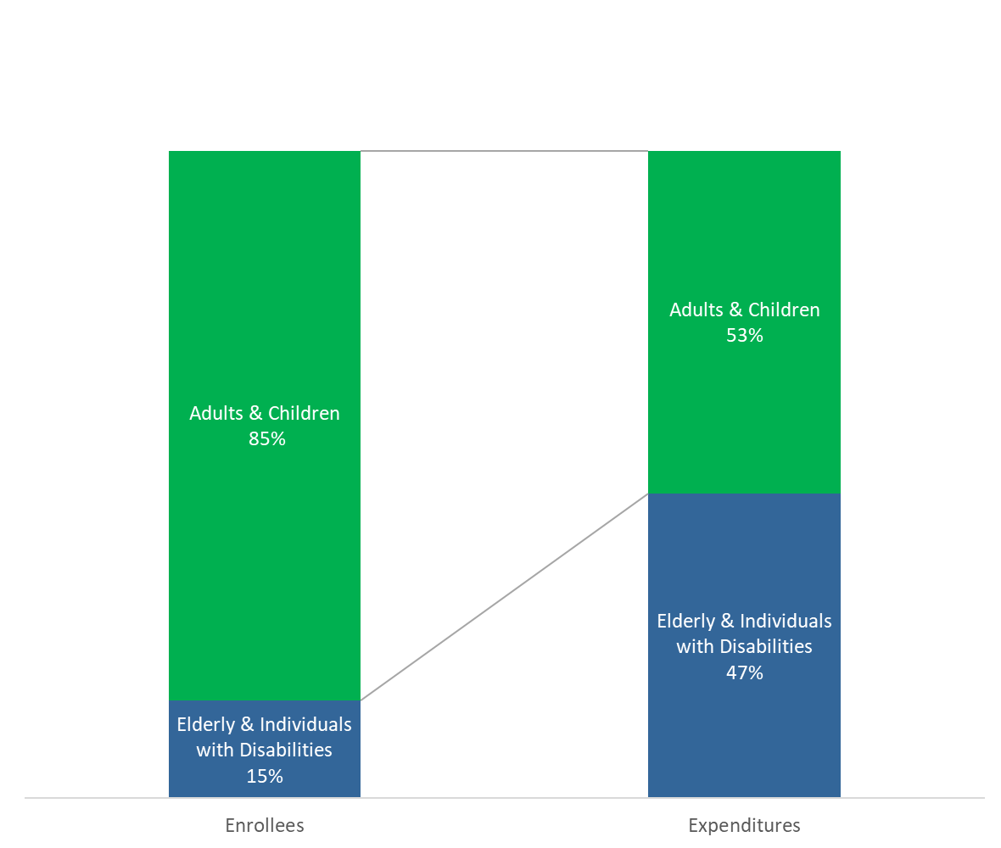

Medicaid Helps Seniors and Individuals with Disabilities
Nationally, Medicaid pays for more than half of spending on long-term care.
Michigan Medicaid covers seniors and individuals with disabilities paying more than $2,000 per month per person.
Michigan Medicaid pays an average of $6,200 per month for an individual needing nursing home care.

Slide 80
Medicaid is a Major Payor in the Health Care System
Michigan Medicaid Expenditures by Service
Nationally, Medicaid accounts for one-fifth of all health care spending.
It is the largest payor of mental health services, long-term care services and births.
As such, it plays a critical role in assuring the sustainability of hospitals, community health centers, physicians and nursing homes.

Slide 81

Medicaid is good for our future
Medicaid Kids High Earners
Medicaid enrollment for children has been shown to:
  Increase positive health outcomes.
  Increase educational attainment.
  Increase wages in adulthood.
  Increase future tax revenue from increased earnings.
Increasing the proportion of low-income pregnant women on Medicaid improved the economic mobility outcomes of their children in adulthood.​
The Congressional Budget Office estimates that long-term fiscal effects of Medicaid spending on children could offset half or more of the program’s upfront costs.

Slide 82
Medicaid Helps Hospitals
Because Medicaid covers a quarter of the state’s population, Michigan’s uninsured rate continues to improve and is now among the best in the country (5.4% in Michigan compared to 8.2% nationally).
Since the launch of Medicaid expansion in 2014, hospital uncompensated care has fallen dramatically – decreasing by more than 50%.
Michigan's hospitals receive nearly $7 billion in Medicaid funding annually, which accounts for almost one-fifth of the state's hospitals' net patient revenue.

Slide 83

Medicaid Helps Providers
Medicaid supports the local Community Mental Health system with nearly
$3.5 billion annually.
Michigan’s nursing homes receive more than $3 billion in Medicaid annually.
Home- and Community-Based Services (HCBS) providers – that support vulnerable seniors and persons with disabilities living in the community –receive more than $1.5 billion in Medicaid dollars each year.
Michigan’s safety net health centers receive $483 million from Medicaid each year,
accounting for 63% of their patient services-related revenue.
During the 2023 school year, Michigan schools received $160.5 million to help provide Medicaid-funded services to students.
Michigan’s Emergency Medical Services providers receive $130.5 million from Medicaid annually to support lifesaving emergency services.
More than 200,000 Medicaid-enrolled providers across Michigan communities deliver essential care, helping sustain the program for the one in four residents who depend on it.

Slide 84
Medicaid Helps the Economy
According to the Michigan Health and Hospital Association, Michigan’s health care industry has a total economic impact of
$77 billion per year – greater than any other industry in the state.
A University of Michigan study found that Medicaid expansion alone sparked the creation of more than 30,000 new jobs every year.
  One-third in health care and 85% in the private sector.
These jobs boost the personal spending power for Michigan residents by about $2.3 billion each year and result in an additional ~$150 million in tax revenue annually.
Notes:
The State also realizes savings by securing federal funding to help support safety net programs that were previously funded exclusively with state general fund dollars.
Additionally, Medicaid coverage has been found to improve enrollees’ rate of employment over time as well.

Slide 85
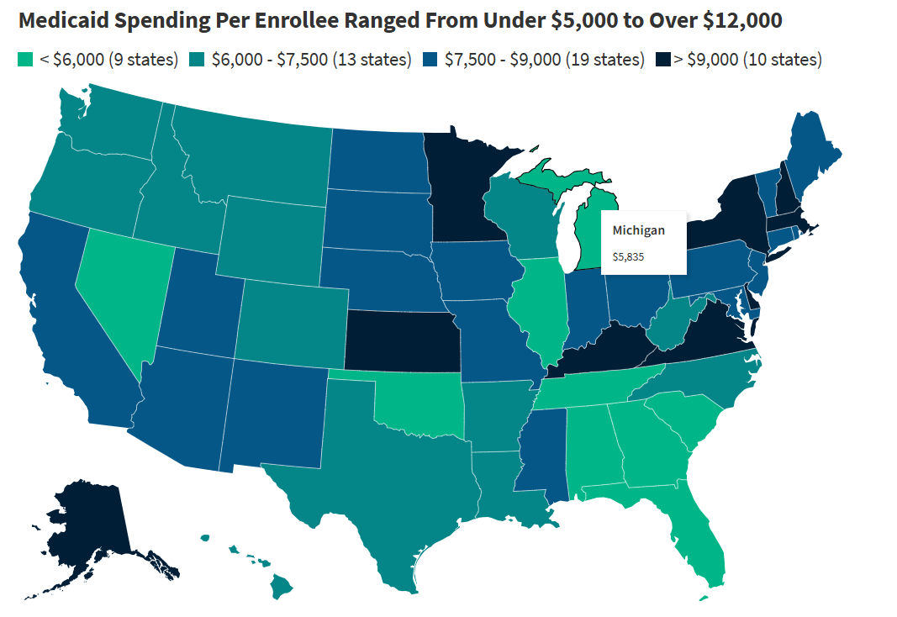
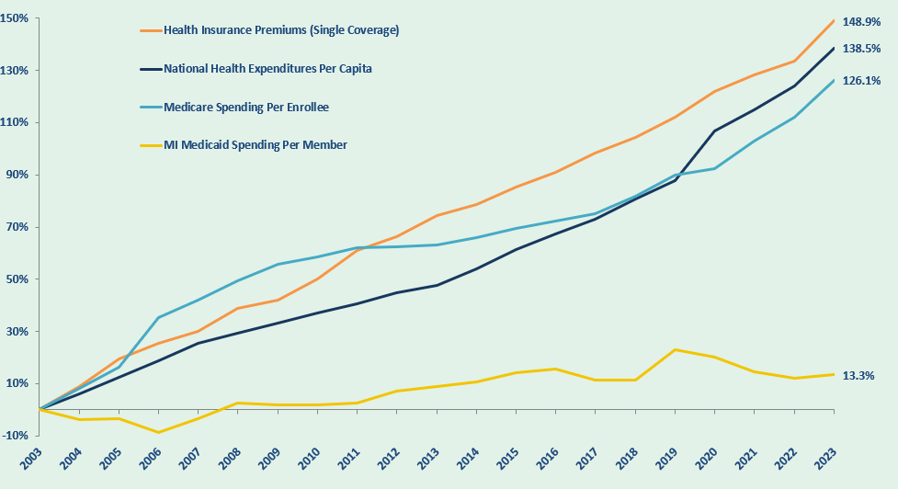
Michigan Medicaid is Cost-Effective
Michigan’s Medicaid program has long been recognized for its cost-effectiveness, providing high-quality coverage to millions while maintaining per-enrollee spending below the national average. However, this efficiency means the program has less room to cut.

Slide 86
Federal Changes

Slide 87

What is H.R. 1?
H.R. 1 is federal legislation that was signed into law in July 2025.
The bill makes significant changes to federal Medicaid rules including introducing new eligibility rules regarding work requirements for some Medicaid enrollees nationwide.
Michigan, like all states, is required to implement most of these changes by Jan. 1, 2027.

Slide 88
Michigan’s Approach
Federal changes are coming. MDHHS will do everything it can to help eligible Michigan residents keep health care coverage.
Keep it Simple
MDHHS will make compliance easy by using available data, simplifying processes and reducing unnecessary administrative steps whenever federal flexibilities allow.
Enable Success
MDHHS will prepare beneficiaries, staff, providers, health plans and community partners with clear information and practical tools so everyone can navigate the new requirements confidently.
Listen and Learn
MDHHS will monitor implementation closely, measure outcomes, engage partners regularly and adjust its approach based on data and feedback.

Slide 89




H.R. 1 Key Changes
Medicaid work requirements January 1, 2027 | Six-month redeterminations January 1, 2027 | Reduced retroactive coverage January 1, 2027 | Limits on non-citizen eligibility October 1, 2026
Applies to Healthy Michigan Plan (HMP) enrollees ages 19–64 without an exemption. Must complete at least 80 hours of allowable activities in a one-month period. | Eligibility checks for HMP now every six months, instead of annually. | No more 90-day retroactive coverage. HMP: One month prior. Other Medicaid: Two months prior. | Fewer coverage pathways for some lawfully present non-citizens. Affected individuals move to Emergency Services Only.

Slide 90

Medicaid Work Requirements
Starting Jan. 1, 2027, people on HMP will need to show they are working, going to school, volunteering or that they have an exemption to keep their health care coverage.
Only applies to people on HMP – not all Medicaid programs.
Those who are not on HMP do not need to do anything new.
Some HMP members are already meeting this requirement through work or school or may qualify for an exemption.

Slide 91
Who is and isn’t impacted
Some HMP enrollees will qualify for an exemption from work requirements.
Others will need to show how they meet work requirements.
Pregnant, postpartum and with kids under 14.
With qualifying health conditions.
Already subject to SNAP work requirements.
Other qualifying reasons.
With an income above $580/month.
In school at least half-time.
Working or volunteering more than 80 hours/month.
Both groups may need to provide information/proof to MDHHS so their status can be determined and/or verified.

Slide 92
Exemptions and Short-Term Hardship Exceptions
Exemptions
Short-Term Hardship Exceptions
  Parent, guardian, or caretaker of:
      Dependent children under age 13.
      Disabled individuals.
  Pregnant or postpartum individuals
  Foster youth or former foster youth under 26
  Medically frail individuals
  Individuals in SUD treatment
  Individuals meeting SNAP/TANF work requirements
  American Indians or Alaska Natives
  Disabled veterans
  Individuals incarcerated or released in the past 90 days
  Individuals who were in:
    Inpatient hospital
    Nursing facility
    Intermediate care facility
    Inpatient psychiatric hospital
  Individuals who reside in a county with:
    A federally declared emergency or disaster
    High unemployment (above 8% or 1.5× the national rate)
  Individuals who traveled outside their community for extended medical care for themselves or a dependent

Slide 93

Ways to Meet Requirements
Work
Education
Volunteering
$580+ income per month, or
80 hours of work including:
  Employment.
  Unpaid/in-kind work.
  Self-employment.
  Seasonal work.
  Work program.
Enrolled at least half-time in college or vocational program. Half-time is defined by the school.
Unpaid work with a structured program that is completed for the direct benefit of the community.
Volunteer hours may be voluntary or required, such as service completed as part of a court order or other mandate.
This is different from SNAP work
requirements – students attending an institution of higher education, i.e., college, trade/technical school, more than half-time are only eligible for SNAP if they meet an exemption.
Activities across these categories can be combined to meet the 80-hour minimum requirement.

Slide 94
Anticipated Impact and Lessons Learned

Slide 95
Expected Impact on Michigan
Coverage and Benefit Loss
Churn, Interrupted Access and Delayed Care
Rising Uninsured and Increased Hardship
Higher Uncompensated Care, Food Insecurity and Household Debt
More than 200,000 individuals at risk of losing Medicaid and/or SNAP benefits.
Losses driven by new eligibility rules, reporting requirements and shortened renewal timelines.
Frequent interruptions in Medicaid and SNAP due to paperwork gaps.
Disrupted care continuity, delayed treatment and reduced food security.
Reduced Medicaid coverage paired with more limited Marketplace access under H.R. 1.
SNAP benefit reductions intensify financial strain, especially for older adults and people with disabilities.
Hospitals, clinics and safety net providers absorb rising uncompensated care costs.
Families face unaffordable medical bills and increased food insecurity.
Increased instability for households juggling both programs.
Local communities experience greater demand for emergency food and health services.
Notes:
Administrative burden is a major driver: A University of Michigan analysis found that most enrollees were already working or otherwise participating in other qualifying activities—yet many could still lose coverage due to complex reporting requirements and red tape.
Risk of increased uncompensated care and pressure on hospitals and local safety nets as people lose access to coverage for procedural—not eligibility—reasons.
Risk: Higher rates of churn and coverage loss due to paperwork issues—not changes in actual eligibility.
Risk: Increases the likelihood of unpaid medical bills and uncompensated care for individuals who experience sudden health events before applying.
Operational Strain on the State
Implementation would require significant new staffing, IT updates, and administrative funding.

Slide 96
What Michigan’s Experience Shows Us
Prior Work Requirement Experience
Nearly $70M in administrative costs anticipated.
Public Health Emergency Unwind Experience
Strategic investments in automation increased passive renewal rates from 12% to ~60%.
$30M in IT upgrades, training and outreach.
Coordinated, consistent messaging across MDHHS and partners reduced confusion and improved beneficiary engagement.
80,000 at risk of losing coverage in Month 1.
100,000 expected to lose coverage in Year 1.
Many met requirements but lost coverage due to administrative burden, not non‑compliance.

Slide 97
Provider Tax and State Directed Payment (SDP) Limits
Provider Tax Cap Reduction:
New Tax Limits for Medicaid Expansion States like Michigan
Gradual reduction of provider tax cap from 6% to 3.5%.
  2028 – 2032; 0.5 percentage points per year.
Michigan will need to significantly reduce hospital taxes to comply.
Further restricts ability to raise any provider tax beyond current levels.
State Directed Payment (SDP) Limitations:
New Medicare-Based Cap for Medicaid Expansion States
SDPs to providers cannot exceed Medicare payment levels.
Replaces previous cap based on average commercial rates.
Michigan SDPs impacted:
  $5.07 billion Hospital Rate Adjustment (HRA) – supports hospital access.
  $610 million Specialty Network Access Fee (SNAF) – supports physician access.

Slide 98
What these changes mean for Michigan
State Budget Impact:
Loss of critical state flexibility to finance Medicaid without relying on the General Fund (GF).
Revised the Insurance Provider Assessment tax to preserve $635 million in core program costs.
Risk to the state’s ability to respond to future economic downturns and unforeseen events that increase demand for safety-net services.
Provider Impact:
Lower provider tax and SDP limits ultimately result in:
  Hospital payment reductions totaling upward of $2.5 billion annually.*
  Physician payment reductions of $309 million annually.
Cost pressures will force providers to make difficult decisions, including cutting services, reducing staff or opting out of the Medicaid program altogether.
Individual Impact:
Reduced funding and declining coverage rates will limit access to care across the state.
Rural and underserved areas—where provider margins are already thin—face the greatest risk.
Rising costs, longer wait times and ripple effects like higher insurance premiums and the need to travel farther for essential services will be felt by statewide.
* Total includes lost supplemental payments and reductions in base payments supported by lost provider tax revenue.

Slide 99
Supportive Communications & Resources

Slide 100
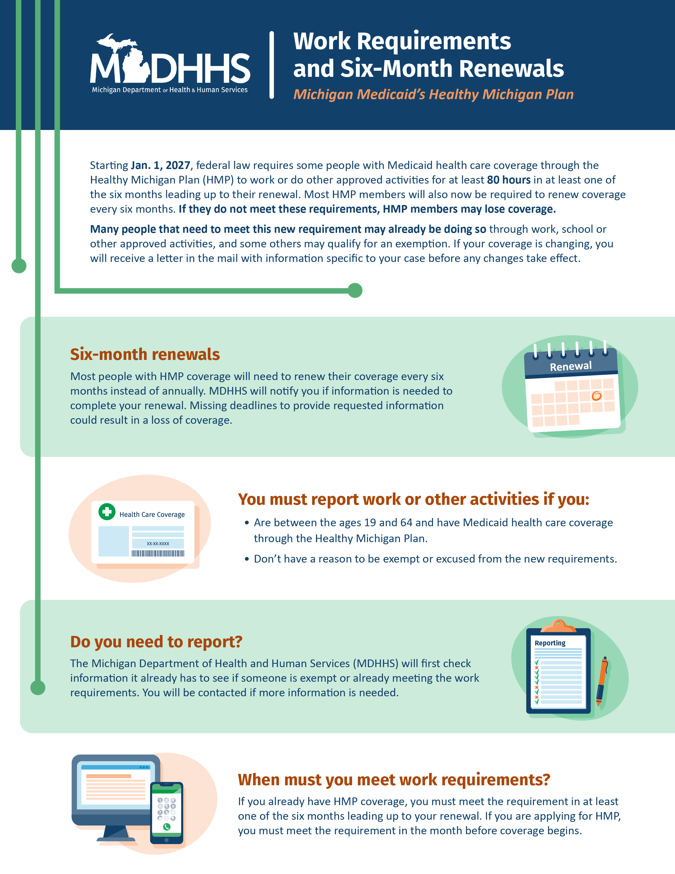

Beneficiary flyer
For all HMP members.
Core message: Changes are coming, some may be exempt, watch for information from MDHHS, keep contact info up to date in MI Bridges.
Support needed: Constituents may call with questions. No action is needed yet, but watch for communications from MDHHS.
Mailed in July.

Slide 101

Media campaign: social media
For general public and HMP members.
Core message: Work requirements are coming and renewal timelines are changing. Learn more at Michigan.gov/HMP.
Support needed: Constituents may call with questions. No action is needed yet, but watch for communications from MDHHS.
Campaign launches in June.

Slide 102

Direct outreach
MEDSMS: Healthy Michigan Plan eligibility changes are coming. What this means for you: www.medicaid.gov/renew-info/MI
Reply STOP to cancel.
Text and email to HMP members from Centers for Medicare & Medicaid Services.
Core message: Eligibility changes are coming. What does this mean for you?
Support needed: Constituents may call with questions. Texts will come from 633767 (MEDSMS); emails from
no-reply@info.medicaid.gov.
July 1-August 24

Slide 103
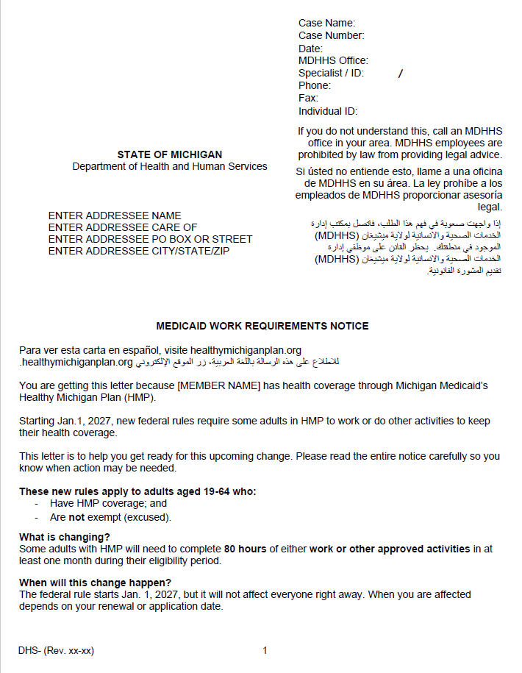
MDHHS letter
To all HMP members.
Core message: Explain work requirements, exemptions and reporting.
Support needed: Letter will not yet include information about specific actions needed. Constituents may call with questions or concerns. Watch for detailed future communications from MDHHS re: renewals.
Mailed in September.

Slide 104
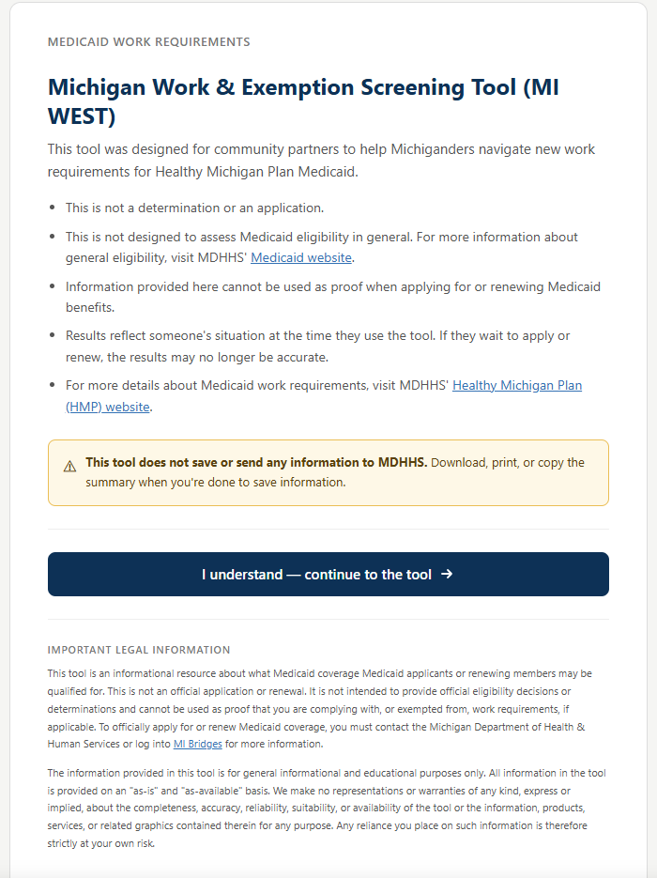
Introducing the Michigan Work & Exemption Screening Tool
The Michigan Work & Exemption Screening Tool (MI WEST) is a new interactive tool designed to help community partners understand how Healthy Michigan Plan work requirements may apply to an individual’s circumstances.
The MI WEST walks through a series of questions and provides personalized guidance on whether someone may be:
  Subject to work requirements.
  Exempt from work requirements.
  Already meeting the requirements.
  Need to take additional steps to meet the requirements.
The MI WEST is a guide — not an eligibility determination.
Notes:
[Megan]

Slide 105
Resources
Visit Michigan.gov/HMP for the latest updates and information, including a work requirements overview and FAQs and a toolkit.

Slide 106
Break

Slide 107
The Truth Is in the Trigger™: Disrupt the Leadership Capacity Crisis and Progressive Muscle Relaxation
Princess Castleberry, Global Keynote Speaker and Leadership Strategist

Slide 108


Slide 109


Slide 110


Slide 111
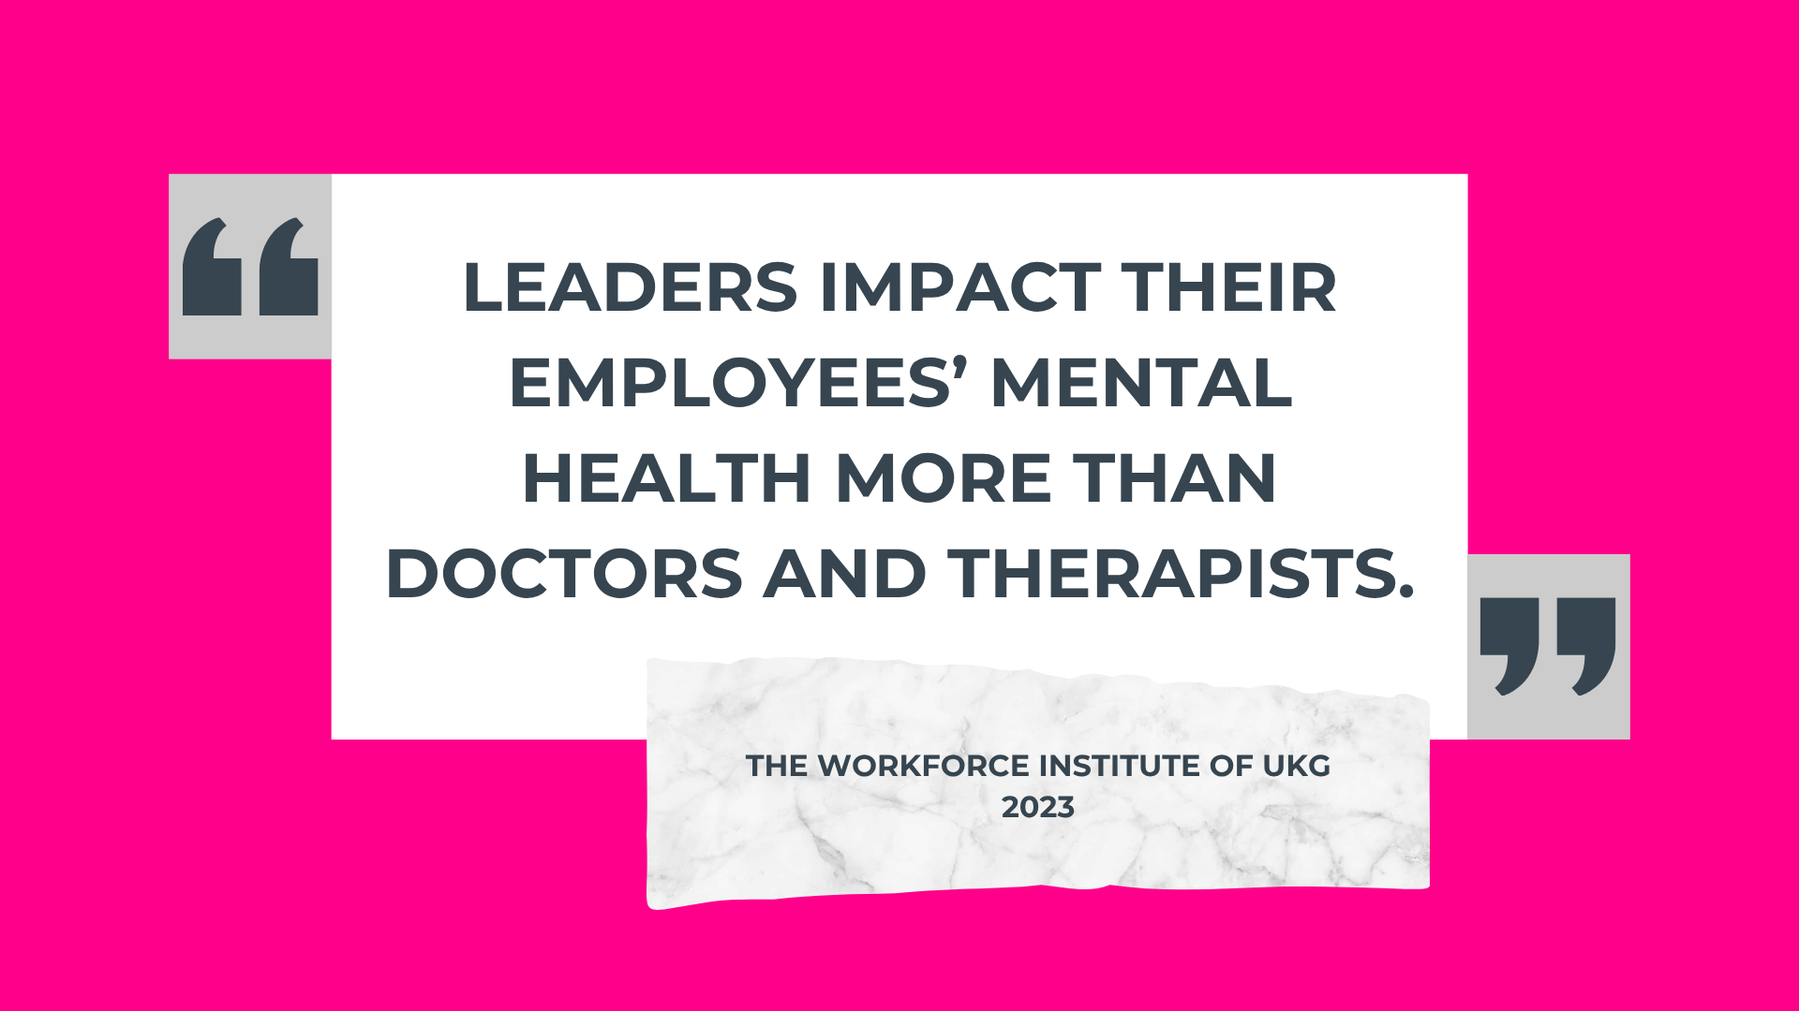

Slide 126


Slide 127


Slide 128


Slide 129


Slide 130


Slide 131


Slide 132


Slide 133


Slide 134


Slide 135


Slide 136
Leadership in Full BLOOM: Planting the Seeds for Thriving Leaders, Flourishing Teams, and Sustainable Organizations
Rose Moten, Clinical Psychologist; Founder, Bloom Transformation Center

Slide 137
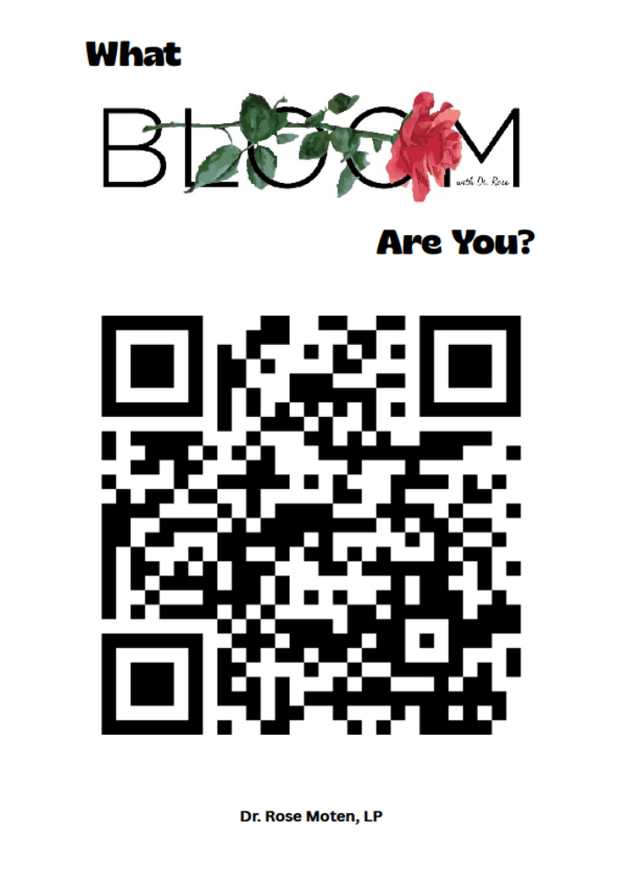

Slide 138
Sound Bath Session
Rose Moten, Clinical Psychologist; Founder, Bloom Transformation Center

Slide 139
Group Discussion
Debrief the day’s conversations and decide on what are three things as a leader you must do to manage your health, wellness, and well-being.
Report out by groups and vote on top three for a class commitment.

Slide 140
Defining Moments

Slide 141
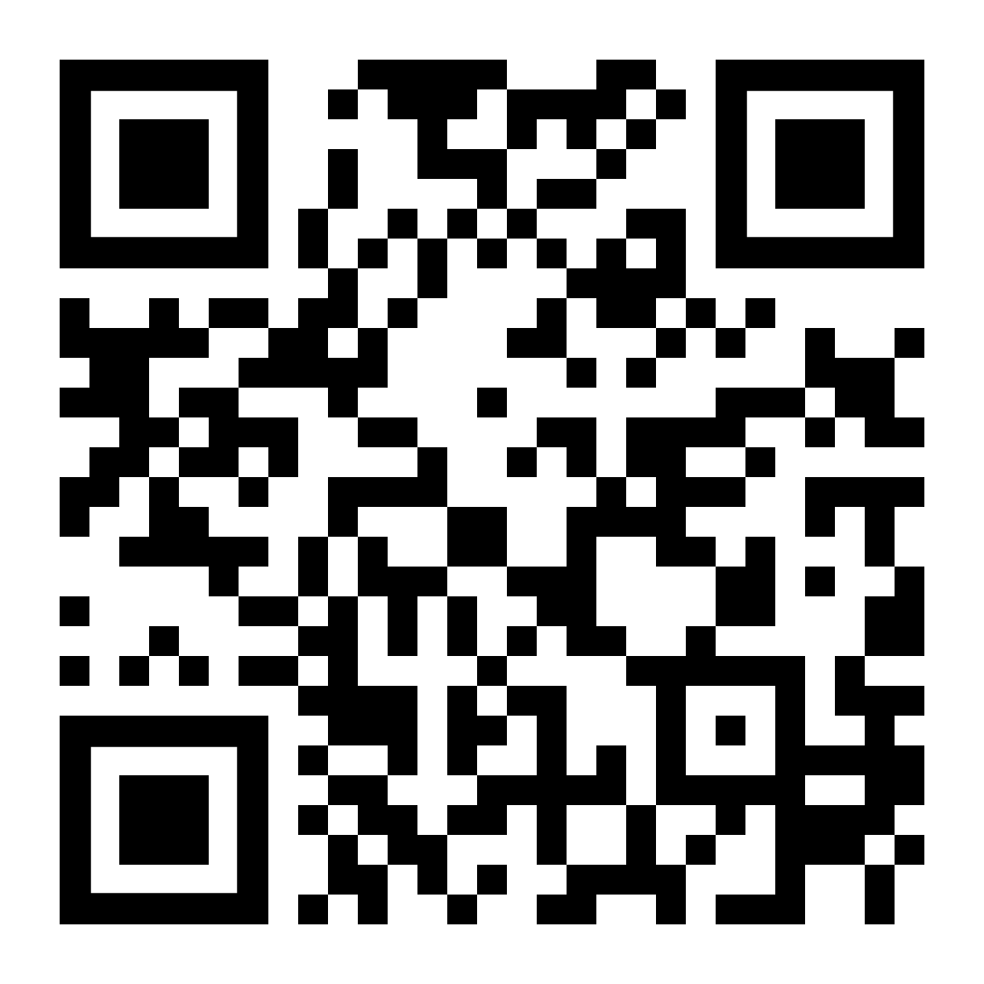
Complete Session Survey

Slide 142
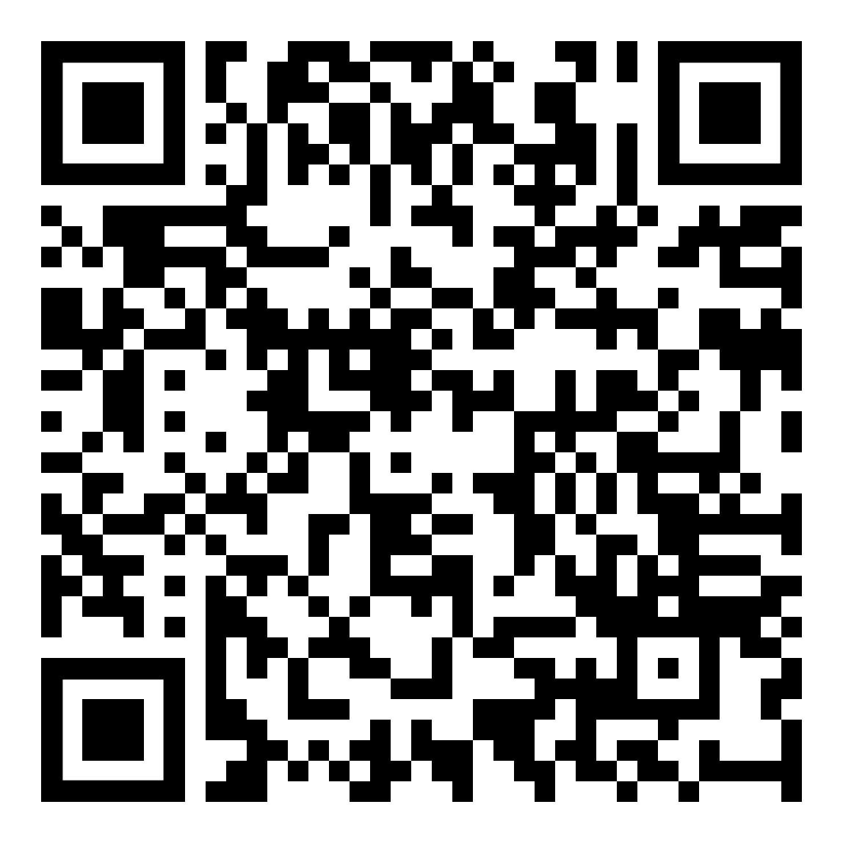
Wrap-Up
Complete Session Survey
Join the WhatsApp Group
Fill Out the Absence Form if Missing a Session

Slide 143
Details for Next Session:​
Education and Mentorship​
Date: Nov. 19
Location: College Career and Beyond​
Time: 8:30 a.m. to 5 p.m.​

Slide 144
Accept Your Complimentary Registration ​
2026 Detroit Policy Conference​
February 4, 2026 ​
8:30 a.m. to 5 p.m. ​
The Department at Hudson's Detroit​
Email Pilar Doakes at pdoakes@detroitchamber.com to register.​

Slide 145
Wrap-Up
Social Hour
The Yard at Corktown
1375 Michigan Ave., Detroit, MI 48226

